Slide 1
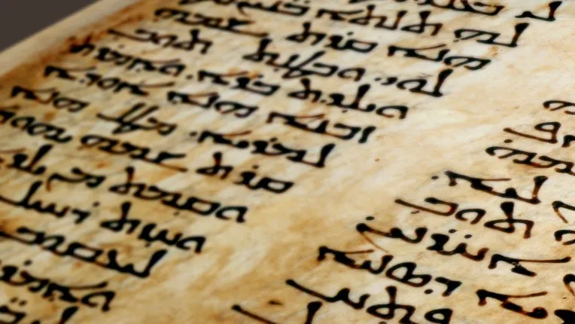
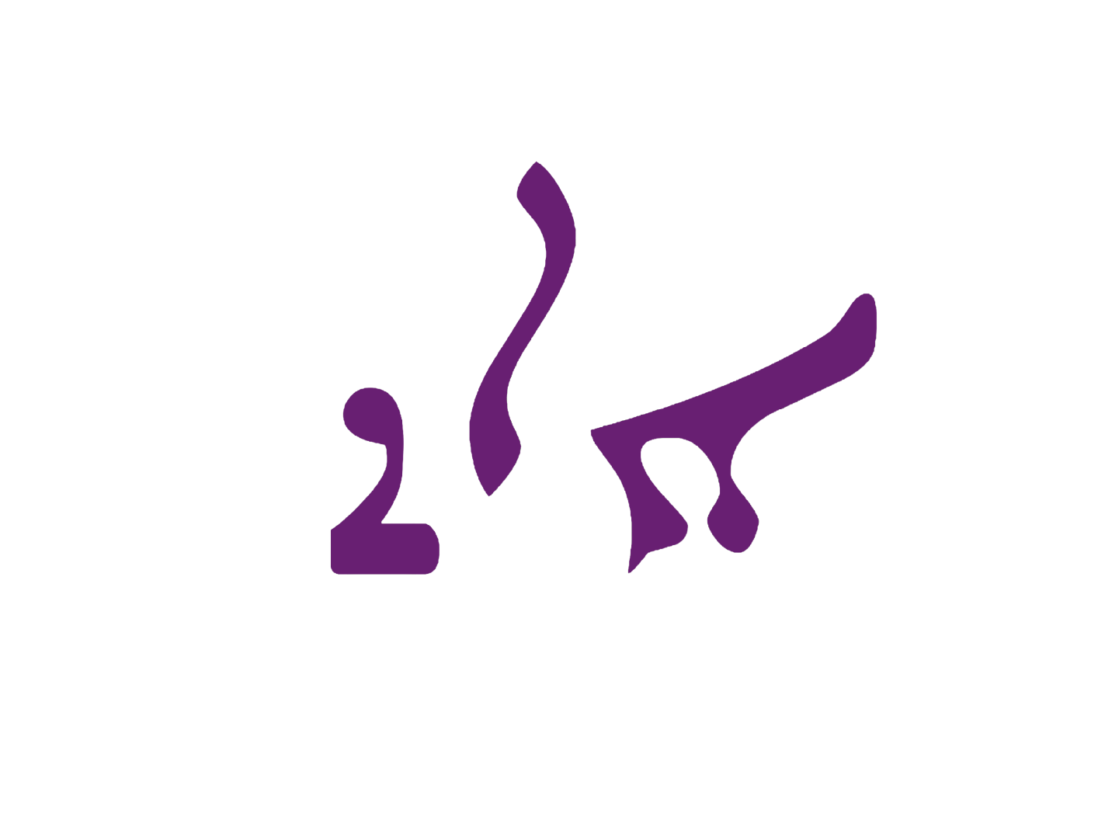
Assyrians in Syriac literature
A two-part presentation

Slide 2
Table of Contents, pg. 1
Introduction, pg. 4-7
Part 1 starts pg. 8
Doctrine of Mar Addai, pg. 9-14
The Didache, pg. 15-16
Tatian the Assyrian, pg. 17-23
Lucian of Samosata, pg. 24-29
Mar Awgin, pg. 30-34
The Cave of Treasures, pg. 35-40
Mor Behnam and Sarah, pg. 41-52
Mar Qardagh, pg. 53-69
Karka d’Beth Selokh, pg. 70-77
Mor Zayno, pg. 78-82
Ezekiel the Monk, pg. 83-88
The Acts of Mar Mari, pg. 89-99
  Nimrod’s connection, pg. 91-99
Thomas the Presbyter, pg. 100-103
Pseudo-Methodius, pg. 104-107
Mar Isho’yahb III, pg. 108-109
Mar Severus Sebokht, pg. 110-114
Mor Jacob of Edessa, pg. 115-123
Mar Timothy I, pg. 124-128
Theodore Bar Konai, pg. 129-135
Dionysius of Tel Mahre, pg. 136-143
Mar Isho’dad of Merv, pg. 144-149
Thabit Ibn Qurra, pg. 150-156
Ibn Wahshiyya, pg. 157-158
Dionysius Bar Salibi, pg. 159-162
Cause of All Causes, pg. 163-165
Mar Eliya Bar Shinaya, pg. 166-173
Giwargis Bar Tobi, pg. 174-177
Christian Palestinian Text, pg. 178-184
Mor Michael the Great, pg. 185-199
Anonymous Chronicle of 1234, pg. 200-207
Bar Ebroyo, pg. 208-216
Giwargis Warda of Erbil, pg. 218-219
Abdisho Bar Brikha, pg. 220-223

Slide 3
Table of Contents, pg. 2
Moses of Mardin, pg. 224-228
Maani Gioerida, pg. 229-234
Final Remarks on Part 1, pg. 235-236
Part 2 starts pg. 237-238
The Name of Nimrod, pg. 239-245
The Name of King Sargon, pg. 246-250
Khinnis Monastic Cells, pg. 251-253
Worship of Mesopotamian gods, pg. 254-258
The Magi in Syriac Tradition, pg. 259-261
The Nabateans of South Mesopotamia, pg. 262-263
Sabians of Harran, pg. 264
Where the Peshitta (OT) Came From, pg. 265-268
The Akitu Festival, pg. 269-272
Rogation of the Ninevites, pg. 273-276
Remembrance of Ishtar, pg. 277-279
Festival of Nusardil, pg. 280-281
The Syriac Legend of Alexander, pg. 282-287
Marutha of Maipherkat, pg. 288-289
EGAL, The Fortress of Sennacherib, pg. 290-291
Syriac? The Continuation of Mesopotamia, pg. 292-312
Final Remarks on Part 2, pg. 313-316
A note of thanks, pg. 316
Supplementary Quotes [Support from Clergy], pg. 318-337

Slide 4
What is this presentation?
In December 2024, an anonymous Assyrian asked Suraye Educational Collective to publish an article into a presentation format. After more than a year of updates and review, the article/presentation have officially been released from February 12, 2026. The latest update to the presentation is from February 15, 2026.
The main aim of this presentation is to show that the term “Athoraya” was not only a gentilic adjective, but was also used to connect the heritage of Suryaye with ancient Assyria and its traditions. The information presented also indicates a common Mesopotamian heritage by including Babylonians, or an “Assyro-Babylonian” identity. Part 1 covers the presence of Assyrians by name and identity in Syriac scripture, while Part 2 covers the remembrance of ancient Assyria locally.

Slide 5
What should I take into note before reading? Pt. 1
Before reading this presentation, it’s important to understand the following…
Suraye Educational Collective is able to confirm that the article/presentation have been scholarly peer-reviewed. However, the scholar of note would prefer to remain anonymous to emphasize the information being presented without holding it to a specific academic.
The information does not seek to attack any other terms our community uses, namely Chaldean/Syriac/Aramean; rather, it’s to spread the information to the larger community of Suraye to show a common linking heritage, and for the knowledge to be spread for the education of any Assyrian, whether in diaspora or homeland
The writers of these scripts did not have the ability to look on our history as we do today, and they mostly relied on Greek/Biblical texts alongside oral traditions. It’s important, therefore, to not view the information as vague or inaccurate
Therefore, this information doesn’t necessarily cover accuracy, but the self-identification of the medieval Assyrians who were our forefathers
Notes:
East and West Syriac churches are listed in the context of modern Assyrians (Suraye/Suryoye)

Slide 6
What should I take into note before reading? Pt. 2
The presentation has been named after Syriac Literature since most of the sources are written in Syriac. However, a small amount of non-Syriac sources are included which show the self-identification of Suraye/Suryoye as Assyrians.
Connotations to the concept of Assyrian nationalism are outside the scope of this project. We aim to show that the ancient Assyrians have always been part of what made the identity of the “Suryaye” in Classical Syriac literature. In tandem, this presentation also challenges the ways in which Chaldean and Aramean identities exists today, as both are used in ways that aren’t like what our forefathers understood them to be.
All the information is chronologically ordered, and where possible, specified as to their origin in Eastern or Western Syriac rites.
The East Syriac Rite refers to literature from the tradition now represented by the Assyrian Church of the East, Ancient Church of the East and Chaldean Catholic Church
The West Syriac Rite refers to literature from the tradition now represented by the Syriac Orthodox and Syriac Catholic Churches
Notes:
East and West Syriac churches are listed in the context of modern Assyrians (Suraye/Suryoye)

Slide 7
The full article is available on our website!
Special credits are provided to u/MLK-Ashuroyo for publicly posting much of this information on his personal Reddit page; the author referenced many scripts that he posted as well as their analyses, so please be sure to check out his profile!
And of course, huge thanks to the original author for allowing us to publish his work! The original article is available now on our website, and we hope you enjoy this presentation!
surayec.org

Slide 8
Pt. 1: Assyrians in Syriac literature
The use of the term “Assyrian” by Syriac Christian figures

Slide 9
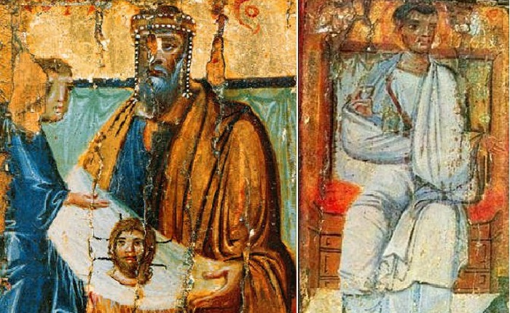
Doctrine of Mar Addai (East/West Syriac Rites) pt. 1
This is a Syriac text with the earliest manuscripts in our possession written in the 4-5th centuries, although it is believed by some scholars that the text itself is from the 3rd or 1st centuries. Nonetheless, it is a very early Syriac text and we can see a clear ethnic usage of Assyrian within this passage inside the work and it details the conversion of Assyrians to Christianity.
Notes:
Based on the 1876 English translation by George Philips, which can be found here: https://www.tertullian.org/fathers/addai_2_text.htm

Slide 10
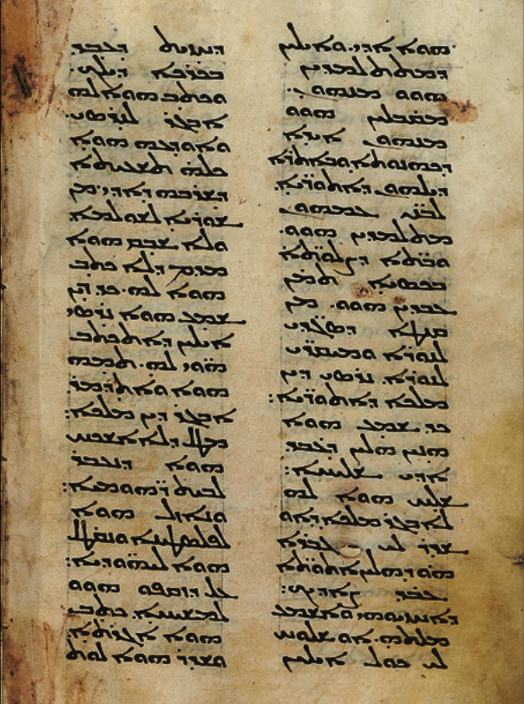
Doctrine of Mar Addai (East/West Syriac Rites) pt. 2
“So also Orientals with the appearance of merchants passed into the country of the Romans to see the signs which Addai did, and those of them who became disciples, received from them the hand of the priesthood, and in their own country of the Assyrians they taught the sons of their people, and houses of prayer they built there secretly, because of the danger arising from the worshippers of fire and the adorers of water.”
Doctrine of Addai, Philips 1876.
Note: Some Translations also render it to “Sons of their Nation” or “Offspring of their people” (THE DOCTRINE OF ADDAI INTERLINEAR ARAMAIC-ENGLISH TEXT, Preacher Mattai, Pg. 105).
Notes:
Based on the 1876 English translation by George Philips, which can be found here: https://www.tertullian.org/fathers/addai_2_text.htm

Slide 11
Doctrine of Mar Addai (East/West Syriac Rites) pt. 3
Here Assyria and the sons of its people/nation are spoken of as an Ethnos and
not simply a geographic designation, evidently shown by the context of Assyria
and Assyrians being a nation (ܥܲܡܐ in the original Syriac) that has offspring. Now, what
exactly is the country of the Assyrians? We can see from the following passages
that the Assyrian identity stretched from Babylon to Adiabene, and was not
confined to the metropolitan of Athor or Mosul. As Bar Bahlul says; “Babylon
was called Athor (Assyria) when the kingdom of the Assyrians was no more.”
Lexicon Syriacum Pg. 322

Slide 12
Doctrine of Mar Addai (East/West Syriac Rites) pt. 4
“But Nersai, the king of the Assyrians, when he had heard of these things which Addai the Apostle had done...” Doctrine of Addai, Philips 1876.
This same Nersai who was a Persian by descent and the son of Ardaches King of Persia according to the Armenian historian Moses of Chorene, ruled over Assyria from Babylon. The fact he was called the “King of Assyria” albeit he was Persian proves that Assyria continued to exist geopolitically and that this was a real region recognized in Parthian Iran. This also demonstrates that Assyrians were extant enough to have a province and that the Assyrian memory was strong even after 600 years of foreign occupation.
“Abgar, having written this letter, placed a copy of it, with copies of the other letters, in his archives. He wrote also to the young Nerseh, king of Assyria, at Babylon...” History of Armenia, VIII
Whether or not Athor extended to Adiabene or Babylon in this text, the land of Assyria had an ethnic connotation and it has been shown that this was an Ethnos. It was not only a geographic designation for multiple ethnicities i.e. a gentilic adjective. Dr Aaron M.Butts: A Rebuttal, Jessi Arabou, Pg. 4-5
Notes:
Assyria A.D. (Documentary) First Look (2019), https://www.youtube.com/watch?v=w2w8OCZZ6Nk

Slide 13
Doctrine of Mar Addai (East/West Syriac Rites) pt. 5
Worship of both Nebu and Bel, which are ancient Mesopotamian deities, are also recorded in this text within Edessa and the broader Mesopotamian region, furthering that it was not simply geographic but referred to an ethnic identity with distinct traditions. Both Nebu and Bel were also worshiped by the Assyrians. Doctrine of Addai, Philips 1876, Notes 45 and 46
“And he also by the hand from which he received made priests and guides in all this country of Mesopotamia. For they also, as of Addai the Apostle, thus took his word and heard and received, as a good and faithful heir of the Apostle of the adorable Christ. But silver and gold he took not from man, and the gifts of the princes approached him not. For instead of gold and silver he enriched the Church of Christ with the souls of the faithful. But all the chiefs of men and women were modest and decorous, and they were holy and pure, and they dwelt singly and modestly without spot, in watchfulness of the ministry decorously, in their carefulness for the poor, in their visitations to the sick; for their goings forth were full of praise from those who saw, and their conversation was covered with glory from strangers; so that even the priests of the temple of Nebo and Bel divided with them the honour at all times, by their honourable aspect, by their truthful discourse, by the confidence which they possessed, and by their freedom, which was not enslaved to greediness, and was not in bondage under blame.” Doctrine of Addai, Philips 1876
Notes:
Doctrine of Addai, Philips 1876, Notes 45 and 46

Slide 14
Scholarly Analysis of the Doctrine of Mar Addai
“Now the reference in this manuscript is quite significant because it clearly shows for us two facts. The first is that at this stage there was a people, an ethnicity that were known as Assyrians. The text does not tell us that these were people of a certain city or of a certain district yet it talks about them as a nation and gives them that name in the Syriac text, ‘The sons of their nation’. And it also provides Assyria as a geographical reality, this is the second significant detail that we obtain from this text. The fact that Christ’s apostles or converts to Christianity travelled to a region or a country called Assyria shows that it was a geographical reality and that people identified with this reality.”
“Assyria A.D. (Documentary) First Look (2019)”, Dr. Nicholas Al-Jeloo, Timestamp; 2:55 - 3:52

Slide 15
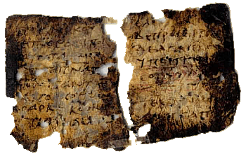
The Didache (East/West Syriac Rites) pt 1
The Didache is an early Christian Greek text that details the acts of the Apostles, and hence why it is also called by this name. It is dated to the 1st century AD, however, the Syriac manuscript we have of it is from 900-1000 AD. Within it, we are informed of Assyrians as an ethnos within Persia.
“The whole of Persia, of the Assyrians, and of the Armenians, and of the Medians, and of the countries roundabout Babylon, the Huzites and the Gelae, as far as the borders of the Indians, and as far as the land of Gog and Magog, and moreover all the countries on all sides, received the apostles' ordination to the priesthood from Aggaeus, a maker of silks, the disciple of Addaeus the apostle.”
The Teaching of the Apostles, Website: New Advent
Notes:
The Teaching of the Apostles, Website: New Advent, https://www.newadvent.org/fathers/0714.htm

Slide 16
The Didache (East/West Syriac Rite) pt. 2
It is shown here Assyrians are an ethnicity compared with Armenians, Medians, and the rest of those who inhabit Persia. Babylon is used in the geographic sense.
“Jerusalem received the ordination to the priesthood, as did all the country of Palestine, and the parts occupied by the Samaritans, and the parts occupied by the Philistines, and the country of the Arabians, and of Phœnicia, and the people of Cæsarea, from James, who was ruler and guide in the church of the apostles which was built in Zion.”
The Teaching of the Apostles, Website: New Advent
This passage further affirms that Assyrians, Armenians and Medians were all ethnic, as they were a part of geographic Persia and yet they were distinct ethnicities, as seen from how Palestine is used here from within the text itself.

Slide 17
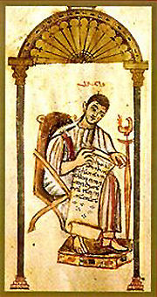
Tatian the Assyrian (East/West Syriac Rites) pt. 1
Tatian was a Christian Assyrian convert, being born in Adiabene or Mesopotamia. However, scholars believe that it is more likely he was born in Roman Syro-Mesopotamia. He lived from 120-180 AD. Tatian is well known for two of his works; that being his address against the Greeks and his Diatessaron (Harmony of the four Gospels). In his address against the Greeks, he concludes by proudly declaring his Assyrian ethnicity.
“These things, O Greeks, I Tatian, a disciple of the barbarian philosophy, have composed for you. I was born in the land of the Assyrians, having been first instructed in your doctrines, and afterwards in those which I now undertake to proclaim.”
Address to the Greeks, Chapter 42
“Tatian, Ad Gr. 42 frames Tatian as an “Assyrian.”
Syrian Identity in the Graeco-Roman World, Andrade, Pg. 264, Footnote 11
Notes:
Address to the Greeks, Chapter 42 - The Teaching of the Apostles, Website: New Advent, https://www.newadvent.org/fathers/0202.htm
Syrian Identity in the Graeco-Roman World, Andrade, Pg. 264, Footnote 11
Clement of Alexandria, John Ferguson, Pg. 14

Slide 18
Tatian the Assyrian (East/West Syriac Rites) pt. 2
Tatian was a proud Assyrian and unashamed to be it, proudly declaring himself as such to the Greeks.
“Tatian was a proud Assyrian, and he clearly stated it in this sentence. Tatian was emphatically and unashamedly Asian. "I am an Assyrian," he said proudly in his Address to the Greeks, the only one of his writings to survive in its entirety. The whole thrust of that work is a recapitulation of all the ways in which Asia (the whole non-Greek world, in fact, for he includes ancient North Africa) excels the West. Where did the Greeks learn their astronomy? he asks. From Babylon (in Asia). Their alphabet? From the Phoenicians (also Asia). Their poetry and music? From Phrygia (Asia Minor). Their postal system? From Persia. "In every way the East excels," said Tatian (to summarize and paraphrase his argument), "and most of all in its religion, the Christian religion, which also comes from Asia and which is far older and far truer than all the philosophies and crude religious myths of the Greeks.”
A History of Christianity in Asia, Moffet, Pg. 74
Notes:
A History of Christianity in Asia, Moffet, Pg. 74

Slide 19
Tatian the Assyrian (East/West Syriac Rites) pt. 3
“In the second century AD, two prominent writers from Roman Syria, Lucian and Tatian, ostentatiously identify themselves as Assyrians (Assúrios). This self-identification is commonly misinterpreted to imply nothing more than that these writers were ethnic Syrians (in the modern sense) speaking Aramaic as their mother tongue. It is perfectly clear from the contexts, however, that they were specifically referring to their native identity and cultural heritage, which they proudly and defiantly contrasted with the Greek culture. That heritage was Assyrian.”
National and Ethnic Identity in the Neo-Assyrian Empire and Assyrian Identity in Post-Empire Times, Pg. 21
Tatian is perhaps also called an Assyrian as one of Clement of Alexandria’s teachers.
Clement of Alexandria, John Ferguson, Pg. 14
Notes:
National and Ethnic Identity in the Neo-Assyrian Empire and Assyrian Identity in Post-Empire Times, Simo Parpola

Slide 20
Tatian the Assyrian (East/West Syriac Rites) pt. 4
Nonetheless, Tatians view on his identity is clear. These sources confirm two things:
1 - Early Syriac Christian converts identified as Assyrians and remembered their past.
2 - Adiabene/Assyria was the land of the Assyrians, and inhabited by them.
Applying Occam’s Razor makes this point even clearer, for we do not have any evidence of an origin contrary to the Assyrian one. As shown already, Assyrians were a nation in not only Syriac literature, but also in Greek (which Tatian was writing in). Tatian would not have identified himself with this term that is familiar to the Greeks unless the truth of the matter was that he was Assyrian, and followed the Assyrian customs as demonstrated in Strabo’s work.
Notes:
Perseus Digital Library, “Tatia'nus”
Syrian Identity in the Graeco-Roman World, Andrade, Pg. 6

Slide 21
A note on Syrian vs Assyrian
Tatian was also from Mesopotamian, perhaps Roman Mesopotamia indeed:
“Epiphanius, in the body of his work (Haeres. xlvi.), and Theodoret (Haeret. Fabul. Compendium, lib. 1. c.20), call him "the Syrian," or " a Syrian by race"; but Epiphanius, in another place (adv. Haeres. Indicul. ad lib. i. vol. iii.), followed by Joannes Damascenus (De Haeresib. apud Coteler. Eccles. Graec. Monum vol. i. p. 292). says he was a Mesopotamian; a statement which is adopted by Cave and some other moderns. Tatian's own authority would of course be decisive, were it not for the vagueness with which the names Assyria and Syria are used by the ancients; however, we think it most probable that by "the land of the Assyrians" Tatian means the country east of the Tigris...”
Perseus Digital Library, “Tatia'nus”
Nonetheless, it is clear. Tatian was an Assyrian and also considered himself a Syrian alongside Mesopotamian. In Greek literature, these terms of Assyrian and Syrian were readily interchangeable. In fact, him being from Mesopotamia further affirms this. Some scholars purpose he was from Roman Syro-Mesopotamia and not Adiabene, but even in this case, his Assyrian heritage is still evident and does not change, as he wanted to display his Assyrian identity to the Greeks, forging a link to his brethren across into Parthia, claiming the same ethnos and legacy as them.
Notes:
Assyrians, Syrians and the Greek Language in the late Hellenistic and Roman Imperial Periods, Andrade, Pg. 305
A State of Mixture, Richard E. Payne, Pg. 227

Slide 22
Scholarly Analysis Regarding Tatian the Assyrian pt. 1
“Despite such differentiation, Syrians of the Roman empire still could meaningfully conceive of themselves as Assyrians. While encapsulating a heterogeneous array of individuals who alternatively traced Greek, Assyrian, and other Near Eastern genealogies, they could emphasize how their ethnos in aggregate constituted the social legacy of the same ancient people from whom the Assyrians of the Parthian and Sasanian empires claimed to have originated.”
Assyrians, Syrians and the Greek Language in the late Hellenistic and Roman Imperial Periods, Andrade, Pg. 316
“Because the Syrian ethnos was comprised of the Greek and Assyrian inhabitants of Roman Syria, the Aramaic-speaking Assyrians (and Arameans) of Parthian territory were by this definition not Syrian, and many (but certainly not all) self-identifying Syrians now spoke Greek and formulated historical memories informed by Greek narratives. But despite such differences, Roman imperial Syrians could still situate themselves in relation to an Assyrian past and legacy and deem Assyrians either their ethnic ancestors or at least the founders of their Syrian ethnos, which Roman imperialism had reconstituted. They for this reason often treated Syrian and Assyrian as synonyms representing the same people. Such complexities informed how Meleager, Lucian, and Tatian endowed their self-ascriptions as Syrian or Assyrian with significance.”
Assyrians, Syrians and the Greek Language in the late Hellenistic and Roman Imperial Periods, Andrade, Pg. 305

Slide 23
Scholarly Analysis Regarding Tatian the Assyrian pt. 2
“Authors writing in Greek and Aramaic in Roman Syro-Mesopotamia in the first two centuries CE made extensive use of the Assyrian past to define their communities in relation to Greek culture and Roman imperialism.”
A State of Mixture, Richard E. Payne, Pg. 227
“Syrians framed themselves as a certain type of Assyrian. They were socially distinct from other Assyrians, but they still shared a heritage as either descendants or heirs of an ancient Assyrian people. In other words, Tatian's revelation of his identity at the climactic conclusion of the Oration is not just a geographical statement, but is instead a claim to continuity with the ancient "Assyrian" έθνός [Ethnos], distinct from the ethnic and cultural heritages represented by Greece and Rome.”
The Rise of the Early Christian Intellectual, Lewis Ayres, Pg. 73

Slide 24
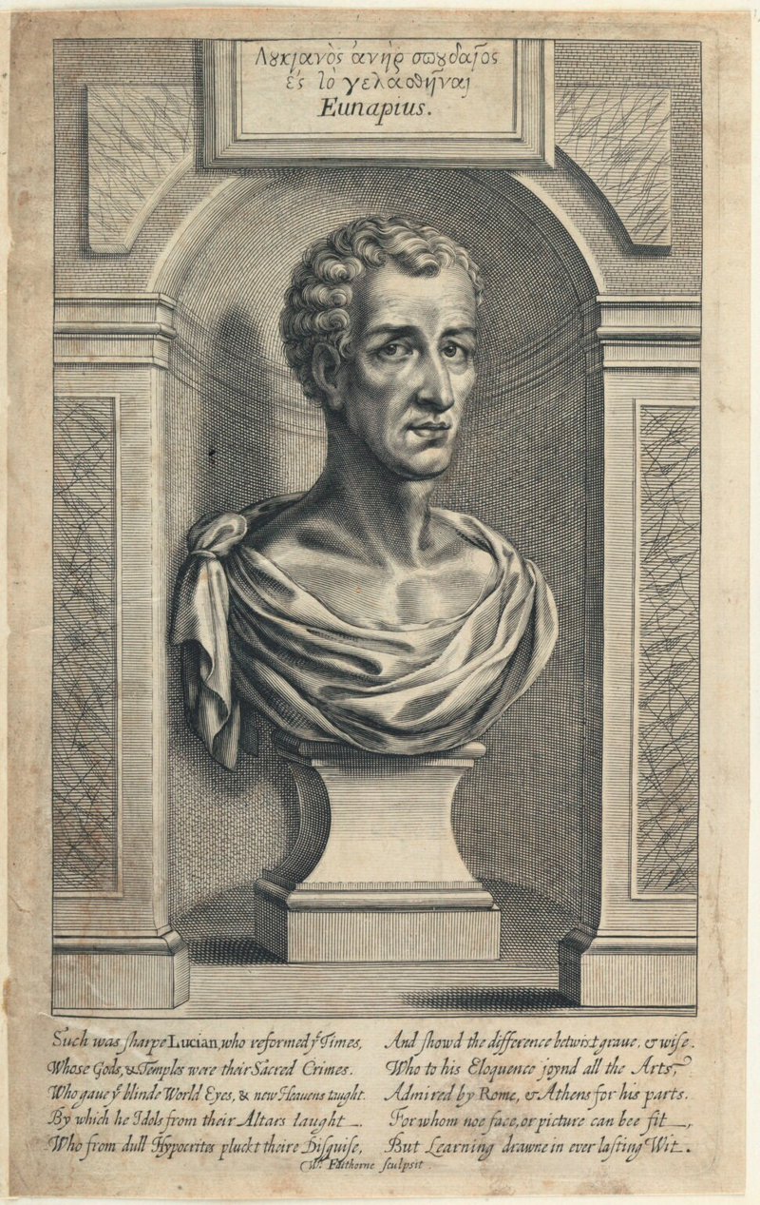
Lucian of Samosata pt. 1
Lucian of Samosata was a Hellenised Assyrian born in Samosata during the timeframe of 125-180 AD. Within his work “The Syrian Goddess” which is written in Greek, he uses the terms Assyrian and Syrian interchangeably to identify himself. This shows that even non-Christian Assyrians used this Syrian term and applied it to themselves. Such an early primary source from an Assyrian gives us far better insight into how these “Syrians” as the Greeks called them, self-identified. They always remembered they were part of Assyria.
Syrian perspectives: Lucian of Samosata on The Syrian Goddess in full

Slide 25
Lucian of Samosata pt. 2
“Because the Syrian ethnos was comprised of the Greek and Assyrian inhabitants of Roman Syria, the Aramaic-speaking Assyrians (and Arameans) of Parthian territory were by this definition not Syrian, and many (but certainly not all) self-identifying Syrians now spoke Greek and formulated historical memories informed by Greek narratives. But despite such differences, Roman imperial Syrians could still situate themselves in relation to an Assyrian past and legacy and deem Assyrians either their ethnic ancestors or at least the founders of their Syrian ethnos, which Roman imperialism had reconstituted. They for this reason often treated Syrian and Assyrian as synonyms representing the same people. Such complexities informed how Meleager, Lucian, and Tatian endowed their self-ascriptions as Syrian or Assyrian with significance.”
Assyrians, Syrians and the Greek Language in the late Hellenistic and Roman Imperial Periods, Andrade, Pg. 305
Notes:
National and Ethnic Identity in the Neo-Assyrian Empire and Assyrian Identity in Post-Empire Times, Simo Parpola
Assyria: The Rise and Fall of the World's First Empire, Eckart Frahm

Slide 26
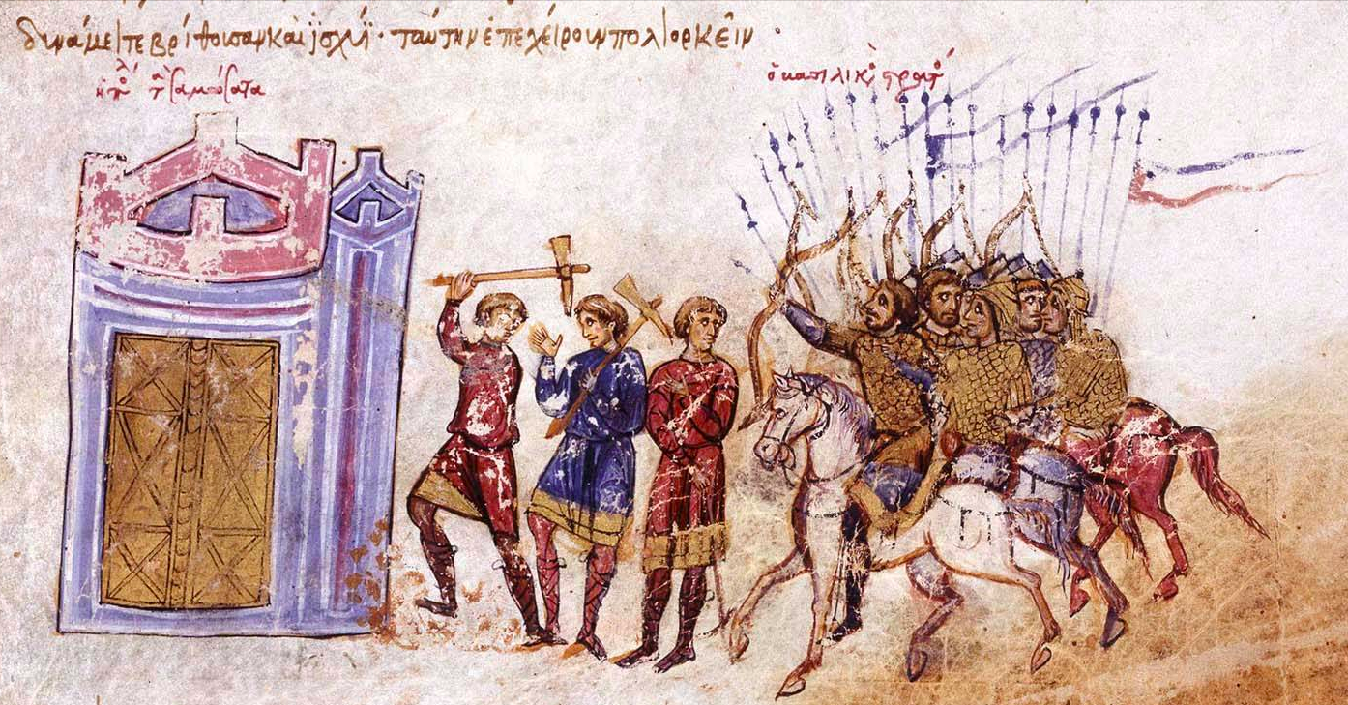
Lucian of Samosata pt. 3
“Despite such differentiation, Syrians of the Roman empire still could meaningfully conceive of themselves as Assyrians. While encapsulating a heterogeneous array of individuals who alternatively traced Greek, Assyrian, and other Near Eastern genealogies, they could emphasize how their ethnos in aggregate constituted the social legacy of the same ancient people from whom the Assyrians of the Parthian and Sasanian empires claimed to have originated.”
Assyrians, Syrians and the Greek Language in the late Hellenistic and Roman Imperial Periods, Andrade, Pg. 316

Slide 27
Lucian of Samosata pt. 4
“In the second century AD, two prominent writers from Roman Syria, Lucian and Tatian, ostentatiously identify themselves as Assyrians (Assúrios). This self-identification is commonly misinterpreted to imply nothing more than that these writers were ethnic Syrians (in the modern sense) speaking Aramaic as their mother tongue. It is perfectly clear from the contexts, however, that they were specifically referring to their native identity and cultural heritage, which they proudly and defiantly contrasted with the Greek culture. That heritage was Assyrian.”
National and Ethnic Identity in the Neo-Assyrian Empire and Assyrian Identity in Post-Empire Times, Pg. 21
“Authors writing in Greek and Aramaic in Roman Syro-Mesopotamia in the first two centuries CE made extensive use of the Assyrian past to define their communities in relation to Greek culture and Roman imperialism.”
A State of Mixture, Richard E. Payne, Pg. 227
Notes:
National and Ethnic Identity in the Neo-Assyrian Empire and Assyrian Identity in Post-Empire Times, Simo Parpola
Assyria: The Rise and Fall of the World's First Empire, Eckart Frahm

Slide 28
Lucian of Samosata pt. 5
He shared his origin as a Hellenized Assyrian with Tatian as well, and likewise, claimed a continuity from Assyria like Tatian did.
“His [Tatian’s] origin as a Hellenized Assyrian, which he shares with his contemporary Lucian of Samosata...”
Continuity and Discontinuity in Early Christian Apologetics, Pg. 24
“Syrians framed themselves as a certain type of Assyrian. They were socially distinct from other Assyrians, but they still shared a heritage as either descendants or heirs of an ancient Assyrian people. In other words, Tatian's revelation of his identity at the climactic conclusion of the Oration is not just a geographical statement, but is instead a claim to continuity with the ancient "Assyrian" έθνός [Ethnos], distinct from the ethnic and cultural heritages represented by Greece and Rome.”
The Rise of the Early Christian Intellectual, Lewis Ayres, Pg. 73

Slide 29
Lucian of Samosata pt. 6
Lucian also recounts a skewed version of the Mesopotamian creation myth, influenced by the original stories.
Myths from Mesopotamia Creation, the Flood, Gilgamesh, and Others, Pg. 7
“Assyrian religious traditions survived deep into the common era. Even in some places beyond the Euphrates, the legacy of Assyria lived on. A prominent example is the city of Nappigi, where Shalmaneser III had settled substantial numbers of Assyrians. Later renamed Hierapolis (the “Holy City”), the town is described in Lucian’s Greek treatise on the “Syrian Goddess” from the second century CE as a place where the deeds of the legendary Assyrian rulers Semiramis and Sardanapallus were faithfully remembered.”
Assyria: The Rise and Fall of the World's First Empire, Eckart Frahm, Pg. 357
Notes:
Syrian perspectives: Lucian of Samosata on The Syrian Goddess in full
Myths from Mesopotamia Creation, the Flood, Gilgamesh, and Others, Stephanie Dalley

Slide 30
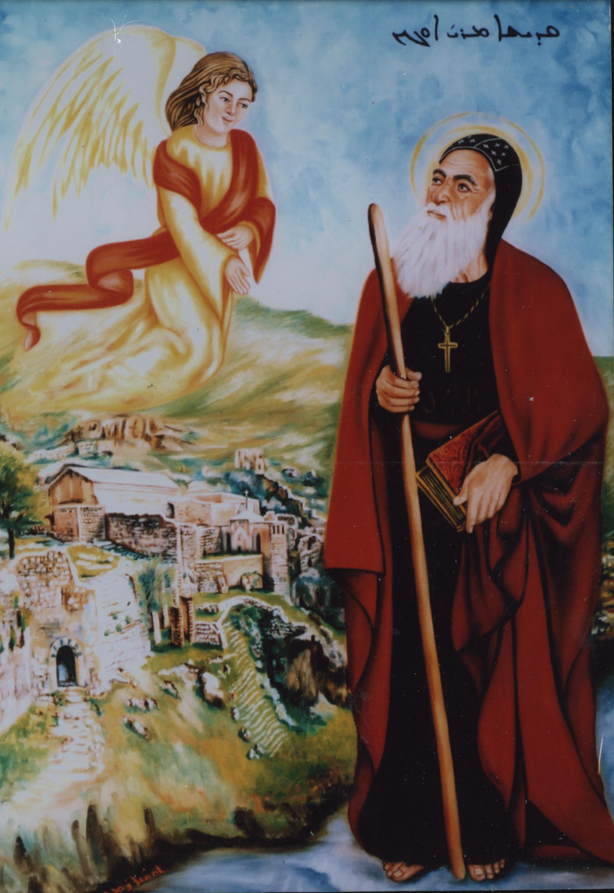
Mar Awgin (East/West Syriac Rites) pt. 1
Mar Awgin is considered to be the first saint to introduce monasticism to Mesopotamia; he lived from 300-363 AD. Within his acts, he is said to have gone to the city of Sarguga (modern-day Sirnak) where he met Assyrians from the time of Sennacherib. Although this is biblically influenced, it shows that the Suryaye in the region were claiming Assyrian descent and that according to early Syriac tradition, Assyrians did not go extinct while also comprehensively showing the use of Assyrians in an ethnic sense.
"Šar-usur, son of Sennacherib, had settled when he fled from the city of Nineveh," following the assassination of his father. In Sarguga (Sirnak), Šar-usur "built his father's temple and was revering it, and the offspring and descendants preserved it until the time in which the saint (Mār Awgin) arrived there."
Mark Gewargis’s Post, “Mar Awgin”
Notes:
Assyrians in History, Mark Gewargis
Sennacherib at the Gates of Jerusalem Story, History and Historiography, Isaac, Pg. 314
Christianising Assyria (II), Ramsin Edward, Pg. 230

Slide 31
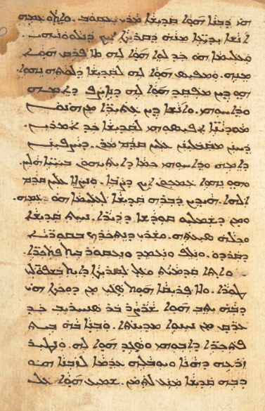
Mar Awgin (East/West Syriac Rites) pt. 2
"And he [Awgin] began to go around in the villages of Qardu, baptizing pagans and destroying temple(s). So he first came to a village at the foot of the mountain not too far from the Ark, the name of which was Sarguga. In it Šar-usur, son of Sennacherib, had settled when he fled from the city of Nineveh, following the assassination of his father. In Sarguga (Sirnak), Šar-usur "built his father's temple and was revering it, and the offspring and descendants preserved it until the time in which the saint (Mār Awgin) arrived there."
HMML - ACK 00213 folio 44r
Notes:
Assyrians in History, Mark Gewargis
Sennacherib at the Gates of Jerusalem Story, History and Historiography, Isaac, Pg. 314
Christianising Assyria (II), Ramsin Edward, Pg. 230

Slide 32
Mar Awgin (East/West Syriac Rites) pt. 3
“Syriac mentions of Sennacherib and his family are found especially in the accounts of various Christian saints in the Sasanian era such as Eugene (Mār ˀAwgen), Behnam (Mār Behnām), Matthias (Mār Mattai), and Qardagh (Mār Qardāg). These seem to have a confused understanding of who he was, but probably rely somewhat on inherited local traditions as well as the Bible for their portrait of the king.”
Sennacherib at the Gates of Jerusalem Story, History and Historiography, Isaac, Pg. 314
“On the other hand, the assumption that such imagery may have been inspired by long-lived traditions among the native populations, as well as their intimate connection with, and knowledge of the land, is otherwise attractive.”
Christianising Assyria (II), Ramsin Edward, Pg. 230
Notes:
Ein iranisches Assyrien, Richard Payne, Pg. 29

Slide 33
Mar Awgin (East/West Syriac Rites) pt. 4
Additionally, Qardu in general had a very strong Assyrian oral memory and tradition likewise with other areas in northern Mesopotamia. Within the Syriac work dubbed “The Pseudo-Methodius” more of this tradition is revealed. The Syriac Christians in Qardu were proud of their region’s history and its associations in the Bible, including the story of Sennacherib’s sons. Furthermore, it preserved the memory of the Assyrian queen Naqia which is remarkable. All this shows an important Qarduite tradition, and most importantly remembrance of Assyria.
Notes:
Ein iranisches Assyrien, Richard Payne, Pg. 29

Slide 34
Mar Awgin (East/West Syriac Rites) pt. 5
“This case is strengthened by another story in Pseudo-Methodius tied to Mount Qardu, this one not mentioned in the Cave of Treasures. It concerns the history of Assyrian kings: "When Sennacherib took in marriage Yaqnath the Qarduite, Adrammelech and Sharezer and Esarhaddon were born. And two of these sons killed their father, and they fled to the land of the Qarduites."... The late antique Christians of Qardu seem to have taken some pride in the region's mention in the Bible, including its connection to Sennacheribs killers: a late antique monastery was apparently built at the place on Mount Qardu where the patricides were held to have settled. One tradition held that the monastery had been built on the site of a town established by one of the exiled patricides, and that this place was later converted to Christianity by Mar Awgen (Eugene), the (probably fictional) fourth-century monk who supposedly brought Christianity to Assyria. Thus, in mentioning that the killers of Sennacherib fled to Qardu, Pseudo-Methodius highlighted an important local Qarduite tradition tied to stories about the Christianization of the region. Moreover, the author of Pseudo-Methodius added details absent from the biblical account about Sennacherib's wife. Her name, Yaqnath, may be a garbled version of Naqia, the real wife of Sennacherib and mother of Esarhaddon. She is not attested in the Bible, and so the author of Pseudo-Methodius would have had to learn of her from some other source (her existence was only rediscovered in the modern period with the decipherment of cuneiform). Importantly, Pseudo-Methodius adds that she was a native of Qardu; her two elder sons, after committing patricide, had fled to the land of their mother. Thus, Pseudo-Methodius seems to have been depending on a tradition that preserved (in garbled form) the name of this powerful Neo-Assyrian queen, the mother of the great king Esarhaddon, a tradition that claimed her as a native of Qardu, thereby heightening the region's prestige. While the etymology of the town Thamanon and the story of Sennacherib's Qarduite wife are mentioned in Pseudo-Methodius with little comment, the implication of both is that the region of Qardu was historically important: it was the resting place of Noah's ark, home to the first town founded after the Flood, also home to a town built by the murderers of Sennacherib that later featured prominently in the story of Assyria's conversion to Christianity, and a woman native to Qardu was the mother of the Assyrian king Esarhaddon and thus ancestor of all the great kings of his line.”
A Prophecy of Empire: The Apocalypse of Pseudo‐Methodius, Christopher J., Pg. 54-55
Notes:
Ein iranisches Assyrien, Richard Payne, Pg. 29

Slide 35
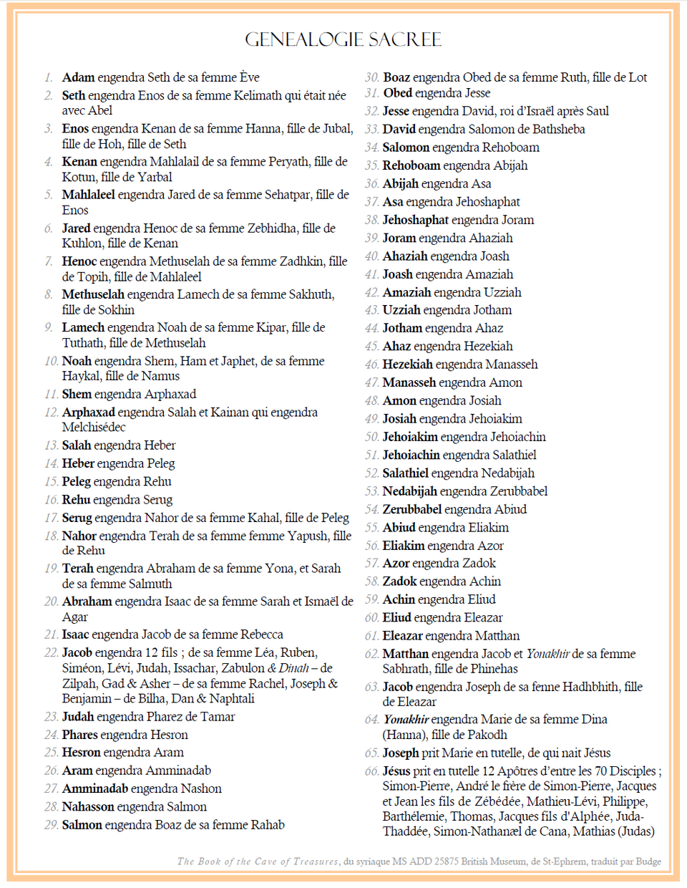
The Cave of Treasures (East and West Syriac) pt. 1
The Cave of Treasures is a Syriac work which retells biblical history in a Mesopotamian context, the author attributed the work to Ephrem the Syrian, however this has since been disregarded and it is considered to be from the 5th century AD in Northern Iraq. In it, the author makes a few interesting connections, particularly to the land of Assyria (called Nod in the text) and focuses on the figure of Nimrod, to build a Syriac identity. Both traditions, East and West, use this text extensively.
Notes:
The History of Mar Behnam and Sarah: Martyrdom and Monasticism in Medieval Iraq, Jeanne-Nicole
Assyrian Continuity Post-Empire: The Relevance of Preserving Assyrian History and Heritage, Dr. Nicholas Al-Jeloo, Timestamp | 27:45 - 28:08

Slide 36
The Cave of Treasures (East and West Syriac) pt. 2
The author of the text uses 3 themes to create a Syrian identity, foundation myths and geography which he attributes to the Nimrod and Assyria, alongside the Syriac language and Christian asceticism. Foundation myths are tales used to present a nation's or region's identity, its origins, etc. The fact that the author ties the Syrians to Nimrod and Assyria is clear evidence of a connection to a Mesopotamian past.
“I intend to focus upon three themes that the author uses to build upon an image of a Suryoyo people, namely his treatment of the province of Assyria...”
Syrian Identity in the Cave of Treasures, Philip Wood, Pg. 131
“Su-Min-Ri situates the text in Assyria because of its repeated focus on the land of Nod. This location,which only appears once in Genesis, becomes, for the Cave of Treasures, the place where Cain is exiled and where he is killed by Lamech: where the magi take their incense and also the location for the journeys of Nimrod, which are described in great detail... Moreover, the Cave gives an unusually positive role to Nimrod, an opponent of Abraham, as the founder of a series of Mesopotamian cities from Seleucia to Edessa and as the creator of the pure, original form of the Zoroastrian religion. Dimly remembered figures of the past were used to provide foundation myth.”
Syrian Identity in the Cave of Treasures, Philip Wood, Pg. 132
Notes:
The History of Mar Behnam and Sarah: Martyrdom and Monasticism in Medieval Iraq, Jeanne-Nicole
Assyrian Continuity Post-Empire: The Relevance of Preserving Assyrian History and Heritage, Dr. Nicholas Al-Jeloo, Timestamp | 27:45 - 28:08

Slide 37
The Cave of Treasures (East and West Syriac) pt. 3
“Moreover, as Fiey notes, a series of local places were already associated with Nimrud, such as Mosul, Nimrud-Athor, and Tell Nimrud, the capital of Ashurnasirpal, king of Assyria. Walker has suggested a number sites, such as Ashur, Nineveh and the shrine of Mar Qardagh at Melqi, where preservation of Assyrian toponyms, settlement patterns and building shapes in new constructions might imply some blurred memory of an Assyrian past. Even though there was no continuous settlement at Tell-Nimrud, the ruins of a mostly forgotten past must have demanded explanation of some kind. Thus the Cave seems to have received a fusion of two traditions, both of which had migrated across communal boundaries. The first explained the great monuments of the past by associating them with the giant Nimrod, drawn from Jewish myth, and then second had fused these foundation myths with the equally shadowy figure of Zoroaster, in abid to resist Sassanian reforms of Zoroastrianism in the third century. By the time that the Cave of treasures was compiled in the early sixth century, both of these traditions had become intertwined in a world of permeable religious boundaries in a shared foundation myth for this territory of Assyria.”
Syrian Identity in the Cave of Treasures, Philip Wood, Pg. 134
Notes:
The History of Mar Behnam and Sarah: Martyrdom and Monasticism in Medieval Iraq, Jeanne-Nicole
Assyrian Continuity Post-Empire: The Relevance of Preserving Assyrian History and Heritage, Dr. Nicholas Al-Jeloo, Timestamp | 27:45 - 28:08

Slide 38
The Cave of Treasures (East and West Syriac) pt. 4
In other words, Assyria is treated as a special region which the author focuses on, it is the land of many events and the destination of Nimrod’s journey. Assyria is treated as a place where the Syrians have a special link, a special connection to. It is their land, and its geography is significant as it is represented as a Syriac homeland for the author. Furthermore, it’s necessary to mention that Assyria is called “Nod” within this text, however the region itself was known as explicitly Assyria in other Syriac works, which the author would have clearly known. Furthermore, in this region of Northern Mesopotamia it is where the Mesopotamian (although explicitly Assyrian in Syriac texts) king Nimrod founded many cities of the region. The author portrayed him in this sense out of local patriotism and a need to explain the ruins of Assyria in the area.
“It appears that the rise of the positive image of Nimrod in Syriac Christian tradition was, to a significant degree, an expression of the phenomenon of “local patriotism,”... It was because this biblical figure began to be considered as a foundational figure and cultural hero by the Christians of Northern Mesopotamia that they chose to supplant the dominant negative image of him with a more positive one. The primary impetus for this development was provided by the biblical information on the close connection between Nimrod and the cities of Babylonia and Assyria (Gen 10:10–12),which were later identified with several important urban centers of Northern Mesopotamia... The important role Nimrod played in the development of a distinctive local identity among the Syriac-speaking Christians of Mesopotamia finds an additional illustration in the appeals to him as an ancestral figure.”
Memory and Identity in the Syriac Cave of Treasures, Minov, Pg. 193-194
Notes:
The History of Mar Behnam and Sarah: Martyrdom and Monasticism in Medieval Iraq, Jeanne-Nicole
Assyrian Continuity Post-Empire: The Relevance of Preserving Assyrian History and Heritage, Dr. Nicholas Al-Jeloo, Timestamp | 27:45 - 28:08

Slide 39
The Cave of Treasures (East and West Syriac) pt. 5
And thus, the figure of Nimrod was used to connect to the Syrian’s Mesopotamian past. These foundation myths of Assyria and Nimrod are how they understood themselves and their identity, they believe that they were descendants of these great kings and land. This specific tradition on Nimrod is continuously found in nearly all Syriac texts, which would be too great of a number to list.
“The names of the cities he is said to have founded according to Genesis were updated and adapted to the context of Late Antiquity, and replaced by local and familiar names of cities in North and South Mesopotamia. In Syriac tradition, he [Nimrod] had become a founding hero, acculturated from the biblical text to form a memory of the local Mesopotamian past.”
Alexandre en Grande le Syriaque, Murie Debie, Pg. 522-523 | Translated from French
Notes:
The History of Mar Behnam and Sarah: Martyrdom and Monasticism in Medieval Iraq, Jeanne-Nicole
Assyrian Continuity Post-Empire: The Relevance of Preserving Assyrian History and Heritage, Dr. Nicholas Al-Jeloo, Timestamp | 27:45 - 28:08

Slide 40
The Cave of Treasures (East and West Syriac) pt. 6
Furthermore, the Cave actually preserves some Assyrian concepts. For example, it mentions that the celestial world is divided into “Three heavens”. This concept is earliest attested in Akkadian literature, and actually from a Neo-Assyrian text in Assur. Thus, the Cave drew on ancient Assyrian concepts from the region, displaying a cultural continuity.
“It is there, among ancient Mesopotamian and Iranian cosmological speculations, that we find imagery of the celestial world being divided into the three heavens that provides us with the background relevant to the passage from CT. One of the earliest explicit mentions of the sky being divided into three levels is attested in Akkadian sources. For example, in KAR 307, a religious explanatory text in Neo-Assyrian script from Assur, dated to the first millennium BCE...”
Dynamics of Christian Acculturation in the Sasanian Empire: Some Iranian Motifs in the Cave of Treasures, Minov, Pg. 156
“All the apocryphal texts written in early Christianity had the purpose of educating a group of faithful who were mostly illiterate and therefore could not understand the sacred texts. For this reason, the creation of stories and fables had necessarily to draw on the patrimony of legends and folk tales of Assyro-Babylonian origin... Archaeological excavations proved that The Cave of Treasures contains stories belonging to the Assyro-Babylonian world and not that they have never been included in the Bible.” Religious Minorities in Iraq, Corticelli, Pg. 56
Notes:
The History of Mar Behnam and Sarah: Martyrdom and Monasticism in Medieval Iraq, Jeanne-Nicole
Assyrian Continuity Post-Empire: The Relevance of Preserving Assyrian History and Heritage, Dr. Nicholas Al-Jeloo, Timestamp | 27:45 - 28:08

Slide 41
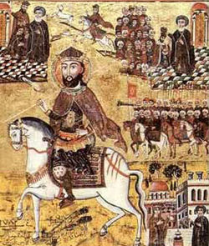
The Legend of Mor Behnam and Sarah (West Syriac Rite) pt. 1
The Legend of Mor Behnam follows the tale of the martyrdom of the prince Behnam and his sister Sarah. The story is believed to take place within the 4th century AD. According to the narrative, Behnam was the son of the Magian king of Assyria and Persia, Sennacherib. Behnam converts to Christianity after a monk cures his sister of her ailment and is then killed by Sennacherib. Sennacherib's wife is later also diseased and healed miraculously, at that point which he converts to Christianity. Although the story is erroneous in some of its historical claims and confusing, the focus is to show how Syriac Christians interpreted their origins and past, claiming to be Assyrians and recasting their ancient king as a persecutor who later on turned to the truth.
Notes:
The History of Mar Behnam and Sarah: Martyrdom and Monasticism in Medieval Iraq, Jeanne-Nicole
Assyrian Continuity Post-Empire: The Relevance of Preserving Assyrian History and Heritage, Dr. Nicholas Al-Jeloo, Timestamp | 27:45 - 28:08

Slide 42
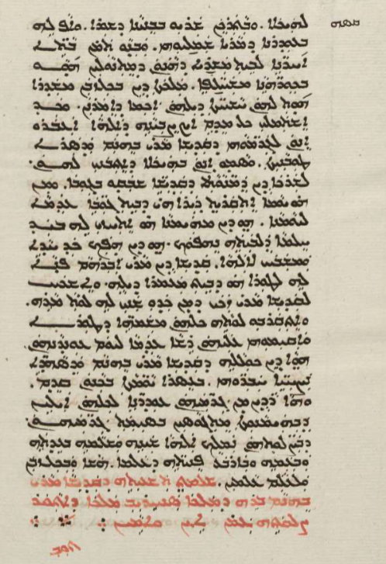
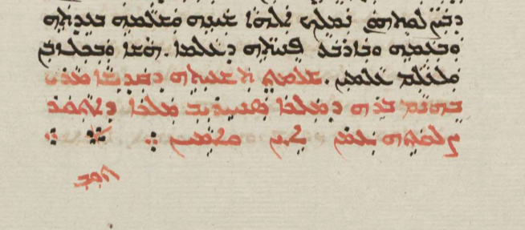
The Legend of Mor Behnam and Sarah (West Syriac Rite) pt. 2
“Completed is the history of the holy Mar Behnam, son of King Sennacherib, king of Assyria. May his prayer be with us forever. Amen.”
The History of Mar Behnam and Sarah: Martyrdom and Monasticism in Medieval Iraq, Jeanne-Nicole, Pg. 138
Sachau - 222 f.166v
Notes:
Assyria A.D. Documentary (2021), Quote by Dr. Nicholas Al-Jeloo, Timestamp; 21:58 - 22:26, https://vimeo.com/ondemand/assyriaad
Sennacherib at the Gates of Jerusalem Story, History and Historiography, Isaac & Seth, Pg. 451
“Assyrians Of The 12th Century AD by Professor Amir Harrak”, Timestamp; 58:09 - 58:34, https://www.youtube.com/watch?v=CtxCc41_CQw

Slide 43
The Legend of Mor Behnam and Sarah (West Syriac Rite) pt. 3
“Behnam and Sarah is not unique among Syriac sources in referring to Sennacherib. Numerous Syriac texts from late antiquity and the early medieval period mention both him and the Assyrians, usually with the goal of portraying Syriac-speaking Christians as the heirs of the ancient Assyrian or Aramaean past. But the text is undeniably odd in presenting the Assyrian king as the father of two Christian martyrs.”
The History of Mar Behnam and Sarah: Martyrdom and Monasticism in Medieval Iraq, Jeanne-Nicole, Pg. 2
“There are, additionally, saints revered in Syriac Christianity in whose hagiographies or life stories are clearly said to be descended from Assyrian royalty. Among them are Saint Behnam and his sister Sarah who died in 350 AD who were the children of a local ruler or governor named Sennacherib.”
Assyrian Continuity Post-Empire: The Relevance of Preserving Assyrian History and Heritage, Dr. Nicholas Al-Jeloo, Timestamp | 27:45 - 28:08
Notes:
Assyria A.D. Documentary (2021), Quote by Dr. Nicholas Al-Jeloo, Timestamp; 21:58 - 22:26, https://vimeo.com/ondemand/assyriaad
Sennacherib at the Gates of Jerusalem Story, History and Historiography, Isaac & Seth, Pg. 451
“Assyrians Of The 12th Century AD by Professor Amir Harrak”, Timestamp; 58:09 - 58:34, https://www.youtube.com/watch?v=CtxCc41_CQw

Slide 44
The Legend of Mor Behnam and Sarah (West Syriac Rite) pt. 4
“One interesting thing that we do find in the Syriac hagiographies, or the lives of saints, is this linkage going back to the ancient Assyrians or providing these saints with an ancient Assyrian lineage or an ancient Assyrian past, which not only establishes them as saints in their own right but also establishes them as royalty and something to be held in awe.”
Assyria A.D. Documentary (2021), Quote by Dr. Nicholas Al-Jeloo, Timestamp; 21:58 - 22:26
“The Mār Behnam story assigns Syriac Christian origins more deeply into antiquity. Behnam was identified both as a “Persian prince” and a “son of Sennacherib,” martyred for his refusal to worship the gods of Sennacherib. Testimony to the enduring power of this story, A. Harrak has recently translated a dedicatory inscription from the Church of Mār Behnam, thirty-five kilometers south-east of Mosul, dated to the sixteenth or seventeenth century c.e. The inscription identifies the saint as the “son of Sanhārīb,” and that he was co-martyred with his sister Sarah; the “queen mother Shirin is said to have built for her martyred children a shrine containing their remains after the conversion of the father [i.e., Sennacherib!] to Christianity.”
Sennacherib at the Gates of Jerusalem Story, History and Historiography, Isaac & Seth, Pg. 451
Notes:
The History of Mar Behnam and Sarah: Martyrdom and Monasticism in Medieval Iraq, Jeanne-Nicole

Slide 45
The Legend of Mor Behnam and Sarah (West Syriac Rite) pt. 5
“In the story of Mar Behnam, there are of course many issues, but the writer wanted to say Mar Behnam is Assyrian. Moreover, the writer considered himself Assyrian to consider his holy man Assyrian. And that is why he said he is the son of Sennacherib, king of Assyria.”
“Assyrians Of The 12th Century AD by Professor Amir Harrak”, Timestamp; 58:09 - 58:34
“Despite Mar Qardagh being about one man rather than a pair, or group, of siblings, the narrative presents several elements that are familiar to that of Behnam and Sarah, including: the conversion of a Sasanian noble; the wise counsel of a mountain-dwelling ascetic; the legacy of the ancient Assyrian Empire; and the literary influence of the Roman military martyr, St. Sergius, whose cult was widespread throughout seventh-century Syro-Mesopotamia. [...] Behnam and Sarah thus significantly one-up Qardagh in that they are not distantly descended from this ancient and “renowned lineage,” but are the very children of Sennacherib himself.”
The History of Mar Behnam and Sarah: Martyrdom and Monasticism in Medieval Iraq, Jeanne-Nicole, Pg. 21-22
Notes:
Ancient Assyria: A Very Short Introduction, Karen Radner, Chapter One

Slide 46
The Legend of Mor Behnam and Sarah (West Syriac Rite) pt. 6
At a point in the story Sennacherib mentions who his gods are. One may notice that the Mesopotamian gods are among those he worships, such as Bel, Belti and Kewan, further proving his native Assyrian origin and the inspiration or origin of the writers.
“When the king heard these things from his son he said, “Lo, I see you have strayed into the sorcery of the Nasraye (Christians). By the great god Kewan, by Bel and Belti, those who are the upholders of the world, by them do I swear that if you do not abandon this evil way of thinking you have embraced, and do not return to the worship of the gods and offer sacrifices as you used to do, I will rid your lives from the face of the Earth in a very terrible way! Do not think that because you are my children I will be merciful to you. For you are not more precious to me than the gods of all the Earth.”
The History of Mar Behnam and Sarah: Martyrdom and Monasticism in Medieval Iraq, Jeanne-Nicole, Pg 78
Notes:
Historical Process and Developments and Archaeological Remains of the Assyrians in Northern Mesopotamia: Exorcism and the Founding Figures of Early Eastern Christianity, Cynthia Jean, Pg. 164-165 | Article within book “The Assyrian Heritage: Threads of Continuity and Influence”

Slide 47
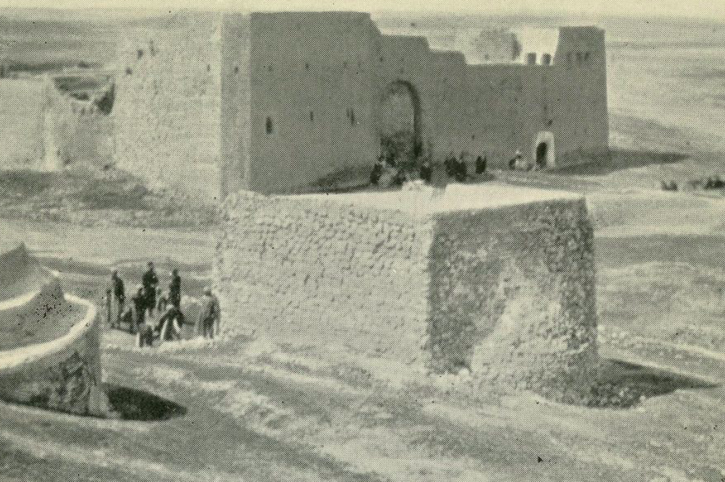
The Legend of Mor Behnam and Sarah (West Syriac Rite) pt. 7
The monastery itself also has Mesopotamian influences, with the ancient Assyrian flower/star being present on the carvings in the walls.
“Assyrians Of The 12th Century AD by Professor Amir Harrak”, Timestamp; 59:11 - 59:19
“Sennacherib invokes three Assyrian/Babylonian astral gods here: Kewan = Saturn; Bel = Jupiter; and Belti = Venus, who is typically identified with Ishtar.”
The History of Mar Behnam and Sarah: Martyrdom and Monasticism in Medieval Iraq, Jeanne-Nicole, Pg 78, Footnote 41
Notes:
Historical Process and Developments and Archaeological Remains of the Assyrians in Northern Mesopotamia: Exorcism and the Founding Figures of Early Eastern Christianity, Cynthia Jean, Pg. 164-165 | Article within book “The Assyrian Heritage: Threads of Continuity and Influence”

Slide 48
The Legend of Mor Behnam and Sarah (West Syriac Rite) pt. 8
“The Eastern Churches flourished subsequently and local Christian traditions found new roles for prominent figures and sites of Assyrian History, quite separate from the information recorded in the Bible. Hence, the city of Aššur and King Sennacherib appear in the legend of the 4th century ad martyr, Saint Behnam, who converts to Christianity after local holy man Saint Matthew (in Aramaic, Mar Mattai) had miraculously healed his sister. Sennacherib was cast as Behnam’s royal father who ordered the prince’s execution. In turn, the king was struck by a disease and only cured when he agreed to be baptized by Saint Matthew in the city of Aššur. Grateful, Sennacherib then founded the monastery of Deir Mar Mattai near Mosul, one of the centres of the Maphrianate of the East (i.e. the Syriac Orthodox Churches east of the Euphrates).Today, Syriac Christian groups of the Eastern Church from the former Assyrian heartland (Nestorians and Jacobites) identify themselves as ‘Assyrians’. The origins of this view remain a matter of debate but they pre-date the spectacular archaeological discoveries of the mid-19th century that put Assyria on the map for the rest of the world.”
Ancient Assyria: A Very Short Introduction, Karen Radner, Chapter One
Notes:
Historical Process and Developments and Archaeological Remains of the Assyrians in Northern Mesopotamia: Exorcism and the Founding Figures of Early Eastern Christianity, Cynthia Jean, Pg. 164-165 | Article within book “The Assyrian Heritage: Threads of Continuity and Influence”

Slide 49
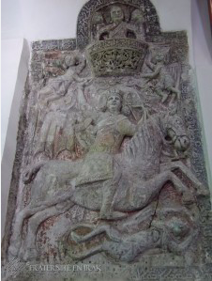
The Legend of Mor Behnam and Sarah (West Syriac Rite) pt. 9
Thus, the tale not only recalls the origin of Syriac Christians and ties us to Assyria but even mentions some of the ancient gods worshipped by the pagan Assyrians in the area, and details their conversion. Mor Behnam was sent to save the Assyrians and Assyria from paganism, and he fulfilled this task, leaving behind his monastery that is believed to have been constructed by either Sennacherib himself or his wife, which is preserved to this day for all visitors to recall the tale.
See: MLK-Ashuroyo’s Post
Notes:
Historical Process and Developments and Archaeological Remains of the Assyrians in Northern Mesopotamia: Exorcism and the Founding Figures of Early Eastern Christianity, Cynthia Jean, Pg. 164-165 | Article within book “The Assyrian Heritage: Threads of Continuity and Influence”

Slide 50
The Legend of Mor Behnam and Sarah (West Syriac Rite) pt. 10
“Some of these men and women are said to come from pagan Persian families enjoying a high status, or have a noble Assyrian lineage, such as Mar Behnam, a ‘son of Sanherib from Nimrud’. Another example is the lineage of Mar Qardagh, ‘who was from a great people (gensa) from the stock kingdom of the Assyrians’. His father was descended from the renowned lineage of the house of Nimrod, and his mother from the renowned lineage of the house of Sennacherib. And he was born of pagan parents lost in the error of Magianism [= Zoroastrian faith], for his father, whose name was Gusnoy, was a prominent man in the kingdom and distinguished among the Magoi [= Zoroastrian priests]. These holy persons are usually torn between faith and family and their conversion is even more deserving. A thorough research should be made on these Christians with so-called ‘Assyrian origins’ and pagan background. It is difficult to find out if they really were the descendants of the remaining Assyrian community after the fall of Nineveh and Nimrud (in 612 and 609 BC, respectively) and modern scholars often debate on the historicity of such arguments. What really matters, in my opinion, is that the authors writing about them felt compelled to mention their high Assyrian lineage, while their pagan Zoroastrian background and their conversion alone would be worth mentioning. In about 600 AD, the importance of identifying Mar Qardagh as an Assyrian, thus, as the heir of the two prestigious ancient characters - The biblical hero Nimrod and the Assyrian king Sennacherib - is of considerable significance and play a key role in the identity of the Church of the East in a Zoroastrian landscape, just before the arrival of Islam, These Assyrian martyrs are considered by hagiographers as the children of true ancient Mesopotamian community.”
Historical Process and Developments and Archaeological Remains of the Assyrians in Northern Mesopotamia: Exorcism and the Founding Figures of Early Eastern Christianity, Cynthia Jean, Pg. 164-165 | Article within book “The Assyrian Heritage: Threads of Continuity and Influence”
Notes:
Historical Process and Developments and Archaeological Remains of the Assyrians in Northern Mesopotamia: Exorcism and the Founding Figures of Early Eastern Christianity, Cynthia Jean, Pg. 164-165 | Article within book “The Assyrian Heritage: Threads of Continuity and Influence”

Slide 51
The Legend of Mor Behnam and Sarah (West Syriac Rite) pt. 11
These hagiographical legends were of immense importance for identity and survived well past their time. Mar Behnam in particular was astoundingly popular within the whole SOC, remaining a major saint until this day, and serving as a link to the Assyrian past. Jacob of Serugh could also find some positive aspects for the Assyrians of his days; his homily elevates Mor Behnam as a national hero for the Assyrians of Assyria's heartland and for the rest of the Suryāye, and even more so for the rest of Christendom. Mor Behnam, descendant of Sennacherib and inheritor of the crown of Nineveh, deserves to be praised by all nations. Thus were the Assyrians held in such honour in Syriac literature, not only as an example of repentance during the days of Jonah which Jacob has a homily on, and the first to recognise Christ through 'the wise men' of Nineveh, but also as among the first nations to give martyrs and to embrace Christianity. Jacob uses ‘our country’ (referring to Assyria, as the homily is about this land) and ‘our nation’ to elevate Behnam, the Assyrian, to a national level. This parallels Dr. Payne's hypothesis and displays here in this hymn an attachment to Assyria, as it's the case in other works of Syriac literature, while also displaying Jacob’s connection to his Assyrian heritage, not only through this passage, but also by his homily on Nineveh.
(For the Ninevites, see local history section, they believed it referred to their own ancestors, as implicitly suggested in such homilies.)
Notes:
Historical Process and Developments and Archaeological Remains of the Assyrians in Northern Mesopotamia: Exorcism and the Founding Figures of Early Eastern Christianity, Cynthia Jean, Pg. 164-165 | Article within book “The Assyrian Heritage: Threads of Continuity and Influence”

Slide 52
The Legend of Mor Behnam and Sarah (West Syriac Rite) pt. 12
“You have become for our country a sharp sword against wrath [...] You have become for our nation an adorned crown and a glorious name [...] Through you the light has increased in the East, the mother of illuminations and from your rays are enriched the (four) quarters and their limits. And that is why you deserve to be praised [...] Oh Mor Behnam, chosen martyr full of all blessings...”
See: MLK-Ashuroyo’s Post | For more on Jacob’s relationship with Assyria, See: MLK-Ashuroyo’s Post
“Neither the novelty nor the consequences of such a reinterpretation should be underestimated. The literary work of East Syriac writers completely transformed the meaning of the Assyrian past, with far-reaching effects on Mesopotamian Christian communities well into the Middle Ages and beyond. The East Syriac hagiographical works gave the Assyrians and their aristocratic descendants central roles in the region's saintly history, providing a communal rather than a specifically aristocratic past. The Christian interpretation of the Assyrians as the originators of the lineages of saints gave them a new significance within these communities. No longer associated with secret, polytheistic rituals and tyrannical rule, the Assyrians—in their newly invented, Christianized form—became a means of communal self-representation and self-fashioning to outsiders. Furthermore, East Syriac writers institutionalized the collective memory of the Assyrian past. Hagiographical works possessed the special potential to disseminate stories, ideas, and identities in ancient societies with limited means of communication. When recited annually in the presence of the Christian public, both elite and lower classes, they addressed entire communities gathered to celebrate festivals in honor of the martyrs... As a consequence, Christianized Assyrians remained prominent figures within Christian communities long after their political or social utility had outlived its usefulness.”
Ein iranisches Assyrien, Richard Payne, Pg. 28- 29 | Payne includes Behnam as an example. This passage complements the idea of Jacob’s reception of the Behnam legend.

Slide 53
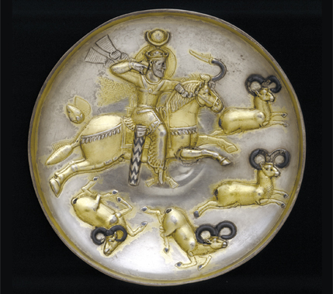
The Legend of Mar Qardagh (East Syriac Rite) pt. 1
The Legend is a hagiography of Saint Mar Qardagh. The original manuscript was dated by the patriarch of the Chaldean Church to the 7-8th century but the original has been lost due to the First World War. However, luckily, a copy was made before it was lost to time. The story in and of itself however dates to 360-380 AD as this is the time Mar Qardagh is believed to have been alive. Within this document, we are told that Mar Qardagh is from the race of the Assyrians, being descended from Sennacherib and Nimrod. Mar Qardagh was also the governor of the region from the Diyala river in Central Iraq to Nisibis in the North and also Assyria and was appointed by Shapur, however he was later persecuted for converting to Christianity after encountering a monk named Abdisho.
Notes:
The Legend Of Mar Qardagh Narrative and Christian Heroism In Late Antiquity, Joel Scott

Slide 54
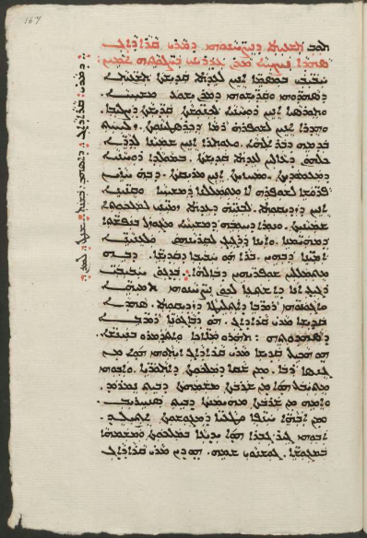
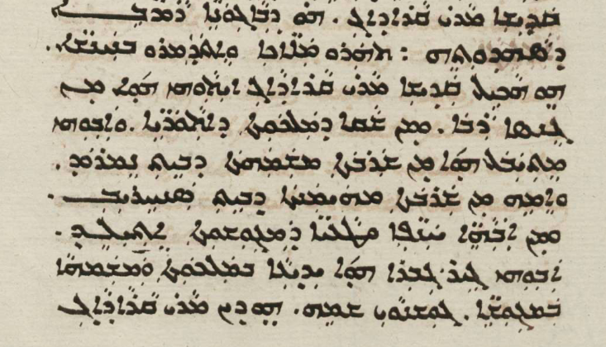
The Legend of Mar Qardagh (East Syriac Rite) pt. 2
“Now holy Mar Qardagh was from a great people (gensa) from the stock of the kingdom of the Assyrians (atoraye). His father was descended from the renowned lineage of the house of Nimrod, and his mother from the renowned lineage of the house of Sennacherib.”
The Legend Of Mar Qardagh Narrative and Christian Heroism In Late Antiquity, Joel Scott, Pg. 80
Sachau - 222 f. 167r
Notes:
The Legend Of Mar Qardagh Narrative and Christian Heroism In Late Antiquity, Joel Scott
Assyrians, Syrians and the Greek Language in the late Hellenistic and Roman Imperial Periods, Andrade
Milqia/Arbel in the 4th Century CE, Joel Walker, Melammu Database

Slide 55
The Legend of Mar Qardagh (East Syriac Rite) pt. 3
Again, such is attested in a prayer note by the scribe who copied down the manuscript;
“By the Divine Power, a sinful servant, begin to copy the noble history of Mar Qardagh of good name, who was from the Assyrian land and from the race of Nimrod. Strengthen me by Your strength, O Lord, that it may be finished.”
The Legend Of Mar Qardagh Narrative and Christian Heroism In Late Antiquity, Joel Scott, Pg. 79
Here, Nimrod is associated with Assyria. Mar Qardagh is also said to be from the Assyrian land among one of his companions, and it is fair to conclude that at least within this text, Athoraya had ethnic implications and the land was called Athor after its inhabitants.
Notes:
The Legend Of Mar Qardagh Narrative and Christian Heroism In Late Antiquity, Joel Scott
Assyrians, Syrians and the Greek Language in the late Hellenistic and Roman Imperial Periods, Andrade
Milqia/Arbel in the 4th Century CE, Joel Walker, Melammu Database

Slide 56
The Legend of Mar Qardagh (East Syriac Rite) pt. 4
“But the blessed Abdiso answered and said to him, "As it was told to me by my parents, they were from Hazza, a village in the lands of the Assyrians.”
The Legend Of Mar Qardagh Narrative and Christian Heroism In Late Antiquity, Joel Scott, Pg. 26
Arbela (Erbil) is also said to be the city of the Assyrians, and where Mar Qardagh is native to elsewhere in the text.
The Legend Of Mar Qardagh Narrative and Christian Heroism In Late Antiquity, Joel Scott, Pg. 22
Again, we are also presented with a calendar from the 14th century in Tur Abdin mentioning Mar Qardagh as being from the race of Sennacherib.
“Mar Qardagh from the race (gensa) of Sennacherib, who was crowned on a Friday.”
The Legend Of Mar Qardagh Narrative and Christian Heroism In Late Antiquity, Joel Scott, Pg. 267
Notes:
Assyrians in History, Mark Gewargis
The Legend Of Mar Qardagh Narrative and Christian Heroism In Late Antiquity, Joel Scott
Christians in the Sassanid Empire: a Case of Divided Loyalties, Brock
Assyrie Chrétienne Vol. I, Fiey, Pg. 48 | Translated from French by DeepL

Slide 57
The Legend of Mar Qardagh (East Syriac Rite) pt. 5
There is no doubt here that Athoraya was a term applied to people during this period of time, and that the geographic region was called Athor after its inhabitants, who were also racially “Athoraye”. These were the Syriac Christians of Northern Mesopotamia. This is evident at least within this specific text of Mar Qardagh’s hagiography. Other Suryaye in the region also likely adopted the name Qardagh and his Assyrian heritage from his martyrdom text.
The Legend Of Mar Qardagh Narrative and Christian Heroism In Late Antiquity, Joel Scott, Pg. 268-269
“By late antiquity, Syriac-speaking authors in Sasanian Persia who lived in the district called Nōdšīragān or Nōd-Ardaxšīragān in Middle Persian and Parthian (but Adiabēnē in Greek) were positing that they, as Assyrians, were descended from Assyrians of antiquity who had inhabited the region.”
Assyrians, Syrians and the Greek Language in the late Hellenistic and Roman Imperial Periods, Andrade, Pg. 299
Notes:
Assyrie Chrétienne Vol. I, Fiey | Translated from French

Slide 58
The Legend of Mar Qardagh (East Syriac Rite) pt. 6
“At the same time, Mar Qardagh is said to have an eminent genealogy going back to the royal “Assyrian” roots—he descended on his father’s side from the house of Nimrod and on his mother’s side from the house of Sennacherib. Qardagh’s father, Gušnōy is accordingly described as a “prominent man in the kingdom and distinguished among the magi”. Qardagh’s genealogy cannot of course be taken literally, as this figure bears many legendary features. However, it reveals the outlook of a Late Sasanian writer from Adiabene who thought of the Adiabene hereditary elites as having a local background, but, at the same time, presented them as fully integrated into the Sasanian aristocratic society.”
Sophene, Gordyene, and Adiabene: Three Regna Minora of Northern Mesopotamia Between East and West, Marciak, Pg. 290
“One interesting thing that we do find in the Syriac hagiographies, or the lives of saints, is this linkage going back to the ancient Assyrians or providing these saints with an ancient Assyrian lineage or an ancient Assyrian past, which not only establishes them as saints in their own right but also establishes them as royalty and something to be held in awe.”
Assyria A.D. Documentary (2021), Quote by Dr. Nicholas Al-Jeloo, Timestamp; 21:58 - 22:26
Notes:
Assyrie Chrétienne Vol. I, Fiey | Translated from French

Slide 59
The Legend of Mar Qardagh (East Syriac Rite) pt. 7
“He [Qardagh] is the quintessential hero of the Syriac Christian community, the man who with his strength and humanity can fight and win thanks to his new faith in the real religion, Christianity. A very important detail to note here is that he is executed in Arbela (Erbil), the city that together with Karka in the sixth century became the centre of the cult of Christian martyrs. Far from being a contradiction, this book, recited during the annual feasts on the tells of Beit Teta in Karka and of the still unidentified tell of Melqi in Arbela, left its auditors with the conviction that their claim of belonging to this land was carved in its more ancient stones because: Now holy Mar Qardagh was from a great people (gensā) from the stock of the kingdom of the Assyrians (‘ātōrāyē)... The protagonist is a new aristocracy and a new lineage that, with a remarkable creative leap thanks to a mixture of literary and cultural traditions present in the area, managed to create a link with the ancient past...”
Religious Minorities in Iraq, Corticelli, Pg. 61-62

Slide 60
The Legend of Mar Qardagh (East Syriac Rite) pt. 8
Regarding his name being Iranian, this does not disprove his Assyrian origins.
“As for Iranian personal names, their holders belong either to the Sasanian government officials (both civil and religious) or to members of the upper social classes. It is of course possible to think that such individuals (especially in the case of officials) were ethnic Iranians (e.g., the two kings of Sasanian Adiabene named Ardashir), but it appears that in many cases the names were chosen as an expression of cultural and political standing (e.g., Mar Qardagh claims local Assyrian lineage, Yazdān-duxt appears to be a local noblewoman from Arbela). To conclude, the analysis of personal names attested in three Syriac sources, closely connected to Adiabene (Acts of Martyrs, Legend of Mar Qardagh) or to its history (Synodicon), shows that most of the population in Adiabene consisted of Semitic-speakers—to be precise, native Syriac speakers—while those who were closely integrated within the social, religious, and political world of the Sasanian state expressed their standing by assuming Iranian names.”
Sophene, Gordyene, and Adiabene: Three Regna Minora of Northern Mesopotamia Between East and West, Marciak, Pg. 336. See also; Ibid, Pg. 224 | Zoroastrianism also began to take root among the local populace of Adiabene and especially the nobles. See; Ibid, Pg. 290
Notes:
Assyrie Chrétienne Vol. I, Fiey | Translated from French

Slide 61
The Legend of Mar Qardagh (East Syriac Rite) pt. 9
Within some variations of the narrative found in later Syriac texts, Qardagh is claimed to be a Persian. This detail actually reinforces the idea that this tale had a distinct local flavour only found in the north. They specifically identified him with the Assyrian heritage only, as they felt connected to it.
“The bishop of Basra identifies Qardagh's family not as "Assyrian", but Persian. He notes Qardagh's descent only from the "house of Nimrod," omitting his maternal lineage via the "house of Sennacherib." This omission is significant, as it exposes the distinctive regional flavor of the original legend.”
Narrative and Christian Heroism In Late Antiquity, Joel Scott, Pg. 259
“Genealogical reports concerning Mār Qardāgh’s ancestry are significant, nonetheless varied. For instance, according to Mār Īshōʿdnaḥ of Basra, Mār Qardāgh’s family are not identified as “Assyrians” but as Parsāyē (Persians). The saint, according to this ninth century prelate and writer of the Church of the East, was only descended from the “house of Nimrod,” omitting his maternal lineage via the “house of Sennacherib.” If such omissions demonstrate anything, it is that the Mār Qardāgh legend may have experienced a process of reinterpretation, influenced by the distinctive cultural milieu in southern Mesopotamia where, unlike in Assyria, there was no interest in any Assyrian ancestry.”
Christianising Assyria (I), Ramsin Edward, Pg. 283, Footnote 8
Notes:
Assyrie Chrétienne Vol. I, Fiey | Translated from French

Slide 62
The Legend of Mar Qardagh (East Syriac Rite) pt. 10
And Mar Qardagh’s story doesn't end here! Occasionally, Qardagh’s hagiography influences synods of the Church of the East. Hence, Mar Henana considered himself the “Metropolitan of the Athoraye (Assyrians)” and allowed archdeacon Bar Aba to sign off for him with this title.
“On behalf of Henana, Metropolitan of the Athoraye (Assyrians)...”
Mark Gewargis’s Post, “Synod of Mar Isho’ Yahb I”
This unusual identification of the eparchy of Adiabene as “Athoraye” is striking indeed, and is directly borrowed from Qardagh’s story. For example, Thomas of Marga declares the Metropolitan of Adiabene as “The Seat of Beth Mar Qardagh”, seeing themselves as Qardagh’s successors.
“Thomas's allusions to this site are clustered in his account of the factional struggle over the metropolitan throne of Adiabene that erupted following the accession of the catholicos Timothy I in 780. It is in this context that Thomas speaks of the "metropolitan throne of Beth Mar Qardagh" as a synonym for the region's highest ecclesiastical office.”
The Legend Of Mar Qardagh Narrative and Christian Heroism In Late Antiquity, Joel Scott, Pg. 270
Notes:
Assyrie Chrétienne Vol. I, Fiey | Translated from French

Slide 63
The Legend of Mar Qardagh (East Syriac Rite) pt. 11
“The semi-legendary fourth-century martyr Kardagh, for example, is said to be ‘of the stock of the kingdom of the Assyrians’, his mother’s side going back to Sennacherib; later in the Acts we find him made ‘prefect of Athor’, and Arbela is described as ‘the capital of the Athoraye’. This sort of usage indeed occasionally finds its way into official church documents: at the synod of 585 the archdeacon Aba from Arbela signs ‘on behalf of Henana, metropolitan of the Athoraye’ (the usual terminology is ‘of Arbela and the whole region of Adiabene’).”
Christians in the Sassanid Empire: a Case of Divided Loyalties, Brock, Pg. 17
“Remarkably, the province of Nōdšīragān [Adiabene] was also occasionally called Atūria or Āthōr; that is, it bore the name after its northern territory around Nineveh. This equivalent name of Nōd-Ardaxšīragān can be found in the Legend of Mar Qardagh (legendary references to kings of Āthōr), and, more importantly, in the acts of the synod of 585 CE which mention a certain Mar Ḥenana as a metropolitan of the Āṯōrayē.”
Sophene, Gordyene, and Adiabene: Three Regna Minora of Northern Mesopotamia Between East and West, Marciak, Pg. 416
Notes:
Assyrie Chrétienne Vol. I, Fiey | Translated from French

Slide 64
The Legend of Mar Qardagh (East Syriac Rite) pt. 12
Therefore, we can conclude that the story of Mar Qardagh which declares us to be ethnic Assyrians (See Andrades Quote) influenced Mar Henana, and he continued this tradition, making his usage of Athoraye here ethnic, and connecting these Syriac Christians in the region of Adiabene with Assyria. The metropolitan of Adiabene was a large area, and one of the five primary archdioceses.
“The six dioceses that make up the Adiabene eparchy cover a territory that far exceeds Adiabene itself. In fact, the bishop of Erbil, metropolitan of Adiabene, has jurisdiction over almost the entire northern part of present-day Iraq.”
Assyrie Chrétienne Vol. I, Fiey, Pg. 48 | Translated from French
Fiey cites Theodoret of Cyrrhus to prove this; “Theodoret of Cyrrhus reveals that during his time the word Adiabene encompassed the western steps [border] of the kingdom of the Persians which is the land that was once Assyria.”
Assyrie Chrétienne Vol. I, Fiey, Pg. 48, Note 2 | Translated from French

Slide 65
The Legend of Mar Qardagh (East Syriac Rite) pt. 13
Thus, Adiabene was not simply the region between the Zab rivers, rather it was the entire area of north Iraq with the exception of Beth Garmai, which was its own metropolitan see. This is what is meant by “Athoraye”.
“The bishop of Arbel or the bishop of Adiabene was explicitly called Metropolitan of the Assyrians (Athoraye), which shows that the Assyrian identity was actually an ethnic identity which was spread all over northern Mesopotamia and it’s centre at the time was Arbel.”
Assyria A.D. Documentary (2021), Quote by Dr. Nicholas Al-Jeloo, Timestamp; 28:24 - 28:56
So we are able to conclude that the Syriac Christians of northern Mesopotamia considered themselves to be of the Assyrian stock, and even continued it in their church traditions. Mar Henana was making an ethnic claim, seeing himself as the successor of this Assyrian heritage which was left behind by Mar Qardagh.
“In their efforts to include themselves in the Sasanian Empire, Christians such as Qardagh and others who lived in the metropolitan regions encompassing the northern Mesopotamian cities of Nineveh (Mosul), Karka d-Bet Slokh (Kirkuk), and Arbela (Erbil) often turned to the Assyrian past to narrate themselves as its heir.”
“When Christians Became Iranian”, Kyle Smith

Slide 66
The Legend of Mar Qardagh (East Syriac Rite) pt. 14
“In places such as Nisibis, Arbela, and Karka de Beth Slouq, the ruins of antiquity may have encouraged imagined connections with the extinct empires of the past [...] Both distant antiquity and Christian martyrdom would serve as twin bases for the construction of developed histories for these regions at the end of the sixth century.”
The Chronicle of Seert, Philip Wood, Pg. 27
“The text of a Syriac martyr’s legend of the 7th century CE, on Mar Qardagh of Arbela, Sasanian marzban [border guard] of northern Iraq under Shapur II in the 360’s CE, has several interesting connections with traditions or memories of Assyria, beginning with Qardagh’s genealogy traced from the royal house of ‘Ator’ (Assyria) via Sennacherib on his mother’s side and Nimrod on his father’s side . . . The cult site of Mar Qardagh at ‘Melqi’ described in the Nestorian literary sources is very probably identical with ‘Milqia’, site of an Ištar temple, noted in the Assyrian sources. If so, we have a very interesting case of long-term continuity in the religious topography of north Mesopotamia.”
Milqia/Arbel in the 4th Century CE, Joel Walker, Melammu Database

Slide 67
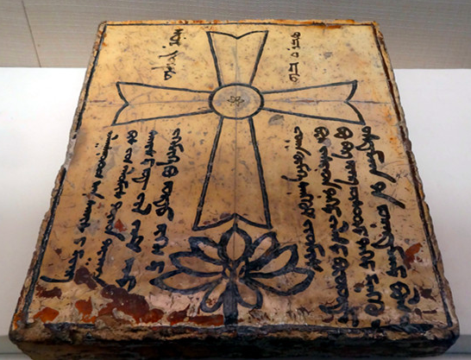
The Legend of Mar Qardagh (East Syriac Rite) pt. 15
“From the seventh century AD, at least, the Nestorian church openly professed its Assyrian identity.”
Historical Process and Developments and Archaeological Remains of the Assyrians in Northern Mesopotamia: Exorcism and the Founding Figures of Early Eastern Christianity, Cynthia Jean, Pg. 164 | Article within book “The Assyrian Heritage: Threads of Continuity and Influence”
“As recently remarked by C. Jean, it is noteworthy that the memory of Assyria and of its rulership was not only alive, but also used as an identity marker for the Church of the East in the 6th century CE in a Zoroastrian milieu.”
The Neo-Assyrian Empire: A Handbook, Lanfranchi & Ponchia, Pg. 528

Slide 68
Scholarly Analysis on The Legend of Mar Qardagh pt. 1
“Some of these men and women are said to come from pagan Persian families enjoying a high status, or have a noble Assyrian lineage, such as Mar Behnam, a ‘son of Sanherib from Nimrud’. Another example is the lineage of Mar Qardagh, ‘who was from a great people (gensa) from the stock kingdom of the Assyrians’. His father was descended from the renowned lineage of the house of Nimrod, and his mother from the renowned lineage of the house of Sennacherib. And he was born of pagan parents lost in the error of Magianism [= Zoroastrian faith], for his father, whose name was Gusnoy, was a prominent man in the kingdom and distinguished among the Magoi [= Zoroastrian priests]. These holy persons are usually torn between faith and family and their conversion is even more deserving. A thorough research should be made on these Christians with so-called ‘Assyrian origins’ and pagan background. It is difficult to find out if they really were the descendants of the remaining Assyrian community after the fall of Nineveh and Nimrud (in 612 and 609 BC, respectively) and modern scholars often debate on the historicity of such arguments. What really matters, in my opinion, is that the authors writing about them felt compelled to mention their high Assyrian lineage, while their pagan Zoroastrian background and their conversion alone would be worth mentioning. In about 600 AD, the importance of identifying Mar Qardagh as an Assyrian, thus, as the heir of the two prestigious ancient characters - The biblical hero Nimrod and the Assyrian king Sennacherib - is of considerable significance and play a key role in the identity of the Church of the East in a Zoroastrian landscape, just before the arrival of Islam, These Assyrian martyrs are considered by hagiographers as the children of true ancient Mesopotamian community.”
Historical Process and Developments and Archaeological Remains of the Assyrians in Northern Mesopotamia: Exorcism and the Founding Figures of Early Eastern Christianity, Cynthia Jean, Pg. 164-165 | Article within book “The Assyrian Heritage: Threads of Continuity and Influence”

Slide 69
Scholarly Analysis on The Legend of Mar Qardagh pt. 2
These hagiographical legends were of immense importance for identity and survived well past their time.
“The East Syriac hagiographical works gave the Assyrians and their aristocratic descendants central roles in the region's saintly history, providing a communal rather than a specifically aristocratic past. The Christian interpretation of the Assyrians as the originators of the lineages of saints gave them a new significance within these communities. No longer associated with secret, polytheistic rituals and tyrannical rule, the Assyrians—in their newly invented, Christianized form—became a means of communal self-representation and self-fashioning to outsiders. Furthermore, East Syriac writers institutionalized the collective memory of the Assyrian past. Hagiographical works possessed the special potential to disseminate stories, ideas, and identities in ancient societies with limited means of communication. When recited annually in the presence of the Christian public, both elite and lower classes, they addressed entire communities gathered to celebrate festivals in honor of the martyrs... As a consequence, Christianized Assyrians remained prominent figures within Christian communities long after their political or social utility had outlived its usefulness.”
Ein iranisches Assyrien, Richard Payne, Pg. 29

Slide 70
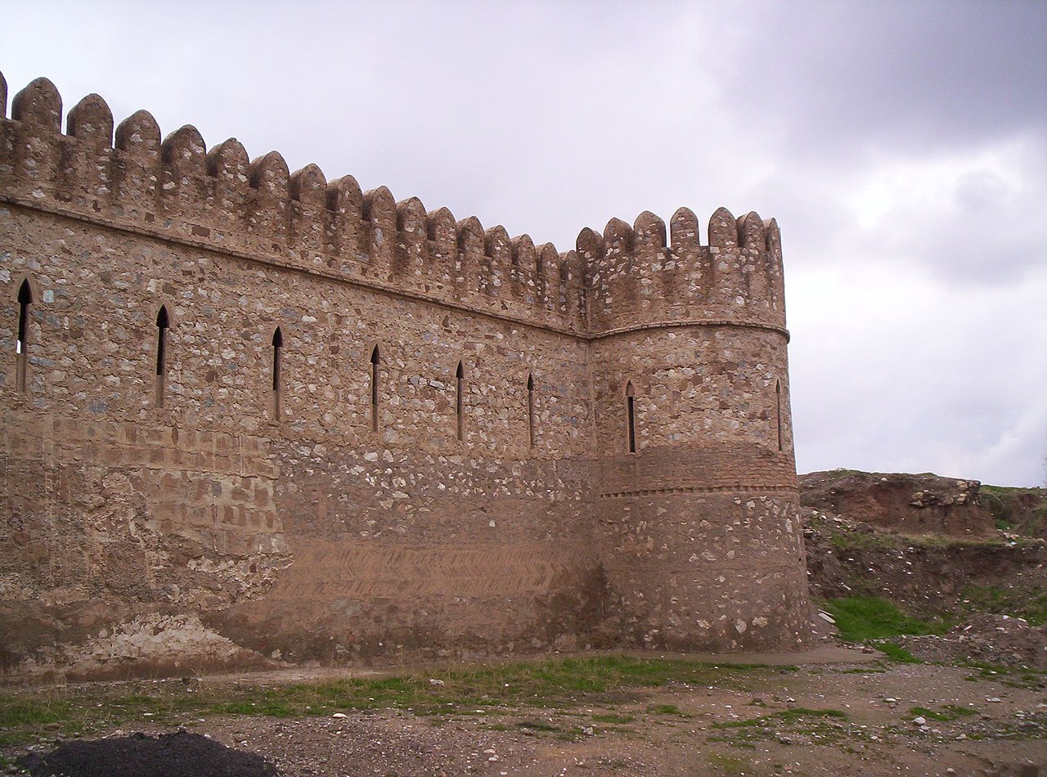
The History of Karka d’Beth-Selokh pt. 1
The History of Karka d’Beth-Selokh is a text which details the foundation and history of Kirkuk. Within this text, Kirkuk is said to be founded by the Assyrian King Sardana (Sargon) who is a descendant of Nimrod. Nonetheless, this account contains garbled accounts of the foundation of Kirkuk by King Sargon and mentions how some noble families living in the city have been there since the time of King Sargon. These are both signs of continuity within the Syriac Christians of Beth Garmai, for they understood and adapted their past. This likely came from oral traditions, further affirming this point.
ܟܪܟܐ ܕܒܝܬ ܣܠܘܟ
Notes:
Debié and Taylor 2012, Syriac and Syro Arabic Historical Writing

Slide 71
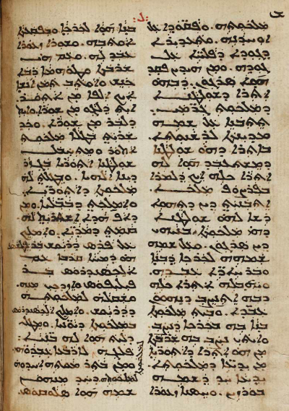
The History of Karka d’Beth-Selokh pt. 2
“And Sargon built it and named the fortress he built after him, and made it free. And he gave him (to his governor ‘Garmai’ after whom the region of Beth Garmai is named) the territory in which it was established, so that it would be subject to him (Sargon). And he built a palace in the fortress he established and established in it a great family from the territory of the Assyrians, from the nobles of the kingdom, a nobleman whose name was Būrzēn. He had built a small citadel in the fortress, and placed it on the plain, and made a small wall around it. And with this great family and lineage, he gathered and settled there about 1,000 people from Assyria, some inside the wall and others outside the wall.”
Notes:
Debié and Taylor 2012, Syriac and Syro Arabic Historical Writing

Slide 72
The History of Karka d’Beth-Selokh pt. 3
“One consequence of this assimilation of the biblical past is that most Syriac authors—with the exception of Michael the Syrian—seem to have been little interested in nations without direct relevance to the biblical accounts of the chosen people, Israel, nor in periods of, for example, Egyptian and Mesopotamian history that were not linked to biblical accounts. Some local histories, like local hagiographical accounts—for example, the Life of Bishop Maruta of Maipherkat (d. c. 420), later used by an Islamic history of the city - do, however, contain garbled accounts of the Assyrian foundation of towns, or of the Assyrian ancestry of social elites (as in the History of Karka d-Bet Slok). The corrupted forms in which the names of Assyrian kings are preserved may also suggest that this information was drawn from oral traditions rather than from written sources.”
Debié and Taylor 2012, Syriac and Syro Arabic Historical Writing, Pg. 163 See Also: Mark Gewargis’s Post, “Karka D’Beth-Selok”
“A small number of local histories celebrating the memory of a city and its first inhabitants and its heroes (martyrs and holy bishops) were produced in Syriac in the sixth century. The history of Karka d-Bet Slok is the only one that recalls its Assyrian origins, albeit with some rather garbled information, as well as the forced settling within it of various population groups by successive empires, and the construction of its citadel and walls... East Syrian local histories mentioned above seem particularly concerned to establish their ancient origins, their early Christianization, and the glory of their martyrs and holy men, partly for reasons of civic pride but also, it appears, in order to press their claims for their cities to be raised up the hierarchy of metropolitan sees in the Church of the East, their position in which had important consequences for the power and status of the local church.”
Debié and Taylor 2012, Syriac and Syro Arabic Historical Writing, Pg. 170-171
Notes:
Debié and Taylor 2012, Syriac and Syro Arabic Historical Writing
National and Ethnic Identity in the Neo-Assyrian Empire and Assyrian Identity in Post-Empire Times

Slide 73
The History of Karka d’Beth-Selokh pt. 4
“Hagiographic sources such as the Syriac Acta Martyrum show that the Assyrians of the Parthian period took pride in their glorious past, many nobles tracing their ancestry to the Assyrian royal house.”
National and Ethnic Identity in the Neo-Assyrian Empire and Assyrian Identity in Post-Empire Times, Pg. 22
“The physical construction of Christian places of worship in Karka shows a continuity which goes beyond the vanishing Sassanid Empire. Contrary to what happened with the sacred texts of the Zoroastrians, all Christian hagiographies were recited loudly during major gatherings. This had the purpose and effect not only of strengthening the identity of the group but also of bolstering a sense of belonging to the land they were living in. The History of Karka is a very good example of this. Its beginning recites: ‘The foundations of this stronghold were laid by a king of Assyria whose Syriac name was Sar-danâ’. These incipits must have immediately called the attention of the auditors to an ancient past, where Sardana of the Hellenistic tradition, Sargon of the Hebrew Bible and the Assyrian king Esarhaddon belong to the same hybrid historical tradition. King Esarhaddon/Sargon was the King of Nineveh who saved his city following the preaching of the biblical Jonas and, for this reason, is considered pious in the eyes of both Jews and Christians.”
Religious Minorities in Iraq, Corticelli, Pg. 60 | The author also speaks of Qardagh as falling under this idea for Christian’s in northern Mesopotamia.
“In other words the Assyrians were monotheists before Christ and Christians after him, and the past therefore led on to the present without a break. Thus the history of Karkha de-Bet Selokh begins with the Assyrian kings and ends with the Assyrian martyrs: Sargon founded it and the martyrs made it 'a blessed field for Christianity’ Likewise in the seventh century before Christ all the world stood in awe of Sardana, and in the seventh century after Christ the saints took his place as the 'sun of Athor' and the 'glory of Ninive'.”
Hagarism, Crone & Cook, Pg. 57-58
Notes:
Hagarism, Crone & Cook, Pg. 57-58
Christianising Assyria (II), Ramsin Edward, Pg. 231
The Legend Of Mar Qardagh Narrative And Christian Heroism In Late Antiquity, Pg. 13

Slide 74
The History of Karka d’Beth-Selokh pt. 5
“The embellishment of such hagiographical traditions with classical motifs was most probably intended to project Syriac Christians, in contrast to their Persian counterparts, as the native population group descending from a genealogy that was distinctly Assyrian.”
Christianising Assyria (II), Ramsin Edward, Pg. 231
“In places such as Nisibis, Arbela, and Karka de Beth Slouq, the ruins of antiquity may have encouraged imagined connections with the extinct empires of the past [...] Both distant antiquity and Christian martyrdom would serve as twin bases for the construction of developed histories for these regions at the end of the sixth century.”
The Chronicle of Seert, Philip Wood, Pg. 27
“As recently remarked by C. Jean, it is noteworthy that the memory of Assyria and of its rulership was not only alive, but also used as an identity marker for the Church of the East in the 6th century CE in a Zoroastrian milieu.”
The Neo-Assyrian Empire: A Handbook, Lanfranchi & Ponchia, Pg. 528
Notes:
Hagarism, Crone & Cook, Pg. 57-58
Christianising Assyria (II), Ramsin Edward, Pg. 231
The Legend Of Mar Qardagh Narrative And Christian Heroism In Late Antiquity, Pg. 13

Slide 75
The History of Karka d’Beth-Selokh pt. 6
It is also then clear these texts were a purely Syriac Christian phenomenon, being at odds with the typical Sasanian representations. Not only did they connect themselves with Ninus/Nimrod, being a local form of patriotism to a more ancient past, but they attributed king Sargon with building their city, himself being a descendant of Belos and Nimrod. They also tied a few great Christian Syriac noble families to Sargon, attributing them to be placed there by him, and saw themselves as the continuation of the Assyrian king Sardana, showing how the martyrs gave themselves for the city and graced it, just like Sardana built it and instituted the righteous fast of the Ninevites. Therefore, they aimed to prove that the past continued to the present without break.
What is especially shocking is how the authors of this hagiography remembered the name of Sargon, which had long been lost and thought to be a mistake in the Bible. Not only that, but drew on a connection between them and this legendary king. Western Scholars were puzzled when encountered with this name in Isaiah 20:1. However, the writer of this chronography remembered and connected himself to king Sargon, a completely irrelevant figure in the Bible.
The Quest for Sargon, Pul and Tiglath-Pileser in the Nineteenth Century, Chavalas, Pg. 70-71
Notes:
Hagarism, Crone & Cook, Pg. 57-58
Christianising Assyria (II), Ramsin Edward, Pg. 231
The Legend Of Mar Qardagh Narrative And Christian Heroism In Late Antiquity, Pg. 13

Slide 76
The History of Karka d’Beth-Selokh pt. 7
These ideas can also be applied to the legend of Mar Qardagh, which I feel is not necessary to cover again. This legend also implies a connection to a more ancient Assyrian past, and in fact; it is possible that the monastery of Mar Qardagh was built upon the pagan temple of Melqi in ancient Assyria.
“A brief epilogue considers the annual trading fair at Melqi, where Christians gathered during the final week of summer to buy, to sell, and to honor Mar Qardagh. The saint's hagiographer claims that the "souk at Melqi" was a direct outgrowth of the annual commemoration of Mar Qardagh on the site of his martyrdom. As we shall see, the opposite is more likely true: the cult of Mar Qardagh developed around the site of a pre-Christian festival. The story of Mar Qardagh, narrated during the annual festival at Melqi, explained and justified Christian veneration for a site once dedicated to Ishtar, the "lady of Arbela." Set into writing in the late Sasanian period by a skilled hagiographer, the legend of Mar Qardagh became part of the Syriac Christian literary tradition. This textual account ensured the survival of the Qardagh legend long after the saint's shrine at Melqi had been abandoned and forgotten.”
The Legend Of Mar Qardagh Narrative And Christian Heroism In Late Antiquity, Pg. 13
Notes:
Hagarism, Crone & Cook, Pg. 57-58
Christianising Assyria (II), Ramsin Edward, Pg. 231
The Legend Of Mar Qardagh Narrative And Christian Heroism In Late Antiquity, Pg. 13

Slide 77
The History of Karka d’Beth-Selokh pt. 8
Another similar example to this is Mari Ibn Sulaiman the COE bishop who attributes the Assyrian Queen Semiramis with building Ctesiphon, which was the most important city for the COE: “He (Mar Mari) headed to the city of Seleucia, which is to the east of al-Madain while Ctesiphon is to its west. Seleucus, one of the servants of Alexander, built this city, and some people said that al-Madain (Ctesiphon) was built by Samiram, queen of Babylon.”
The Acts of Mar Mari, Harrak, Pg. 85
Such legends long outlived their time period, and were institutionalized as the heritage of the Church.
“Neither the novelty nor the consequences of such a reinterpretation should be underestimated. The literary work of East Syriac writers completely transformed the meaning of the Assyrian past, with far-reaching effects on Mesopotamian Christian communities well into the Middle Ages and beyond. The East Syriac hagiographical works gave the Assyrians and their aristocratic descendants central roles in the region's saintly history, providing a communal rather than a specifically aristocratic past. The Christian interpretation of the Assyrians as the originators of the lineages of saints gave them a new significance within these communities. No longer associated with secret, polytheistic rituals and tyrannical rule, the Assyrians—in their newly invented, Christianized form—became a means of communal self-representation and self-fashioning to outsiders. Furthermore, East Syriac writers institutionalized the collective memory of the Assyrian past. Hagiographical works possessed the special potential to disseminate stories, ideas, and identities in ancient societies with limited means of communication. When recited annually in the presence of the Christian public, both elite and lower classes, they addressed entire communities gathered to celebrate festivals in honor of the martyrs... As a consequence, Christianized Assyrians remained prominent figures within Christian communities long after their political or social utility had outlived its usefulness.”
Ein iranisches Assyrien, Richard Payne, Pg. 28- 29
Notes:
Hagarism, Crone & Cook, Pg. 57-58
Christianising Assyria (II), Ramsin Edward, Pg. 231
The Legend Of Mar Qardagh Narrative And Christian Heroism In Late Antiquity, Pg. 13

Slide 78
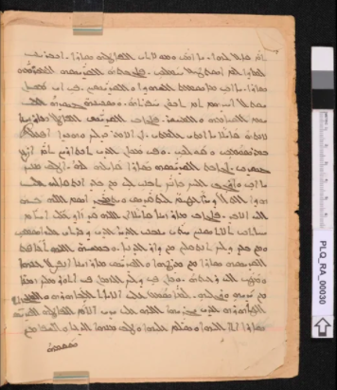
Mor Zayno, the Martyred Bishop (West Syriac) pt. 1
Mor Zayno was a bishop in the 7th century within the SOC, specifically in the eastern regions of Tikrit. He was bishop between 614-624 AD. Mor Zayno was the son of the king of Athor (Assyria), which Fiey believes is ancient Assur itself. Nonetheless, the story should be taken with skepticism. However, this shows that Suryaye and bishops in the SOC claimed Assyrian descent, and remembered bits of their past repurposing it in a Christian light. This is evidently shown from this king being situated in the heartland of Assyria, Assur. This is yet another way for the remembrance of Assyria, and it strikingly resembles also the story of Mor Behnam, reaffirming this.
PLQ RA 00030 - folio f.5v
Notes:
Debié and Taylor 2012, Syriac and Syro Arabic Historical Writing

Slide 79
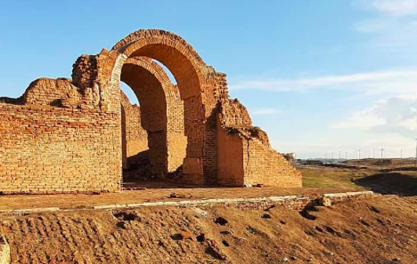
Mor Zayno, the Martyred Bishop (West Syriac) pt. 2
“Zayno/Zayna, martyred bishop, and his sister Sarah: Celebrated on November 22 in the Syriac Orthodox calendars, especially those in relation to Qaraqosh (Nau XIII, Benni and Brock, "Calendar"), this saint, and his sister Sarah, have a legend quite close to that of Mor Behnam. The first spread especially in the movement of Takrit, while the second has been linked to the rival seat, that of Mor Mattai.
Zayno is a monk of the 7th century, also presented as the son of the king of Othur, who seems here to be the ancient Assur, while that of Behnam is linked to Nimrod-Nineveh-Mosul. With all the embellishments of slain dragons and healed kings, we arrive at the (historical?) detail of the hero's appointment as bishop of Beth Rimmon, near Talait, between 614 and 624. He and his sister founded convents. He was martyred several years after his sister's death, but on the same day. Several churches in his name are found in the satellites of Takrit.”
Saints Syriaques, Fiey, Pg. 199: Translated from French
MLK-Ashuroyo’s Post and Manuscript in Garshuni Syriac (Arabic)
Notes:
Debié and Taylor 2012, Syriac and Syro Arabic Historical Writing
National and Ethnic Identity in the Neo-Assyrian Empire and Assyrian Identity in Post-Empire Times

Slide 80
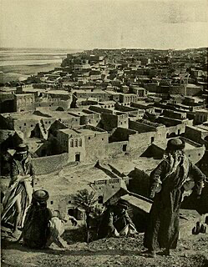
Mor Zayno, the Martyred Bishop (West Syriac) pt. 3
“There are, additionally, saints revered in Syriac Christianity in whose hagiographies or life stories are clearly said to be descended from Assyrian royalty... and also St. Zena, bishop of Beth-Ramman, and his sister Sarah (d. 629 AD), from Beth Waziq.”
Assyrian Continuity Post-Empire: The Relevance of Preserving Assyrian History and Heritage, Dr. Nicholas Al-Jeloo, Timestamp | 27:45 - 28:35
“One interesting thing that we do find in the Syriac hagiographies, or the lives of saints, is this linkage going back to the ancient Assyrians or providing these saints with an ancient Assyrian lineage or an ancient Assyrian past, which not only establishes them as saints in their own right but also establishes them as royalty and something to be held in awe.”
Assyria A.D. Documentary (2021), Quote by Dr. Nicholas Al-Jeloo, Timestamp; 21:58 - 22:26
Notes:
Debié and Taylor 2012, Syriac and Syro Arabic Historical Writing
National and Ethnic Identity in the Neo-Assyrian Empire and Assyrian Identity in Post-Empire Times

Slide 81
Mor Zayno, the Martyred Bishop (West Syriac) pt. 4
Yet again we can see the memory of Assyria prevail in the hearts of Suryaye and church figures. This is clearly a piece of local history indeed, and we can see that the Syriac Christians repurposed their Assyrian surroundings into a Christian lense.
“In any case, while the new temple and Aššur’s cult fell victim to the Sasanian conquest of the kingdom of Hatra in about ad 240, the Eastern Churches flourished subsequently and local Christian traditions found new roles for prominent figures and sites of Assyrian History, quite separate from the information recorded in the Bible.”
Ancient Assyria: A Very Short Introduction, Karen Radner, Chapter One
Notes:
Debié and Taylor 2012, Syriac and Syro Arabic Historical Writing
National and Ethnic Identity in the Neo-Assyrian Empire and Assyrian Identity in Post-Empire Times

Slide 82
Scholarly Analysis on Mor Zayno
Once again, this is another example of the institutionalization of Assyrian saints, it was a means to self-identify, as with the stories of Karka, Behnam, Qardagh, Awgin, and Zayno, as shown.
“The East Syriac hagiographical works gave the Assyrians and their aristocratic descendants central roles in the region's saintly history, providing a communal rather than a specifically aristocratic past. The Christian interpretation of the Assyrians as the originators of the lineages of saints gave them a new significance within these communities. No longer associated with secret, polytheistic rituals and tyrannical rule, the Assyrians—in their newly invented, Christianized form—became a means of communal self-representation and self-fashioning to outsiders. Furthermore, East Syriac writers institutionalized the collective memory of the Assyrian past. Hagiographical works possessed the special potential to disseminate stories, ideas, and identities in ancient societies with limited means of communication. When recited annually in the presence of the Christian public, both elite and lower classes, they addressed entire communities gathered to celebrate festivals in honor of the martyrs... As a consequence, Christianized Assyrians remained prominent figures within Christian communities long after their political or social utility had outlived its usefulness.”
Ein iranisches Assyrien, Richard Payne, Pg. 29
Notes:
The Quest for Sargon, Pul and Tiglath-Pileser in the Nineteenth Century, Chavalas

Slide 83
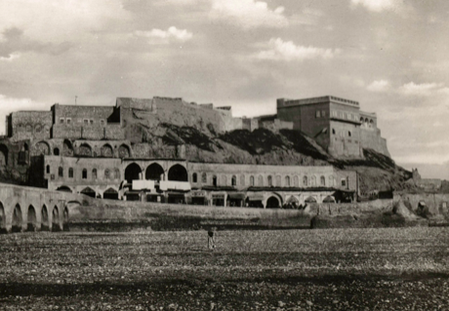
Ezekiel the Monk (East Syriac Rite) pt. 1
Ezekiel the Monk (East Syriac) was born in the same year as Constantine the Great and converted from Judaism to follow Mar Awgen in his travels. His hagiography provides key details about his travels, particularly to Bet Garmai, and it was composed in late antiquity. Within it, notable Assyrian traditions emerge, following closely those of Karka and Qardagh. The hagiography mentions various Assyrian kings such as Nimrod and Sardana, alongside attributing them as the ancestors of the nobles in the region, one of whom was actually named after Nimrod himself. It also identifies northern Mesopotamia as Assyria and ‘the upper land of Nimrod, son of Nimrod, king of Assyria’. This lecture was recently presented by Dr. Nicholas, and will be summarised here using the conclusion which was provided in dotpoints.

Slide 84
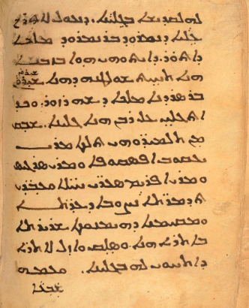
Ezekiel the Monk (East Syriac Rite) pt. 2
“That he may enter the upper land of Nimrod, son of Nimrod, king of Assyria. That was in that time under the rule of this Shirwan Bar Sardana king of Shahrazor”
ACK 00074 - folio 105v

Slide 85
Ezekiel the Monk (East Syriac Rite) pt. 3
“Clear references to ancient Assyrians that obviously remained in memory of the text's author. Evident reflection of general attitude in historical Assyria at the time, especially in Adiabene and Bet-Garmaï, where there was significant subcurrent of local identity among Christians and continuing awareness of past Assyrian empire. Garbled accounts detailing Assyrian ancestry of social elites and Assyrian foundation of towns, with corrupted forms of names. Information extracted from oral traditions rather than written sources. Clear references to Neo-Assyrian monarchs: Ashur-dan, Sargon, Sennacherib, Esarhaddon, and Ashurbanipal. Managed to remain part of local Assyrian memory as late as the 7th century AD - nearly 14 centuries later! Local patriotism of late antique Syriac writers for northern Mesopotamia, i.e., Assyria. Consequent promotion of biblical villain Nimrod. Location of local rulers with Assyrian names, or links to ancient Assyrians, so far west in areas now considered ethnically Kurdish (Shahrzor and Kermanshāh). These are found in a 7th-century AD text set in the 4th century nearly a millennium after the fall of the Assyrian Empire! Survival of such names and their associations, especially awareness of Assyrian civilisation and monarchs. Strong evidence for cultural memory and continuity between Assyrians of ancient Mesopotamia and their medieval Syriac Christian successors in the same region.”
The Fourth International Congress of the Nineveh University Chair - Part 8 | Timestamp; 26:03 - 29:59 | For an in-depth and scholarly analysis alongside primary quotes, see Dr. Nicholas’ lecture.
“Look, a lot of us don’t even remember our great great-grandparent’s names. So it’s interesting how after hundreds of years, these people remember the names of kings who their great-great grandparents didn’t even see or remember. So obviously, after so many years these names get garbled up and mixed, but the fact that some essence of Assyrian identity and Assyrian memory stayed in the culture and literature is very significant.”
The Fourth International Congress of the Nineveh University Chair - Part 8 | Timestamp; 34:36 - 35:13

Slide 86
Ezekiel the Monk (East Syriac Rite) pt. 4
The text is indeed a unique attestation of the Assyrian memory and tradition of Syriac Christian’s. Likewise with other texts of the time, we find a special connection to Assyria and upper Mesopotamia through its references to Nimrod and Sardana, who makes a surprising reappearance from the Karka text that he is originally found in. Such kings were revered and praised among the Aramaic-speaking inhabitants of upper Mesopotamia being claimed as the ancestors of Assyrian social elites in these texts due to oral traditions about the Assyrians persisting among the regional population. This occurs in the text and intertwines with Payne’s theory. The work is nothing other than a piece affirming what we already knew before it, Syriac Christians were the inheritors and successors of the Assyrian legacy and memory to which they belonged.

Slide 87
Ezekiel the Monk (East Syriac Rite) pt. 5
“The literary revival of the Assyrians resonated with the elite groups of northern Mesopotamia precisely because of their pre-existing awareness of the region's ancient imperial heritage. [...] Local communities commemorated a great past of something they called 'Atur (Assyria), even if its historical details had been forgotten. The local rural elite of northern Mesopotamia—who claimed Nimrod and Sargon [Sardana] as the origin of their lineages—recognized some of the ruins and tells in the region as the works of their ancestors. The association of the settlement at Melqi with the House of Qardagh and the townscape of Karka d-Bet Slok with houses of Assyrian, Persian, and Seleucid origin attest to a pre-existing aristocratic interest in claiming the ancient sites as the basis for their family histories. They knew of the Assyrians and the achievements of their empire...”
Ein iranisches Assyrien, Richard Payne, Pg. 27-28 | Brackets are mine
“To account for the appearance of Sennacherib and Esarhaddon in these texts, scholars have argued that orally transmitted, folkloric memories of the Assyrians continued to be associated with particular sites, such as Assur, Nineveh, Arbela, and the shrine of Mar Qardagh at Melqi, more than a millennium after the collapse of the Neo-Assyrian dynasty. The Neo-Assyrian kings loomed large in a landscape that had once formed the heart of their empire, long after its collapse.”
A State of Mixture, Payne, Pg. 148

Slide 88
Ezekiel the Monk (East Syriac Rite) pt. 6
In its geography, it calls northern Mesopotamia ‘the upper land of Nimrod’, which was understood to be the Assyrian kingdom by Syriac authors, so it further identifies the Syriac-speaking homeland as Assyria also. Additionally, Nimrod also makes a positive appearance in this text as many others due to local patriotism, which Dr. Nicholas discusses. This is yet another connection to Assyria and ancient Mesopotamia through biblical figures.
“Biblical hunter king who built Tower of Babel and rebelled against God, perceived as ancestral foundational figure and cultural hero by Syriac-speaking Christians of Mesopotamia. [He] Played an important role in the development of distinctive local identity. Expression of territorial self-identification among late antique Syriac Christians and phenomenon of "local patriotism." Lexicographer Isho' bar 'Ali (late 9th-century AD) identified "Land of Nimrod" with "kingdom of the Assyrians." In contrast to most literature about Nimrod, the majority of Syriac texts present him in conspicuously positive light as first ruler of Babylon and first earthly king in the history of the human race. According to Homilies of Narsaï (5th-century), God gave him primacy and temporal kingship, and made him a valiant warrior.”
The Fourth International Congress of the Nineveh University Chair - Part 8 | Timestamp; 19:45 - 21:45

Slide 89
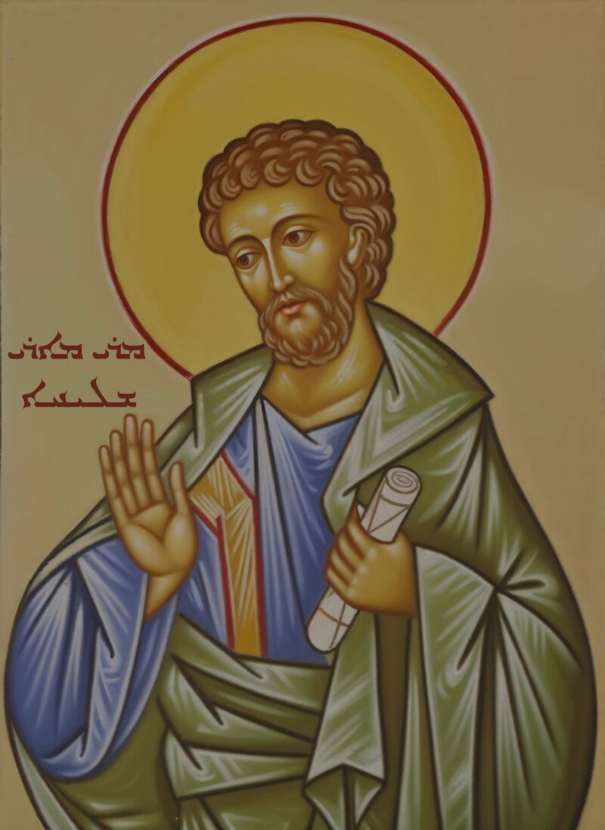
The Acts of Mar Mari (East Syriac Rite) pt. 1
This is a text translated in full by the Syriac Scholar Amir Harrak. It dates from the 4th to 6th centuries AD and takes inspiration from the Doctrine of Addai, being written by an East Syriac monk in the monastery of Qunni, 90 km south of Baghdad. It details the acts of the apostle Mar Mari and his journey throughout Mesopotamia converting many of the native inhabitants. This Syriac text mentions the conversion of both Assyria and Babylonia, which the author of the text refers to these areas as “Our own territories”:
“So far were (the stories) about the conversion of Mesopotamia. Let us now turn our attention to show how the fear of God moved from there to our own territories. Because this story is not told clearly, I am putting into writing the old tradition that is transmitted in the books, as follows.”
Acts of Mar Mari, Harrak, Pg. 11
“The phrase “our territories” in the following sentence refers to the lands of Assyria and Babylonia proper, of which the writer was native.”
Acts of Mar Mari, Harrak, Pg. 11, Footnote 18
Notes:
Acts of Mar Mari, Amir Harrak

Slide 90
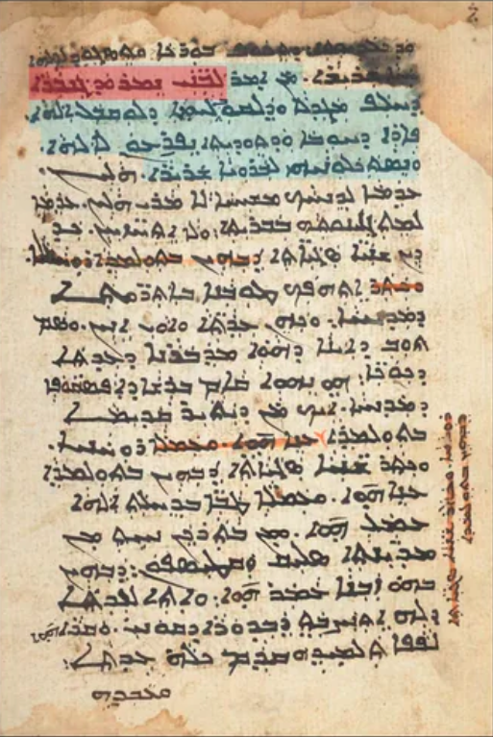
The Acts of Mar Mari (East Syriac Rite) pt. 2
“Who would have told the sons of the warrior Nimrod that instead of the tower and the revolt against God, they would return to God fruits of love and praise and recognize the true creator.”
Translation: Textes Syriaques Dieu Misèricode, dieu Amour. Patrimoine Syriaque Colloque VIII.
ACK 00213 - folio 253v
Notes:
Acts of Mar Mari, Amir Harrak

Slide 91
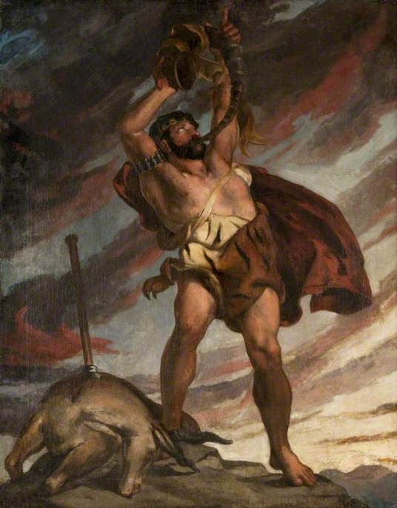
Nimrod’s connection to Assyria (Mar Mari pt. 3)
What is truly amazing here is that when speaking about these lands, the author states that we are the Sons of the Warrior Nimrod. In Syriac tradition Nimrod is held in a positive light and is thought to have built both the cities of Babylonia and Assyria. What is striking here is that these words closely resemble that of Mar Ephrem’s when he speaks of Assyrians as the race/descendants of the warrior Nimrod, alongside those of David Bar Pawlos, whereupon his commentary in Genesis tells us that Nimrod is Ninus (an Assyrian king) who built Nineveh.
“As for the blessed apostle [Mari], he returned with his companions and went up to Beth-Aramaye, Seleucia, and Ctesiphon. He went around all the eastern territories, visiting the disciples and increasing their former numbers [...] Praise to you, Jesus, power that cannot be overpowered, for it was through simple and uneducated people that you filled the earth with the knowledge of the truth! Who could say to the East, mother of magic and Chaldeanism (astrology/paganism), that it would bend its knees in worship of the Living and True God? Who could say to the sons of powerful Nimrod, that instead of an adversary tower that they built against God, they would offer him the fruits of love and thanksgiving, acknowledging him as the true Creator?”
Acts of Mar Mari, Harrak, Pg. 75
Notes:
Ephrem Repentance of Ninevites, Rodoljub Kubat
A Syriac tabula gentium from the Early Abbasid Period: Dawid bar Pawlos on Genesis 10, Sergey Minov
Yūḥannā ibn al-Ġurayr, Passeur de la Tradition Syriaque et Arabe Chrétienne, Jean Fathi, Pg 151, Footnote 108 | Translated from French

Slide 92
Nimrod’s connection to Assyria (Mar Mari pt. 4)
“The important role Nimrod played in the development of a distinctive local identity among the Syriac-speaking Christians of Mesopotamia finds an additional illustration in the appeals to him as an ancestral figure. The fact that the inhabitants of this geographical area considered themselves to be Nimrod’s descendants is expressed, for instance, in the Acts of Mār Mari, whose author, in a rhetorical digression expressing amazement at the apostle’s success in converting the peoples of the regions of Bēt Arāmāyē, Seleucia, and Ctesiphon, refers to them as “the sons of powerful Nimrod” (bnay Nemrud ganbārā).”
Memory and Identity in the Syriac Cave of Treasures, Sergey Minov, Pg. 194
We are able to then determine that the Syriac-speaking Christians of Mesopotamia or Assyria and Babylon, which are called the eastern territories, considered themselves to be the direct descendants of Nimrod, the great progenitor of the ancient Mesopotamian kingdoms, who was primarily considered Assyrian at the time by East and West Syriac writers alike.
“While Mari busied himself with Assyria and Babylonia, from Nisibis (Nusaybin) to Babylon, and with some nearby provinces of Persia (the rest of Persia being converted by Saint Thomas)...”
Historical Process and Developments and Archaeological Remains of the Assyrians in Northern Mesopotamia: Exorcism and the Founding Figures of Early Eastern Christianity, Cynthia Jean, Pg. 160 | Article within book “The Assyrian Heritage: Threads of Continuity and Influence”
Notes:
Cave of Treasures
Lexicon Syriacum, Duval

Slide 93
Nimrod’s connection to Assyria (Mar Mari pt. 5)
The term ‘Chaldean’ as used here signifies astrology or paganism, and not an ethnicity. This shows that they identified more so with the Assyrian Nimrod who ruled over Babylon than any sort of proper ethnic Babylonian past.
“In the south, the term Chaldean had too strong pagan connotations to be accepted by Christians for themselves. The term Chaldean remained pagan in tenor.”
The Last Pagans of Iraq: Ibn Waḥshiyya and his Nabatean Agriculture, Jaakko Hämeen-Anttila, Pg. 34
The author also recognizes Assyria as the country of the Suryaye (Syrians) elsewhere in the text.
Acts of Mar Mari, Harrak, Pg. 41
Another notable point; to further the fact that it was ethnic, both Ishtar and the Sun god of Justice (i.e. Shamash) are also mentioned to have been present and worshiped throughout Mesopotamia. It is important here to also mention that this work takes inspiration from the Doctrine of Addai, which also attests to gods like Nebo and Bel being worshiped throughout Mesopotamia and further proves that “Assyrians” was used in an ethnic sense.
Acts of Mar Mari, Harrak, Pg. xvi
Notes:
Cave of Treasures
Lexicon Syriacum, Duval

Slide 94
Nimrod’s connection to Assyria (Mar Mari pt. 6)
Mar Ephrem and David Bar Pawlos quotes affirming Nimrod has an Assyrian connotation;
“Nineveh, the mother of heroes, is afraid of a solitary feeble one. The lioness in her lair, Trembles at the Hebrew. Asshur has roared against the world. But the voice of Jonah roared against her. Behold! The race/descendants of Nimrod – the mighty one – Is altogether brought low...” - Mar Ephrem
Ephrem Repentance of Ninevites, Rodoljub Kubat, Pg. 198
The Khudra, Pg. 352
The reason Nineveh is also called the mother of heroes as Ephrem says is that one used to bless a person by saying “May you be like Nimrod” the Gabbara (Brave/Hero), hence Nineveh is the mother of Gabbare. This reference to Nimrod is also found in the Holy Bible.
St. Ephrem the Syrian Selected Prose Works, Edward G. Matthews, Pg. 146-147
“Nimrod, who is Ninus, built Nineveh and its fellow (cities) according to what is written above.” - David Bar Pawlos
A Syriac tabula gentium from the Early Abbasid Period: Dawid bar Pawlos on Genesis 10, Sergey Minov, Pg. 71
Notes:
Cave of Treasures
Lexicon Syriacum, Duval

Slide 95
Nimrod’s connection to Assyria (Mar Mari pt. 7)
What is more to note here is that “The East” usually refers to all of Mesopotamia. Furthermore, in the Syriac tradition, Nimrod is said to have founded many of the cities in Upper Mesopotamia, including Edessa. This is a common opinion among many Syriac writers, including Solomon of Basra to name one of multiple, further affirming this connection to Mesopotamia generally. (Book of Bee, 1866, Pg. 37)
“But that [knowledge] which the Magians have, viz. astrology, is sorcery and the teaching of devils. There are some who say that it doth indeed [teach concerning] luck, and happenings (i.e. future events), and fate, but these are in error. Now Nimrod builded strong cities in the east, Babel, and Nineveh, and Râsân (Râs `Ain), and Selîk: (Seleucia), and Ctesiphon, and Âdhôrbaighân; and he made three fortresses.”
The Cave of Treasures, Pg. 145
“And in the fiftieth year of [the life of] Reu, Nimrod went up and built Nisibis, and Edessa, and Harrân, which is Edessa.”
The Cave of Treasures, Pg. 154
Notes:
Cave of Treasures
Lexicon Syriacum, Duval

Slide 96
Nimrod’s connection to Assyria (Mar Mari pt. 8)
Such is also attested within the Bible itself! “They shall waste with the sword the land of Assyria, And the land of Nimrod at its entrances; Thus He shall deliver us from the Assyrian, When he comes into our land And when he treads within our borders.”
Micah 5:6 NKJV
And as quoted by Bar Bahlul; “The Land of Nimrod;The kingdom of the Assyrians.”
Lexicon Syriacum, Duval, Pg. 301
“The sixth-century Cave of Treasures pointedly excluded Arbela from the list of foundations; its suppression of Arbela is a trace of a debate in late Sasanian Mesopotamia concerning which cities could claim Nimrod as their founder. The History of Karka and the History of Mar Qardagh responded to doubts about their cities’ associations with Nimrod by identifying Nimrod with Ninus, the son of Belos, the founder of the Assyrian dynasty in the Chronicle of Eusebius. In the late seventh century, the Chronicle of Khuzistan reveals the culmination of the process by which Nimrod was reinvented as an Assyrian king. Here it was Ninus, son of Belos, not Nimrod who built the cities enumerated in Genesis 10, so completely was Nimrod subsumed into the Eusebian Assyrian genealogy.”
Visions of Community in the Post-Roman World, Pg. 215
Note: In “Short Chronicle on the End of the Sasanian Empire and Early Islam: 590-660” on Pg. 94, we find once again that Nimrod is replaced with Ninus.
“By Jacob of Edessa and other Syriac writers, Nimrod is identified as Ninus son of Belus, the eponymous founder of Nineveh.”
Edessa the Blessed City, Segal, Chapter 1, Footnote 1mi
Notes:
Cave of Treasures
Lexicon Syriacum, Duval

Slide 97
Nimrod’s connection to Assyria (Mar Mari pt. 9)
While on the topic of Nimrod, I believe it necessary to mention the patriarch Nemrod in the Syriac Orthodox Church and his cousin Nebuchadnezzar the priest in the 13th Century. These two personal names are clear indications of a deliberate connection to a Mesopotamian past, and such is agreed also by the Syriac Scholar Jean Fathi.
Mark Gewargis’s Post, “Nebuchadnezzar the Priest”
“In view of Gehin's recent rediscovery of the name of Nebuchadnezzar son of Simeon, it is worth noting that the elitist, unattested use by Simeon's family in the 13th century of the names of the ancient kings of Assyria and Chaldea, Nimrod and Nebuchadnezzar, is undoubtedly in keeping with the historical vision of the Chronicle of Michael the Syrian, according to which the kings of the ancient Mesopotamian empires were Syrian kings...”
Yūḥannā ibn al-Ġurayr, Passeur de la Tradition Syriaque et Arabe Chrétienne, Jean Fathi, Pg 151, Footnote 108 | Translated from French
Notes:
Cave of Treasures
Lexicon Syriacum, Duval

Slide 98
Nimrod’s connection to Assyria (Mar Mari pt. 10)
Simeon, the father of Nebuchadnezzar was a part of a prominent Syriac Orthodox family which was heavily influential in the church, with his cousin being Nemrud. Such names were conscious attempts to link the family to ancient Mesopotamia, and displays yet another example of the Syriac Orthodox intentionally linking themselves with Assyria and Babylon.
“Simeon and Nebuchadnezzar were members of a prominent ecclesiastical family that included the Patriarch Philoxenus Nemrod...”
Islamic Manuscripts of Late Medieval Rūm, Cailah Jackson, Pg. 69
“Nebuchadnezzar and his cousin Philoxenus Nemrod had unusual names for the period, which may have been a conscious attempt to link the family to ancient Mesopotamian kings.”
Islamic Manuscripts of Late Medieval Rūm, Cailah Jackson, Pg 81
Notes:
Cave of Treasures
Lexicon Syriacum, Duval

Slide 99
Analysis on Nimrod’s connection to Assyria
For a final point on Nimrod, Sergey Minov believes these connections of Nimrod being viewed positively within the Syriac tradition and building the most important cities in Syriac Christianity to be a local patriotism by the Assyrians in the region of Mesopotamia. So much so, that they even claimed descent from him as seen above. Our forefathers did not forget they were Assyrians and were neither afraid nor ashamed to claim them as our ancestors. On the contrary, Nimrod is viewed positively and identified as a great warrior, who is the forefather of our Assyrian people, which was a form of local patriotism made by the Suryaye to recognize their powerful past, even at times equating him with the Assyrian king Ninus.
Memory and Identity in the Syriac Cave of Treasures, Sergey Minov, Pg. 193
See Also: MLK-Ashuroyo’s post on the significance of the foundations of cities by Assyrian kings in Syriac Literature. These were often projected in a nationalistic sense for Syrians, identifying them with their most important and greatest cities.
Notes:
Cave of Treasures
Lexicon Syriacum, Duval

Slide 100
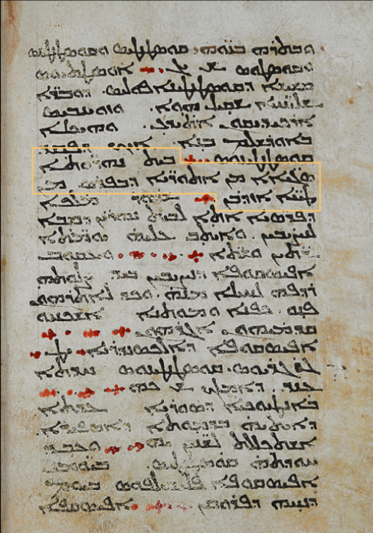
Thomas the Presbyter (West Syriac Rite) pt. 1
Thomas the Presbyter was a West Syriac monk who lived in the 7th century. Thomas wrote a chronicle called “The Chronicle of 640”, in which he details the time from Abraham to Constantine thereafter he then discusses the Arab invasions of Persia and Byzantium. Thomas while mentioning Persia gives us some insight on this region, and presents us with an interesting passage.
“In Mesopotamia, many of the Assyrians which were in the Persian Empire were sold by the Arabs.”
Mark Gewargis’s Post, “Thomas the Presbyter”
British Library AD. MS. 14,643
Notes:
Assyrians in History, Mark Gewargis, “Thomas the Presbyter”
The Imam of the Christians: The World of Dionysius of Tel-Mahre
Seeing Islam As Others Saw It: A Survey and Evaluation of Christian, Jewish and Zoroastrian Writings on Early Islam, Robert Gmose

Slide 101
Thomas the Presbyter (West Syriac Rite) pt. 2
A few takeaways on this. First, Mesopotamia in Syriac literature is a somewhat confined region and didn’t include all of the region between the Euphrates and Tigris. This is seen in many Syriac texts, and even seen in the Acts of Mar Mari and the Doctrine of Addai.
“But terms such as Mesopotamia are increasingly used in a wider sense in the seventh century material (Edessa as a city of Mesopotamia or Mesopotamia employed in distinction to Syria): MS XI. 13 and 14 (IV, 441 / II, 463). The bishoprics of Mesopotamia are listed as Edessa, Harran, Callinicum, Circesium, ‘Armenia’, Serug, Samosata, Melitene, Amida, Tella, ReshKepha, Arzun, Mardin and Hasn-Keph (MS XI, 23 [IV, 470 / II, 516]), a list that extends well beyond the Roman administrative unit around Amida and Dara.”
The Imam of the Christians: The World of Dionysius of Tel-Mahre, Pg. 227, Footnote 89
In fact, right after the section mentioned above, Thomas sheds some light on what geographical Mesopotamia is.
“Shapur, King of the Persians, came to Mesopotamia (Bethnahrin) to take Nisibis.”
Mark Gewargis’s Post, “Thomas the Presbyter”, Section right after highlighted areas.
Notes:
Assyrians in History, Mark Gewargis, “Thomas the Presbyter”
The Imam of the Christians: The World of Dionysius of Tel-Mahre
Seeing Islam As Others Saw It: A Survey and Evaluation of Christian, Jewish and Zoroastrian Writings on Early Islam, Robert G

Slide 102
Analysis related to Thomas the Presbyter pt. 1
Therefore it is evident with this quote “Athoraye” was being used in the ethnic sense for the inhabitants of Mesopotamia, the geographic region. Not only this, but we can also conclude that Nisibis was Assyrian. Mesopotamia and Persia are the geographic terms used by Thomas, not Assyria. This also shows that the term “Assyrian” was readily used as an ethnic term and not simply confined to geographic “Athor”. Furthermore, how could Assyrians be used as a geographic term for the inhabitants of Athor if these Athoraye weren’t living in the region of Athor, but rather the region of Mesopotamia? Thus, the ethnic usage is evident.
Thomas also later informs us in another section of his text also provided by Mark Gewargis on the same manuscript:
“In the year 947 (634 AD), indiction 9, the Arabs invaded the whole of Syria and went down to Persia and conquered it. The Arabs climbed the mountain of Mardin and killed many monks there in [the monasteries of] Qedar and Bnata. There died the blessed man Simon, doorkeeper of Qedar, brother of Thomas the priest.”
Seeing Islam As Others Saw It: A Survey and Evaluation of Christian, Jewish and Zoroastrian Writings on Early Islam, Robert G, Pg. 119

Slide 103
Analysis related to Thomas the Presbyter pt. 2
We can see the usage of Persia and Syria as geographical terms. It is not therefore too far-fetched, to also assume that the author of this text saw Tur Abdin as Assyrian with all the evidence presented. This is especially due to the proximity of Nisibis which is in Mesopotamia to Tur Abdin. For if Nisibis is Mesopotamian inside Persia; then naturally should not Edessa or Tur Abdin be Roman Mesopotamia? The SOC’s utilization of “Mesopotamia” and its dioceses, as quoted above, also follows this usage, extending to Tur Abdin, Amid and Edessa. The fact also that the Assyrians were “many” implies that the “Othouroye” were numerous in Mesopotamia.

Slide 104
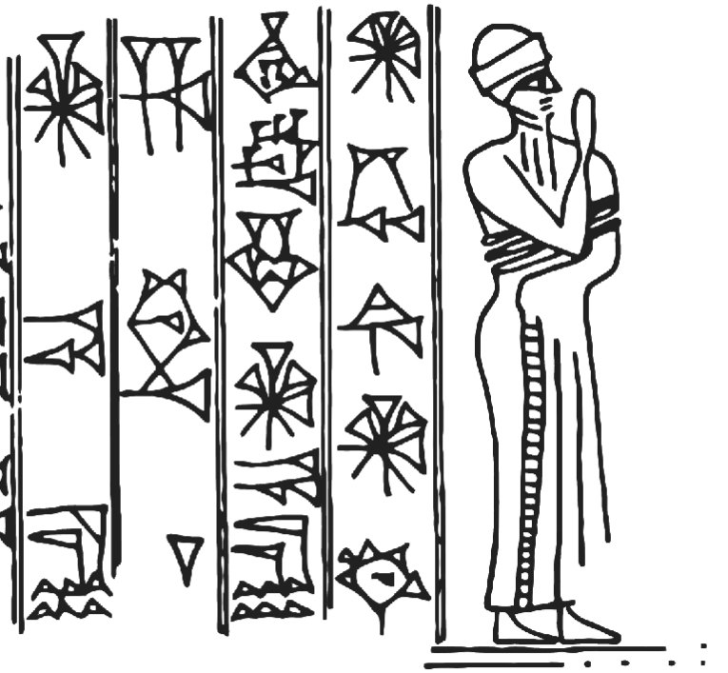
The Apocalypse of Pseudo-Methodius (West Syriac Rite) pt. 1
Pseudo-Methodius was a Syriac work from the late 7th century, detailing future Christian prophecies alongside history. It was written by a West Syriac author and was also read in the East Syriac tradition, although it was not as popular. Nonetheless, the text is very significant as it preserves the garbled names of ancient Assyrian kings and queens, alongside praising Nimrod as the first earthly ruler and seeing him as a positive figure as usual in Syriac literature. The work actually retains the names of Naqia (Yaqnath) and possibly Shamshi-Adad (Shamshanakar). The author of the text likely drew on a local source which preserved the memory of the ancient Assyrian kingdom, and thus these names arise. Such texts confirm that Assyrian oral memory and tradition persisted in Mesopotamia among the Syriac Christians, despite centuries without a kingdom.
Notes:
Assyrians in History, Mark Gewargis, “Thomas the Presbyter”
The Imam of the Christians: The World of Dionysius of Tel-Mahre
Seeing Islam As Others Saw It: A Survey and Evaluation of Christian, Jewish and Zoroastrian Writings on Early Islam, Robert G

Slide 105
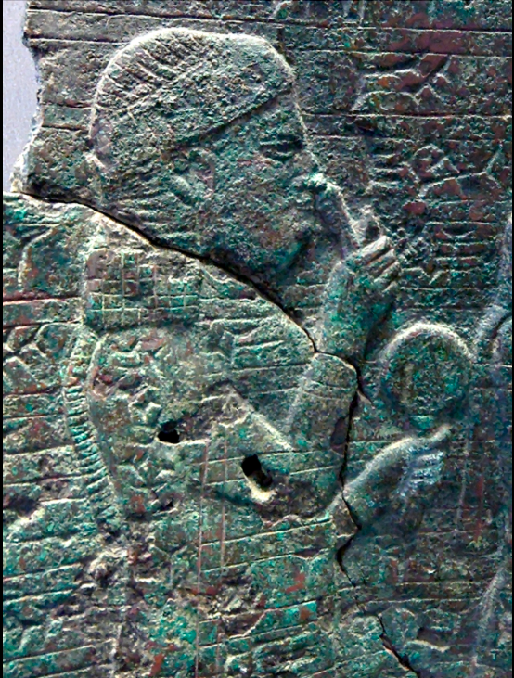
The Apocalypse of Pseudo-Methodius (West Syriac Rite) pt. 2
“Some sort of lost source preserving local memory of the ancient empires of Mesopotamia could also explain certain names in Pseudo-Methodius, such as “Shamshasnakar" (possibly related to the names of Assyrian kings like Shamshi-Adad) and "Yaqnath" (as discussed above, possibly a corrupt form of Naqia, the Assyrian queen). This lost source or sources appear to have narrated Near Eastern history from a Christian-Sasanian perspective. Notably, Pseudo-Methodius clearly did not rely on the influential world chronicle of Eusebius of Caesarea; nor does Pseudo-Methodius's information about ancient Mesopotamia have much, if anything, in common with the classical histories of the ancient Near East that circulated in the Greek-speaking world-for example, those of Herodotus or Ctesias.”
A Prophecy of Empire: The Apocalypse of Pseudo‐Methodius, Christopher J., Pg. 71 | See Mar Awgen’s section for the Qardu and Naqia quote.
Notes:
Assyrians in History, Mark Gewargis, “Thomas the Presbyter”
The Imam of the Christians: The World of Dionysius of Tel-Mahre
Seeing Islam As Others Saw It: A Survey and Evaluation of Christian, Jewish and Zoroastrian Writings on Early Islam, Robert G

Slide 106
The Apocalypse of Pseudo-Methodius (West Syriac Rite) pt. 3
Nimrod also appears as the first earthly ruler, and is endowed with a positive position, reaffirming the Assyrian identity of the author.
“Many Syriac authors went further, claiming that Nimrod was history's first king; his genealogical proximity to Noah fit with a very old Mesopotamian tradition that kingship descended upon the earth soon after the Flood. As a consequence, he was also sometimes conflated with the legendary Assyrian king Ninos, the eponymous founder of Nineveh and the first king according to the classical Greek tradition. While the Greek and Latin traditions tended to treat Nimrod with hostility- for example, attributing to him the construction of the Tower of Babel- the Syriac tradition was far more positive, and by late antiquity many Northern Mesopotamian cities—like Edessa—claimed Nimrod as their founder.”
A Prophecy of Empire: The Apocalypse of Pseudo‐Methodius, Christopher J., Pg. 111
Notes:
Assyrians in History, Mark Gewargis, “Thomas the Presbyter”
The Imam of the Christians: The World of Dionysius of Tel-Mahre
Seeing Islam As Others Saw It: A Survey and Evaluation of Christian, Jewish and Zoroastrian Writings on Early Islam, Robert G

Slide 107
The Apocalypse of Pseudo-Methodius (West Syriac Rite) pt. 4
“The Apocalypses of the Pseudo-Methodius and the texts descended from them take up the idea that Nimrod was the first ruler on earth. While he was associated in the Bible (Gen 8:10-12) with the Tower of Babel and rebellion against God, Syriac scholars endowed him with a positive image. Without mentioning the link with Babel, they made him the first ruler of Babylon and, more broadly, the first earthly ruler, a ruler who had received kingship from God, who had made him a valiant warrior. As seen above, according to Aphraates, the first beast Daniel saw was the descendants of Nimrod, the sons of Ham, i.e. the Babylonians. The names of the cities he is said to have founded according to Genesis were updated and adapted to the context of Late Antiquity, and replaced by local and familiar names of cities in North and South Mesopotamia. In Syriac tradition, he had become a founding hero, acculturated from the biblical text to form a memory of the local Mesopotamian past.”
Alexandre en Grande le Syriaque, Murie Debie, Pg. 522-523 | Translated from French
Notes:
Assyrians in History, Mark Gewargis, “Thomas the Presbyter”
The Imam of the Christians: The World of Dionysius of Tel-Mahre
Seeing Islam As Others Saw It: A Survey and Evaluation of Christian, Jewish and Zoroastrian Writings on Early Islam, Robert G

Slide 108
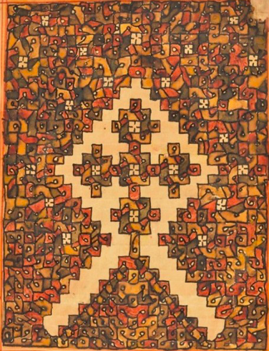
Mar Isho’yahb III (East Syriac Rite) pt. 1
Mar Isho’Yahb III was the Patriarch of the Church of the East from 649-659 AD. He was from the region of Adiabene and was bishop of Nineveh in 629 AD before becoming patriarch. Not only is he an important source for historians to examine how Christians interacted with early Muslims, but he also wrote many letters. Within one of his letters, we are informed of Suryaye (Syrians) and Aramaye (Arameans) as being distinct among other ethnic groups of the region.
“There are, however, reasons to believe that such an understanding of "Syrianness" is not an idiosyncratic invention of Dionysius, but an echo of the earlier tradition of perceiving "Syrians" as a group distinctive from (or within) "Aramaeans." One of the earliest expressions of this outlook was that of Išoʻyahb III of Adiabene (ob. 659), an East Syrian Catholicos, who in one of his letters mentions "Syrians" and "Aramaeans" separately alongside such groups as "Huzites" and "Persians."
Memory and Identity in the Syriac Cave of Treasures, Sergey Minov, Pg. 267
Notes:
Memory and Identity in the Syriac Cave of Treasures, Sergey Minov

Slide 109
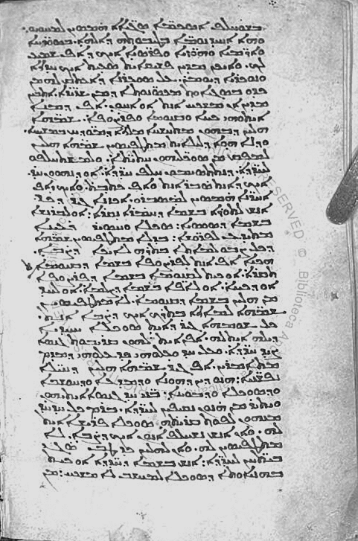
Mar Isho’yahb III (East Syriac Rite) pt. 2
This text clearly distinguishes the Arameans and Syrians. Without too much speculation, it is fair to say this usage by Mar Isho’yahb likely referred to the Assyro-Babylonians, or perhaps only Assyrians. Nonetheless, the Suryaye of Mesopotamia/Assyria considered themselves distinct from the Arameans within this text and probably considered themselves as the descendants of the Assyro-Babylonians, as evident by Mor Michael or Dionysius of Tel Mahre mentioning the Syrians east of the Euphrates as having kings in Assyria and Babylon. This among the references to us being the Sons of Nimrod as seen from before which was written by a writer from the COE before Isho Yahb’s elevation to patriarch alongside Assyria being the country of the Syrians in the Acts of Mar Mari likely reaffirms these points.
See also; Mark Gewargis’s Post, “Mar Isho’Yahb III”
Vat.sir.157
Notes:
Assyrians in History, Mark Gewargis, “Mar Isho’Yahb III”

Slide 110
Mar Severus Sebokht (East -> West Syriac Rite) pt. 1
Mar Severus Sebokht was a bishop and Syriac writer who dwelled in the realm of astrology. He was born in 575 and passed away in 667 AD. One of his disciples was Mor Jacob of Edessa. Within his work “Treatise on the Constellations” written in 660 AD, Mar Severius informs the reader that the Babylonians were Suryaye (Syrians). Amazingly, Mar Severius cites Ptolemy’s Canon of Kings and includes Assyrian kings within this list. He calls Nabonassar an Assyrian King and implies that he belonged to our people, counting them under a unified heritage. It is worth noting here that there are many Assyrian kings in Ptolemy’s Canon of Kings. Here this is clearly in the ethnic sense.
(Britannica Article, “Babylonian, Assyrian, Dating - Chronology”)
ܣܦܝܪܝܘܣ ܣܒܘܟܬ
Notes:
The Treatise on the Constellations, Introduction by François Nau

Slide 111
Mar Severus Sebokht (East -> West Syriac Rite) pt. 2
“That the Babylonians were Syrians, I believe that nobody will deny. Consequently, they are greatly mistaken who say that it is not possible that the Syrians know something of such matters (astronomy), since these Syrians were the inventors and the first Masters in these matters. Ptolemy again renders witness to this in the "Syntax"(Almageste), because when he chooses an origin for the computation of the Sun, the Moon and the five planets, he does not start with the years of Greek kings, but with those of the kings of Babylon, that is, Nebuchadnezzar, king of the Assyrians. I said Nebuchadnezzar, not the one of whom the prophet Daniel was the contemporary, but another more ancient. Ptolemy has thus given in the "Syntax" that the years that have passed since this first Nebuchadnezzar ---- i.e. of the Babylonian and Persian kings ---- until Philip (Arrhidaeus) the Macedonian, the successor of Alexander the founder of Alexandria, (are in the number of) four hundred and twenty-four years. There he rightly shows that he found among the Babylonians, and not among the Greeks, the beginning and foundation of the calculations which he made. It is thus on this foundation that he built and that he piled up the many calculations that he made."
The Treatise on the Constellations, Introduction by François Nau, Pg. 333
“For our purposes, the most striking features of Severus’ history are that it celebrates astronomy as one of the sciences that mark a civilization, that it identifies the ancient peoples of Iraq as Suryaye and that the opponents of this discourse are the Greeks, as they were with Tatian.”
The Imam of the Christians: The World of Dionysius of Tel-Mahre, Pg. 232
Notes:
Imam of the Christian’s, Pg. 232
Assyrian Cultural Institute, Ramsin Edward, “Here's How Indigenous Assyrians Helped Usher in a Golden Age”

Slide 112
Mar Severus Sebokht (East -> West Syriac Rite) pt. 3
“Michael's views about continuity between Aramaic and Semitic-speaking peoples' in the Near East were not unique; before him, in 662, the learned (and bilingual) Miaphysite Severus Sebokht (d. 666/7) wrote a letter about astronomy from which only a portion now survives in a manuscript in Paris... Like Michael, Severus invoked this continuity as a prophylactic against claims of cultural superiority that Greek-speakers were making against Aramaic speakers.”
What is Syriac? Explorations in the History of a Name, Jack Tannous, Pg. 104
“According to this seventh-century Syriac Orthodox bishop, certain writers of his day propagated the view that the Greeks held a monopoly over wisdom and the sciences. These, Severus pointed out, did not realise that it was the Assyrians and Babylonians, the ancestors of his Syriac Christian contemporaries, who invented such sciences. He also demonstrated his awareness of celestial observances which the ancients practiced. For instance, in his treatise on the causes of solar and lunar eclipses, Severus refers to a certain celestial dragon known asathlīyā; a word undoubtedly inherited from the ancient Assyrian word in Akkadian with the same meaning —attalū.”
Christianising Assyria (II), Ramsin Edward, Pg. 233
Notes:
Imam of the Christian’s, Pg. 232
Assyrian Cultural Institute, Ramsin Edward, “Here's How Indigenous Assyrians Helped Usher in a Golden Age”

Slide 113
Mar Severus Sebokht (East -> West Syriac Rite) pt. 4
Furthermore, Mar Severius recognized which kings belonged to us (The Babylonians/Assyrians) and distinguished the Babylonian and Persian kings, but did not bother to distinguish the Assyrian and Babylonian kings. Hence why some institutes render it as:
“The [Assyrians and] Babylonians were Syriacs, I believe no one will deny, so those who say (i.e., the Greeks) that it is in no way possible for Syriacs to know about these matters (i.e., astronomy) are much mistaken.”
Assyrian Cultural Institute, Ramsin Edward, “Here's How Indigenous Assyrians Helped Usher in a Golden Age”
The Babylonian king Baladan which is present on Ptolemy’s list is also said to be an Assyrian in Michael’s Chronicle.
See MLK-Ashuroyo’s Post, Slide 4
Notes:
https://www.reddit.com/user/MLK-Ashuroyo/comments/1hf51jq/ancient_assyrian_kings_in_syriac_literature/

Slide 114
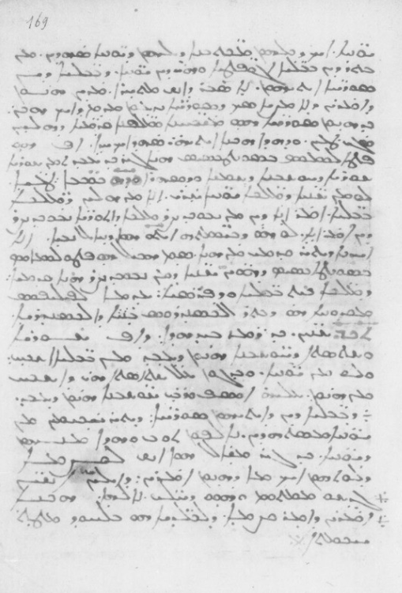
Mar Severus Sebokht (East -> West Syriac Rite) pt. 5
“Certain people believe that the Greeks alone know how to perform astronomical calculations [...] But all the Greek writers recognize that the Babylonians and the Egyptians preceded the Greeks and that the Babylonians are Suryaye. [...] Ptolemy in his Syntax shows more: that the computation of the sun, the moon and stars occurred under the Babylonian kings, I mean Nebuchadnezzar, king of the Assyrians [...] and not under the Greeks”
Mar Severus Sebokht (d. 666/7) [Syr. Orth.]
BNF SYRIAQUE 346 f.169v
Notes:
https://www.reddit.com/user/MLK-Ashuroyo/comments/1hf51jq/ancient_assyrian_kings_in_syriac_literature/

Slide 115
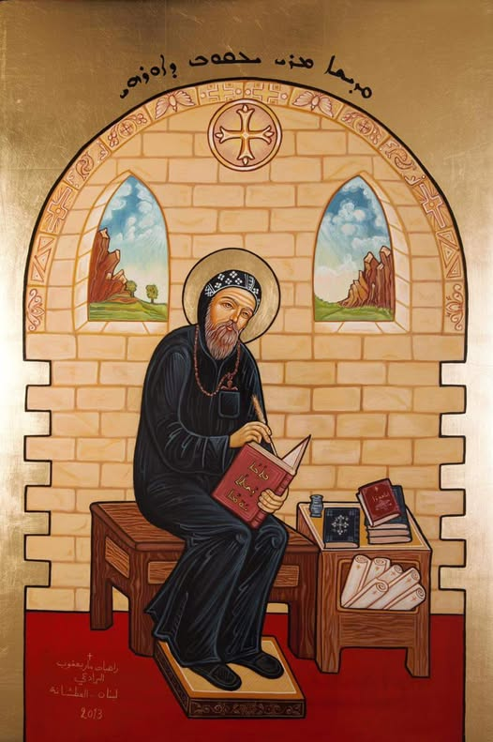
Mor Jacob of Edessa (West Syriac tradition) pt. 1
Mor Jacob of Edessa, born in 640 and passed away in 708, Mor Jacob was a prolific bishop and polymath of the Syriac Orthodox Church. Jacob enforms in a lost work, which is quoted by Mor Michael that from our people arose kingdoms greater than all the others of their time. He proves this using the books of the Greeks against them. Within the context of Michael’s Chapter, he is referring to the Assyrian and Babylonian kingdoms. It is clear this did not refer to a geographic region.
ܝܥܩܘܒ ܕܐܘܪܗܝ
Notes:
SOAA 00250 S.379v & SOAA 00250 S.380r: https://www.reddit.com/user/MLK-Ashuroyo/comments/1gajy3x/mor_jacob_of_edessa_our_kingdoms_had_no_equal/
Syriac Historiography and Identity Formation, Muriel Debié, Pg. 104
Chabot, Chronique, cd. Vol. 4. pg. 18, trans. Vol. I - https://www.reddit.com/user/MLK-Ashuroyo/comments/1ej1aa9/jacob_of_edessa_the_arameans_of_mesopotamia/

Slide 116

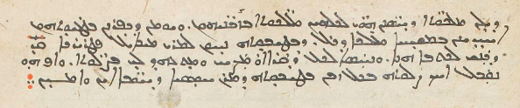
Mor Jacob of Edessa (West Syriac tradition) pt. 2
SOAA 00250 - S.379v & SOAA 00250 S.380r
“Mor Jacob of Edessa demonstrates according to their (the Greeks) books, that our people created kingdoms more powerful than all the kingdoms of their time”
- Mor Michael Rabo
Notes:
SOAA 00250 S.379v & SOAA 00250 S.380r: https://www.reddit.com/user/MLK-Ashuroyo/comments/1gajy3x/mor_jacob_of_edessa_our_kingdoms_had_no_equal/
Syriac Historiography and Identity Formation, Muriel Debié, Pg. 104
Chabot, Chronique, cd. Vol. 4. pg. 18, trans. Vol. I - https://www.reddit.com/user/MLK-Ashuroyo/comments/1ej1aa9/jacob_of_edessa_the_arameans_of_mesopotamia/

Slide 117
Mor Jacob of Edessa (West Syriac tradition) pt. 3
“Mor Jacob of Edessa demonstrates, according to their (Greek) books, that our people created kingdoms more powerful than all the kingdoms of their time.”
SOAA 00250 S.379v & SOAA 00250 S.380r: MLK-Ashuroyos Post
“Jacob of Edessa also stresses the fact that the Chaldean or, synonymously, Assyrian kings, the alleged ancestors of the Syrians, 'used our Aramaic tongue and script' and 'belonged to our tongue'.”
Syriac Historiography and Identity Formation, Muriel Debié, Pg. 104 | Emphasis on ‘synonymously’, for they were one people and the same heritage for the Syriac forefathers in both traditions of east and west.
“Moreover, religious historian Dorothea Weltecke and other scholars have shown that the patriarchate of the medieval Syrian Orthodox church, the church of Antioch, described the ancient Assyrians as the ancestors of the region's Christians.”
The Assyrian Genocide, Travis, Pg. 6 | Dorothea and Debie’s 2009 articles are included, thus referring to the examples of Jacob, Dionysius, and Michael.

Slide 118
Mor Jacob of Edessa (West Syriac tradition) pt. 4
“It is undoubtedly to the scholar Jacob of Edessa (d. 708), transmitted to the Syrian — Orthodox historian and patriarch Dionysius of Tel Mahre (d. 945), himself taken up by another Syrian Orthodox patriarch and historian, Michael the Syrian (d. 1199), that we owe the Syriac version of the history of the ancient kingdoms, centered on the idea that there were powerful "Syrian" kingdoms east and west of the Euphrates. The authorities of the Syriac Orthodox Church wanted to show that they had sovereigns of their own even though in Late Antiquity and the Middle Ages they no longer had their own kings to represent them. This passage is written against the (Byzantine) Greeks and has an apologetic dimension aimed at defending the Syriacs by showing the importance of the kingdoms that emerged from them.. he rereads world history through this prism and situates Alexander between the kingdoms he calls "Syrian" of the Chaldeans and Assyrians ("Syrian" because they all used Aramaic, like the Suryoye, Syrian or Syriac), which existed until Cyrus the Great conquered them... This reading of history, which aims to show "that empires arose from our people more powerful than all the empires of their time," places Alexander as the restorer of a "Syrian" power since he put an end to the kingdom of the Persians which had triumphed over the "Syrian" Mesopotamian empires...”
Alexander le Grande en Syriaque, Muriel Debié, Pg. 309-310
Notes:
https://www.reddit.com/user/MLK-Ashuroyo/comments/1hf51jq/ancient_assyrian_kings_in_syriac_literature/
Michael and the Syrian Orthodox Identity, Dorothea Weltecke

Slide 119
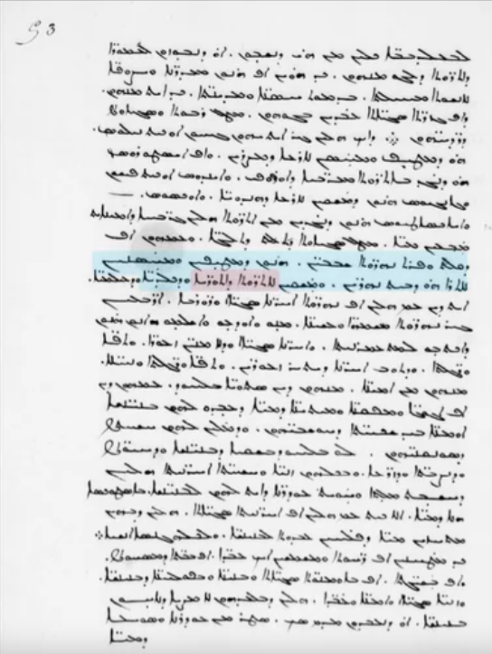
Mor Jacob of Edessa (West Syriac tradition) pt. 5
Additionally, within Jacob’s Hexameron insight is given into his usage and understanding of the Mesopotamian region. While describing Mesopotamia’s rivers, he mentions that the Tigris and Euphrates irrigate the countries of the Assyrians and Chaldeans, clearly referring to the north Mesopotamia for Assyria, and the south for Chaldea or Babylon.
“The Tigris and Euphrates, the neighbouring rivers which flood and strengthen the land of Mesopotamia, and irrigate the countries of the Assyrians and Chaldeans...”
Notes:
https://www.reddit.com/user/MLK-Ashuroyo/comments/1hf51jq/ancient_assyrian_kings_in_syriac_literature/
Michael and the Syrian Orthodox Identity, Dorothea Weltecke

Slide 120
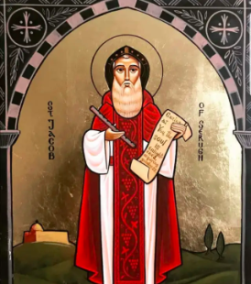
Mor Jacob of Edessa (West Syriac tradition) pt. 6
Furthermore, Mor Jacob’s usage of “Sons of Aram” did not deny Assyrian heritage. In fact, Mor Jacob and Mor Michael agree that Assyrians and Elamites are the descendants of Aram, the first son of Shem. Elamites are not considered a part of our people as we never claim their kingdoms or call them Suryaye. (Michael and the Syrian Orthodox Identity, Dorothea Weltecke, Pg. 119)
“...according to what Jacob wrote. He says of the first Aram, who was one of the sons of Shem: “He Dwelt in the East and from him are descended the Elamites and Assyrians.”
Chabot, Chronique, cd. Vol. 4. pg. 18, trans. Vol. I, pg. 34
MLK Ashuroyo’s Post

Slide 121
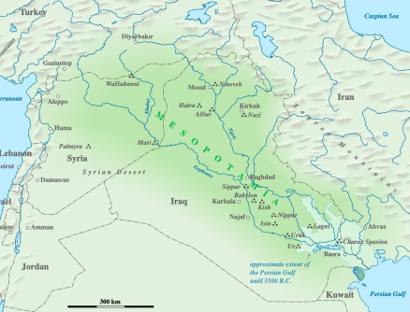
Mor Jacob of Edessa (West Syriac tradition) pt. 7
This statement is accepted by Michael and is quoted in his Chronicle. Such a passage calls into question what Syriac authors might have really meant by or perceived the ‘sons of Aram’ to be. It is clear, at the very least, that Michael and Jacob do not consider the sons of Aram to be only the ancient Arameans, but also the ancient Assyrians. Even in their genealogies, Syriac writers find ways to claim both heritages. When Michael and Jacob speak of Syriac Christians as the ‘sons of Aram’, it seems, from this passage, that they mean the Assyrians and Arameans. The usage appears to be more of a grouping term rather than a strict ethnic-racial identity, denoting what some call ‘Aramization’.
Notes:
https://www.reddit.com/user/MLK-Ashuroyo/comments/1hf51jq/ancient_assyrian_kings_in_syriac_literature/
Michael and the Syrian Orthodox Identity, Dorothea Weltecke

Slide 122
Analysis related to Mor Jacob of Edessa pt. 1
Another interesting passage which is similar to this arises from the Peshitta, within the book of Tobit. Whereas the Greek renders Assyria in Tobit 14:4 as simply "Assyria", the Syriac translators of the Bible instead dropped the reference to Athur and Assyria, instead replacing Athur/Ashur with Ārāmāyē (Arameans) and Assyria, the land, with Bēth Ārāmāyē (House of the Arameans). Although at first seeming a bit unorthodox, it reveals the levels to which Syriac authors understood their heritage in the earliest stages of Syriac Christianity. The nomenclature used to designate themselves occasionally, Ārāmāyē (Arameans) was understood by them to be none other than the Assyrians found in the Bible. Furthermore, Assyria itself is coined Bēth Ārāmāyē, the Syriac Christian homeland. The term “Aramean” never denied the Assyrian heritage, on the contrary, it was used by the earliest Syriac translators of the Bible as synonyms for Assyrians and Assyria, while the Arameans from Damascus were never termed Aramaye, but Edomites in the Peshitta. Even if Syriac writers used the term Aramaya, they believed it to be Assyrian in heritage and meaning. Such a passage reveals the interchangeability of the terms Aramean, Syrian, and Assyrian, which is precisely what Michael argued for.
Notes:
https://www.reddit.com/user/MLK-Ashuroyo/comments/1hf51jq/ancient_assyrian_kings_in_syriac_literature/
Michael and the Syrian Orthodox Identity, Dorothea Weltecke

Slide 123
Analysis related to Mor Jacob of Edessa pt. 2
“Writers in Edessene Aramaic were aware that "Syrian," "Syriac," and "Syrian" could all be synonyms for "Aramaic," "Aramaean," and "Aram." But there could also be an awareness that "Assyria" and "Aram" were the same as well: Tobit 14:4's "upon/against Ashur and Ninevah" (ἐπὶ Αθουρ καὶ Νινευη) would become in the Peshitta, "against Aramaeans and against Ninevah," and the same verse's ἐν Ἀσσυρίοις, “in Assyria," would be translated as Bēth Arāmāyē in Syriac, "in the region of the Aramaeans." This equation between Aramaeans, Syrians, and Assyrians was a point that Michael Rabo had argued strenuously for in the appendix he wrote against the "vainglorious" Greeks, which we saw above.”
What is Syriac? Explorations in the History of a Name, Jack Tannous, Pg. 117
Moreover: Jacob of Edessa calls Syriac the Mesopotamian language and believes that those who live in Mesopotamia speak this language the purest. Given all the evidence presented above: it is within reason to say Mesopotamia is a reference to Assyria and Babylonia.
MLK Ashuroyo’s Post
Notes:
https://www.reddit.com/user/MLK-Ashuroyo/comments/1hf51jq/ancient_assyrian_kings_in_syriac_literature/
Michael and the Syrian Orthodox Identity, Dorothea Weltecke

Slide 124
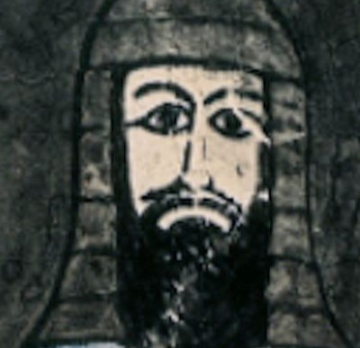
Mar Timothy I (East Syriac) pt. 1
Born in 740 and passed away in 823 AD, Mar Timothy I was by far one of the greatest and most influential patriarchs of the COE due to his many deeds in aiding the church. On top of this, Mar Timothy was a prolific writer. Within his 26th letter, Mar Timothy sheds some light on our past and ancestors while justifying the primacy of the See of Qtespon (Ctesiphon).
“And if the first place and station is due to those who before all confessed and believed in Christ, we also, the sons of the East, before all confessed and believed in Christ, and gave an open declaration of our faith, through our twelve ambassadors guided by the star, and the gifts we offered him: gold, as to the King of all kings and Lord of all lords, frankincense, as to him who is God over all, and myrrh, as foreshadowing the passion of his humanity on our behalf. The conclusion is therefore known, that it is right and fair to grant the first See to the sons of the East.”
Ecumenism, Christology, and Ethnicity: The 26th Letter of Patriarch Timothy of the Church of the East (Translation and Commentary), Fr. Andrew Younan, Pg. 8
Notes:
Ecumenism, Christology, and Ethnicity: The 26th Letter of Patriarch Timothy of the Church of the East (Translation and
Commentary), Fr. Andrew Younan

Slide 125
Mar Timothy I (East Syriac) pt. 2
Then, He claims Nimrod as being from our people, for him being Assyrian, see above in the Acts of Mar Mari. As for the Magi, within Syriac literature, they are usually considered to be Assyrians.
(Who were the Biblical Magi in the Syriac Tradition? Here’s What we Know, Ramsin Edward)
“Regarding the honor of the ends of the earth, the queen of all ends being the East, and if because of the crown by which Paradise was crowned, the type of Paradise on earth which is the Kingdom of Heaven, and if for the reason of the earthly crown and kingship, before all is made the kingly crown of Nimrod, and if regarding the forefathers in the flesh of our Savior, in and from [the East] Abraham was born and came forth, and if regarding the primacy of our Faith before all in our Lord, when he was two years old we sent ambassadors and offerings for his Kingship, and at three years old before anyone else we confessed in his Lordship and adored his Divinity. The Romans indeed and the Greeks, insofar as they signified giving the primacy of the see of the sons of Persia, by all things being beaten and made to suffer by their hands–bitter sufferings and various trials.”
Ecumenism, Christology, and Ethnicity: The 26th Letter of Patriarch Timothy of the Church of the East (Translation and Commentary), Fr. Andrew Younan, Pg. 8
Notes:
Ecumenism, Christology, and Ethnicity: The 26th Letter of Patriarch Timothy of the Church of the East (Translation and
Commentary), Fr. Andrew Younan
The Chronicle of Seert, Philip Wood, Pg. 235-236

Slide 126
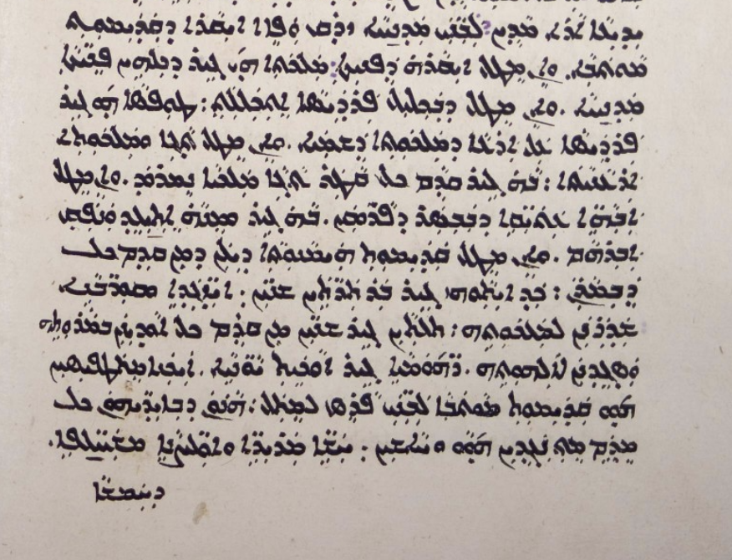
Mar Timothy I (East Syriac) pt. 3
“Regarding the honor of the ends of the earth, the queen of all ends being the East, and if because of the crown by which Paradise was crowned, the type of Paradise on earth which is the Kingdom of Heaven, and if for the reason of the earthly crown and kingship, before all is made the kingly crown of Nimrod, and if regarding the forefathers in the flesh of our Savior, in and from [the East] Abraham was born and came forth, and if regarding the primacy of our Faith before all in our Lord, when he was two years old we sent ambassadors and offerings for his Kingship, and at three years old before anyone else we confessed in his Lordship and adored his Divinity. The Romans indeed and the Greeks, insofar as they signified giving the primacy of the see of the sons of Persia, by all things being beaten and made to suffer by their hands–bitter sufferings and various trials.”
Ecumenism, Christology, and Ethnicity: The 26th Letter of Patriarch Timothy of the Church of the East (Translation and Commentary), Fr. Andrew Younan, Pg. 8
Notes:
Ecumenism, Christology, and Ethnicity: The 26th Letter of Patriarch Timothy of the Church of the East (Translation and
Commentary), Fr. Andrew Younan
The Chronicle of Seert, Philip Wood, Pg. 235-236

Slide 127
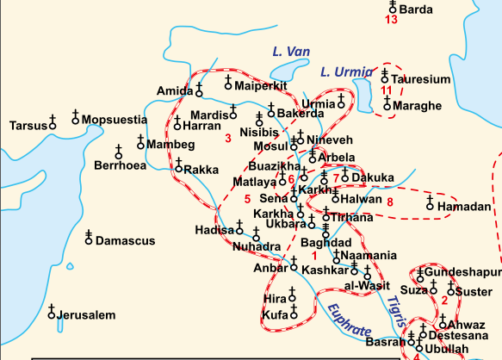
Mar Timothy I (East Syriac) pt. 4
Although it is never explicitly stated, Mar Timothy is drawing on a connection to us, sons of the East, that being the Church of the East, to ancient Mesopotamia and Assyria. Furthermore, Sons of Persia here is being used in a ecclesiastical sense as there is no mention of Persian figures, and the COE was often called the “Persian Church” as well
(The Church of the East: A Concise History, Pg. 4).
This is also evidenced by the context of Sees. The East was associated with Mesopotamia due to the mentions of Nimrod and in fact, even the see he is discussing (Ctesiphon) is in Mesopotamia.
(See Above in Acts of Mar Mari, Cave of Treasures Quotation)
Ecumenism, Christology, and Ethnicity: The 26th Letter of Patriarch Timothy of the Church of the East (Translation and Commentary), Fr. Andrew Younan, Pg. 2-3

Slide 128
Mar Timothy I (East Syriac) pt. 5
“Even so, he [Timothy] felt that many reasons gave natural primacy of honor to his own Seleucia. If Rome drew its authority from Peter, Mesopotamia looked to Christ himself, a descendant of that ancient Sumerian Abraham. Was not Mesopotamia the original source of monarchy and civilization, not to mention the location of the Garden of Eden? Just as the rivers flowed out of Eden, so the other patriarchates flowed forth from Mesopotamia. And obviously it was the East, rather than the West, that had first embraced the Christian message. The natural home of Christianity was in Mesopotamia and points east. According to the geographical wisdom of the time, Seleucia stood at the center of the world’s routes of trade and communication, equally placed between the civilizations that looked respectively to the Atlantic and the Pacific.”
The Lost History of Christianity, Philip Jenkins, Pg. 14
“However, it is the East that has primacy over the other parts of the world, since Nimrod, the first king, ruled in the East and since Ctesiphon is the see of Peter. The East, he [Timothy] goes on to argue, was the first land to embrace Christianity and the point of origin of Christ’s own family (presumably via Abraham). [...] At the same time, Timothy claims a pre-eminent position for his see within this Christian world-system. He asserts the status of the East by concentrating on its claims to antiquity and its importance as the site of the Old Testament narrative.”
The Chronicle of Seert, Philip Wood, Pg. 235-236
“Indeed, in one of his letters, Catholicos Timothy brought up Nimrod, the first king, to claim Nimrod as an ancestor for the Christians of the East and therefore positioned himself, in his capacity of leader of those Christians, as Nimrod’s heir.”
A Prophecy of Empire: The Apocalypse of Pseudo‑Methodius, Christopher J., Pg. 162
Within Timothy’s letters, an Assyrian ethnos is portrayed clearly, as shown from the evidence above, among other examples.
Dr Aaron M.Butts: A Rebuttal, Jessi Arabou, Pg. 5 | Citation for sentence provided by Jessi can be found under “Mar Timothy I” within Mark Gewargis’s Post

Slide 129
Theodore Bar Konai (East Syriac) pt. 1
Theodore Bar Konai was a COE exegete who interpreted scripture, namely the Holy Bible. He lived perhaps during Mar Timothy’s reign, being 780-823 AD, although some scholars place him a century later in the late 9th century. Nonetheless, we are informed about this key piece of information within his Book of Scholion.
“There are those who say that the first language was Hebrew, because, they claim, the Scriptures were delivered in it. But this is not true, for Hebrew is not one of the seventy-two languages; it is indeed composite. The word Hebrew itself makes it clear where it comes from. Abram indeed was called Hebrew because he passed the river Euphrates. If, then, Aruk, Abraham's village, is in Babylonia, and the Babylonians are Arameans, as their language attests, how could Abraham have used a language other than that of his parents, the language in which he had been brought up? But it is certain that it was Syriac; while this alone remained the only language of one house, which had not left its country, the others, with their languages, fled and moved to their regions... If the Scriptures were delivered in Hebrew, it was not because of its dignity or its extension - it is indeed very limited - but because it was not opportune that they should be given to them in another language, in the use of which they were not trained and which they would inevitably have been prevented from studying; indeed, we are not unaware of how much work the difficulty of the words, from language to language, makes for those who wish to learn another language.”
Translated from La langue du Paradis, la langue comme patrie», dans M. Farina (éd.), Les syriaques et leur langue (Études syriaques 15), Paris, 2018, pg. 13-14
Notes:
La langue du Paradis, la langue comme patrie», dans M. Farina (éd.), Les syriaques et leur langue (Études syriaques
15), Paris, 2018

Slide 130
Theodore Bar Konai (East Syriac) pt. 2
Within the previous passage, Babylonian is being equated to Aramaic, which is Syriac. Theodore Bar Koni argues for the primacy of the Syriac language by drawing into Abraham and the Babylonians, connecting the Suryaye with ancient Mesopotamia, on the basis of the Babylonian’s language. For he says if Abraham was Babylonian, and the Babylonians are Arameans (Aramaic Speakers) as their language attested, then our Syriac language must be the first language to roam the earth. He thereby also implies the Babylonians as part of his Syrian people through this process. This is a clear self-identification by Theodore Bar Koni and further again shows that “Aramean” did not imply there was not a local identification, and certainly does not assume that it denies our ancient Mesopotamian heritage, as language was the core of the Syrian identity. Claiming them due to their language is claiming them ethnically, and this process is called identity formation where the Suryaye saw the Aramaic language as a way to link themselves towards the ancient Assyro-Babylonian past. It is also an interesting parallel to the Peshitta, where Assyria and Assyrians are translated as “Arameans” or “House of the Arameans”. It seems for Syriac writers, Aramean was a broad linguistic term which served to connect them with a Mesopotamian past via linguistics, seeing the term as interchangeable with at least, “Assyrian”.
(See Jacob of Edessa’s section for the relevant quote.)
Notes:
The Formation of a Communal Identity among West Syrian Christians, Pg. 43

Slide 131
Theodore Bar Konai (East Syriac) pt. 3
“Through a process of selection and resignification, gradually other features from the complex cultural background of the Syrian Christians were added: language, for example—one of the most easily recognizable, and therefore strongest, features of identity—, became very important, but only after some time... As soon as the use of Syriac became recognized as a symbol of the religious association that was in the process of becoming a community, it offered the possibility of establishing a link to a more distant, and more glorious, pre-Christian past: did not the Bible say that the Babylonians and Assyrians spoke Aramaic, that is, Syriac? So they were Syrians, too. We should not think of ancient fault lines here, but of a social process of identity construction.”
The Formation of a Communal Identity among West Syrian Christians, Pg. 43
Notes:
Memory and Identity in the Syriac Cave of Treasures, Sergey Minov,

Slide 132
Theodore Bar Konai (East Syriac) pt. 4
Furthermore, some light is shed on Theodore Bar Koni’s usage of Aramean. He does not mean it as those who dwelt in Aram/West of the Euphrates but instead associates it with Mesopotamia and Babylonians, which is against what modern Arameanists would claim about their heritage.
“A valuable addition to the repertoire of negative reactions towards "Syrians" on the part of East Syrian writers comes from the Book of Scholia by Theodore bar Koni (8th c.). In the second mēmr of his book, Theodore offers his own version of the biblical tabula gentium, the catalog of nations from Genesis 10. What is remarkable about his adaptation of the scriptural material is that while numbering "Aramaeans" (Aramaye) together with the rest of the descendants of Shem, in complete agreement with Scripture (cf. Gen 10:22-23), Theodore lists "Syrians" (Suryaye) as a separate ethnic entity and includes them among the descendants of Ham, together with Western groups such as "Antiochenes," "Emessenes," and "Tyrians." Given Ham's negative image and his posterity in the Christian ethnographical tradition, this use of the term "Syrian" might be interpreted as an intentional attempt to tarnish the reputation of West Syrian Christians and to widen the distance between them and Theodore's own community even more by articulating it not in religious, but in ethnic categories.”
Memory and Identity in the Syriac Cave of Treasures, Sergey Minov, Pg. 270
Notes:
Some Reflexions About The Figure Of Abraham In The Syriac Literature At The Beginning Of Islam
The Hidden Pearl, Volume 1, Brock
Commentaire d'Isodad de Merv sur l'Ancien Testament, Ceslas van den Eynde, Louvain 1955, Pg. 142

Slide 133
Theodore Bar Konai (East Syriac) pt. 5
As we can see, Theodore Bar Koni distances himself from the regions west of the Euphrates and attacks them (unfortunately). This further indicates for him, Aramean is Babylonian, and just as how Jacob believes Assyrians descend from Aram, perhaps Theodore Bar Koni believed this as well for Babylonians. It is best not to delve into speculations, however. Furthermore, to hammer the point in, for Theodore Bar Koni Aramaic/Syriac originally came from Babylon, and after the confusion of tongues, only Mesopotamia continued to remember and speak this language.
“This is the same logic as that of Theodore bar Koni, in his Book of Scolia (II. 113),15 who, while evoking the question of the confusion of languages in connection with the Tower of Babel episode, shows that the first language, in Mesopotamia, was Syriac. After the destruction of the tower of Babel, those who had dispersed in the world had adopted other languages, but those who had remained in Mesopotamia, as Abraham, had preserved Aramaic. And Theodore bar Koni adds: "it is in Edessa that Syriac is maintained pure nowadays." Another source insists on the fact that it is only while passing the Euphrates that Abraham became a Hebrew, taking up the traditional biblical etymology of this term. As for Hebrew as a language, it is for them a mixture of Aramaic and of the language of Canaan, that Abraham learned to know. It is thus a hybrid language, distinct from the pure language spoken in paradise, Syriac.”
Some Reflexions About The Figure Of Abraham In The Syriac Literature At The Beginning Of Islam, Pg. 163-164
Therefore it has been shown that even Aramaic as a language for Theodore Bar Koni originated from Babel, and that only those who stayed in Mesopotamia preserved this language.

Slide 134
Theodore Bar Konai (East Syriac) pt. 6
Furthermore, Theodore Bar Koni also gives the reader a local tradition on how the god Nabu was interpreted, being a school teacher at Mabbug (Manbij) who was later on worshiped.
MLK-Ashuroyo’s Post
Whatever the case, it is evident that Theodore Bar Koni saw Babylonians as a part of his heritage and claimed them as his ancestors while Aramean was used as a linguistic term for the Aramaic speakers of his contemporary time, whom he draws a connection to the Babylonians indeed;
“Although the term “Aramaean” originally referred to an ethnic grouping, in due course it often lost that sense, and instead took on the designation of “a speaker of Aramaic.”
The Hidden Pearl, Volume 1, Brock, Page 8 The contemporary ‘Chaldeans’ of his time are distinct from the ancient Babylonians for him: and In fact, the “Chaldean” for him means pagan and fornicator, so it is not a likely self-identification for Theodore Bar Koni.
The Melammu Project, Chaldean View of the Cosmos
To add on, Babylonian usage never denied Assyrian heritage. Babylonians had Assyrian kings such as Nimrod who was the originator of the Tower of Babel. Theodore Bar Koni mentions Nimrod throughout his book as well. This will be seen later on within Bar Ebroyo’s and Mar Eliya’s sections.
For Nimrod, See; Liber Scholiorum Pg. 117. He is mentioned to be the first king (after the flood) and all other kings followed after him. Obviously, Nimrod’s kingdom was in Babel as known to all, and he was first king in Babel. This is also found in the Holy Bible.
Notes:
https://www.reddit.com/user/MLK-Ashuroyo/comments/1b8fy2b/nabu_the_divine_schoolmaster_of_mabbogh_hierapolis/
The Melammu Project, Chaldean View of the Cosmos

Slide 135
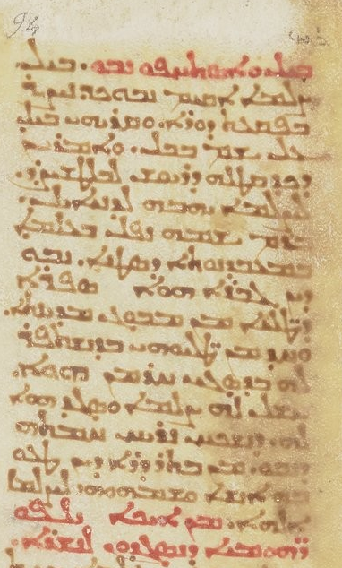
Theodore Bar Konai (East Syriac) pt. 7
“Nebo / Nabu was a man, a teacher of youths, from the town of Mabbogh / Hierapolis; and one of his youths, to please him because he was very cruel, made him a statue and worshipped it to appease Nebo's irritation; after one generation, the people were misled by it and called the statue god.”
Theodore Bar Konai, end of 8th century
BNF Syriaque 366, folio 105v
Notes:
https://www.reddit.com/user/MLK-Ashuroyo/comments/1b8fy2b/nabu_the_divine_schoolmaster_of_mabbogh_hierapolis/
The Melammu Project, Chaldean View of the Cosmos

Slide 136
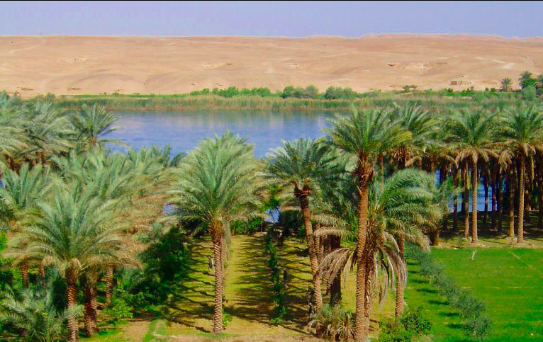
Mor Dionysius of Tel Mahre (West Syriac tradition) pt. 1
Mor Dionysius of Tel Mahre passed away in 845 AD and was installed as patriarch of the SOC in 818 AD. His work is also unfortunately lost, but remnants of it are quoted by Mor Michael. According to Dionysius “Suryaye” was applied metaphorically to all those who spoke Aramaic, and he identified the Suryaye East of the Euphrates with Assyria and Babylon. This is quoted by Michael on two occasions, and this is where the origin of Michael’s arguments are derived from.
Notes:
https://www.reddit.com/user/MLK-Ashuroyo/comments/1geg99j/understanding_mor_dionysios_of_tel_mahre_9th/#lightbox
The Imam of the Christians: The World of Dionysius of Tel-Mahre

Slide 137
Mor Dionysius of Tel Mahre (West Syriac tradition) pt. 2
“Syrians are those who speak the Aramaic language, either west or east of the Euphrates, i.e. from the sea to Persia. And in this region there were many kings: in Edessa, those of the family of Abgar; In ‘Araba, those of the family of Sanatruq, who reigned in the city of Hatra; In Nineveh those of the family of Bel and Ninus; In Babylon, those of the family of Nebuchadnezzar, who spoke the Aramaic language concerning the dream and the interpretation of the image. And these things we say to show that the Syrians are properly west [of the Euphrates]. And the Jazireans, that is, the Mesopotamians, are those who are to the east of the Euphrates. ”
MLK Ashuroyo’s Post
“Dionysius argues that the name ‘Syria’ should properly be used for the lands west of the Euphrates, in contrast to Mesopotamia. However, he also argues that the Suryaye were a people with kings, listing biblical figures from Damascus and Babylonia as well as other kings from Assyria and Edessa. Finally, he claims that Edessa, a city famous in earlier Syriac chronicles, was the home of the Syriac language. This chapter shows how Dionysius reused the Old Testament to assert the existence of a distinctive Suryaya people, with its own prestigious history.”
The Imam of the Christians: The World of Dionysius of Tel-Mahre, Pg. 209

Slide 138
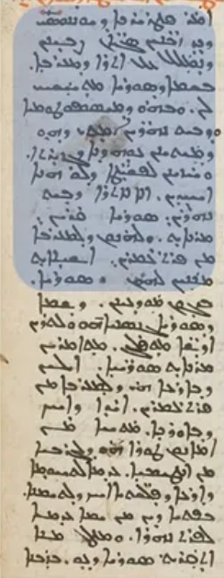
Mor Dionysius of Tel Mahre (West Syriac tradition) pt. 3
“Many times when we want to speak of the country of the West we use the name Syria, and that of Mesopotamia or Beth-Nahrain when we mention Jazira (lit. Gozarto). And we see simple people who do not observe this, but call the country of Mesopotamia ‘Syria proper’, and metaphorically call those who live west of the Euphrates ‘Syrians’”.
Mor Dionysius of Tel Mahre
SOAA 00250 S f.265v

Slide 139
Mor Dionysius of Tel Mahre (West Syriac tradition) pt. 4
Furthermore, as again quoted in the chapter of Syrian kings Michael provides, he recognizes the east of the Euphrates as having and holding the Assyro-Babylonian kings. They belonged to these people, i.e. the Syrians east of the Euphrates as Mor Michael clarifies. Dionysius believed that the Assyrians and Babylonians belonged to the people of Syrians, but specifies like Michael this heritage is given chiefly to those in Mesopotamia. Dionysius lived in a time which had a growth in a form of ‘nationalism’, where ancient kingship and past began to matter. Dionysius aimed to prove the identity and power of the Suryaye against people who claimed they had no ancient past, and he turned to the Assyrian past to do so.
“Dionysius argues that the name ‘Syria’ should properly be used for the lands west of the Euphrates, in contrast to Mesopotamia. However, he also argues that the Suryaye were a people with kings, listing biblical figures from Damascus and Babylonia as well as other kings from Assyria and Edessa. Finally, he claims that Edessa, a city famous in earlier Syriac chronicles, was the home of the Syriac language. This chapter shows how Dionysius reused the Old Testament to assert the existence of a distinctive Suryaya people, with its own prestigious history.”
The Imam of the Christians: The World of Dionysius of Tel-Mahre, Pg. 209

Slide 140
Mor Dionysius of Tel Mahre (West Syriac tradition) pt. 5
“Next Dionysius turns to the lands east of the Euphrates. These, he argues, can be called ‘Suryaya’ metaphorically, as one would call anyone ‘who speaks the Aramaic language, whether in the east or in the west, that is, from the sea up to Persia’. In this region, he says, there have been numerous kings, such as the family of Abgar at Edessa, the family of Sanatruq at Hatra, the family of Bel and Ninus at Nineveh and the family of Nebuchadnezzar at Babylon.”
The Imam of the Christians: The World of Dionysius of Tel-Mahre, Pg. 225
“Dionysius of Tel Mahre also attempted to demonstrate the continuous existence of a Syrian Empire, the Chaldeans and Assyrians being considered as belonging to 'the people' of the Syrians... According to Dionysius, the Syrians are only one part of a larger group of Aramaic speakers stretching from the shores of the Mediterranean to the east of the Euphrates, into Persia and Babylonia. He tries to demonstrate through citations from the Book of Kings that Syria proper is situated west of the Euphrates and that the 'Syrians' live there. It is only metaphorically that the Aramaic speakers living east of the Euphrates are called Syrians… According to Dionysius, there existed kingdoms to the east of the Euphrates: that of the Assyrians (with Nebuchadnezzar who spoke Aramaic with the magicians summoned to interpret his dream), that of the Abgarids in Edessa, and that of the 'araba (with Sanatruq).”
Syriac Historiography and Identity Formation, Debie, Pg. 97, 104 and 109

Slide 141
Mor Dionysius of Tel Mahre (West Syriac tradition) pt. 6
“Moreover, religious historian Dorothea Weltecke and other scholars have shown that the patriarchate of the medieval Syrian Orthodox church, the church of Antioch, described the ancient Assyrians as the ancestors of the region's Christians.”
The Assyrian Genocide, Travis, Pg. 6 | Dorothea and Debie’s 2009 articles are included, thus referring to the examples of Jacob, Dionysius, and Michael.
“Dionysius of Tel Mahre in the ninth century: for him, not all ancient Near Eastern empires were Syrian, only the Aramean kingdoms of the west. West of the Euphrates one would therefore find the real Syrians, to the east only Syrians in metaphorical sense.”
Religious Origins of Nations, Haar Romeny, Pg. 330

Slide 142
Mor Dionysius of Tel Mahre (West Syriac tradition) pt. 7
“It is undoubtedly to the scholar Jacob of Edessa (d. 708), transmitted to the Syrian — Orthodox historian and patriarch Dionysius of Tellmahre (d. 945), himself taken up by another Syrian Orthodox patriarch and historian, Michael the Syrian (d. 1199), that we owe the Syriac version of the history of the ancient kingdoms, centered on the idea that there were powerful "Syrian" kingdoms east and west of the Euphrates. The authorities of the Syriac Orthodox Church wanted to show that they had sovereigns of their own even though in Late Antiquity and the Middle Ages they no longer had their own kings to represent them. This passage is written against the (Byzantine) Greeks and has an apologetic dimension aimed at defending the Syriacs by showing the importance of the kingdoms that emerged from them.. he rereads world history through this prism and situates Alexander between the kingdoms he calls "Syrian" of the Chaldeans and Assyrians ("Syrian" because they all used Aramaic, like the Suryoye, Syrian or Syriac), which existed until Cyrus the Great conquered them... This reading of history, which aims to show "that empires arose from our people more powerful than all the empires of their time," places Alexander as the restorer of a "Syrian" power since he put an end to the kingdom of the Persians which had triumphed over the "Syrian" Mesopotamian empires...”
Alexander le Grande en Syriaque, Muriel Debié, Pg. 309-310

Slide 143
Mor Dionysius of Tel Mahre (West Syriac tradition) pt. 8
Dionysius’s key role in defining the identity of the Syrians led him to influence Arab authors, particularly Masudi, who accepted the claims of kingship Dionysius and perhaps other Syriac authors made, and led Masudi to call the kings of Nineveh and Mosul ‘Syrians’.
“For instance, Masʿudi discusses... the kings of Nineveh and Mosul, whom he identifies as ‘Nabat and Suriyāniyyūn.’ In the case of Masʿudi, at least, it seems that claims of a politically autonomous past for the Suryaye, such as those made by Dionysius, had been accepted and that the ‘Suriyāniyyūn’ constituted an umma in Masʿudi’s eyes,analogous to the Romans (‘the Rūm’), the Arabs and the Persians.”
The Imam of the Christians: The World of Dionysius of Tel-Mahre, Pg. 229-230
Michael, who followed Dionysius and used his arguments, would have likewise approved.
“Similarly, Mas'ūdī (d. AH 346/AD 956) included a section in his Muruj al-dhahab on "the Kings of the Syrians" (al-suryāniyyīn), stating the first kings in human history were in fact the Syrian kings who ruled after the Flood. He was dealing with an understanding of suryānī, “Syrian,” of which Michael Rabo would have approved.”
What is Syriac? Explorations in the History of a Name, Jack Tannous, Pg. 113-114

Slide 144
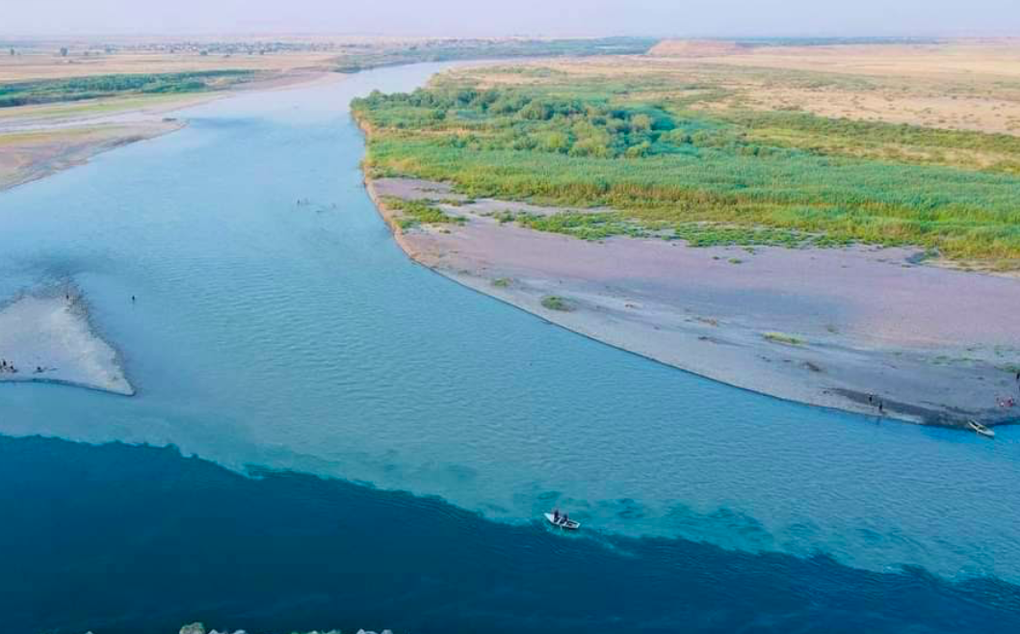
Mar Isho’dad of Merv (East Syriac) pt. 1
Mar Isho’dad of Merv was a bishop within the Church of the East over the diocese of Hdatta in Athor (Assyria). He lived between the 8th and 9th centuries and he became bishop in 837 AD. He was a prolific writer and made multiple commentaries on different books of the bible. Within his commentary on Daniel, specifically Daniel 1:4, he informs us that; “The language of the Chaldeans that is of the Suryaye (Syrians).”
MLK Ashuroyo’s Post
Confluence of the Great Zab and Tigris near Hdatta, Iraq
Notes:
https://www.reddit.com/user/MLK-Ashuroyo/comments/1gj09ze/mar_ishodad_of_merv_on_the_chaldean_language/
Daniel 1:4, NKJV
https://cal.huc.edu/showachapter.php?fullcoord=6310013110 - Ishodad of Merv on Psalms as per Celas van den Eynde, ed., Commentaire d'Išoˁdad de
Merv sur l'Ancien Testament: VI. Psaumes, (CSCO, 433; Scriptores Syri, 185) (Peeters, Louvain): 1981.
The Anonymous Syriac Chronicle of 1234 and its Sources, Andy Hilkens, Pg. 204

Slide 145
Mar Isho’dad of Merv (East Syriac) pt. 2
It is clear from this passage that Isho’dad believes that the kingdoms of old spoke our language and that he was making a conscious decision to equate Chaldeans with Syrians. This also shows he believed us Suryaye to have a connection to the Ancient Mesopotamians. It becomes even more evident when you refer to the verse he is commentating on, which details how young men went to the Babylonian king’s palace to learn the Babylonian ways and language:
“young men in whom there was no blemish, but good-looking, gifted in all wisdom, possessing knowledge and quick to understand, who had ability to serve in the king’s palace, and whom they might teach the language and literature of the Chaldeans...”
Daniel 1:4, NKJV
Notes:
https://www.reddit.com/user/MLK-Ashuroyo/comments/1gj09ze/mar_ishodad_of_merv_on_the_chaldean_language/
Daniel 1:4, NKJV
https://cal.huc.edu/showachapter.php?fullcoord=6310013110 - Ishodad of Merv on Psalms as per Celas van den Eynde, ed., Commentaire d'Išoˁdad de
Merv sur l'Ancien Testament: VI. Psaumes, (CSCO, 433; Scriptores Syri, 185) (Peeters, Louvain): 1981.
The Anonymous Syriac Chronicle of 1234 and its Sources, Andy Hilkens, Pg. 204

Slide 146
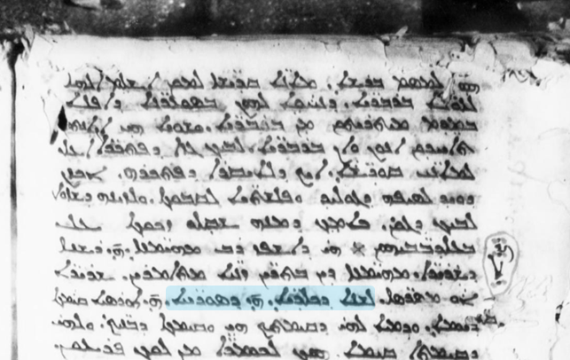
Mar Isho’dad of Merv (East Syriac) pt. 3
“The language of the Chaldeans, that is of
the Suryaye”
Mar Isho’dad of Merv
Syriac 10. Exegesis of Old Testament. 1380 A.D. 429 f. Pa. 58 ft.
Notes:
https://www.reddit.com/user/MLK-Ashuroyo/comments/1gj09ze/mar_ishodad_of_merv_on_the_chaldean_language/
Daniel 1:4, NKJV
https://cal.huc.edu/showachapter.php?fullcoord=6310013110 - Ishodad of Merv on Psalms as per Celas van den Eynde, ed., Commentaire d'Išoˁdad de
Merv sur l'Ancien Testament: VI. Psaumes, (CSCO, 433; Scriptores Syri, 185) (Peeters, Louvain): 1981.
The Anonymous Syriac Chronicle of 1234 and its Sources, Andy Hilkens, Pg. 204

Slide 147
Mar Isho’dad of Merv (East Syriac) pt. 4
What is important to note is that Mar Isho'dad did not distinguish between the Assyrians and Babylonians. For him, they were one people, one kingdom, and one language.
Indeed, he says; “the Assyrians were called Babylonians and the Babylonians, Assyrians; for they were one nation and one language and one kingdom."
Source and Sources cited by the website; Ishodad of Merv on Psalms as per Celas van den Eynde, ed., Commentaire d'Išoˁdad de Merv sur l'Ancien Testament: VI. Psaumes, (CSCO, 433; Scriptores Syri, 185) (Peeters, Louvain): 1981.
It is clear Isho'dads usage here does not imply he did not see Assyrians as part of his heritage, that not only were they one language which is the usage here, but even that they were One Kingdom. Again I repeat, Isho’dad did not imply he did not see Assyrians as part of his people, but Chaldean was a grouping term for the Assyro-Babylonians.
Notes:
https://www.reddit.com/user/MLK-Ashuroyo/comments/1gj09ze/mar_ishodad_of_merv_on_the_chaldean_language/
Daniel 1:4, NKJV
https://cal.huc.edu/showachapter.php?fullcoord=6310013110 - Ishodad of Merv on Psalms as per Celas van den Eynde, ed., Commentaire d'Išoˁdad de
Merv sur l'Ancien Testament: VI. Psaumes, (CSCO, 433; Scriptores Syri, 185) (Peeters, Louvain): 1981.
The Anonymous Syriac Chronicle of 1234 and its Sources, Andy Hilkens, Pg. 204

Slide 148
Mar Isho’dad of Merv (East Syriac) pt. 5
Furthermore, Isho’dad believed that the city of Babylon itself was created by the legendary Assyrian Queen Shamiram (Semiramis) which is also found in the many Greek texts, so we can furthermore see how Babylonians are an offshoot of Assyrians (as per Greek Tradition) for him, or at the very least, one people.
“And in the year 77 of Abraham reigned 42 years Semiramis the wife of Ninus. And she built Babylon from the start and ruled of Asia.”
MLK-Ashuroyo’s Post
He also states that Belus the Assyrian is one of Nimrod’s successors:
“Nimrod’s successors Qambiros, Samiros, Kisaronus, Arphakid and Belus the Assyrian are also mentioned by Isho’dad and Agapius, confirming that this information also originated from Andronicus’ Chronicle.”
The Anonymous Syriac Chronicle of 1234 and its Sources, Andy Hilkens, Pg. 204
Notes:
https://www.reddit.com/user/MLK-Ashuroyo/comments/1gj09ze/mar_ishodad_of_merv_on_the_chaldean_language/
Daniel 1:4, NKJV
https://cal.huc.edu/showachapter.php?fullcoord=6310013110 - Ishodad of Merv on Psalms as per Celas van den Eynde, ed., Commentaire d'Išoˁdad de
Merv sur l'Ancien Testament: VI. Psaumes, (CSCO, 433; Scriptores Syri, 185) (Peeters, Louvain): 1981.
The Anonymous Syriac Chronicle of 1234 and its Sources, Andy Hilkens, Pg. 204

Slide 149
Mar Isho’dad of Merv (East Syriac) pt. 6
On a final note, it is worthwhile to note that Isho’dad repeated the statement of Theodore Bar Koni, where he argued the Babylonians were Aramaye, and thus Abraham spoke Syriac, and belonged to our people/tongue. The significance of this has already been covered under Bar Koni’s section. Once again, it testifies to the idea that ‘Aramaye’ did not simply refer to the ancient Arameans or deny the Assyrian-Babylonian heritage of Syriac Christians. In fact, he seems to also imply that Aramaic itself originated in Mesopotamia, only later ‘fleeing’ to other regions such as Syria. Whatever one may make of this argument, it is clear he sees himself as Mesopotamian firstly.
“Now, indeed, Abraham was from Kashkar of Babylon, and the Babylonians are Aramaeans (Aramaye) and Abraham must have spoken the language of his region and of his father when he was in his village of Uruk, which is in Babylon, and when he departed from there, he and his father, and lived in Harran of Mesopotamia. For it was after he crossed over the Euphrates that he lived for a period in the land of Canaan; his language and that of his children was mixed with Canaanite. Indeed, Hebrew also resembled Syriac (suryāyā) and was not distinct from Canaanite... in the case of Syriac, that from the changing of time and the length of generations, it was corrupted and confused, and nearly fled from where it was dwelling and settled in other regions, that is, in Homs and Apamea and Edessa, etc...”
What is Syriac?, Jack Tannous, Pg. 84
Notes:
https://www.reddit.com/user/MLK-Ashuroyo/comments/1gj09ze/mar_ishodad_of_merv_on_the_chaldean_language/
Daniel 1:4, NKJV
https://cal.huc.edu/showachapter.php?fullcoord=6310013110 - Ishodad of Merv on Psalms as per Celas van den Eynde, ed., Commentaire d'Išoˁdad de
Merv sur l'Ancien Testament: VI. Psaumes, (CSCO, 433; Scriptores Syri, 185) (Peeters, Louvain): 1981.
The Anonymous Syriac Chronicle of 1234 and its Sources, Andy Hilkens, Pg. 204

Slide 150
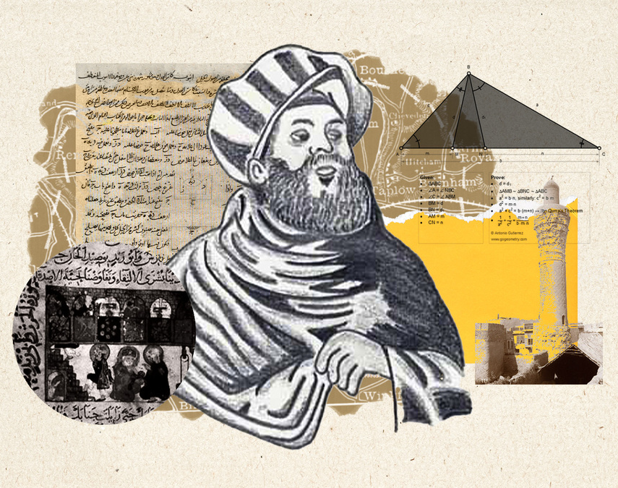
Thabit Ibn Qurra (Sabian) pt. 1
Thabit Ibn Qurra was a Sabian (Pagan) scholar from the city of Harran. Born in 836 and passed away in 901 AD, he was a great polymath and was trilingual in Arabic, Syriac, and Greek. In Bar Ebroyo’s entry on him, we are given a few of the books he wrote, and we are informed that he had written a book on the Ancient Syrian kings who are the Chaldeans. Indeed, we are told;
“A book on the Ancient Syrian kings, who are Chaldeans.”
Thabit Ibn Qurra, Gorgias Encyclopedic Dictionary of the Syriac Heritage
ثابت بن قرة
Notes:
Thabit Ibn Qurra, Gorgias Encyclopedic Dictionary of the Syriac Heritage
Al-Nadim, Firhist, 9.1
Bar Ebroyo on Identity: Remarks on his Historical Writing, Dorothea Weltecke, Pg. 311

Slide 151
Thabit Ibn Qurra (Sabian) pt. 2
“A book on the Ancient Syrian kings, who are Chaldeans.”
Thabit Ibn Qurra, Gorgias Encyclopedic Dictionary of the Syriac Heritage
Notes:
Thabit Ibn Qurra, Gorgias Encyclopedic Dictionary of the Syriac Heritage
Al-Nadim, Firhist, 9.1
Bar Ebroyo on Identity: Remarks on his Historical Writing, Dorothea Weltecke, Pg. 311

Slide 152
Thabit Ibn Qurra (Sabian) pt. 3
“For other examples of identification with the ancient peoples, we can quote… the book entitled History of the Ancient Syrian Kings who are the Chaldeans, written in Syriac in the 9th century by the Sabean Thabit b. Qurra, quoted by Bar Hebraeus in his Histories of the Times…” (Fathi, pg. 158)
This proves that other authors who were not Christian wrote down our history and heritage and furthermore shows that Thabit identified with the Suryaya (Syrian) community and saw Ancient Mesopotamians as part of his own heritage, demonstrating self-identification.
Notes:
Yūḥannā ibn al-Ġurayr, Passeur de la Tradition Syriaque et Arabe Chrétienne, Jean Fathi, Pg 158, Footnote 118 | Translated from French
The chronography of Gregory Abû'l Faraj, the son of Aaron, the Hebrew physician, commonly known as Bar Hebraeus, Pg. 153 - https://www.reddit.com/user/MLK-Ashuroyo/comments/19eeyxr/9th_century_pagan_assyrian_in_defence_of_paganism/

Slide 153
Thabit Ibn Qurra (Sabian) pt. 4
To add onto this point, within Harran, it is attested and mentioned that many of the ancient Assyro-Babylonian traditions carried on, including the persistence of ancient gods of the Assyrians. Particularly Sin, the ancient and heavily revered moon god of the Assyrians, was greatly worshiped within Harran among the pagan Sabians. This continues to prove that Thabit identified with the ancient Mesopotamian kingdoms and was a Sabian. Furthermore, Thabit defended his city’s Mesopotamian paganism, and he wrote this in Syriac.
"Whereas many submitted to the false doctrine under torture, our ancestors held out with the help of God and came through by a heroic effort; and this blessed city (Harran) has never been sullied by the false doctrine of Nazareth. Paganism (hanputa), which used to be the object of public celebration in this world, is our heritage, and we shall pass it on to our children. Lucky the man who endures hardship with a well-founded hope for the sake of paganism! Who was it that settled the inhabited world and propagated cities, if not the outstanding men and kings of paganism? Who applied engineering to the harbors and the rivers? Who revealed the arcane sciences? Who was vouchsafed the epiphany of that godhead who gives oracles and makes known future events, if not the most famous of the pagans? It is they who blazed all these trails. The dawn of medical science was their achievement: they showed both how souls can be saved and how bodies can be healed. They filled the world with upright conduct and with wisdom, which is the chief part of virtue. Without the gifts of paganism, the earth would have been empty and impoverished, enveloped in a great shroud of destitution."
The chronography of Gregory Abû'l Faraj, the son of Aaron, the Hebrew physician, commonly known as Bar Hebraeus, Pg. 153; See also MLK-Ashuroyo’s Post
Notes:
Yūḥannā ibn al-Ġurayr, Passeur de la Tradition Syriaque et Arabe Chrétienne, Jean Fathi, Pg 158, Footnote 118 | Translated from French
The chronography of Gregory Abû'l Faraj, the son of Aaron, the Hebrew physician, commonly known as Bar Hebraeus, Pg. 153 - https://www.reddit.com/user/MLK-Ashuroyo/comments/19eeyxr/9th_century_pagan_assyrian_in_defence_of_paganism/

Slide 154


Thabit Ibn Qurra (Sabian) pt. 5
"Whereas many submitted to the false doctrine under torture, our ancestors held out with the help of God and came through by a heroic effort; and this blessed city (Harran) has never been sullied by the false doctrine of Nazareth. Paganism (hanputa), which used to be the object of public celebration in this world, is our heritage, and we shall pass it on to our children. Lucky the man who endures hardship with a well-founded hope for the sake of paganism! Who was it that settled the inhabited world and propagated cities, if not the outstanding men and kings of paganism? Who applied engineering to the harbors and the rivers? Who revealed the arcane sciences? Who was vouchsafed the epiphany of that godhead who gives oracles and makes known future events, if not the most famous of the pagans? It is they who blazed all these trails. The dawn of medical science was their achievement: they showed both how souls can be saved and how bodies can be healed. They filled the world with upright conduct and with wisdom, which is the chief part of virtue. Without the gifts of paganism, the earth would have been empty and impoverished, enveloped in a great shroud of destitution."
The chronography of Gregory Abû'l Faraj, the son of Aaron, the Hebrew physician, commonly known as Bar Hebraeus, Pg. 153; See also MLK-Ashuroyo’s Post
MBLM 00011, fol. 77r and 77v
Notes:
Yūḥannā ibn al-Ġurayr, Passeur de la Tradition Syriaque et Arabe Chrétienne, Jean Fathi, Pg 158, Footnote 118 | Translated from French
The chronography of Gregory Abû'l Faraj, the son of Aaron, the Hebrew physician, commonly known as Bar Hebraeus, Pg. 153 - https://www.reddit.com/user/MLK-Ashuroyo/comments/19eeyxr/9th_century_pagan_assyrian_in_defence_of_paganism/

Slide 155
Thabit Ibn Qurra (Sabian) pt. 6
In Greek literature, the Assyrian and Babylonian kings were seen as some of the first originators of these acts Thabit mentioned. Therefore, paired with his city's worship of ancient Mesopotamian gods and his knowledge of who the ancient Syrians were, we can say he is likely referring to and praising the Assyrian and Babylonian kings.
On the creation of cities and sciences, see: MLK-Ashuroyo’s Post
While mentioning the traditions of the Sabians of Harran, to whom Thabit was one, Al-Nadim mentions;
“(On) Sunday, to the Sun, whose name is Aylīyūs (= Helios); (on) Monday, to the Moon, whose name is Sīn; (on) Tuesday, to Mars, whose name is Lārīs (= Ares); (on) Wednesday, to Mercury, whose name is Nābiq (= Nebo); (on) Thursday, to Jupiter, whose name is Bāl (= Bel); (on) Friday, to Venus, whose name is Balthā (= Bēltu); (on) Saturday, to Saturn, whose name is Qirqish (= Kronos).”
Al-Nadim, Firhist, 9.1
Notes:
Yūḥannā ibn al-Ġurayr, Passeur de la Tradition Syriaque et Arabe Chrétienne, Jean Fathi, Pg 158, Footnote 118 | Translated from French
The chronography of Gregory Abû'l Faraj, the son of Aaron, the Hebrew physician, commonly known as Bar Hebraeus, Pg. 153 - https://www.reddit.com/user/MLK-Ashuroyo/comments/19eeyxr/9th_century_pagan_assyrian_in_defence_of_paganism/

Slide 156

Thabit Ibn Qurra (Sabian) pt. 7
Some more on this Chaldean term: Within Bar Ebroyo’s works, Chaldean is a grouping term for Assyrians and Babylonians, but even Arameans. This is also attested in Michaels Chronicle, from whom Bar Ebroyo took much influence.
“Bar ʻEbroyo omits these difficulties by speaking about the “ancient Syrians (sūryōyē ʿatīqē )”, which is an open ethnic designation that includes ancient writers and speakers of Aramean from East and West. Assyria, Babylonia as well as the Aramean principalities of the West are thus included.”
Bar Ebroyo on Identity: Remarks on his Historical Writing, Dorothea Weltecke, Pg. 311 See also MLK-Ashuroyo’s Post
Notes:
Yūḥannā ibn al-Ġurayr, Passeur de la Tradition Syriaque et Arabe Chrétienne, Jean Fathi, Pg 158, Footnote 118 | Translated from French
The chronography of Gregory Abû'l Faraj, the son of Aaron, the Hebrew physician, commonly known as Bar Hebraeus, Pg. 153 - https://www.reddit.com/user/MLK-Ashuroyo/comments/19eeyxr/9th_century_pagan_assyrian_in_defence_of_paganism/

Slide 157

Ibn Wahshiyya (Pagan/Muslim) pt. 1
I believe it fair to include Ibn Wahshiyya within this list due to the fact he spoke Syriac and translated an ancient Syriac document, that he identified himself with the Nabat of Iraq (Aramaic Speakers), who were a part of our people. Please read The Last Pagans of Iraq for more information on these Nabateans or refer to the Wikipedia page. Nonetheless, Ibn Wahshiyya was a pagan or Muslim Nabatean scholar from the southern regions of Mesopotamia and he passed away in 930 AD. Within the Firhist of Ibn Al-Nadim, an entry on the Scholar is presented; and we are told that he is a descendant of Sennacherib.
“Kasdani” means he was one of the Nabateans who were the inhabitants of the first land. He was a descendant of Sinharib (Sennacherib)...”
The Fihrist of al-Nadim; a tenth-century survey of Muslim culture, Pg. 731-32
ابن وحشية
Notes:
The Fihrist of al-Nadim; a tenth-century survey of Muslim culture
"Ibn Waḥshiyya". In Fleet, Kate; Krämer, Gudrun; Matringe, Denis; Nawas, John; Rowson, Everett (eds.). Encyclopaedia of Islam,
Three. Link

Slide 158
Ibn Wahshiyya (Pagan/Muslim) pt. 2
Furthermore, in general, amongst the Nabat of south Iraq, the Assyrian king Sennacherib was venerated as an illustrious ancestor for them.
“He may himself have derived his origin from the Assyrian king Sennacherib whom the Anbat (Nabateans), considered their glorious ancestor, and, in any case, identified himself with the Anbat (Nabateans) who are usually despised in Arabic literature.”
"Ibn Waḥshiyya". In Fleet, Kate; Krämer, Gudrun; Matringe, Denis; Nawas, John; Rowson, Everett (eds.). Encyclopaedia of Islam, Three. Link, Pg. 7
Furthermore, as he was not a Christian, it is highly unlikely he would have derived any of this from the Bible. Either way, Sennacherib was a venerated ancestor among the Nabateans and was considered to be a part of our people and our Assyrian identity. It goes without saying this is not geographic only and proves that even our people who were pagans in the far south of Mesopotamia remembered bits of their past as well as identified as Assyrians (!)

Slide 159

Dionysius Bar Salibi (West Syriac Rite) pt. 1
Dionysius Bar Salibi was a prolific Syriac Orthodox metropolitan of Amid, which is today known as Diyarbekir. He wrote many works and treatises in Syriac, defending the Syriac Orthodox faith adamantly. In his spiritual commentary on the book of Isaiah, he presents an interesting passage regarding Isaiah 19:23.

Slide 160

Dionysius Bar Salibi (West Syriac Rite) pt. 2
“THERE WILL BE A WAY FROM EGYPT TO ASSYRIA i.e.this indeed is seen in that the Assyrians agreed with the Egyptians in the faith of the Messiah. And lo, these enter Egypt, and out of Egypt come envoys of peace who bring good tidings by synodical letter concerning unanimity in the faith. Until this day we agree with them and they with us.”
A Translation and Critical Discussion of the Commentary of Dionysius Bar Salibi on the Book of Isaiah, Robert Clement Weatherlake, Pg. 229 | See Also: MLK-Ashuroyo’s Post

Slide 161
Dionysius Bar Salibi (West Syriac Rite) pt. 3
Dionysius Bar Salibi’s spiritual commentaries relate to the faith of the Church and Christianity, while his literal commentary discusses the actual material itself. This passage is found in his spiritual commentary, indicating it relates to his Church. He firstly presents the idea that the ancient Assyrians and Egyptians were ‘united in the faith of the Messiah’, and continues to elaborate that the Assyrians enter Egypt and bring out synodical letters of unanimity in the Christian faith. He continues on and states ‘until this day we agree with them and they with us.’ Clearly, Dionysius is stating the monotheistic faith continued from ancient times of the Assyrians and Egyptians, and that even to this day, they agree with each other. The ‘we’ in his passage can be no other than the Syriac Orthodox, as the Copts and the Syriac Orthodox have been united in their faith until the present day.

Slide 162
Dionysius Bar Salibi (West Syriac Rite) pt. 4
Bar Salibi’s usage of “Assyrian” in this context is clearly ethnic, as he is mentioning the Old Testament people who were of Assyrian stock, but later also quotes a passage from the Bible which states that through Abraham the nations will be blessed, while in reference to Israel, Egypt and Assyria. As he says in his commentary on Isaiah 19:25;
“ISRAEL WILL BE THIRD i.e. though first in the city of the Law, he was third because many from Israel believed after the Egyptians and Assyrians believed. Then the prophet goes on as from God to bless the Egyptians and the Assyrians, and then Israel. At the same time he shows that when these things happen, that will be fulfilled which was spoken to Abraham, "And in thy seed the nations (ܥܡܡܐ) will be blessed."
A Translation and Critical Discussion of the Commentary of Dionysius Bar Salibi on the Book of Isaiah, Robert Clement Weatherlake, Pg. 230 | Brackets and Syriac are mine
This argument is also found among the Coptic clergy, who also hold to this belief.
“This is exactly what we believe, as a church, that this is a spiritual communion - spiritual unity [regarding the passage of Isaiah]... Is this prophecy fulfilled yet? Syrian; Assyrian [Orthodox Church of Antioch], are we united with them or not in faith? We are, we are, we are [...] so this prophecy is fulfilled.”
“Upper Room Bible Study - Isaiah 19” posted by St. Maurice and St. Verena Coptic Orthodox Church on YouTube; Timestamp from 28:27 to 33:11

Slide 163

Cause of All Causes (East/West Syriac rites) pt. 1
The Cause of all Causes is a text written by an anonymous bishop from Edessa in the 10th century, while some place it in the 12th century. Although originally written by a Western Syrian, it was most popular within the COE and was copied down in their tradition greatly. It is a book that deals with how human knowledge may attain 3 types of wisdom: natural, scriptural, and spiritual. Within this text, an excerpt can be found recognizing the Babylonians as the ancestors of the contemporary Aramaic-speaking people of the author's time.
"And the knowledge of the whole star system, discovered by the Babylonian Arameans, that is to say the Chaldeans, those who in the south-east regions are growling because of the sandy soil in all their places and the unknown paths and roads leading from place to place and from city to city."
Das Buch Von Der Erkenntniss Der Wahrheit, Pg. 259 (Translated from German)
Edessa, Urhay in Syriac (modern Şanlıurfa) at the beginning of the 20th Century.
Notes:
Das Buch Von Der Erkenntniss Der Wahrheit
https://www.reddit.com/user/MLK-Ashuroyo/comments/1hz09m2/ancient_assyrian_kings_in_syriac_literature/?utm_source=share&utm_medium=web3x&utm_name=web3xcss&utm_term=1&utm_content=share_button

Slide 164

Cause of All Causes (East/West Syriac rites) pt. 2
“And concerning the greatness of the living, rational, and spiritual soul, that is, the knowing mind within, and about its nature, excellence, feelings, senses, properties, and functions, and the rest of the knowledge and discourse about it, what words suffice to name them? As not even all the ancient wise men of the school of Nimrod could…”
The Cause of Causes (1oth-12th cent.)
Das Buch Von Der Erkenntniss Der Wahrheit, Pg. 32
Notes:
Das Buch Von Der Erkenntniss Der Wahrheit
https://www.reddit.com/user/MLK-Ashuroyo/comments/1hz09m2/ancient_assyrian_kings_in_syriac_literature/?utm_source=share&utm_medium=web3x&utm_name=web3xcss&utm_term=1&utm_content=share_button

Slide 165
Analysis related to Cause of All Causes
Again as explained within Theodore Bar Koni’s section: Aramean was a large linguistic term, and the author of this work was associating his ancestors with the Babylonians (who spoke Aramaic and were therefore “Arameans”). Nonetheless, he recognizes that his past extended into the Mesopotamian kingdoms.
Nimrod is also viewed positively as per usual in Syriac tradition, being associated with creating medicine within this text, also having his own School of Nimrod.
Das Buch Von Der Erkenntniss Der Wahrheit, Pg. 356 (Translated from German)
MLK-Ashuroyo’s Post
Babylonian never denied Assyrian heritage and they were interchangeable. This is evidenced by the usage of Nimrod in this text.
Notes:
Das Buch Von Der Erkenntniss Der Wahrheit

Slide 166
Mar Eliya Bar Shinaya (East Syriac rite) pt. 1
Mar Eliya was born in 975 and passed away in 1046 AD. He became metropolitan of Nisibis in 1008 AD and studied in a monastery near Mosul. Although most of his works are written in Arabic, he does write a Syriac chronograph on which he deals with many topics and he is considered one of the most prolific writers of this period. Within this work of his, the reader is told that the Chaldeans are Suryaye (Syrians);
“Chaldeans, that is to say Syrians...”
Opus Chronologicum by Elias, Pg. 6 Or French Translation; La Chronographie d'Elie Bar Shinaya, Pg. 144
This is a clear self-identification by Mar Eliya, drawing back on the Ancient Assyro-Babylonian heritage and identifying them with his people, the Suryaye.
Notes:
Opus Chronologicum by Elias Or French Translation; La Chronographie d'Elie Bar Shinaya
Chronology - Britannica, Babylonian, Assyrian, Dating

Slide 167

Mar Eliya Bar Shinaya (East Syriac rite) pt. 2
But what does he mean by the usage of Chaldean mean here? Is he saying we are the people from Bit Dakuri and the tribes of the south? No, as we saw from Mar Isho’dad’s usage; this is another term for the Assyro-Babylonians. This is attested within his Babylonian Kings List which I must add, is completely copied from Ptolemy’s Canon of Kings.
La Chronographie d'Elie Bar Shinaya, Pg. 30-31

Slide 168
Mar Eliya Bar Shinaya (East Syriac rite) pt. 3
Ptolemy’s list includes many Assyrian kings, like Esharhaddon and others. The starting king, Nabunasir, is said to be an Assyrian king by Mar Severius of Nisibis. Nonetheless within the Syriac tradition as seen from Mar Severius, there is no distinguishing between the Assyrian and Babylonian kings, yet there is a distinction between the Medes and Persians. This is attested in Eliya’s list, as he mentions Cyrus is a Persian and Darius is a Mede but makes no separation between the Assyrians and Babylonians like Mar Severius of Nisibis. It is clear with this, that “Chaldean” as discussed before was a grouping term for the Assyro-Babylonians, and Mar Eliya certainly did not consider Assyrians not part of his heritage as he includes Assyrian kings within his list, for they too, were kings of Babylon and a part of his history. To alleviate the troubles placed on the reader by reading French; A list of Ptolemy’s Canon can be found here color-coded on which kings are under Assyria and which are under Babylon.
Therefore, it has been vividly shown that Mar Eliya claims both the Assyrian and Babylonian kings within his list, and in fact; perhaps there were more Assyrian kings of Babylon than actual Babylonians! This is shown under Severius of Nisibis, who predated Mar Eliya and started with the first King of Babylon Nabunasir, whom he calls an Assyrian king and also by Mor Michael calling the king Baladan an Assyrian, reigning over the Assyrians. It is then fair to assume that the kings of Babylon who were under Assyria were considered Assyrians in the Syriac tradition, and in fact, many kings present on this list were pure Assyrian kings or the sons of Assyrian kings.
See Also MLK-Ashuroyo’s Post On Chaldean Usage
Notes:
Das Buch Von Der Erkenntniss Der Wahrheit
Ptolemy’s Canon - https://www.livius.org/articles/concept/ptolemys-canon/

Slide 169
Mar Eliya Bar Shinaya (East Syriac rite) pt. 4
“Moreover, some of the Assyrian kings in the annals were also kings of Babylonia and as such were included in Ptolemy’s Canon.”
Britannica Article, “Babylonian, Assyrian, Dating - Chronology”
Furthermore, Eliya of Nisibis or the scribe who later copied his dictionary likewise with Bar Bahlul both consider the city of Babylon to be a part of Assyria or called Assyria (Athor) within their dictionaries. Interestingly, Edessa is also included. Babylon is the east Syriac tradition, and is always seen as part of Assyria or interchangeable with it. It is highly doubtful that Eliya would have not considered the Assyrians his ancestors.
“Assyria: The city of Mosul and the country of Edessa; The city of Babylon [...]”
Khader Bar Maqdisha 18th century, BNF SYR 256 f.62r | From the Gallica website | Translated from Arabic
“And if Abdisho ‘confuses’ Babylon and Assyria, it is because he didn’t distinguish between the two, as the term Assyria sometimes included all of Mesopotamia. A native of Awana, in the diocese of Tirhan, Hassan Bar Bahloul (who lived in the middle of the 10th century) illustrates this very well in his Syriac-Syriac Encyclopedic Lexicon when he defines the term Atour (Assyria), which for him is equivalent to Babylon.”
Ninway Magazine, Septembre 2017, Dr. Joseph Yacoub, Pg. 32 | Translated from French
Notes:
https://www.reddit.com/user/MLK-Ashuroyo/comments/1ad4wbs/who_were_the_ancient_suryoye_sury%C4%81ye_kings_aka/
https://www.reddit.com/user/MLK-Ashuroyo/comments/17t2wyk/eliya_of_nisibis_and_assyrians_new_year/

Slide 170
Mar Eliya Bar Shinaya (East Syriac rite) pt. 5
Actually, Eliya of Nisibis (or the scribe who copied the text) wrote a definition of Atoraya also. He includes the inhabitants of Edessa as Atoraye, alongside of course Mosul! Geography is quite important. Eliya, or the scribe, wants to show that Mesopotamia is Ator, and from Edessa up to Mosul, the Syriac Christian’s are the Atoraye. This attests to the fact, at the very least, that they considered Assyria their homeland and origin. (See Frye’s quote in Bar Ebroyo and Harrak’s quotes in Michael.)
“Assyrian: Mosulite Athurian, Ruhawi (Edessan)...”
Khader Bar Maqdisha 18th century, BNF SYR 256 f.62r | From the Gallica website. | The author wrote above about the region of
Edessa being included within his understanding of Ator (Assyria), and used the Arabic name Ruha الرھا, whereas for Edessan he wrote رھاوی (Ruhawi), or an inhabitant of Edessa. Under his Urhay section, he once again turns Urhay into Al-Ruha and Urhaya into Ruhawi, in the exact same spelling.
I will also point out that Mar Eliya’s entire goal of this chapter is to show how nations such as the Persians, Greeks and Syrians measured their time. He states that we Suryaye used to employ the Lunar calendar, and celebrate the Spring Equinox (Akitu). Clearly, both Assyria and Babylon conducted these activities and used these calendars, adding onto the points above. Evidently, he was tying himself back to the Assyrian and Babylonian empires, and connecting us Suryaye with their traditions.
MLK Ashuroyo’s Post
Notes:
https://www.reddit.com/user/MLK-Ashuroyo/comments/1ad4wbs/who_were_the_ancient_suryoye_sury%C4%81ye_kings_aka/
https://www.reddit.com/user/MLK-Ashuroyo/comments/17t2wyk/eliya_of_nisibis_and_assyrians_new_year/

Slide 171

Mar Eliya Bar Shinaya (East Syriac rite) pt. 6
I will also point out that Mar Eliya’s entire goal of this chapter is to show how nations such as the Persians, Greeks and Syrians measured their time. He states that we Suryaye used to employ the Lunar calendar, and celebrate the Spring Equinox (Akitu). Clearly, both Assyria and Babylon conducted these activities and used these calendars, adding onto the points above. Evidently, he was tying himself back to the Assyrian and Babylonian empires, and connecting us Suryaye with their traditions.
MLK Ashuroyo’s Post
Opus Chronologicum by Elias, Bishop of Nisibis
Notes:
https://www.reddit.com/user/MLK-Ashuroyo/comments/1ad4wbs/who_were_the_ancient_suryoye_sury%C4%81ye_kings_aka/
https://www.reddit.com/user/MLK-Ashuroyo/comments/17t2wyk/eliya_of_nisibis_and_assyrians_new_year/

Slide 172
Mar Eliya Bar Shinaya (East Syriac rite) pt. 7
Finally, Eliya in his Arabic work also writes about the primacy of the seat of the COE, making a similar argument to Mar Timothy. He claims the Apostles were through Abraham who was from Babylonia in Kutha, and that the Magi who are generally considered Assyrians were also from the East. Through these claims, Eliya placed importance on the spiritual and historical identity of the East Syriacs, basically claiming these figures as being from our people, similar to Timothy. Although he does not make the link to Nimrod that Timothy does, Eliya would have certainly been aware of it, and would have recognised him as one of the kings of the East like Timothy.
“One final element of the East Syriac identity our author delineates, and that I would like to highlight here, is the significance of the “East” as opposed to the “West,” which represents the land of the Byzantines. According to Elias, the East holds special importance as it is associated with the location of paradise and because it is the homeland of the Fathers and Prophets, like Adam, Noah, and Abraham. God honoured the Easterners when He directed prostration towards the East rather than the West. Additionally, the sun, which symbolizes the life of the world, and all other lights rise from the East, indicating how God preferred the East. Therefore, we find our author asserting that the Angel appeared to the Virgin from the East, the Apostles of the Lord, who hailed from the tribe of Abraham, were all from the East, and the Magi who brought gifts to the Lord came from the East. Moreover, the East, being the place where paradise is located, is believed to be also the dwelling place of Enoch and Elijah, who did not experience death, as well as the souls of Peter, Paul, and all the Prophets, Apostles, and righteous persons. It is certain that this emphasis on the importance of the East serves to strengthen the East Syriac identity and underscores its unique spiritual and even historical significance.”
Elias of Nisibis and his Book of Demonstration: An East Syriac Identity in Arabic Language, Bishara Ebeid | For the original work, see German translation: Des Metropolitan Elias von Nisibis Buch vom Beweis der Wahrheit des Glaubens, Pg. 112-114
Notes:
https://www.reddit.com/user/MLK-Ashuroyo/comments/1ad4wbs/who_were_the_ancient_suryoye_sury%C4%81ye_kings_aka/
https://www.reddit.com/user/MLK-Ashuroyo/comments/17t2wyk/eliya_of_nisibis_and_assyrians_new_year/

Slide 173
Mar Eliya Bar Shinaya (East Syriac rite) pt. 8
Thus it is clear, Eliya acknowledged the Assyrian heritage through Babylonia, considering Assyrian kings a part of Babylon, and the city of Babylon itself being part of Assyria or called Assyria. Eliya would have never denied the Assyro-Babylonian past, which the Suryaye descend from, and claimed various figures who are held to be Assyrians like the Magi from the East in order to provide East Syriacs with a historical significance, closely following Timothy’s arguments and reasoning (see his section).
Notes:
https://www.reddit.com/user/MLK-Ashuroyo/comments/1ad4wbs/who_were_the_ancient_suryoye_sury%C4%81ye_kings_aka/
https://www.reddit.com/user/MLK-Ashuroyo/comments/17t2wyk/eliya_of_nisibis_and_assyrians_new_year/

Slide 174
Giwargis Bar Tobi pt. 1
Giwargis Bar Tobi was a bishop of the Church of the East in the 10th century AD. He is responsible for writing an extensive and large commentary on the liturgy of the COE, where he undertakes the process of answering questions regarding the rites. This book is split into seven sections, and perhaps also this book was written by another Pseudo-Gewargis of Arbel, but nonetheless, we can find a verse in this work where he claims Nissan to be when the world was created.
“Why did Eusebius set the New Year in Teshrin Qadmoyo (October) and not on Nisan (April), on the day the world was created?...”
Christianising Assyria (I), Ramsin Edward, Pg. 285 | See Also; Firas Jatou’s Manuscript
“Memories of Nīsān, on the other hand, do appear in an East Syriac text ascribed to Gīwārgīs bar Ṭobi of Arbelā (c. 987)... Of course, we know from the surviving evidence such as incantation bowls that laypeople or villagers continued to observe certain traditional practices in secret while outwardly professing Christianity. This, of course, was quite common and demonstrates the wide range of efforts that were made within the domestic world to engage their newly founded faith alongside older traditions. One may thus argue that the acknowledgment of the month of Nīsān as the beginning of the year may not have been obliterated but observed through new gestures or modes of cultural expression.”
Christianising Assyria (I), Ramsin Edward, Pg. 285
Notes:
Christianising Assyria (I), Ramsin Edward, Pg. 285 | See Also; Firas Jatou’s Manuscript

Slide 175

Giwargis Bar Tobi pt. 2
“Why did Eusebius set the New Year in Teshrin Qadmoyo (October) and not on Nisan (April), on the day the world was created?...”
Christianising Assyria (I), Ramsin Edward, Pg. 285 | See Also; Firas Jatou’s Manuscript
Corpus scriptorum Christianorum orientalium. Scriptores Syri
Notes:
Christianising Assyria (I), Ramsin Edward, Pg. 285 | See Also; Firas Jatou’s Manuscript

Slide 176
Giwargis Bar Tobi pt. 3
“It is plausible that Syriac Christian conceptions of Nīsān — as the beginning of the year — may have developed due to the intersections between non-Christians and Christians or converts from the old faith to Christianity during the first half of the first millennium CE. In fact, Late Antique Syriac writers, as we have already seen, were aware of pre-Christian religious holidays such as the New Year festival being openly observed in Upper Mesopotamia. One may argue that the sacredness of Nīsān may have been maintained by those indigenous Assyrian converts to Christianity from the old faith. The lingering influence of such traditions may have entered Syriac Christianity directly from the old faith as they were within the historical period of transmission.”
Christianising Assyria (I), Ramsin Edward, Footnote 26
“Ephrem's reference to 'victorious Nisan' probably reflects a Christian reflex to the same issue, harking back to the ancient Mesopotamian calendar with a spring new year - all the more intriguing in that for Syriac writers an autumnal new year was the ecclesiastical and civil norm from the time of the earliest writers onwards. In our present poem even though victory is not specifically allotted to Nisan, the fact that Nisan is the first month to appear before the presiding Year is certainly significant. Reminiscences of the old Mesopotamian new year in Nisan can in fact be found in a number of places in Syriac literature...”
From Ephrem to Romanos, Sebastian Brock, VIII | Pg. 186
Notes:
Christianising Assyria (I), Ramsin Edward, Footnote 26
From Ephrem to Romanos, Sebastian Brock, VIII | Pg. 186

Slide 177
Analysis related to Giwargis Bar Tobi
It is evident from what has been quoted that the month of Nissan continued to be remembered in a positive light throughout Syriac literature, most likely also being a tradition that was carried once the Assyrians converted to Christianity. Giwargis Bar Tobi’s and other Syriac writer’s remembrance of Nissan as the first month in the world and year highlights that the Mesopotamian calendar did not go out of use, and that our ancestors were aware of the ancient beginning of the year (see Eliya’s section) and chose to continue this tradition. Although these Assyrians became Christians, Nissan was still close and dear to their hearts and shows the continuity of the Assyrian heritage and proves they consciously remember their past, identifying with it.
Notes:
Das Buch Von Der Erkenntniss Der Wahrheit
Ptolemy’s Canon - https://www.livius.org/articles/concept/ptolemys-canon/

Slide 178

Digitized Christian Palestinian Aramaic Text pt. 1
This is a recently digitized manuscript dated to the 10th or 11th century AD. It is written in Western Aramaic, which was used in the Levant by the Melkite Christian communities in Palestine and Transjordan. We read two interesting lines in this text. Asuraya and Suraya are used interchangeably within Micah 5:5 and Isaiah 10:24 respectively.
In Micah 5:5 it reads: “And he will be our peace when the Āsūrāyā (Assyrians) invade our land and march through our fortresses.”
“What Does This Newly Digitised Manuscript Reveal About the Assyrian Identity?”, Ramsin Edward, ACYSA
And in Isaiah 10:24 it reads: “O My people, who dwell in Zion, do not be afraid of the Sūrāyā (Assyrians).”
“What Does This Newly Digitised Manuscript Reveal About the Assyrian Identity?”, Ramsin Edward, ACYSA
Notes:
https://www.acsya.org/post/23012022

Slide 179

Digitized Christian Palestinian Aramaic Text pt. 2
It is clear here that Assyrians and Syrians are used interchangeably indeed, and it is striking that Suraya is equated to Asuraya without the Alap. This somewhat confirms the theories of Mar Toma Audo, in which he proposed that Suraya comes from Asuraya. Nonetheless, within these passages, we are shown the interchangeability of these 2 terms in the Syriac Christian tradition.
“And it appears as though the word ‘Suraya’ is a shortening of Assyrian (Atoraya), as in the ‘Alap’ at the beginning is vanished”
-Mar Toma Audo, Qaryaneh Goobyeh. Pg. 171
Notes:
https://www.acsya.org/post/23012022
Gorgias Encyclopedic Dictionary of the Syriac Heritage, “Amid”

Slide 180
On Christian Palestinian Aramaic as a whole
What is Christian Palestinian Aramaic (CPA)?
CPA was a native western Aramaic dialect using a modified version of the Upper Mesopotamian Estrangelo Syriac script in Palestine and Transjordan. It was only used by Melkites.
These Melkites (writing in Syriac), in their translations of the Bible they not only used Asuraya and Suraya as Synonyms, but also Suray and Suryaye too where Assyria would usually be mentioned in these verses. These are significant as they come from native sources, and show that in Melkite tradition and among the more general Syriac tradition, these terms were interchangeable. This provides us with clues on the synonymity of these terms.
Notes:
Christian Palestinian Aramaic, Morgenstren

Slide 181
On Christian Palestinian Aramaic as a whole
These Melkites (writing in Syriac), in their translations of the Bible they not only used Asuraya and Suraya as Synonyms, but also Suray and Suryaye too where Assyria would usually be mentioned in these verses. These are significant as they come from native sources, and show that in Melkite tradition and among the more general Syriac tradition, these terms were interchangeable. This provides us with clues on the synonymity of these terms.
“In a bid to ascertain whether the two variant forms were a result of a mere scribal error led the author of this article to a comparative assessment of CPA palimpsest fragments in the Taylor-Schechter Collection at the University of Cambridge. These fragments, tentatively dated between the fifth– or eighth–century, contain passages derived from the Book of Isaiah.
According to the fragments, additional variant forms were identified for the biblical Assyrians— Sūrāy and Sūryāyē —both of which without the initial ʾālap̄h or –a. Remarkably, these references may further our understanding on the symbiotic relationship between these nomenclatures.”
“What Does This Newly Digitised Manuscript Reveal About the Assyrian Identity?”, Ramsin Edward, ACYSA
Notes:
Christian Palestinian Aramaic, Morgenstren

Slide 182
On Christian Palestinian Aramaic as a whole
Melkites were not only part of the Syriac tradition and heirs to a Syriac heritage, but there were many Melkites in Mesopotamia even until the 19th century. To add onto this, some Assyrians were Melkites.
“The Melkite community, which had been Syriac-speaking in pre-Islamic times, dwindled after the Arab conquest, but was reinforced by migrants from Aleppo in the 17th century.”
Gorgias Encyclopedic Dictionary of the Syriac Heritage, “Amid”
Furthermore; Scribes of CPA were also educated in Classical Syriac and the Melkite Church generally was also influenced by the Syriac Church. They knew what they were translating these terms into, and continued on nonetheless, equating Assyrian and Syrian.
Palestinian Syriac, a name which reflects the contemporary Palestinian usage of the term ‘Syriac’ as a name for Aramaic, for example in the writings of the Church Fathers and in rabbinic literature. It also emphasizes the early influence of the Syrian church on the Melkite community. In the early period, this expresses itself most apparently in the adoption of a script based upon the Northern Mesopotamian Estrangelo.
Christian Palestinian Aramaic, Morgenstern, Pg. 629
“On the linguistic level, the texts of the latter period are characterized by the loss of many of the distinctive dialect features found in the earlier texts, as well as a marked increase in the number of copying errors. Many of these changes stem from the copyists familiarity with Classical Syriac...”
Christian Palestinian Aramaic, Morgenstern, Pg. 631
Notes:
Christian Palestinian Aramaic, Morgenstern

Slide 183
What is Christian Palestinian Aramaic and who are the Melkites?
Christian Palestinian Aramaic (CPA) was a native western Aramaic dialect using a modified version of the Upper Mesopotamian Estrangelo Syriac script in Palestine and Transjordan. It was only used by Melkites.
These Melkites (writing in Syriac), in their translations of the Bible they not only used Asuraya and Suraya as Synonyms, but also Suray and Suryaye too where Assyria would usually be mentioned in these verses. These are significant as they come from native sources, and show that in Melkite tradition and among the more general Syriac tradition, these terms were interchangeable. This provides us with clues on the synonymity of these terms. Melkites were not only part of the Syriac tradition and heirs to a Syriac heritage, but there were many Melkites in Mesopotamia even until the 19th century. To add onto this, some Assyrians were Melkites.
Furthermore; Scribes of CPA were also educated in Classical Syriac and the Melkite Church generally was also influenced by the Syriac Church. They knew what they were translating these terms into, and continued on nonetheless, equating Assyrian and Syrian. Therefore, we can conclude that Melkites in their Aramaic-Syriac translations of the Bible equated Assyrians with Syrians. This is significant as these copyists were well informed in Classical Syriac, and shows that in the general Aramaic/Syriac tradition these terms were interchangeable, presenting that Assyrians were considered Suraya or Suryaye (Syrians). The usage of Suryaye is especially significant here, using the same term the Assyrians in Mesopotamia called themselves. This also ties back with the Classical Syriac knowledge. Nonetheless, if these Melkites didn’t consider the “Suryaye” of their time as Assyrians, then they wouldn’t have written it down as such!

Slide 184
Analysis related to the Digitalized Christian Palestinian Aramaic Text
Therefore, we can conclude that Melkites in their Aramaic-Syriac translations of the Bible equated Assyrians with Syrians. This is significant as these copyists were well informed in Classical Syriac, and shows that in the general Aramaic/Syriac tradition these terms were interchangeable, presenting that Assyrians were considered Suraya or Suryaye (Syrians). The usage of Suryaye is especially significant here, using the same term the Assyrians in Mesopotamia called themselves. This also ties back with the Classical Syriac knowledge. Nonetheless, if these Melkites didn’t consider the “Suryaye” of their time as Assyrians, then they wouldn’t have written it down as such!
As Prof. Simo Parpola comments:
“The interchange of Asūrāyē and Surāyē in an Aramaic Bible translation was of course to be expected on the basis of what we already knew, but to find it in a 10th to 11th-century manuscript is a powerful additional confirmation of the continuity of Assyrian identity through the millennia.”
Simo Parpola, ACSYA

Slide 185

Mor Michael the Great (West Syriac) pt. 1
Mor Michael was a Historian and Patriarch of the Syriac Orthodox Church. He was born in 1126 and passed away in 1199. Among being one of the greatest patriarchs of the SOC in terms of theological and ecclesiastical organization matters, he also wrote many books and collected much knowledge. His Syriac Chronicle is the largest medieval document in the world. Nonetheless, given its huge size and the effort that must have been undertaken to copy it, the chronicle must have been very popular, hence he is dubbed the ‘The Great’. This is especially among Western Syrians, but probably also among some Eastern Syrians, and it was known among Armenians too. Within this Chronicle, he goes to extensive lengths to detail everything that has occurred since creation to his time. Michael collected all these sources and compiled them into one book, creating his historiography with everything he learned from them. Within a chapter of Michael's chronicle, he dedicates this piece to the ancient kings of the Suryoye, whom he identifies as Assyrians, Arameans, and Babylonians.
Notes:
Gorgias Encyclopedic Dictionary of the Syriac Heritage, Dorothea Weltecke
Syriac and Syrians in the Later Roman Empire, Nathanael Andrade

Slide 186
Mor Michael the Great (West Syriac) pt. 2
“The second appendix is a treatise on the historical identity of the Syrians, who are connected to the Ancient Oriental Empires, the Assyrians, the Babylonians, and the Arameans. When the chronicle was translated into Armenian, in two different translations, in 1246 and 1247, it was transformed according to Armenian interests.”
Gorgias Encyclopedic Dictionary of the Syriac Heritage, Dorothea Weltecke, Michael I Rabo
Within this excerpt from his book which will be shown; we are told key info about the Suryaye. As mentioned before, Michael in this chapter quotes both Dionysius of Tel Mahre and Jacob of Edessa. Michael informs the reader that those Suryaye living East of the Euphrates have had many kings, and that indeed to our people belonged the Assyrian and Babylonian kings among others. We are told:
“It is evident from this context, that Syria is situated to the west of the Euphrates, and that all of those who spoke our Aramaean language were called Syrians* because they are a part of the total. The rest dwelt east of the Euphrates, that is, from the Euphrates to Persia. In this region arose several kings. In Athor arose Bel, Ninnus, and others who succeeded them. In Babylon was Nebuchadnezzar who spoke Aramaic (Syriac) with the magicians whom he summoned to interpret his dream. In Edessa arose kings from the Abgar clan, and from the Arabs the kings from the clan of Sanatrouq. We say this to make clear that the people who lived west of the Euphrates are, in truth, Syrians, and that Orhoi (Edessa) is the origin of this language (Syriac). Therefore, there is no validity to the claim that no kings were set up from these people. It is manifest that the Chaldean and Assyrian kings were from these people who were called Syrians. They total one hundred ninety-four kings, ten of whom were before the Flood, seventy-six after the Flood and forty after the Medes. Forty-five kings were set up in Nineveh and twenty-three kings of the dynasty of Sennacherib and Nebuchadnezzar after the Persians. We have gathered these names from as many books as much as possible.”
The Late 12th Century from Michael Rabo’s Chronicle, Matti Moosa, Pg. 739
Note: Next to the Asterisk, Matti Moosa translates this word into Arameans again. This is false. The word used there is Syrian, Suryaye. Therefore I have replaced it with Syrians. See; MLK Ashuroyo’s Post and Manuscript
Notes:
The Late 12th Century from Michael Rabo’s Chronicle, Matti Moosa, Pg. 739
https://www.reddit.com/user/MLK-Ashuroyo/comments/1d1t7mr/mor_michael_rabo_12th_century_the_assyrians_kings/?rdt=58027
Chabot, Chronique, ed. Vol. 4, p. 17, trans. Vol. 1, p. 32.

Slide 187

Mor Michael the Great (West Syriac) pt. 3
“It is evident from this context, that Syria is situated to the west of the Euphrates, and that all of those who spoke our Aramaean language were called Syrians* because they are a part of the total. The rest dwelt east of the Euphrates, that is, from the Euphrates to Persia. In this region arose several kings. In Athor arose Bel, Ninnus, and others who succeeded them. In Babylon was Nebuchadnezzar who spoke Aramaic (Syriac) with the magicians whom he summoned to interpret his dream. In Edessa arose kings from the Abgar clan, and from the Arabs the kings from the clan of Sanatrouq. We say this to make clear that the people who lived west of the Euphrates are, in truth, Syrians, and that Orhoi (Edessa) is the origin of this language (Syriac). Therefore, there is no validity to the claim that no kings were set up from these people. It is manifest that the Chaldean and Assyrian kings were from these people who were called Syrians. They total one hundred ninety-four kings, ten of whom were before the Flood, seventy-six after the Flood and forty after the Medes. Forty-five kings were set up in Nineveh and twenty-three kings of the dynasty of Sennacherib and Nebuchadnezzar after the Persians. We have gathered these names from as many books as much as possible.”
The Late 12th Century from Michael Rabo’s Chronicle, Matti Moosa, Pg. 739
Note: Next to the Asterisk, Matti Moosa translates this word into Arameans again. This is false. The word used there is Syrian, Suryaye. Therefore I have replaced it with Syrians. See; MLK Ashuroyo’s Post and Manuscript
SOAA 00250 S f.379v
Notes:
The Late 12th Century from Michael Rabo’s Chronicle, Matti Moosa, Pg. 739
https://www.reddit.com/user/MLK-Ashuroyo/comments/1d1t7mr/mor_michael_rabo_12th_century_the_assyrians_kings/?rdt=58027
Chabot, Chronique, ed. Vol. 4, p. 17, trans. Vol. 1, p. 32.

Slide 188
Mor Michael the Great (West Syriac) pt. 4
“His main sources were Josephus, Eusebius, Jacob of Edessa, and Dionysius of Tel-Maḥre (ninth century). In keeping with Greek antecedents, Michael acknowledged that the term Syrian could describe people east of the Euphrates who spoke the language of the Aramaeans and were putatively descended from Assyrians and Babylonians (‘Chaldaeans’), who had spoken their language too. But despite the prominence of Edessa, he also maintained that ‘Syrian’ referred most specifically to Aramaic-speakers (‘Aramaeans’) west of the Euphrates who traced descent from Aram.”
Syriac and Syrians in the Later Roman Empire, Andrade, Pg. 167
“Michael the Great, the 12th century patriarch of the Syrian Orthodox/Jacobites, acknowledges that both Arameans and Assyrians were known as Suryoye but distinguishes between the two by writing those who lived “in the east of Euphrates, going to Persia, had many kings from Assyria and Babylon and Urhay.”
Ethno-cultural and Religious Identity of Syrian Orthodox, Donabed and Mako, Pg. 90
“As one can observe, Syriac Christians from Assyria and northern Mesopotamia — both Eastern and Western — conceived themselves not as the offspring of conquered peoples, but those of great victors and empire builders. This connection with the Assyrians may also be inferred from the Chronography of Mār Mīkhāʾēl Rabbā (“the Great,” c. 1126–1199), Patriarch of the Syriac Orthodox Church. According to this twelfth-century chronicler, ancient Assyrian and Babylonian kings — Sennacherib included — were acknowledged as the ancestors of his Syriac Christian contemporaries.”
Christianising Assyria (II), Ramsin Edward, Pg. 229
Notes:
Language, Literacy and Historical Apologetics: Hippolytus of Rome's lists of literate peoples in the Syriac tradition, Andy Hilkens
The Formation of a Communal Identity among West Syrian Christians: Results and Conclusions of the Leiden Project

Slide 189
Mor Michael the Great (West Syriac) pt. 5
“According to Michael the Syrian, patriarch of the Syriac Orthodox Church from 1166 to 1199, in his Chronicles, the longest and richest work in the Syriac language, the peoples called Syrians who inhabited Mesopotamia were in reality Assyrians.”
Il monastero di Gabriel Mor nella regione di Tur Abdin come caso simbolo di intolleranza religiosa in Turchia, Vittorio Cattelan, Pg. 26 (Footnote 108) | Translated from Italian
“By the end of the twelfth century, reflection had progressed. Michael the Syrian elaborated his monumental Chronicle with full knowledge of the facts. Rarely does a historian express the objectives of his work with such frankness and clarity. They are found in the finale of the 2nd appendix entitled "Remembrance of the empires that were formed in Antiquity by our race of Arameans...." And to specify that if he established chronologies and calculations, "with as much care as possible through the testimony of writing," it is because he wanted to show that his people descend from the ancient Mesopotamian sovereigns preceding the Persian kingdom and to explain why their names have disappeared from his history.”
La couronne de Nemrod in Early Christian Voices (2003), Alain Desrumeaux, Pg. 194 | Michael’s appendix is quite interesting. It seems that Aramean in this sense is being used as a broad term not in reference only to the biblical Arameans, as he claims ‘our race’ is ‘the sons of Aram’ which he clarified beforehand in his Chronicle was the Assyrians and not simply the Arameans only, following Jacob of Edessa. The Peshitta too, uses Aramean as a synonym for Assyrian; there appeared to be an existing awareness of their interchangeability. Michael argued precisely for the interchangeability of these three terms, Syrian, Aramean, and Assyrian, also recognising that his people were descended from Assyria and Babylon even if they were “Arameans” which is the occurrence here. Thus, no “Aramization” is occurring in Michael’s heading. Even if ‘bnay Aram’ (sons of Aram) or Aramaye (Arameans) is used, it was still inseparable from the Assyrian heritage of the Suryaye. See Jacob of Edessa’s section and Jack Tannous’s quote below for clarification on Aramean and Assyrian. | Passage translated from French
Notes:
Syriac and Syrians in the Later Roman Empire, Andrade, Pg. 167
Christianising Assyria (II), Ramsin Edward, Pg. 229
Il monastero di Gabriel Mor nella regione di Tur Abdin come caso simbolo di intolleranza religiosa in Turchia, Vittorio Cattelan, Pg. 26 (Footnote 108) | Translated from Italian

Slide 190
Mor Michael the Great (West Syriac) pt. 6
“It is undoubtedly to the scholar Jacob of Edessa (d. 708), transmitted to the Syrian — Orthodox historian and patriarch Dionysius of Tellmahre (d. 945), himself taken up by another Syrian Orthodox patriarch and historian, Michael the Syrian (d. 1199), that we owe the Syriac version of the history of the ancient kingdoms, centered on the idea that there were powerful "Syrian" kingdoms east and west of the Euphrates. The authorities of the Syriac Orthodox Church wanted to show that they had sovereigns of their own even though in Late Antiquity and the Middle Ages they no longer had their own kings to represent them. This passage is written against the (Byzantine) Greeks and has an apologetic dimension aimed at defending the Syriacs by showing the importance of the kingdoms that emerged from them.. he rereads world history through this prism and situates Alexander between the kingdoms he calls "Syrian" of the Chaldeans and Assyrians ("Syrian" because they all used Aramaic, like the Suryoye, Syrian or Syriac), which existed until Cyrus the Great conquered them... This reading of history, which aims to show "that empires arose from our people more powerful than all the empires of their time," places Alexander as the restorer of a "Syrian" power since he put an end to the kingdom of the Persians which had triumphed over the "Syrian" Mesopotamian empires...”
Alexander le Grande en Syriaque, Muriel Debié, Pg. 309-310
Notes:
Syriac and Syrians in the Later Roman Empire, Andrade, Pg. 167
Christianising Assyria (II), Ramsin Edward, Pg. 229
Il monastero di Gabriel Mor nella regione di Tur Abdin come caso simbolo di intolleranza religiosa in Turchia, Vittorio Cattelan, Pg. 26 (Footnote 108) | Translated from Italian

Slide 191
Mor Michael the Great (West Syriac) pt. 7
“An example of this is Michael the Syrian, Patriarch of the Syriac Orthodox Church from 1166 to 1199 and an outstanding intellectual. In his chronicle, he comments on Greek insults, according to which his people had never produced a kingdom or significant rulers. He then emphasized that Syria actually meant the area west of the Euphrates, and that Edessa was the center of the Syriac language. He then moved on to the area east of the Euphrates, where there were many kings. The Assyrian and Chaldean kings, Michael added, were called Syrians and belonged to his people. At this point, he emphasized that the "Syrian people" also included those who lived further east and had produced many kings. These and other passages in the Chronicle, in which Michael the Syrian speaks of "the Assyrians, that is, the Syrians," are usually quoted by modern-day Assyrians. In the dispute known as the "War of Quotations," the opposing side quotes statements by Michael in which he speaks of "the Arameans, that is, the Syrians." Thus, the same patriarch sometimes claims that the Syrians (Suryoye) are Assyrians and at other times that they are Arameans. How is this to be understood? As already explained, Assyrian identity was never based on biological descent. In the Assyrian Empire, peoples of different ethnic backgrounds were Assyrianized by submitting to Assyrian kings, worshipping Assyrian deities, and adopting Assyrian traditions. One of the peoples affected by this were the Aramaeans. Their contribution to the Assyrian tradition was more important than that of any other people, as their language, Aramaic, quickly rose to become the primary language of the Assyrian Empire. The modern Assyrian movement has never denied that an Aramaic element exists in Assyrian tradition. This is probably the same view expressed by Michael the Syrian, who refers to the Syriacs alternately as Assyrians and Aramaeans. This does not mean more but no less important than that his people bear both Assyrian and Aramaic traits. The important thing in this context is that the Assyrian heritage was established among Assyrian Christians long before modern nationalism. Thus, it wasn’t only the European visitors who saw the connection between ancient and modern Assyrians. The latter themselves held this view.”
Die Assyrer: Von Ninive bis Gütersloh, Svante Lundgren, Pg. 140-143 | Translated from German
Notes:
Syriac and Syrians in the Later Roman Empire, Andrade, Pg. 167
Christianising Assyria (II), Ramsin Edward, Pg. 229
Il monastero di Gabriel Mor nella regione di Tur Abdin come caso simbolo di intolleranza religiosa in Turchia, Vittorio Cattelan, Pg. 26 (Footnote 108) | Translated from Italian

Slide 192
Mor Michael the Great (West Syriac) pt. 8
“Writers in Edessene Aramaic were aware that "Syrian," "Syriac," and "Syrian" could all be synonyms for "Aramaic," "Aramaean,” and “Aram.” But there could also be an awareness that “Assyria” and “Aram” were the same as well: Tobit 14:4's "upon/against Ashur and Ninevah” (ἐπὶ Αθουρ καὶ Νινευη) would become in the Peshitta, “against Aramaeans and against Ninevah," and the same verse's ἐν Ἀσσυρίοις, "in Assyria,” would be translated as Bēth Ārāmāyē in Syriac, "in the region of the Aramaeans." This equation between Aramaeans, Syrians, and Assyrians was a point that Michael Rabo had argued strenuously for in the appendix he wrote against the "vainglorious” Greeks, which we saw above.”
What is Syriac? Explorations in the History of a Name, Jack Tannous, Pg. 117
“It is clear, besides, that Michael attempts a harmonization of different argumentations, in which he succeeds in identifying Syrian with Aramean and Assyrian history.”
The Description of the Times, Dorothea Weltecke, Pg. 209
Notes:
Syriac and Syrians in the Later Roman Empire, Andrade, Pg. 167
Christianising Assyria (II), Ramsin Edward, Pg. 229
Il monastero di Gabriel Mor nella regione di Tur Abdin come caso simbolo di intolleranza religiosa in Turchia, Vittorio Cattelan, Pg. 26 (Footnote 108) | Translated from Italian

Slide 193
Mor Michael the Great (West Syriac) pt. 9
A few takeaways from this: Michael recognises a unified Syriac heritage based on language on both sides of the Euphrates, and conspicuously understood the ancient Assyrians to be one of his ancestors, continuing Dionysius and Jacob’s tradition. However, Michael retains that the Syrians east of the Euphrates are specifically descended from the Assyro-Babylonians, and these Assyrian and Babylonian kings belonged to their people, while also positing that Arameans are primarily those west of the Euphrates. His usage here is clearly ethnic and not simply designating a geographic region called Athor, as he even equates Assyrians as the ancestors of his contemporary Syrian people. Even the great city of Edessa and the kingdom of Abgar is included within these Assyrian-Syrian people.
Notes:
Syriac and Syrians in the Later Roman Empire, Andrade, Pg. 167
Christianising Assyria (II), Ramsin Edward, Pg. 229
Il monastero di Gabriel Mor nella regione di Tur Abdin come caso simbolo di intolleranza religiosa in Turchia, Vittorio Cattelan, Pg. 26 (Footnote 108) | Translated from Italian

Slide 194
Mor Michael the Great (West Syriac) pt. 10
One may also notice that, Michael, after naming all the sons of Shem (the Arameans, Assyrians, Aphraxadians and Elamites) concludes by stating that all of them are generally called Chaldeans or Assyrians. Once again, his link to Shem’s descendants is clear, and he is trying to portray that they were all rightfully under the name of Assyrians, or Chaldeans, and thus connecting himself to this lineage racially.
See: MLK-Ashuroyo’s post
Again when listing the Sons of Shem and those of them who have a script; Mor Michael states that Assyrians are among these people and he adds “Who are the Suryoye (Syrians)”.
“Names of the peoples from the sons of Shem that have a script: Chaldeans, Assyrians who are Syrians (Suryoye), Hebrews, Persians, Medes, Arabs..”
Chabot, Chronique, ed. Vol. 4, p. 17, trans. Vol. 1, p. 32.
Notes:
Syriac and Syrians in the Later Roman Empire, Andrade, Pg. 167
Christianising Assyria (II), Ramsin Edward, Pg. 229
Il monastero di Gabriel Mor nella regione di Tur Abdin come caso simbolo di intolleranza religiosa in Turchia, Vittorio Cattelan, Pg. 26 (Footnote 108) | Translated from Italian

Slide 195
Mor Michael the Great (West Syriac) pt. 11
It is clear then, that Michael proudly identified his people with the ancient Assyrian and Babylonian kings, and vividly saw them as the predecessors to our whole Syrian people on both sides of the Euphrates based off Jacob and Dionysius’s statements, even claiming the Assyrians as his ancestors racially directly through his list of the sons of Shem. Alongside this, Michael consciously included tales about Babylon/Chaldea and Assyria, integrating them within his Chronicle to boost Syrian prestige and cultivate a national identity.
“We cannot assume, however, that Michael depended entirely on Greek authorities for their knowledge of Jewish sources. Interwoven into Michael's narrative of events from the flood up to the time of Abraham are several fabulous tales about ancient Chaldea, the purpose of which seems to be to promote Syrian national identity.”
Tracing the Threads Studies in the Vitality of Jewish Pseudepigrapha, Pg. 165 | Michael’s usage of Chaldean included both Assyrian and Babylonian kings. He also mentions tales about Semiramis and various other figures. See; MLK-Ashuroyo’s Post on Chaldeans, and on Semiramis see: MLK-Ashuroyo’s Post
Notes:
Syriac and Syrians in the Later Roman Empire, Andrade, Pg. 167
Christianising Assyria (II), Ramsin Edward, Pg. 229
Il monastero di Gabriel Mor nella regione di Tur Abdin come caso simbolo di intolleranza religiosa in Turchia, Vittorio Cattelan, Pg. 26 (Footnote 108) | Translated from Italian

Slide 196
Mor Michael the Great (West Syriac) pt. 12
Moreover, geography is also of great importance in his Chronicle. Michael the Great’s usage of terms such as Babylon, and especially Assyria and Nineveh display signs of his Assyrian ethnicity and the special connection he had to the ancient Near East, although it was long gone. He considered these regions his ancestral lands, and opted to use their original names rather than contemporary terms like ‘Mosul’ to describe these regions, displaying his unique perception of his own homeland.
“With regard to geography, the Chronicler systematically used ancient names and not current ones. Although the author is a top ecclesiastical leader, and hence versed in the biblical language, these names are not drawn from the Old Testament, but possibly from his awareness that such names as Assyria, Nineveh, and Babylonia were his ancestral lands... “Nineveh” contains several Christian towns and villages, in addition to the large Monastery of Mōr Mattai, where the inhabitants were essentially farmers, speaking Aramaic as a mother tongue. Assyria is the north of Mesopotamia, the heartland of ancient Assyria.”
The Chronicle of Michael the Great: From the Year 1050 to 1195 AD, Prof. Amir Harrak, Pg. xxii-xxiii
“In 1195 AD, the geographical map of Michael the Syrian reflects his Assyrian ethnic identity, otherwise why would he identify northern Mesopotamia as Ator [Assyria]? Why would he differentiate between Mosul and Ninwe [Nineveh]? and so on.”
“Assyrians Of The 12th Century AD by Professor Amir Harrak”, Timestamp; 1:12:24 - 1:12:42
Notes:
Syriac and Syrians in the Later Roman Empire, Andrade, Pg. 167
Christianising Assyria (II), Ramsin Edward, Pg. 229
Il monastero di Gabriel Mor nella regione di Tur Abdin come caso simbolo di intolleranza religiosa in Turchia, Vittorio Cattelan, Pg. 26 (Footnote 108) | Translated from Italian

Slide 197

Mor Michael the Great (West Syriac) pt. 13
Michael’s usage aimed to portray the Suryaye as a distinct people, with their own history. While Arabs would have used Mosul and etc, Michael wanted to demonstrate that it was the Syrians who remembered these regions and were their natural inheritors.
“But he also knew that his Syrian Orthodox community was distinct from other communities, and this may have inspired him to use ancient names to highlight the identity of his people, who were not Greeks or Armenians or Arabs.”
The Chronicle of Michael the Great: From the Year 1050 to 1195 AD, Prof. Amir Harrak, Pg. xxvi
Notes:
Syriac and Syrians in the Later Roman Empire, Andrade, Pg. 167
Christianising Assyria (II), Ramsin Edward, Pg. 229
Il monastero di Gabriel Mor nella regione di Tur Abdin come caso simbolo di intolleranza religiosa in Turchia, Vittorio Cattelan, Pg. 26 (Footnote 108) | Translated from Italian

Slide 198
Mor Michael the Great (West Syriac) pt. 14
Furthermore, Michael's statements about Assyrians being Syrians in his list of the sons of Shem are not his own words (although he agrees with them clearly) but instead derive from an earlier anonymous lost Syriac work that equated Assyrians to Syrians.
“Sometime between the fifth and the ninth centuries, perhaps before the end of the reign of ‘Abd el-Malik (685-705) or even the advent of Islam, a Syriac author, most likely a chronicler, transmitted material from a Greek chronicle with Diamerismos material into Syriac. This chronicle is now lost, but was used by Michael, who is the only representative of what can be identified as a conservative ‘Greek’ tradition in Syriac. This conservative Greek tradition follows Hippolytus’ version closely, with some minor updates including a change in the order of names and most notably the addition of the Syrians who came to be equated with the Assyrians and the removal of the Indians from the Shemites to the Hamites. Although only Michael preserves this unknown Syriac chronicler’s opinion, his influence also emerges from the eight other West-Syriac as well as East-Syriac witnesses, which belong to what I have called the progressive Syriac tradition.”
Language, Literacy and Historical Apologetics: Hippolytus of Rome's lists of literate peoples in the Syriac tradition, Andy Hilkens, Pg. 31
I will cover this passage quoted above specifically under the Chronicle of 1234 in more detail.
Notes:
Syriac and Syrians in the Later Roman Empire, Andrade, Pg. 167
Christianising Assyria (II), Ramsin Edward, Pg. 229
Il monastero di Gabriel Mor nella regione di Tur Abdin come caso simbolo di intolleranza religiosa in Turchia, Vittorio Cattelan, Pg. 26 (Footnote 108) | Translated from Italian

Slide 199
Mor Michael the Great (West Syriac) pt. 15
To end off for Michael; It is clear that our forefathers remembered and were aware of Assyria. They had no problem with identifying with it and were proud to have Assyrians as their ancestors. Michael himself ends his chapter by quoting Jacob of Edessa, which has been shared above to show that from our [Syrian] people arose kingdoms stronger than all the others.
“Therefore their identity was not just religiously motivated— although that element was always dominant—but also included the cultural traditions of pagan empires such as those of the Assyrians and the Aramean kingdoms. As is the case with other examples of ethnogenesis, this core of traditions is not a given, but something that crystallized out of the available stories and customs and only slowly came into existence. It is not unchangeable, but is continuously reinterpreted, added to, and detracted from. However, the Syriac Orthodox were by the twelfth century aware of having such a core.” The Formation of a Communal Identity among West Syrian Christians: Results and Conclusions of the Leiden Project, Pg. 28
“Since at least the ninth century, West and East Syriac ecclesiastical elites have taken disparate and shifting positions on how to translate the term “Suryoyo” into other languages. Suryoyo, in these ancient texts, referred to both the Syriac language and the Roman province of Syria and was linked by medieval ecclesiastical historians to both the ancient Aramaeans and the ancient Assyrians. Patriarch Michael the Great, for example, wrote in his twelfth-century ecclesiastical history that both the ancient Assyrians and the ancient Aramaeans were forebears of the Syriac tradition because there were Aramaic speakers in both societies.”
Syriac Christianity, Ethnicity, and Secular Legibility, Kellogg, Pg. 479
Notes:
Syriac and Syrians in the Later Roman Empire, Andrade, Pg. 167
Christianising Assyria (II), Ramsin Edward, Pg. 229
Il monastero di Gabriel Mor nella regione di Tur Abdin come caso simbolo di intolleranza religiosa in Turchia, Vittorio Cattelan, Pg. 26 (Footnote 108) | Translated from Italian

Slide 200

The Anonymous Chronicle of 1234 (West Syriac) pt. 1
The Anonymous Chronicle of 1234 was penned by an unknown Syriac writer probably from Edessa, and it is a universal chronicle that covers the period of Constantine’s reign to 1234. When listing the literate peoples from Hippolytus’s list, this anonymous writer not only equates Assyrians to Syrians, but in fact; He completely removes “Assyrians” from this list and replaces it with “Suryaye”. Note that Hippotylus’s original list only mentions the Assyrians, and no other people who could be equated to Syrians, so it cannot be in reference to anything, like the Arameans, as they are not listed.
Chronicon anonymi auctoris ad annum Christi 1234 pertinens
Notes:
Chronicon anonymi auctoris ad annum Christi 1234 pertinens
https://www.reddit.com/user/MLK-Ashuroyo/comments/1gddkxb/1234_anonymous_syriac_chronicle_and_the_assyrians/
The Anonymous Syriac Chronicle of 1234 and its Sources, Andy Hilkens

Slide 201
The Anonymous Chronicle of 1234 pt. 2
The Anonymous Chronicle of 1234 was penned by an unknown Syriac writer probably from Edessa, and it is a universal chronicle that covers the period of Constantine’s reign to 1234. When listing the literate peoples from Hippolytus’s list, this anonymous writer not only equates Assyrians to Syrians, but in fact; He completely removes Assyrians from this list and replaces it with “Suryaye”, which we see in our first quote.
Hippolytus of Rome’s list of literate peoples was immensely popular in the Syriac tradition. It had been copied down many times and applied while being adapted. Indeed, for it is attested in the same quote we saw under Mor Michael the Great.
Within the Syriac tradition, over 8 writers in both the East and West Syriac traditions (10 including the lost work of that Syriac Chronicler who influenced the rest), 3 or 4 being from the East Syrian tradition and the rest being West Syrians when copying down Hippolytus’s list do make the same statement as the Chronicle of 1234. That being they strike off “Assyrian” replacing it with Syrian instead, thereby equating the two and drawing on a heritage to ancient Assyria, noting that Syrian and Assyrian were interchangeable terms for our people. The Chronicle of 1234 also quotes Dionysius’s statement seen under his section, evidently showing that the author was aware of the connection of Assyrians to Syrians.

Slide 202
The Anonymous Chronicle of 1234 (West Syriac) pt. 3
“There are people in the world who know writing and literature. Among them are: Hebrews, Syrians, Babylonians, Persians, Elamites, and Arabs.”
Chronicon anonymi auctoris ad annum Christi 1234 pertinens, Pg. 44. MLK Ashuroyo’s Post
“Though Michael's list is very close to Hippolytus', it shares some similarities with the Chronicle of 1234's: both Syriac witnesses equate the Syrians with the Assyrians, have updated the reference to the Latins (to Romans or Franks) and include the Arabs among the Shemites. Whereas Michael's list is much more conservative, the Chronicle of 1234's is a highly updated version of Hippolytus', even mentioning the Alans, a Christian Caucasian people. The identity of the Anonymous Chronicler's source is uncertain, but was definitely different from Michael's, who used a chronicle that preserved a tradition that was very close to the original list of Hippolytus. The Chronicle of 1234's list on the other hand resembles much more closely other Syriac traditions that are preserved in three other Syriac texts.”
The Anonymous Syriac Chronicle of 1234 and its Sources, Andy Hilkens, Pg. 111
Notes:
Language, Literacy and Historical Apologetics: Hippolytus of Rome's lists of literate peoples in the Syriac tradition, Andy Hilkens

Slide 203
The Anonymous Chronicle of 1234 (West Syriac) pt. 4
Hippolytus of Rome’s list of literate peoples was immensely popular in the Syriac tradition. It had been copied down many times and applied while being adapted. Indeed, for it is attested;
“Sometime between the fifth and the ninth centuries, perhaps before the end of the reign of ‘Abd el-Malik (685-705) or even the advent of Islam, a Syriac author, most likely a chronicler, transmitted material from a Greek chronicle with Diamerismos material into Syriac. This chronicle is now lost, but was used by Michael, who is the only representative of what can be identified as a conservative ‘Greek’ tradition in Syriac. This conservative Greek tradition follows Hippolytus’ version closely, with some minor updates including a change in the order of names and most notably the addition of the Syrians who came to be equated with the Assyrians and the removal of the Indians from the Shemites to the Hamites. Although only Michael preserves this unknown Syriac chronicler’s opinion, his influence also emerges from the eight other West-Syriac as well as East-Syriac witnesses, which belong to what I have called the progressive Syriac tradition.”
Language, Literacy and Historical Apologetics: Hippolytus of Rome's lists of literate peoples in the Syriac tradition, Andy Hilkens, Pg. 31
Notes:
Language, Literacy and Historical Apologetics: Hippolytus of Rome's lists of literate peoples in the Syriac tradition, Andy Hilkens

Slide 204

The Anonymous Chronicle of 1234 (West Syriac) pt. 5
Within the Syriac tradition, over 8 writers in both the East and West Syriac traditions (10 including the lost work of that Syriac Chronicler who influenced the rest and the Chronicle which replaced “Assyrian” fully with Syrian), 3 or 4 being from the East Syrian tradition and the rest being West Syrians when copying down Hippolytus’s list do make the same statement as the Chronicle of 1234. That being they strike off “Assyrian” replacing it with Syrian instead, thereby equating the two and drawing on a heritage to ancient Assyria, noting that Syrian and Assyrian were interchangeable terms for our people. The Chronicle of 1234 also quotes Dionysius’s statement seen under his section, evidently showing that the author was aware of the connection of Assyrians to Syrians.
(Hilkens, pg. 24)
Language, Literacy and Historical Apologetics: Hippolytus of Rome's lists of literate peoples in the Syriac tradition, Andy Hilkens, Pg. 24
Notes:
Language, Literacy and Historical Apologetics: Hippolytus of Rome's lists of literate peoples in the Syriac tradition, Andy Hilkens

Slide 205
The Anonymous Chronicle of 1234 (West Syriac) pt. 6
“More importantly, however, the result of the moving of the Shemites to the front of the text was that the Syrians, who had gradually replaced the Assyrians among the literate Shemites, became one of the first peoples to be mentioned, not only among the Shemites, but among all of the literate peoples of the earth. Hippolytus may have placed the Assyrians last in his list of Shemites, but in the Syriac tradition their equivalent – the Syrians – are moved forward to first or second place, after the Hebrews or in one case (Michael) after the Chaldeans.”
Language, Literacy and Historical Apologetics: Hippolytus of Rome's lists of literate peoples in the Syriac tradition, Andy Hilkens, Pg. 22-23
“That Michael’s source stood at the cusp of the Greek and the Syriac tradition is demonstrated by the case of the Assyrians. Presumably, Michael’s source not only copied the reference to the Assyrians from a Greek source, Hippolytus or perhaps more likely another Greek chronicle, but also equated them with the Syrians. This is the origin for all later references to the Syrians in these Syriac lists. Presumably, the reference to the Assyrians was dropped by a dependant of Michael’s source, perhaps another chronicle, which then influenced all later Syriac witnesses.”
Language, Literacy and Historical Apologetics: Hippolytus of Rome's lists of literate peoples in the Syriac tradition, Andy Hilkens, Pg. 25
Notes:
Language, Literacy and Historical Apologetics: Hippolytus of Rome's lists of literate peoples in the Syriac tradition, Andy Hilkens

Slide 206
The Anonymous Chronicle of 1234 (West Syriac) pt. 7
The significance of these is that Assyrian continued to be equated with Syrian throughout the ages, and these scribes were making conscious decisions to replace “Assyrian” with “Syrians” thereby indicating a self-identity and identification. Assyrian continued to be equated with Suryaye and our forefathers understood who we were. It is also imperative to note that it was the anonymous Syriac writer who took ‘Assyrian’ from the Greek and himself added the equation to ‘Syrian’, which Michael copied. This is from a native source, and not the result of foreign influence.
I must also mention that Michael’s Chronicle and Hippolytus’s original Greek list would have been available to these writers. They were aware that the original wrote “Assyrian” and equated it to Syrian nonetheless, as Michael states in his chronicle. As scribe Bishop Moses of Mardin states in the late 16th century, the inhabitants of Beth Nahrain had Michael's works in their possession and access.
“Pursuant to his view of the project, he [Michael] sorted out ecclesiastical (events) and, where possible, he gathered them in the superior column, just as we have written, and the succession of the kingdoms in the middle column, and the accidental things and miracles in the inferior column. He had great trouble with the separation, for the accounts were written helter skelter...”
The World Chronicle by Patriarch Michael the Great (1126-1199): Some reflections, Pg. 7
Notes:
Language, Literacy and Historical Apologetics: Hippolytus of Rome's lists of literate peoples in the Syriac tradition, Andy Hilkens

Slide 207
The Anonymous Chronicle of 1234 (West Syriac) pt. 8
For a more in-depth look at the manuscripts and their contexts, as well as for full understanding: I would encourage the viewer to read Andy Hilken’s article on this, which has been quoted and sourced above.
Asides the equation of Assyrian to Syrian, the Chronicler also repeats and accepts the statement of Dionysius Telmahroyo on the kings of the Syrians, which has already been covered in detail within his section. This is what the author writes;
“And in this region there were many kings: in Edessa, those of the family of Abgar; in 'Araba, those of the family of Sanatruq, who reigned in the city of Hatra; in Nineveh, those of the family of Bel and Ninus; in Babylon, those of the family of Nebuchadnezzar, who spoke the Aramaic language, concerning the dream and the interpretation of the image. And these things we say to show that the Syrians are properly the sons of the West. And the Jazireans, that is, the Mesopotamians, are those who are to the east of the Euphrates.” Chronicon anonymi auctoris ad annum Christi 1234 pertinens, Pg. 113
Clearly, the anonymous author was not ashamed of his Assyrian heritage and vividly claimed it, like those before him, being Jacob, Dionysius and Michael.
Notes:
Language, Literacy and Historical Apologetics: Hippolytus of Rome's lists of literate peoples in the Syriac tradition, Andy Hilkens

Slide 208

Bar Ebroyo (West Syriac, Maphrian of the East) pt. 1
Bar Ebroyo was the Maphrian of the East. He was born in 1226 and passed away in 1286 AD. Bar Ebroyo wrote extensive works on many topics, grammar, humor, and among others; but the most notable of his works is the Chronicle which took inspiration from Michael’s chronicle. Due to his reputation as a great writer, he is dubbed by many names; one of them being “Prince of Learning Men”. Nonetheless in his chronography, the reader is informed that the Chaldeans are Ancient Suryaye (Syrians). It is needless to say here this is a reference to a more ancient past.
Notes:
The chronography of Gregory Abû'l Faraj, the son of Aaron, the Hebrew physician, commonly known as Bar Hebraeus
https://www.reddit.com/user/MLK-Ashuroyo/comments/19d780m/that_is_to_say_ancient_suryoye/?ref=share&ref_source=link
https://www.reddit.com/user/MLK-Ashuroyo/comments/1aybfji/the_admirable_orientals_first_sons_of_the/

Slide 209
Bar Ebroyo (West Syriac, Maphrian of the East) pt. 2
After naming kings who preceded the flood, Bar Ebroyo adds:
“All these were Chaldeans, that is to say ancient Syrians according to the tradition of the early writers..”
The chronography of Gregory Abû'l Faraj, the son of Aaron, the Hebrew physician, commonly known as Bar Hebraeus, Pg. 4. See Also: MLK Ashuroyo’s Post
Again this is attested in his grammar book;
“The venerable Orientals (Easterners) first sons of the Chaldeans.” Manuscript
On Bar Ebroyo’s Chaldean usage, this did not mean only Neo-Babylonians. As discussed before, Chaldean encompassed both Assyrians and Babylonians as a grouping term. This is seen from these excerpts which will be mentioned below:
The Kings Bar Ebroyo calls Chaldeans, are mentioned to be also Assyrians by Eusebius, showing how these terms are interchangeable. This entire list of Chaldean kings is copied from Eusebius’s list. The Chaldean Chronicle, Eusebius. Link
Notes:
The chronography of Gregory Abû'l Faraj, the son of Aaron, the Hebrew physician, commonly known as Bar Hebraeus

Slide 210

Bar Ebroyo (West Syriac, Maphrian of the East) pt. 3
“The venerable / admirable Orientals first sons of the Chaldeans”
-Bar Ebroyo
TEH SJ 00001, 18th century
Notes:
The chronography of Gregory Abû'l Faraj, the son of Aaron, the Hebrew physician, commonly known as Bar Hebraeus

Slide 211
Bar Ebroyo on Identity
Within Bar Ebroyo’s writings, he uses the terms Babylonian and Assyrian interchangeably. This is attested in 3 examples:
“And in the seventieth year of reu the building of the Great Tower in the land of sen'ar (shinar) began, and Nimrod, the son of rush, fed the builders on the beasts which he hunted. And forty years after the Tower was finished God sent a wind and the Tower was overturned, and Nimrod died in it. It was he who after the flood reigned in babil. Now his royal crown was of woven work, even as ’Asaph wrote. And Nimrod built three cities ’arach (erech), ’akhar (akkad), and kalya (calach), that is to say ’urhai (edessa), nisibis, and salik (seleucia). And the speech of them (i.e. the builders of the Tower) was divided into seventy languages. And the land of sen'ar (shinar) was called ‘babhel’, that is to say, ‘Confusion’. And Saint Basil and mar ’aprim (ephrem) have decided that the first (i.e. oldest) language which existed before the division of tongues was Syriac, even as the word ‘bhulbala’ itself testifieth.... And after Nemrod arose the second king in Babel..”
The chronography of Gregory Abû'l Faraj, the son of Aaron, the Hebrew physician, commonly known as Bar Hebraeus, Pg. 8
As it is shown above, Nimrod was also considered to be a king of Babylon. Bar Ebroyo uses Mar Ephrem as his source on these, and Mar Ephrem calls Assyrians as being descended from Nimrod (See above in the Acts of Mar Mari for more on Nimrod). The Chaldean term did not deny our Assyrian heritage, but I will continue with more evidence.
“And Daniel was full of zeal and he smashed the idol of Bel, the god of the Babylonians, who was the first king of the Chaldeans, the father of Ninos, who built Nineveh.”
The chronography of Gregory Abû'l Faraj, the son of Aaron, the Hebrew physician, commonly known as Bar Hebraeus, Chapter VI
Notes:
Bar Ebroyo on Identity: Remarks on his Historical Writing, Dorothea Weltecke

Slide 212
Bar Ebroyo (West Syriac, Maphrian of the East) pt. 4
In fact, Chaldean kings such as Nebuchadnezzar are given the same titles of Ninus and others, all ‘reigning over the Assyrians.’ This clearly shows that Bar Ebroyo understood the Assyrians to be a part of his heritage, and a synonym for ‘Chaldean’.
“And in the third year of ’elyakim, Nebuchadnezzar, the Chaldean, the son of Nabhupalsar (Nabopolassar), reigned over the Assyrians forty-four years.”
The chronography of Gregory Abû'l Faraj, the son of Aaron, the Hebrew physician, commonly known as Bar Hebraeus, Pg. 26
See also MLK Ashuroyo’s Post on the Chaldean usage from Michaels Chronicle, from which Bar Ebroyo took heavy influence and was an important source, as even Bar Ebroyo acknowledges this in his work. (Bar Ebroyo on Identity: Remarks on his Historical Writing, Abstract Section)
Notes:
The chronography of Gregory Abû'l Faraj, the son of Aaron, the Hebrew physician, commonly known as Bar Hebraeus

Slide 213
Bar Ebroyo (West Syriac, Maphrian of the East) pt. 5
As for Bar Ebroyo’s geography, he is quite systematic. Like Michael, Bar Ebroyo speaks of his homeland or ancestral land as Assyria, often terming the entirety of northern Mesopotamia as Ator, mentioning it as a country in its own right. He distinguishes it from other regions such as Syria (west of the Euphrates) or Beth Rhomaye (Byzantium). Such a usage of geography compliments the idea he saw himself as connected to Assyria and Mesopotamia more broadly, and displays his Assyrian connection.
“The designation of the ancient homeland of the Aramaic speaking people as Assyria, however, did not vanish among some educated Assyrians. For example, Bar Hebraeus, writing at the end of the thirteenth century, mentions Assyria (Athor in Syriac), in his Chronography several times. He distinguishes Syria from Assyria, as does the Syriac geography of an unknown author, usually designated as pseudo-Bar Hebraeus... Surely now we can claim that among some Assyrians the names Assyria for the homeland and Assyrian for the people continued to exist to the present time.”
Mapping Assyria, Prof. Richard N. Frye, Pg. 77
Notes:
The chronography of Gregory Abû'l Faraj, the son of Aaron, the Hebrew physician, commonly known as Bar Hebraeus

Slide 214

Bar Ebroyo (West Syriac, Maphrian of the East) pt. 6
He used these terms, following his predecessor Michael, to show the distinctive identity of the Suryaya people, portraying them as the natural inheritors of such lands and titles.
“But he also knew that his Syrian Orthodox community was distinct from other communities, and this may have inspired him to use ancient names to highlight the identity of his people, who were not Greeks or Armenians or Arabs.”
The Chronicle of Michael the Great: From the Year 1050 to 1195 AD, Prof. Amir Harrak, Pg. xxvi
Notes:
The chronography of Gregory Abû'l Faraj, the son of Aaron, the Hebrew physician, commonly known as Bar Hebraeus

Slide 215
Bar Ebroyo (West Syriac, Maphrian of the East) pt. 7
To conclude: the term Chaldean encompassed Assyro-Babylonians, and sometimes even Arameans. It did not deny Assyrian heritage and Bar Ebroyo was not only claiming to be from the tribes of Bit Dakuri and Chaldea as modern research has enlightened us on. In fact, they were never remembered by our forefathers at all and its usage was taken from the Greek, with them being equally unaware of these Chaldean tribes or the reality of their ethnicity. This is why Chaldean in general for them is Babylonian or Assyro-Babylonian. Furthermore, Bar Ebroyo saw Assyria as northern Mesopotamia and the Syriac homeland. Bar Ebroyo used the term ‘ancient Suryoye’ to claim Assyria and Babylonia, as he was proud of the history of the Syrians.
“Beside their religious affiliation, another aspect of the identity of Bar ʻEbroyo’s readers is their historical connection to the world of the Ancient Near Eastern Empires and their ethnic origin. Bar ʻEbroyo’s source, Michael the Great, had mentioned both Arameans and Assyrians as ancestors of his people, identifying them with the Chaldeans. In another passage he had stated that the Assyrians were the Syrians, and in a third passage he had offered that the Arameans were the Syrians. Bar ʻEbroyo omits these difficulties by speaking about the “ancient Syrians (sūryōyē ʿatīqē )”, which is an open ethnic designation that includes ancient writers and speakers of Aramean from East and West. Assyria, Babylonia as well as the Aramean principalities of the West are thus included. Bar ʻEbroyo also identifies the Chaldeans with these ancient Syrians (“kulhūn hōlēn kaldōyē ēnūn [i.e. some kings he had mentioned] awkīt suryōyē ʿatīqē ”).
Bar Ebroyo on Identity: Remarks on his Historical Writing, Dorothea Weltecke, Pg. 311
Notes:
The chronography of Gregory Abû'l Faraj, the son of Aaron, the Hebrew physician, commonly known as Bar Hebraeus

Slide 216
Bar Ebroyo (West Syriac, Maphrian of the East) pt. 8
“Bar ʻEbroyo used self-designations to define the historical, the ethnic-cultural, the linguistic, and the religious identity of the members of the Syriac Orthodox Church. He connected them to the world of the Ancient Near Eastern Empires and to their common Aramaic language and he defined them in the multi denominational situation of the present.”
Bar Ebroyo on Identity: Remarks on his Historical Writing, Dorothea Weltecke, Pg. 323
“A sense of continuity between the Aramaic and Semitic-speaking peoples of the ancient Near East and those of the Late Antique and medieval Near East would also continue after Michael. In the thirteenth century, Bar Hebraeus (d. AD 1286) would offer a list of the first ten kings in history in his Chronicon Syriacum. “All these are Chaldeans,” he observed; That is, ancient Syrians (suryāyē)...”
What is Syriac? Explorations in the History of a Name, Jack Tannous, Pg. 105
Notes:
The chronography of Gregory Abû'l Faraj, the son of Aaron, the Hebrew physician, commonly known as Bar Hebraeus

Slide 217
Giwargis Warda of Erbil (East Syriac) pt. 1
Giwargis Warda Of Arbel (East Syriac) was an East Syriac writer and poet from Arbel (Erbil) in the 13th century. He has written over 150 poems and works. His most notable is the Book of Rose which compiles many hymns and festivals in the Christian tradition. An interesting passage can be found in Giwargis’s writings on the Rogation of the Ninevites, and the members of the COE are said to be Assyro-Babylonians. Indeed this is attested as:
“Our lord heed the rogation of the Babylonians and Assyrians now that Church leadership is distressed and confused. Our lord heed the rogation of our destitute country [Mesopotamia], I glorify your Godliness and ask for your forgiveness.”
"We are Assyrians", Odisho Malko: trans. Youel A. Baaba, Pg. 84 Mark Gewargis’s Post, “Giwargis Warda of Arbel”
Notes:
"We are Assyrians", Odisho Malko: trans. Youel A. Baaba
Assyrians in History, “Giwargis Warda of Arbel” - https://www.atour.com/history/continuity/20210129a.html
William Warda’s Article

Slide 218

Giwargis Warda of Erbil (East Syriac) pt. 2
It is worthy noting that through Giwargis’ paragraph in this section of his book, he only mentions ethnicities. For example, Egyptians are mentioned before this passage, among Turks and others. Furthermore, Giwargis seems to be using Assyrian and Babylonian in conjunction with each other, not distinguishing between them as he did with the Turks and Egyptians. Assyrians and Babylonians were one people in the Syriac tradition, as Isho’dad and others state. What is more to notice is that Giwargis referring to his church (i.e. the COE) as he does not add this ending seen above to any of the other peoples he mentions, and only asks God to simply accept their rogation. With this, it is clear that Giwargis was drawing on his church as being ancient and the Syriac speaking of Mesopotamia connected to the Assyrian and Babylonian empires.
Folio: Canticle to the Patriarchs of the East
Notes:
"We are Assyrians", Odisho Malko: trans. Youel A. Baaba
Assyrians in History, “Giwargis Warda of Arbel” - https://www.atour.com/history/continuity/20210129a.html
William Warda’s Article

Slide 219
Giwargis Warda of Erbil (East Syriac) pt. 3
With the above stated, it is also apparent to observe that Giwargis calls many of the COE patriarchs Assyrians. It is fair then to assume here he is making an ethnic statement by the above given, or at the least Assyrian has ethnic connotations and that the COE Patriarchs identified with it.
Mark Gewargis’s Post, “Giwargis Warda of Arbel”
As the researcher William Warda states:
“The 13th Century Nestorian, Giwargis Arbilaya on the occasion of the Fast of the Ninevites observed by the Church of the East, Chaldean Church, and the Syrian Orthodox church describes the nationality of his people as Assyrians and Babylonians.” William Warda’s Article
Also as Dr. Odisho Malko states:
“The Assyrian poet, Gewargis Warda of Arbil who lived in the 13th century, in his famous hymn “Yea Listener of Prayers” used on Wednesday of the Ninevite rogation is asking the Lord to accept the rogation and the fasting of the Christian people leaders of his Eastern Church...”
“We are Assyrians”, Odisho Malko, Pg. 83
Notes:
"We are Assyrians", Odisho Malko: trans. Youel A. Baaba
Assyrians in History, “Giwargis Warda of Arbel” - https://www.atour.com/history/continuity/20210129a.html
William Warda’s Article

Slide 220
Abdisho Bar Brikha (East Syriac) pt. 1
Abdisho Bar Brikha was the bishop of Nisibis in the Church of the East. He lived from 1250-1318 AD. During this time, Abdisho reformed the Church of the East’s liturgy and was one of the last great writers of the Syriac renaissance alongside Bar Ebroyo. His catalog of authors is a valuable high skilled work today, used for tracing many lost authors. In his book “The Paradise of Eden” he offers an interesting passage, tying himself back to Assyria and recalling our heritage while mentioning the See of the COE, Babylon:
“The first Babylon, for it is the metropolis and the mother of all cities. Therefore it was the capital of the kingdom of the Assyrian as the first of the prophets (Moses) informed.”
MLK-Ashuroyo’s Post
Notes:
https://www.reddit.com/user/MLK-Ashuroyo/comments/1i3ttcv/on_the_prestigious_and_glorious_past_of_the/
Ninway Magazine, Septembre 2017, Dr. Joseph Yacoub, Pg. 32 | Translated from French by DeepL

Slide 221

Abdisho Bar Brikha (East Syriac) pt. 2
“The first Babylon, for it is the metropolis and the mother of all cities. Therefore it was the capital of the kingdom of the Assyrian as the first of the prophets (Moses) informed.”
-Mar ‘Abdisho bar Brikkha Ebedjesus (d. 1318)
APSTCH THRI 00064 f.380
Notes:
https://www.reddit.com/user/MLK-Ashuroyo/comments/1i3ttcv/on_the_prestigious_and_glorious_past_of_the/
Ninway Magazine, Septembre 2017, Dr. Joseph Yacoub, Pg. 32 | Translated from French by DeepL

Slide 222
Abdisho Bar Brikha (East Syriac) pt. 3
“The terms Assyrian, Babylonian, Aramaic, Chaldean then became synonymous with pagans, and were therefore rejected, as were their books. Subsequently, these terms were replaced by terms with equally confusing content: Nestorians and Jacobites. But, over time, authors such as the canonist Abdisho of Nisibis (1250-1318) would defend an opposite point of view. His view of heritage was more positive. Referring to the five patriarchal sees of the universal Church, he mentions Babylon as the first among his peers... And if Abdisho ‘confuses’ Babylon and Assyria, it is because he didn’t distinguish between the two, as the term Assyria sometimes included all of Mesopotamia.”
Ninway Magazine, Septembre 2017, Dr. Joseph Yacoub, Pg. 32 | Translated from French
Notes:
https://www.reddit.com/user/MLK-Ashuroyo/comments/1i3ttcv/on_the_prestigious_and_glorious_past_of_the/
Ninway Magazine, Septembre 2017, Dr. Joseph Yacoub, Pg. 32 | Translated from French by DeepL

Slide 223
Abdisho Bar Brikha (East Syriac) pt. 4
What may one take from this? Firstly, while referencing the Sees of the Churches (Antioch, Rome, Babylon etc.) he speaks of his own see, that is Babylon, and connects the Church of the East via Babel to the kingdom of the Assyrians. His view was clear, he was claiming a heritage from the Assyrian kingdom, which he placed in Babylon while discussing the primacy of his Church and Seat in Christendom. This was used to justify his See being first over the other Sees of different churches, and this shockingly resembles Mar Timothy I’s 26th letter. In other words, Abdisho was proud of his Assyrian heritage, despite past struggles.
Abdisho also offers an interesting passage where he calls our language Suryaya and our people Suryaye. ACK 66, fol. 4r (1477)
Notes:
https://www.reddit.com/user/MLK-Ashuroyo/comments/1i3ttcv/on_the_prestigious_and_glorious_past_of_the/
Ninway Magazine, Septembre 2017, Dr. Joseph Yacoub, Pg. 32 | Translated from French by DeepL

Slide 224

Moses of Mardin (West Syriac) pt. 1
Moses of Mardin (West Syriac) was a priest or bishop within the Syriac Orthodox Church. He was also a scribe and copied many manuscripts, including aiding in the process of penning a copy of Michael's Chronicle. He lived during the 16th century and passed away in 1592 AD. Moses was sent by the patriarch to Europe in 1549 AD so Bibles in Syriac could be printed. During his stay in Europe, he met up with many Western Scholars who were interested in Syriac and taught them, one of them being Andreas Masius.
Andreas refers to Moses as his teacher and calls him an Assyrian from Assyria. Considering that Andreas knew Moses personally and spent a lot of time with him; This is likely accurate to what Moses himself would have identified as.
See MLK Ashuroyo’s Post
Notes:
https://www.reddit.com/user/MLK-Ashuroyo/comments/1cy52lq/moses_of_mardin_assyrian_jacobite_1569/
https://www.reddit.com/user/MLK-Ashuroyo/comments/1cy9qq6/moses_of_mardin_1554_assyrian_jacobite_part_2/
Pier Giorgio Borbone (Pisa) “Monsignore Vescovo di Soria”, also Known as Moses of Mardin, Scribe and Book Collector, Translated from Latin

Slide 225
Moses of Mardin (West Syriac) pt. 2
An even clearer reference is attested by Moses’ own hands. He equates Syrian and Assyrian with each other in his Latin letter.
“You, King, beloved of God, met with the opportunity divinely offered to us, that you would sustain us, through expenses and through your Royal care, as we are hungry for the bread of the Gospel, so far as God has gathered our simplicity under the wings of the Roman Church and Empire, and that you would impart Gospel books to the once-flourishing kingdoms of the Syrians and Assyrians, printed in your kingdom and in our language, moreover that of Christ Our Savior.”
Pier Giorgio Borbone (Pisa) “Monsignore Vescovo di Soria”, also Known as Moses of Mardin, Scribe and Book Collector, Pg. 103, Translated from Latin. See Also: MLK Ashuroyo’s Post
Notes:
https://www.reddit.com/user/MLK-Ashuroyo/comments/1cy52lq/moses_of_mardin_assyrian_jacobite_1569/
https://www.reddit.com/user/MLK-Ashuroyo/comments/1cy9qq6/moses_of_mardin_1554_assyrian_jacobite_part_2/
Pier Giorgio Borbone (Pisa) “Monsignore Vescovo di Soria”, also Known as Moses of Mardin, Scribe and Book Collector, Translated from Latin

Slide 226


Moses of Mardin (West Syriac) pt. 3
You, King, beloved of God, met with the opportunity divinely offered to us, that you would sustain us, through expenses and through your Royal care, as we are hungry for the bread of the Gospel, so far as God has gathered our simplicity under the wings of the Roman Church and Empire, and that you would impart Gospel books to the once-flourishing kingdoms of the Syrians and Assyrians, printed in your kingdom and in our language, moreover that of Christ Our Savior.”
Pier Giorgio Borbone (Pisa) “Monsignore Vescovo di Soria”, also Known as Moses of Mardin, Scribe and Book Collector, Pg. 103, Translated from Latin. See Also: MLK Ashuroyo’s Post
Notes:
https://www.reddit.com/user/MLK-Ashuroyo/comments/1cy52lq/moses_of_mardin_assyrian_jacobite_1569/
https://www.reddit.com/user/MLK-Ashuroyo/comments/1cy9qq6/moses_of_mardin_1554_assyrian_jacobite_part_2/
Pier Giorgio Borbone (Pisa) “Monsignore Vescovo di Soria”, also Known as Moses of Mardin, Scribe and Book Collector, Translated from Latin

Slide 227
Moses of Mardin (West Syriac) pt. 4
The use of -que in regnis Syrorum Assyriorumque indicates close, even inextricable connection, as opposed to the conjunction et. Moses of Mardin is not distinguishing Syrian and Assyrian here but is using them as synonyms or very closely related words.
The Oxford Latin Syntax Volume II The Complex Sentence and Discourse, Harm Pinkster, Pg. 621
MLK Ashuroyo’s Post
The words added to the end here are due to the Latin abbreviations. The U at the end is transformed into um and likewise the suffix at the end of Assyrian; q turns into que. If you run the words mentioned here with the abbreviations, they will not translate: but if you run them without the Latin abbreviations it will be “Syrians and Assyrians” This is confirmable from many sources. As pointed out: these two suffixes indicate that Assyrian and Syrian were interchangeable for him and his students who knew him personally called him an Assyrian.
Notes:
https://www.reddit.com/user/MLK-Ashuroyo/comments/1cy52lq/moses_of_mardin_assyrian_jacobite_1569/
https://www.reddit.com/user/MLK-Ashuroyo/comments/1cy9qq6/moses_of_mardin_1554_assyrian_jacobite_part_2/
Pier Giorgio Borbone (Pisa) “Monsignore Vescovo di Soria”, also Known as Moses of Mardin, Scribe and Book Collector, Translated from Latin

Slide 228

Moses of Mardin (West Syriac) pt. 5
The previous example is attested within the same paragraph as Syroru and Syrorum are used within the same context, interchangeably. These two terms were abbreviations.
As for Assyriorumq, in Latin is it common to replace Que with only Q usually to save space. Evidently within this context: it is referring to the suffix que and replacing Assyriorumque with Assyriorumq.
List of Classical Abbreviations, Q Section. See Also: Abbreviations in Latin List For Examples
At first glance, the letter at the end does not look like q, but instead an e. But in fact: this is a strange spelling of the letter Q. Indeed, Nostraq appears to be Nostrae, but this is not correct. As the editor Pier Giorgio (See to the left for picture) states: it is Nostraq and likewise Assyriorume is Assyriorumq.
(Giorgio Borbone, pg. 103)
Notes:
https://www.reddit.com/user/MLK-Ashuroyo/comments/1cy52lq/moses_of_mardin_assyrian_jacobite_1569/
https://www.reddit.com/user/MLK-Ashuroyo/comments/1cy9qq6/moses_of_mardin_1554_assyrian_jacobite_part_2/
Pier Giorgio Borbone (Pisa) “Monsignore Vescovo di Soria”, also Known as Moses of Mardin, Scribe and Book Collector, Translated from Latin

Slide 229

Maani Gioerida (East Syriac) pt. 1
Maani Gioerida was a COE or Chaldean Catholic Church member born in Mardin, but later moved to Baghdad when she was four years old due to the Kurdish raids being conducted on her village. Maani married the traveller Pietro Della Valle in 1616 AD, when she was 16-18 years old and passed away 6 years later in 1622 AD, but she always accompanied him on his journeys during this time period. Nonetheless, Pietro describes her as an Assyrian by nation.
Notes:
Travels of Pietro Della Valle in India vol.1; Under “Life of Pietro De Valle” Heading, Pg. ii-iii
The Pilgrim: The Travels of Pietro Della Valle

Slide 230
Maani Gioerida (East Syriac) pt. 2
“He asked me from what Taifa she was, that is from what people, nation, or race (I do not know the proper meaning of the word Taifa, but it is one of these, or similar to these), and I replied, of Arabic language, and of the Assyrian nation. He responded that Christian Arabs were found among Syrians of several kinds (which is true); which of these was she? So then I said Chaldean, not so much because this is her land, which properly is Mesopotamia, but because that is the name given to Catholics obedient to the Pope in these parts. They are thus distinguished, those that remain, from the schismatic Nestorians, Jacobites, and other such Syrians who use the name of their sect's founder, and are named after him, rather than by the name of their native land, though they may all be Syrians. And although Signora Maani by blood was from those who are called Nestorians, and of the Chaldean rite, yet in her opinion she was either without error or just a little in ignorance through having lacked someone to instruct her well in her own land. However, thank God, she was now not only Catholic but of the Latin rite (as were all her household, through her repeated endeavours, and she had great hopes of soon being able to draw in, through friends and relations, many, many others). And so she shall be known no more by the name of Nestorius, which is cursed by the Holy Church, and used in ignorance by her people as a name for their nation, but by the ancient and proper name of her country, that is, Assyrian or Chaldean.”
The Pilgrim: The Travels of Pietro Della Valle, Pg. 165
Clearly, we can see his wife identifying as an Assyrian ethnically, by nation as he states. Needless to say, if his wife whom he spent much time with didn’t identify as Assyrian, he would not have called her such. Clearly: she accepted the term and did not deny it, for he spent a lot of time with her and got to know her well.
Notes:
The Pilgrim: The Travels of Pietro Della Valle

Slide 231
Maani Gioerida (East Syriac) pt. 3
Maani was also a well educated woman, and literate in Arabic. She also knew Turkish. So it is clear this is not the result of confusion or a misunderstanding, yet a conscious decision to accept the Assyrian label. She was also a noblewoman, born into a prestigious family on both sides of her ancestry.
“She appears to have been well educated and was acquainted with the Turkish language in addition to her own which was Arabic.”
Travels of Pietro Della Valle in India vol.1; Under “Life of Pietro De Valle” Heading, Pg. ii-iii
“She is lithe of movement yet of noble bearing, she talks and smiles with incredible grace, revealing small and dazzling white teeth. All her attributes too are of the kind I find most agreeable. Her name is Maani, an Arabic word, which means reason or intelligence. She was brought up in Babylonia in Baghdad: but she was born in Mardin, the principal city of Mesopotamia, into the Joerida family, which from ancient times was unchallenged as the first in the land, before its members were driven out in the war of the Kurdish rebels, or in great part despoiled of their goods.”
The Pilgrim: The Travels of Pietro Della Valle, Pg. 108
Not only is she called an Assyrian, but Pietro uses the terms “Assyrian” and “Syrian” interchangeably for her!
Notes:
Pietro Della Valle: Christian pilgrimage, antiquarianism and cosmopolitanism in the age of the Baroque
Ethno-cultural and Religious Identity of Syrian Orthodox Christians, Sargon Donabed

Slide 232
Maani Gioerida (East Syriac) pt. 4
“Della Valle interchanged the words Syrian and Assyrian to refer to members of the various Eastern churches from Syria and Mesopotamia (modern Iraq) using Syriac as their liturgical language – Jacobites, Nestorians, and “Chaldeans” (their everyday language was often Arabic). He used the word Chaldean to refer to those who in theory accepted Roman Catholic doctrine, and sought to attract his wife’s Nestorian family into that category as a prelude to full assimilation to Roman Catholicism.”
Pietro Della Valle: Christian pilgrimage, antiquarianism and cosmopolitanism in the age of the Baroque, Note 60
“Early travel literature provides a first glimpse of these people through a western lens. Pietro della Valle (1586–1652) was an Italian traveller in Asia; his wife named Maani, was a native of Mardin. What is noteworthy are the two distinct ways she is identified: “When his Assyrian wife, Sitti Maani, died in Persia, he had her embalmed and carried the body with him for 4 years, finally burying her in the Aracoeli church in Rome.” (Pietro della Valle, par. 2) The New Advent Catholic Encyclopaedia, on the other hand, refers to her as a Syrian Christian. (Pietro della Valle, par. 1) In most cases it appears Assyrian and Syrian are interchangeable, yet, the modern usage of the term Syrian makes the usage ‘Syrian Christian’ both confusing and misleading.”
Ethno-cultural and Religious Identity of Syrian Orthodox Christians, Sargon Donabed, Pg. 82-83
Notes:
Pietro Della Valle: Christian pilgrimage, antiquarianism and cosmopolitanism in the age of the Baroque
Ethno-cultural and Religious Identity of Syrian Orthodox Christians, Sargon Donabed

Slide 233
Maani Gioerida (East Syriac) pt. 5
Therefore, we can understand a few points from these.
1 - Maani identified as an Assyrian, and she had no problem accepting this. Otherwise; her husband Pietro would not identify as such. She was also educated and born of a noble Assyrian (and Armenian) family, therefore she understood the meaning behind this term and accepted it.
2 - Maani also used Syrian and Assyrian interchangeably in the 17th century, drawing back on the connection of “Suryaya” to Assyrian.
Notes:
Pietro Della Valle: Christian pilgrimage, antiquarianism and cosmopolitanism in the age of the Baroque
Ethno-cultural and Religious Identity of Syrian Orthodox Christians, Sargon Donabed

Slide 234


Maani Gioerida (East Syriac) pt. 6
1 - Maani identified as an Assyrian, and she had no problem accepting this. Otherwise; her husband Pietro would not identify as such. She was also educated and born of a noble Assyrian (and Armenian) family, therefore she understood the meaning behind this term and accepted it.
2 - Maani also used Syrian and Assyrian interchangeably in the 17th century, drawing back on the connection of “Suryaya” to Assyrian.
The Pilgrim: The Travels of Pietro Della Valle

Slide 235
Final Remarks on Part 1
With all this evidence presented, compiled, and sourced, it is clear that our forefathers did not only use Assyria as a geographic term but instead equated the Assyrians with the contemporary Syrians (which is their usual self-identification) and claimed a more ancient past: directly calling on their kings and mentioning them as ours. I will end this section off with a quote from Sargon Donabed’s article, as he explains it well:
“The language used is reflective of a position based on selective observation or by demanding impossible perfection as in the case of Athoraya being simply a “geographical term.” Again, there is a clear inclination to diverge from Ockham’s razor as in every case where ‘Assyrian’ is used in literature from the fall of the Assyrian Empire to the present day, it is (usually) categorically rejected by historians.”
Ethno-cultural and Religious Identity of Syrian Orthodox Christians, Sargon Donabed, Pg. 84
“Conveniently, in almost all cases, any mention of ‘Assyrian’ after the fall of Nineveh in 612 B.C. has been interpreted by scholars as a ‘mistake’ or ‘geographical confusion’ but not in actuality meaning ‘Assyrian’ in the sense of a distinct identity and culture descending from ancient Assyria.”
Ethno-cultural and Religious Identity of Syrian Orthodox Christians, Sargon Donabed, Pg. 89
Notes:
Pietro Della Valle: Christian pilgrimage, antiquarianism and cosmopolitanism in the age of the Baroque
Ethno-cultural and Religious Identity of Syrian Orthodox Christians, Sargon Donabed

Slide 236
Final Remarks on Part 1
It is also noteworthy to mention that the results of the Leiden Project, which was focused on West Syrian identity formation, came to the conclusion that it was both the Assyrians and Arameans who were claimed, after analysing passages from Jacob, Dionysius, and Michael.
“Therefore their identity was not just religiously motivated— although that element was always dominant—but also included the cultural traditions of pagan empires such as those of the Assyrians and the Aramean kingdoms. As is the case with other examples of ethnogenesis, this core of traditions is not a given, but something that crystallized out of the available stories and customs and only slowly came into existence. It is not unchangeable, but is continuously reinterpreted, added to, and detracted from. However, the Syriac Orthodox were by the twelfth century aware of having such a core.”
The Formation of a Communal Identity among West Syrian Christians: Results and Conclusions of the Leiden Project, Pg. 28
Notes:
Pietro Della Valle: Christian pilgrimage, antiquarianism and cosmopolitanism in the age of the Baroque
Ethno-cultural and Religious Identity of Syrian Orthodox Christians, Sargon Donabed

Slide 237

Pt. 2: Remembrance of Assyrian locally
Assyrian continuity through personal names, traditions, oral tales, etc.

Slide 238
Local Remembrance
For the second part of this document, I shall list examples of Assyrian continuity through personal names, traditions, oral tales, and other bits and pieces of our past. For if these Suryaye were not Assyrians ethnically, would they remember and preserve pieces of this ancient past? Or would they adopt and use biblical Mesopotamian names and even ancient Assyrian names? And if Assyria was only biblically inspired, would pagans remember the name of Assyria and continue its usage? The answer is no. MLK-Ashuroyo has already covered over 6 cases of this local remembrance and hence I feel it is not necessary to dwell on these examples, but will provide some of my own and mention any he missed or elaborate upon some. For clarification, I shall only mention sources after AD written by our people, in any language.
(MLK-Ashuroyo’s Post Here)
Notes:
Travels of Pietro Della Valle in India vol.1; Under “Life of Pietro De Valle” Heading, Pg. ii-iii
The Pilgrim: The Travels of Pietro Della Valle

Slide 239
The Name of Nimrod pt. 1
As already discussed before, Nimrod was a biblical Assyrian-Mesopotamian figure in the Bible. We have covered the usage of Nimrod as a patriarch's name in the SOC alongside his cousin Nebuchadnezzar, but there is also a reference to a martyr named “Nimrod” within Beth Garmai. This is suggested to be a local patriotic touch by the Assyrians in the region according to the author. Nonetheless, the connection to a Mesopotamian past is clear.
Persian Martyr Acts Under King Yazdgird I, Pg. 36
Notes:
Travels of Pietro Della Valle in India vol.1; Under “Life of Pietro De Valle” Heading, Pg. ii-iii
The Pilgrim: The Travels of Pietro Della Valle

Slide 240
The Name of Nimrod pt. 2
“Who would have told the sons of the warrior Nimrod that instead of the tower and the revolt against God, they would return to God fruits of love and praise and recognize the true creator.”
Translation: Textes Syriaques Dieu Misèricode, dieu Amour. Patrimoine Syriaque Colloque VIII. / refer back to the section “The Acts of Mar Mari” for discussion of Nimrod’s connection to Assyria
ACK 00213 - folio 253v
Notes:
Acts of Mar Mari, Amir Harrak

Slide 241
The Name of Nimrod pt. 3
Furthermore, as already discussed before: This positive view of Nimrod seems to be a form of local patriotism and the Syriac Christians connecting themselves to this Assyrian king and clinging to him believing that he created our most important cities. Minov also covers the theory of how this view of Nimrod could possibly come from a hypothetical Jewish tradition in Mesopotamia, but proves how this theory is “hardly a viable solution”. Not only is this attested by these personal names, but by the acts of Mar Mari and the many other references to Nimrod in Syriac Literature.
“While not denying the legitimacy of such an approach to idiosyncratic exegetical traditions in principle, I believe that in this particular case the roots of the unusual positive portrayal of Nimrod in the works of Ephrem and similarly minded authors should be sought in the realm of internal Syriac cultural and theological developments. It appears that the rise of the positive image of Nimrod in Syriac Christian tradition was, to a significant degree, an expression of the phenomenon of “local patriotism,” that is a marked propensity for putting additional emphasis on and giving a positive treatment of those themes or figures that are related in one way or another to an author’s regional context or that of his intended audience [...] It was because this biblical figure began to be considered as a foundational figure and cultural hero by the Christians of Northern Mesopotamia that they chose to supplant the dominant negative image of him with a more positive one [...] The important role Nimrod played in the development of a distinctive local identity among the Syriac-speaking Christians of Mesopotamia finds an additional illustration in the appeals to him as an ancestral figure.”
Memory and Identity in the Syriac Cave of Treasures, Sergey Minov, Pg. 193-194 | See Ibid for refutation of Jewish Tradition theory on Nimrod being passed into Syriac. It was an internal Syriac Christian development.
Notes:
Travels of Pietro Della Valle in India vol.1; Under “Life of Pietro De Valle” Heading, Pg. ii-iii
The Pilgrim: The Travels of Pietro Della Valle

Slide 242
The Name of Nimrod pt. 4
Therefore, even though Christian and Jewish traditions portray Nimrod as a someone who rebelled against God and built the tower of Babel, Syriac authors do not expand on this issue or even completely omit it, as he became a positive founding figure of Mesopotamia for Suryaye. With this, they aimed to cultivate a Mesopotamian (Assyro-Babylonian) past for themselves expressed through the scriptures. This is why the many Syriac writers attribute the foundation of their most important cities to him, seeing Nimrod as their ancestor. Additionally, Nimrod is almost always seen as an Assyrian, or at least not purely a Babylonian ruler.
“The Apocalypses of the Pseudo-Methodius and the texts descended from them take up the idea that Nimrod was the first ruler on earth. While he was associated in the Bible (Gen 8:10-12) with the Tower of Babel and rebellion against God, Syriac scholars endowed him with a positive image. Without mentioning the link with Babel, they made him the first ruler of Babylon and, more broadly, the first earthly ruler, a ruler who had received kingship from God, who had made him a valiant warrior. As seen above, according to Aphraates, the first beast Daniel saw was the descendants of Nimrod, the sons of Ham, i.e. the Babylonians. The names of the cities he is said to have founded according to Genesis were updated and adapted to the context of Late Antiquity, and replaced by local and familiar names of cities in North and South Mesopotamia. In Syriac tradition, he had become a founding hero, acculturated from the biblical text to form a memory of the local Mesopotamian past.”
Alexandre en Grande le Syriaque, Murie Debie, Pg. 522-523 | Translated from French
Notes:
Travels of Pietro Della Valle in India vol.1; Under “Life of Pietro De Valle” Heading, Pg. ii-iii
The Pilgrim: The Travels of Pietro Della Valle

Slide 243
The Name of Nimrod pt. 5
“Many Syriac authors went further, claiming that Nimrod was history's first king; his genealogical proximity to Noah fit with a very old Mesopotamian tradition that kingship descended upon the earth soon after the Flood. As a consequence, he was also sometimes conflated with the legendary Assyrian king Ninos, the eponymous founder of Nineveh and the first king according to the classical Greek tradition. While the Greek and Latin traditions tended to treat Nimrod with hostility- for example, attributing to him the construction of the Tower of Babel- the Syriac tradition was far more positive, and by late antiquity many Northern Mesopotamian cities—like Edessa—claimed Nimrod as their founder.”
A Prophecy of Empire: The Apocalypse of Pseudo‑Methodius, Christopher J., Pg. 111
“Biblical hunter king who built Tower of Babel and rebelled against God, perceived as ancestral foundational figure and cultural hero by Syriac-speaking Christians of Mesopotamia. [He] Played an important role in the development of distinctive local identity. Expression of territorial self-identification among late antique Syriac Christians and phenomenon of "local patriotism." Lexicographer Isho' bar 'Ali (late 9th-century AD) identified "Land of Nimrod" with "kingdom of the Assyrians." In contrast to most literature about Nimrod, the majority of Syriac texts present him in conspicuously positive light as first ruler of Babylon and first earthly king in the history of the human race. According to Homilies of Narsaï (5th-century), God gave him primacy and temporal kingship, and made him a valiant warrior.”
The Fourth International Congress of the Nineveh University Chair - Part 8 | Timestamp; 19:45 - 21:45
Notes:
Travels of Pietro Della Valle in India vol.1; Under “Life of Pietro De Valle” Heading, Pg. ii-iii
The Pilgrim: The Travels of Pietro Della Valle

Slide 244
The Name of Nimrod pt. 6
Furthermore, in the great heart of Syriac Christianity — Edessa — was a fortress with Syriac inscriptions on columns in the middle. The tradition since Roman times was the Syriac inhabitants of the city identifying this area as ‘The Throne of Nimrod’ showing their local patriotism and special connection with this king, who they considered to be their ancestor and cultural hero. This idea attests to the fact that they continuously believed him to be their mighty king, who built the city itself and ruled it.
“Modern Urfa, that is, ancient Edessa, a key center for early Syriac Christianity, maintains to the present day a tradition that Nimrod resided in the city. On the rock acropolis that forms a natural fortress in the middle of the city, the two columns remaining from an earlier structure, one of which bears one of the oldest extant Syriac inscriptions, are commonly known as the throne of Nimrod. The most popular tourist destination in south eastern Turkey, Nemrut Dag, or Nimrod Mountain, where the famous massive heads of the kings of Commagene remain, also attests to the continuous tradition in the region of a special identification with Nimrod.”
The Ancient Near East in the Late Antique Near East: Syriac Christian Appropriation of the Biblical East, Becker, Pg. 15
Notes:
Travels of Pietro Della Valle in India vol.1; Under “Life of Pietro De Valle” Heading, Pg. ii-iii
The Pilgrim: The Travels of Pietro Della Valle

Slide 245
The Name of Nimrod
As already discussed before, Nimrod was a biblical Assyrian-Mesopotamian figure in the Bible. We have covered the usage of Nimrod as a patriarch's name in the SOC alongside his cousin Nebuchadnezzar, but there is also a reference to a martyr named “Nimrod” within Beth Garmai. This is suggested to be a local patriotic touch by the Assyrians in the region according to the author. Nonetheless, the connection to a Mesopotamian past is clear. (Yazdgird 1, pg. 36)
Furthermore, as already discussed before: This positive view of Nimrod seems tobe a form of local patriotism and the Syriac Christians connecting themselves to this Assyrian king and clinging to him believing that he created our most important cities. Not only is this attested by these personal names, but by the acts of Mar Mari and the many other references to Nimrod in Syriac Literature.
Notes:
Persian Martyr Acts Under King Yazdgird I

Slide 246

The Name of King Sargon pt. 1
As it has already been covered in detail and sourced by MLK-Ashuroyo, I will encourage the reader to redirect to his page instead. To sum it up, however: There have been multiple peoples within the SOC bearing the ancient Assyrian name Sargon. Furthermore, this attests to a continuity of Assyrian names from ancient times and justifies the usage of modern names such as Sargon for our people.
MLK-Ashuroyo Posts: 1, 2, 3, 4 and 5
Notes:
Semitic inscriptions, Littman & Enno, 1904
The Ancient Near East in the Late Antique Near East: Syriac Christian Appropriation of the Biblical East, Adam Becker

Slide 247
The Name of King Sargon pt. 2
The Syriac word means Sargon;
“The first of them, ܣܪܓܘܢ, may be derived from two different sources: either it is the old Assyrian name, which is to my mind more likely, or, pronounced Sergou, it might be a hypocoristicon of Sergius.”
Semitic inscriptions, Littman & Enno, 1904, Pg. 37
Even the Scholar Adam Becker, who is skeptical of Assyrian continuity admits and cites Fred Aprim;
“There is confusion in the manuscript of the History in that this Sardana is also referred to as Sargon. This is Sargon II, the father of Sennacherib, who destroyed the northern kingdom of Samaria. The Peshitta version of this name is attested as in use from the seventh century onward among Christians. For example, the father of John of Damascus was named Sargon.”
The Ancient Near East in the Late Antique Near East: Syriac Christian Appropriation of the Biblical East, Pg. 8
Notes:
Semitic inscriptions, Littman & Enno, 1904
The Ancient Near East in the Late Antique Near East: Syriac Christian Appropriation of the Biblical East, Adam Becker

Slide 248
The Name of King Sargon pt. 3
Also, even the ancient city of Dur-Sharrukin, later known as Khorasabad, was remembered by the Syriac Christian inhabitants of the Nineveh Plains to be ‘the ruins of Sargon’, as shown by Yaqut.
“The memory of some Assyrian rulers survived in the land of Mesopotamia centuries before Assyriology brought them to life once more through art and literature. This is, for example, the case of Sargon II. The ruins of his capital city Dur-Sharrukin, under its mediaeval name Khurustabadh (modern Khorsabad), was correctly identified by the thirteenth-century Arab geographer Yaqut as 'the ruins of Sar'un'. About 2000 years separated the Arab geographer from the time when the Assyrian empire collapsed, ending Assyria as a political entity once and for all. The famous geographer must have gathered this information from the natives of the Assyrian heartland, his contemporaries, who were also aware that Athur was the ancient name of Mosul where the ruins of ancient Nineveh are found.”
Tales about Sennacherib: The Contribution of the Syriac Sources, Harrak, Pg. 181-182
The name for Sargon Yaqut used here is also a corruption of the Syriac version, showing it came from the native people, the Syriac Christian Assyrians.
“It is quite possible that the Arabic name of the Assyrian king is a garbled transcription of a Syriac original.”
Tales about Sennacherib: The Contribution of the Syriac Sources, Harrak, Pg. 182, Footnote 23
Notes:
Semitic inscriptions, Littman & Enno, 1904
The Ancient Near East in the Late Antique Near East: Syriac Christian Appropriation of the Biblical East, Adam Becker

Slide 249
The Name of King Sargon pt. 4
To add on, in the early days of the Church of the East, there were two patriarchs who had ‘Chaldean’ names, one of them even being called Tammuz. By Chaldean names, Bar Ebroyo obviously means Assyro-Babylonian names which date back to Akkadian.
“After Shahdost, BARBʿASHMIN [Barbʿashmin, 345–46]. This is a Chaldean name and signifies ‘with four names’. He was from Beth Garmai...”
Bar Hebraeus The Ecclesiastical Chronicle, Wilmshurst, Pg. 320
"After Barbʿashmin, TAMUZA [Tomarsa, 388–95]. This is a Chaldean name for one of the wandering stars, and translates as ‘Ares’ in Greek...”
Bar Hebraeus The Ecclesiastical Chronicle, Wilmshurst, Pg. 320
One can quite clearly see a pattern of Mesopotamian names among Syriac Christians.
Notes:
Semitic inscriptions, Littman & Enno, 1904
The Ancient Near East in the Late Antique Near East: Syriac Christian Appropriation of the Biblical East, Adam Becker

Slide 250

The Name of King Sargon pt. 5
ܣܪܓܘܢ ܩܫܝܫܐ ܘܪܝܫܕܝܪܐ ܕܕܝܪܐ ܕܦܪܣܝܕܝܢ ܂ ܐܪܡ̇ܝܬ ܐܝܕܐ ܒܟܝܪܬ ܐܝܕܗ ܕܡܪܝ ܪܚ̇ܡ ܐܠܗܐ ܩܫܝܫܐ ܘܪܝܫܕܝܪܐ ܘܣܥܘܪܐ ܓܐܘܪܓܝ ܕܕܝܪܐ ܕܚܪܝܡܝܐ̈
6th century, Syriac Orthodox Church
Documenta ad origenes monophysitarum illustrandas, pg. 220
Notes:
Semitic inscriptions, Littman & Enno, 1904
The Ancient Near East in the Late Antique Near East: Syriac Christian Appropriation of the Biblical East, Adam Becker

Slide 251

Khinnis Monastic Cells pt. 1
These are inscriptions and reliefs of the ancient Assyrian kings. During the Christianization era for Assyrians; these reliefs had monastic cells for members of the COE to worship and pray in. Thomas of Marga mentions how the monks conducted this building of cells to remove their pagan past from the area. This form of continuity is called “Adaptive Reuse” and was often found in Copts as well, tying them back to Ancient Egypt, and likewise for Suryaye; Ancient Assyria.
Mark Gewargis’s Post, “Khinnis”
Notes:
The Church of the East: An Illustrated History of Assyrian Christianity

Slide 252
Khinnis Monastic Cells pt. 2
“The famous Nestorian cave monastery of Khinnis in northern Iraq, which was described by Thomas of Marga in 840. Today one may still see 15 cells, which the monks intentionally created out of the stone wall that had been decorated with old Assyrian reliefs and cuneiform texts from the time of King Sennacharib (ruled 705 – 681BCE). They wanted in this way to reconsecrate the ‘heathen’ sacred site.”
The Church of the East: An Illustrated History of Assyrian Christianity, Pg. 128
“Syriac authors, natives of the Assyrian heartland, were also familiar with Assyrian 'idols' through the many rock reliefs still standing at Khinis, Bavian and Ma'althaia. Rows of anthropomorphic deities, rulers and many symbols depicted in the reliefs must have left spectators in wonder. At any rate, the Assyrian reliefs in question were marks of paganism par excellence as far as the Syriac monks and authors are concerned. Thomas, bishop of Marga (ninth century), wrote about the cells carved by pioneering monks, in rocks not subjected to steel' as opposed to those that were carved with Assyrian tools. It isspeculated that the caves cut in virgin rocks by monks were considered fit to become graves for deceased monks, whereas the rocks 'manipulated' by the ancient Assyrians (as in Khinis) were considered spoiled by paganism. They were, therefore, not fit to become the final resting place for monks unless the latter 'purified' them by cutting caves in them and living inside them”
Tales about Sennacherib: The Contribution of the Syriac Sources, Harrak, Pg. 184
Notes:
The Church of the East: An Illustrated History of Assyrian Christianity

Slide 253
Khinnis Monastic Cells pt. 3
“Now yes, this archeological evidence is quite interesting because it does show the extent to which early Assyrian Christianity, especially monks and hermits and ascetics, tried to stamp out evidence of pre-Christian Assyrian civilization. But also, in a way, there is an idea that they Christianized them somehow by carving their hermitages and cells into these sites, such as at Khinnis and Maltai, but then you also have the idea that, well, maybe these sites were already considered sacred by the pagan Assyrians, and they were Christianized so that they could continue to be held sacred by Christian Assyrians, in the same way that after the coming of Islam, many churches remained sacred sites even though they were converted into mosques.”
Assyria A.D. Documentary (2021), Quote by Dr. Nicholas Al-Jeloo, Timestamp; 19:30 - 20:25
Notes:
The Church of the East: An Illustrated History of Assyrian Christianity

Slide 254

Worship of Mesopotamian gods pt. 1
As already attested in early Syriac literature, before Christisation the Syrians were worshiping ancient Mesopotamian gods such as Nabu, Bel (Marduk), Ishtar, Shamash, and others. I have already provided examples of such in the acts of Mar Mari and the doctrine of Addai. Needless to say: if these Syrians were not Assyrians, why would they continue traditions of ancient Mesopotamian worship? Why would they praise these idols, and not the idols of Aram, Persia, or Greece? It is clear then, that we must have a continuous timeline of this Mesopotamian worship. Outside Syriac literature: worship of Ashur is also attested. Furthermore, in the Acts of Mar Mari, the author draws on ancient Mesopotamian literary sources and how banquets were conducted within ancient Mesopotamia.
See Also: MLK-Ashuroyo’s Post
Notes:
Acts of Mar Mari, Harrak

Slide 255
Worship of Mesopotamian gods pt. 2
“According to the Acts, there were in Seleucia three assemblies: one for the elders, another for the youth, and a third for the children. Mar Mari opted for the assembly of the elders, “for they were more flexible,” according to Liber Turris. Because he was a foreigner, he was placed at the back of the assembly. After miraculously healing the president of the assembly and his deputy, who fell ill to the point of death one after the other, Mar Mari became more acceptable at least to these two influential men within the assembly. He was even asked to prepare a banquet for the members of this assembly, “for there was a custom in Seleucia according to which the one who did the service had to bring bread, wine, perfume, and musicians from his house.”
Acts of Mar Mari, Harrak, Pg. xxii
“It is thus clear that the banquet at the assembly existed in Mesopotamian mythology, while cuneiform sources never referred to it in the historical assembly. The assembly in the Acts, including the banquet, is closer in structure to the mythical rather than to the historical assembly of ancient Mesopotamia, in such a way that the Syriac term pur means solely “banquet” outside the Acts of Mar Mari. Thus, the Mesopotamian literary legacy served as yet another source for the writer of the Acts of Mar Mari.”
Acts of Mar Mari, Harrak, Pg. xxvi-xxvii
(I would encourage the reader to view the full section in Amir Harrak’s book for greater detail, which has been cited above.)
Notes:
Acts of Mar Mari, Harrak
Syriac Historiography and Identity Formation, Muriel Debie, Pg. 103
Ancient and Modern Assyrians A Scientific Analysis, George V. Yana

Slide 256
Worship of Mesopotamian gods pt. 3
“Finally, with regard to whether the assembly in the Acts of Mar Mari was historical or mythological, the fact that it was drawn from the ancient Mesopotamian heritage highlights the role of Syriac literature as a link between the Assyrian-Babylonian antiquities and early medieval Mesopotamia.”
The Assembly of Seleucia on the Tigris according to the Syriac Acts of Mār Māri, Harrak, Pg. 118
“The history of Ahiqar the Wise, the survival of the literary genre of dialogue poems, and perhaps also the use of archives and practice of record keeping as exemplified by the Edessan archives or reminiscences of Assyrian rites and assemblies in the Acts of Mar Mari are some of the recognizable traces of the Mesopotamian past.”
Syriac Historiography and Identity Formation, Muriel Debie, Pg. 103
Notes:
The Assyrian Genocide Cultural and Political Legacies, Hannibal Travis

Slide 257
Worship of Mesopotamian gods pt. 4
It is then clear from these, that even ancient Mesopotamian practices and customs continued to be practiced and even attested in Syriac literature! This is alongside the worship of Mesopotamian gods. If these Syrians worshipped Mesopotamian gods before Christianity and practiced Mesopotamian customs, then they must have been Assyro-Babylonians. One could argue that even with all this, they possibly could have just practiced these customs and religions, but retained their ethnic identity, presumably being Aramean. I believe these quotes should suffice here.
“We saw above that Assyrians survived the fall of the empire; that their temples were rebuilt and their gods, such as Ashur, were worshipped throughout the Parthian period, which also continued into The Sassanian period. It is self-evident that these people who worshipped Ashur were Assyrians. Therefore, it is against common sense to consider these people as exclusively Arameans, instead of accepting the more logical answer that these people were a mixture of Arameans, Assyrians, and Babylonians, with the more likely situation being that of Arameans having adopted the Assyrian identity, thus leaving Assyrians and Babylonians, only. There is no convincing reason why Arameans and not Assyrians should be the worshippers of Ashur. If Arameans were so Assyrianized that they worshipped Ashur, then, that means they had acquired Assyrian identity and had become Assyrians.”
Ancient and Modern Assyrians A Scientific Analysis, Pg. 44
Notes:
The Assyrian Genocide Cultural and Political Legacies, Hannibal Travis

Slide 258
Worship of Mesopotamian gods pt. 5
This passage also in general covers some more traditions linked to Assyria continued by us Suryaye:
“That the “Assyrians” survived as a population and not simply the inhabitants of a geographic zone is clear from ancient texts’ description of the pagan heritage of the Edessan Christians as including the worship of the Assyrian gods Bel, Nabu, and Nin-gal, rather than the Aramaean gods Hadad, Atargatis, and Śahr/Śehr. The “Syriac” martyrdom and early church chronicles also confirm the conversion of the Edessan Christians from the worship of the Assyrian gods Bel and Nabu. The early church in Mesopotamia competed with Assyrian magic before the seventh century CE. Ancient Assyrian rituals such as the “medicine of life” were used in the Syrian Orthodox liturgy. The Akkadian terms for father and brother, bread and water, sun and moon, among others, are still in use in “Syriac.” Akkadian hymns of praise for the Assyrian gods appeared in reference to the Christian God, Christ and the earthly church. The Assyrians honored Šameš, the Sun god, well into the Christian period, in Adiabene (which spanned from Arbil to Tur Abdin) and the rest of Persian Assyria. Even in the nineteenth century CE, Assyrians continued casting ancient magical spells.”
The Assyrian Genocide Cultural and Political Legacies, Hannibal Travis, Pg. 3-4
While on the topic, I would also like to mention the Shamsiyah who were Sun worshippers, probably from ancient Mesopotamia, who continued their traditions for even longer than the Harranians within their home of Mardin.
Shamsiyah Wikipedia Page
Notes:
The Assyrian Genocide Cultural and Political Legacies, Hannibal Travis

Slide 259

The Magi in Syriac tradition pt. 1
The Magi within the Syriac tradition were popularly held to be Assyrians/Chaldeans. It is needless to say that this was yet another way our forefathers attributed themselves to being Assyrians. This is further evidenced by Timothy’s claiming of the Magi as from our people, as seen above. This likely was some sort of oral tradition/adaptation by the Suryaye in Mesopotamia, as it is not usually found in any other Christian tradition. It is nonetheless, certainly a local tradition propagated by Syriac Christians, perhaps in efforts to display their Christianity and Assyrian heritage at the same time.
Notes:
The Magi in the Syriac Tradition, Witold

Slide 260
The Magi in Syriac tradition pt. 2
“Persia is generally regarded in Christian thought as the country of origin of the Magi “from the east,” since it was the country immediately to the east of the Roman Empire. This opinion was of course shared by many of the Syriac witnesses, but not exclusively so. The view that they were descendants of Elam may be regarded as a more learned variant of the view that they were of the Persian origin, whereas referring to them as ‘Chaldeans’ and ‘Assyrians’ (e.g., in the liturgical Hymns) reflects perhaps a more popular view. Some exegetes, such as Isho‛dad of Merv and Dionysius BarSalibi, knew of their coming from Sheba and Seba (again based on Ps 72,10), but at least one text—the Story—has them originating in the mythical country of Shir.”
The Magi in the Syriac Tradition, Witold, Pg. 83
“These passages lead us to an intriguing question: Why did St. Ephrem link the magi with Assyria? One may argue that, as a territorial reality in the Persian Empire, Assyria was geographically to the east of the holy land and was considered one of the earliest centres of Eastern Christianity... As one can see, the association of the magi with Assyria may have developed as a local tradition. This tradition persisted in the ensuing centuries among various Syriac Christian writers... As we can see, early writers belonging to both branches of Syriac Christianity— that is, East Syriac and West Syriac —particularly those who hailed from Assyria, developed a local tradition for themselves concerning the origins of the magi. Despite this tradition being non-canonical, it was transmitted in a variety of Syriac works as early as the fourth century.”
Who Were the Biblical Magi in the Syriac Tradition?, Ramsin Edward
Notes:
The Magi in the Syriac Tradition, Witold

Slide 261

The Magi in Syriac tradition pt. 3
“These passages lead us to an intriguing question: Why did St. Ephrem link the magi with Assyria? One may argue that, as a territorial reality in the Persian Empire, Assyria was geographically to the east of the holy land and was considered one of the earliest centres of Eastern Christianity... As one can see, the association of the magi with Assyria may have developed as a local tradition. This tradition persisted in the ensuing centuries among various Syriac Christian writers... As we can see, early writers belonging to both branches of Syriac Christianity— that is, East Syriac and West Syriac —particularly those who hailed from Assyria, developed a local tradition for themselves concerning the origins of the magi. Despite this tradition being non-canonical, it was transmitted in a variety of Syriac works as early as the fourth century.”
Who Were the Biblical Magi in the Syriac Tradition?, Ramsin Edward
Vat.Sir.498, fol. 49v
Notes:
The Magi in the Syriac Tradition, Witold

Slide 262

The Nabateans of South Mesopotamia pt. 1
As already discussed before, the Nabat were pagans of South Mesopotamia, and they worshipped Assyro-Babylonian gods. They were Aramaic speakers and the indigenous people of the land, and they were the same race and people as the Syrians. Not only did they remember Sennacherib and view him as their venerated ancestor, but a remarkable Aramaic name that could be tied back to an ancient Assyrian name can also be found within Ibn Wahshiyya’s Nabatean Agriculture.
Notes:
The Last Pagans of Iraq

Slide 263
The Nabateans of South Mesopotamia pt. 2
Under the Name Sanbada: “Without making too much of this speculation, one might note that the Assyrian name Sin-uballit proved long-lived, and we find it in later sources as Sanballat (Nehemia 2:10.19; 13:28; also in Josephus). Babylonian Jewish texts also know a Babylonian pagan Uballit ( 5 BLT; the first part, the divine name, is here left away, presumably to be completed as Sin), see Greenfield-Sokoloff (1989): 213. The identification of Nabatean names is usually hopeless, and here, too, the resemblance may, of course, be accidental.”
The Last Pagans of Iraq, Pg. 245
Coupled with the fact they claimed Assyrian descent and worshiped Mesopotamian gods, it is possible that this was the Assyrian name. Nonetheless, these show a clear local and oral tradition within the region.
About Mesopotamian gods worship:
“All Sabians, both Babylonian and Harranian, weep and lament for Tammuz until our days in the month called Tammuz in a feast of theirs which is attributed to Tammuz. They read long litanies, especially the women who, both here and in Harran, weep and lament together for Tammuz and rave long ravings (hadhayan) about him.”
The Last Pagans of Iraq, Pg. 228
Notes:
The Last Pagans of Iraq

Slide 264
Sabians of Harran
I have covered them under Thabit’s section. Needless to say, the moon god Sin, who was an Assyrian deity specifically worshiped in Harran continued to be worshiped by these inhabitants of Harran until the 10th century. This is a connection to a more ancient past, only found in local traditions of the area. I have included the pagans of Harran and South Iraq as they were a part of our people, and continued some ancient traditions from the times of Assyria and Babylon, showing that we did not simply claim Assyria because of the bible or foreign sources.
See Also: MLK Ashuroyo’s Post
“Thus, what he is actually saying is that Iraqi Sabianism contains elements both from the Biblical tradition and local paganism, i.e. Assyro-Babylonian religion. The only thing to be added to this is the strong Hellenistic influence on both Iraqi and Harranian paganism. Otherwise, one can agree with al-Bīrünī's opinion.”
The Last Pagans of Iraq, Pg. 49
Notes:
The Last Pagans of Iraq

Slide 265

Where the Peshitta (OT) Came From pt. 1
Within Bar Ebroyo’s chronicle, the reader can find an interesting passage. The Peshitta (i.e. The Old Testament) that is in the hands of the Suryaye today, is believed to have come from the Assyrian king Shalmaneser and his scribe, who wrote in Aramaic.
“And in the eighth year of Hezekiah, Shalmaneser, the Assyrian, sent men to keep guard over Judah. And because the Lord made him to have dominion over them Shalmaneser commanded that they should keep the judgement of the God of the land. And he sent to them a certain priest, whose name was 'azarya, that he might teach them the Law of Moses. And he wrote for them the ’oraita (pentateuch) in Hebrew, and for this reason the shamraye (Samaritans) accept the Pentateuch only. And it is said that this ' azarya, by the help also of an Aramean book, that is to say, Syrian, wrote the ’oraita, and this is the peshitta edition which is in the hands of the Syrians.”
The chronography of Gregory Abû'l Faraj, the son of Aaron, the Hebrew physician, commonly known as Bar Hebraeus, Pg. 24: See Also MLK-Ashuroyo’s Post
ܦܫܝܛܬܐ
Notes:
The chronography of Gregory Abû'l Faraj, the son of Aaron, the Hebrew physician, commonly known as Bar Hebraeus
https://www.reddit.com/user/MLK-Ashuroyo/comments/197g1mt/when_and_how_did_the_assyrians_received_the_old/
Ancient and Modern Assyrians A Scientific Analysis, George V. Yana
2 Kings 18:26 NKJV

Slide 266
Where the Peshitta (OT) Came From pt. 2
This is found in the Bible (2 Kings 17:6, 24), which details the Samaritan’s. The first mention that explicitly talks about Assyria comes from the Panarion of Epiphanius of Salamis in the 4th century.
"So too at this time we have been discussing. Since there had been a change in Israel's one religion, and the scripture of the Law had been transferred to other nations-I mean to Assyrians, the ancestors of the colonist Samaritans.."
The Panarion of Epiphanius of Salamis. Book I (Sects 1-46) / translated by Frank Williams, page 32. See MLK-Ashuroyo’s Post
Bar Ebroyo takes these passages and ties this Old Testament to the one in the hands of the Suryaye at his time. We can see him almost equating Assyrian and Syrian together when he replaces the nation that the OT was spread to (the Assyrians) with Syrians instead, but nonetheless, the connection between Assyria and the holy books is clear for these ancient writers.
This story also somewhat resembles that of Ahiqar, the wise sage.
“Furthermore, if these Christians were not Assyrian, why would they keep the memory of Ahiqar alive? Crone writes: “ . . . and just as the Egyptian heritage in Coptic literature is limited to motifs of popular stories, so the Assyrian heritage in Christian literature is limited to Ahiqar, the vizier of the Assyrian kings.”
Ancient and Modern Assyrians A Scientific Analysis, Pg. 46
Notes:
The chronography of Gregory Abû'l Faraj, the son of Aaron, the Hebrew physician, commonly known as Bar Hebraeus
https://www.reddit.com/user/MLK-Ashuroyo/comments/197g1mt/when_and_how_did_the_assyrians_received_the_old/
Ancient and Modern Assyrians A Scientific Analysis, George V. Yana
2 Kings 18:26 NKJV

Slide 267
Where the Peshitta (OT) Came From pt. 3
As for the usage of “Aramean Book”, he clearly means the Aramaic language. This language is then equated to the Syriac language.
Assyrians spoke Aramaic in the Bible:
“Then Eliakim the son of Hilkiah, Shebna, and Joah said to the Rabshakeh (High Ranking Assyrian Military Official), "Please speak to your servants in Aramaic, for we understand it; and do not speak to us in Hebrew in the hearing of the people who are on the wall."
2 Kings 18:26 NKJV
Notes:
The chronography of Gregory Abû'l Faraj, the son of Aaron, the Hebrew physician, commonly known as Bar Hebraeus
https://www.reddit.com/user/MLK-Ashuroyo/comments/197g1mt/when_and_how_did_the_assyrians_received_the_old/
Ancient and Modern Assyrians A Scientific Analysis, George V. Yana
2 Kings 18:26 NKJV

Slide 268

Where the Peshitta (OT) Came From pt. 4
“And in the eighth year of Hezekiah, Shalmaneser, the Assyrian, sent men to keep guard over Judah. And because the Lord made him to have dominion over them Shalmaneser commanded that they should keep the judgement of the God of the land. And he sent to them a certain priest, whose name was 'azarya, that he might teach them the Law of Moses. And he wrote for them the ’oraita (pentateuch) in Hebrew, and for this reason the shamraye (Samaritans) accept the Pentateuch only. And it is said that this ' azarya, by the help also of an Aramean book, that is to say, Syrian, wrote the ’oraita, and this is the peshitta edition which is in the hands of the Syrians / Suryoye.”
The chronography of Gregory Abû'l Faraj, the son of Aaron, the Hebrew physician, commonly known as Bar Hebraeus, Pg. 24: See Also MLK-Ashuroyo’s Post
SMMJ 00211 fol. 15
Notes:
The chronography of Gregory Abû'l Faraj, the son of Aaron, the Hebrew physician, commonly known as Bar Hebraeus
https://www.reddit.com/user/MLK-Ashuroyo/comments/197g1mt/when_and_how_did_the_assyrians_received_the_old/
Ancient and Modern Assyrians A Scientific Analysis, George V. Yana
2 Kings 18:26 NKJV

Slide 269

The Akitu Festival pt. 1
Before Christianization, Assyrians openly celebrated Akitu, the ancient Mesopotamian festival. Yet another example of the worship of Mesopotamian gods is attested, and also shows us that these Assyrians before they became Christians, continued on cultural traditions from Mesopotamia, just as seen before in the Acts of Mar Mari within Seleucia. This festival is attested in Syriac literature through the Acts of Sharbil which details the conversion of a Mesopotamian pagan priest to Christianity in the city of Edessa.
"When the edict arrived at the city of Edessa of the Parthians, it was the great festival on the eighth of Nissan (April), on the third day of the week. The whole city was assembled together near the great altar which was in the middle of the city opposite the office of records, all the gods having been brought together, and been decorated, and set up in honor, both Nebu and Bel together with their companions."
Mark Gewargis’s Post, “Acts of Sharbil”
ܐܟܝܬܘ
Notes:
The post by Mark Gewargis mentioned in the slide is no longer available as of making this presentation
“We are Assyrians”, Odisho Malko

Slide 270
The Akitu Festival pt. 2
The name of Sharbil is also an interesting point of continuity and shows that these Suryaye gave themselves Mesopotamian personal names and worshiped Mesopotamian gods. Bel is a general epithet for “Lord” but likely stands for Ishtar or even possibly Assur.
“Sarbel is in fact a shortened form of a name parallel to the Assyrian name Tab-sar-Assur “Good is the breath of Assur”. In Assyrian sources we find Tab-Bel “(the breath of) Bel is good,” whereas the Syriac preserved Sar-Bel “the breath of Bel (is good).” Originally the name was borne by a pagan priest said to have converted to Christianity in Arbela. Today Sarbel is only borne by Christians, namely Maronites, such as the saint of modern times Sarbel Mahluf.” Pagan Traces in Syriac Christian Onomastica, Harrak, Pg. 2 | See original article for greater detail on pagan names in Syriac literature.
“Aptly titled the Chronicle of Arbelā, this work not only presents a sequential catalogue of the first twenty bishops in Assyria’s capital, but also provides possible evidence for the continuous devotion to a local goddess called Sharbēl. The name Sharbēl — in this text — is the abbreviated theonym of the more ancient Ishārbēl, or Ishār; both of which are the Assyrian dialectal forms of the Babylonian Ishtār.”
Christianising Assyria (I), Ramsin Edward, Pg. 288
Whatever the meaning of the name is, a connection to an Assyrian past is vividly seen within the Syrians. This name of Sharbil continued beyond paganism and Christian’s bore the name later on, even being the name of the popular Lebanese saint Mar Charbel.
Notes:
Pagan Traces in Syriac Christian Onomastica, Harrak, Pg. 2 | See original article for greater detail on pagan names in Syriac literature.
Christianising Assyria (I), Ramsin Edward, Pg. 288

Slide 271
The Akitu Festival pt. 3
Furthermore, Mar Eliya also attests that the Assyrians initially used a lunar calendar and celebrated the new year in Spring.
MLK Ashuroyo’s Post
Another interesting detail is that a blurred form of the Akitu festival actually continued and was preserved in the mountains of Hakkari, although the pagan gods were removed. Odisho Malko writes referring to Akitu Brikha, or the Assyrian New Year;
"Even the simple ceremony that our ancestors celebrated in their homeland Hakkari on April 1st as they hung bouquets of flowers, greens on the entrance doors of their homes and called it the "beard of Nissan,” was not but continuation of the great ceremony of Akitu, the New Year of Assyrians which falls on the beginning of Nissan [April]. If our fathers were not from the same origin or ancestry of Assyrians they would not have kept this legend alive and celebrated it until this time."
“We are Assyrians”, Odisho Malko, Pg. 87
Notes:
Pagan Traces in Syriac Christian Onomastica, Harrak, Pg. 2 | See original article for greater detail on pagan names in Syriac literature.
Christianising Assyria (I), Ramsin Edward, Pg. 288

Slide 272

The Akitu Festival pt. 4
Furthermore, Mar Eliya also attests that the Assyrians initially used a lunar calendar and celebrated the new year in Spring.
Opus Chronologicum by Elias, Bishop of Nisibis
Notes:
Pagan Traces in Syriac Christian Onomastica, Harrak, Pg. 2 | See original article for greater detail on pagan names in Syriac literature.
Christianising Assyria (I), Ramsin Edward, Pg. 288

Slide 273

Rogation of the Ninevites pt. 1
This is a fast commemorating the Ninevite’s repentance in the story of the prophet Jonah. If these Syrians were not Assyrians, and did not connect themselves to Assyria, then, why would they commemorate the fast of Nineveh? This fast is only found and began within the Syriac tradition. It spread to other churches from the Syrians but originally came from them only. Pope Abraham of Alexandria who was ethnically a Syrian introduced it to the Copts, who spread it to the Ethiopians and Eritreans.
“These “Syrians” also commemorated the rogation of the Ninevites. Why are Armenians or the Spanish or any other Christian nations are not commemorating this event? Even though their memories have been somehow clouded during this short period but certain things have survived, as the above two examples demonstrated.”
Ancient and Modern Assyrians A Scientific Analysis, Pg. 81
ܒܥܘܬܐ ܕܢܝܢܘܝ̈ܐ
Notes:
Ancient and Modern Assyrians A Scientific Analysis, George V. Yana
Christians in the Sasanian Empire: A Case of Divided Loyalties, Brock

Slide 274
Rogation of the Ninevites pt. 2
“These Christians, and the Jewish communities scattered amongst them, not only kept alive the memory of the sites of their Assyrian predecessors but also combined them with traditions from the Bible. The Bible, indeed, came to be a powerful factor in keeping alive the memory of Assyria and particularly of Nineveh. Nineveh was at the centre of one of the most fascinating of the Old Testament legends, the story of the prophet Jonah who attempted in vain to escape the God-given duty of preaching to the great pagan capital. On part of the ruins of Nineveh there was a sacred mound, and this probably originally an Assyrian temple - Christians and Jews came to identify with the spot where Jonah preached. A church was built on the site.” (Saggs, pg. 290n)
“Assyrian Christianity displays certain rituals and festivals that are unique to this community and link to its ancient heritage, including the Petition of the Ninevites during which members of the community fast for three days commemorating the repentance of the Ninevites at the hands of Prophet Jonah according to the Bible.” (Malko, pg. 216)
“In fact, the northern Syriac Christians were fascinated by the story of Jonah. Some works imply that the Ninevites, and therefore their Assyrian ‘ancestors’, were the first Gentile converts to Christianity, since Jonah is seen as prefiguring Christ.”
Babylon and Nineveh in Aramaic Sources, Alison Salvesen, Pg. 157 | Salveson is likely citing Narsai’s homilies on Jonah for the quoted section. See ibid; Pg. 161
Notes:
The Might That Was Assyria, Saggs, Pg. 290n
Cultural Genocide: Law, Politics, and Global Manifestations, Helen Malko, Pg. 216
Syriac Christian Appropriation of the Biblical Past, Becker

Slide 275
Rogation of the Ninevites pt. 3
And in fact, the bishops of Karka D’Beth Selokh were the ones who introduced this fast into the COE which was nearly immediately adopted by the SOC. They saw themselves as the continuation of Sardana (Sargon) who had instituted the fast, tying back with the history of Karka d’Beth-Selok.
“A little further south, in Beth Garmai, the local history of Karka d-Beth Slokh in Syriac sources starts with Sennacherib’s son Sardana and ends with the martyrdoms under Yazdgard II. There was liturgical rationale for this, hinted at by a Syriac chronicler when he says that it was during Sardana’s reign that Jonah preached to the Ninevites: it was a metropolitan of Karka, Sabrisho, who in the late sixth century introduced the pre-Lenten ‘Fast of Nineveh’ into the calendar of the Church of the East.”
Christians in the Sasanian Empire: A Case of Divided Loyalties, Brock, Pg. 17
“As Alison Salvesen has pointed out, it is probably not a coincidence that it was the bishop of Karkha d-Beth Slokh who introduced the so-called Fast of the Ninevites into the East-Syrian liturgy in the late sixth century. Sabrisho‘, the bishop of the city who instituted this fast was acting like the righteous king Sardana who listened to the prophet Jonah.”
Syriac Christian Appropriation of the Biblical Past, Becker, Pg. 10-11
Notes:
The Might That Was Assyria, Saggs, Pg. 290n
Cultural Genocide: Law, Politics, and Global Manifestations, Helen Malko, Pg. 216
Syriac Christian Appropriation of the Biblical Past, Becker

Slide 276
Rogation of the Ninevites pt. 4
Indeed, even Narsai, Ephrem and Jacob of Serug’s homilies on the Ninevites implicitly display their connection to the Assyrian heritage, as Professor Lundgren states. They identified themselves with the ancient Assyrian empire, and hence why the story of Jonah plays such an enormous role specifically in the Syriac tradition.
“Amidst all the negativity written about the Assyrians in the Old Testament, we find this strange story about a prophet whose proclamation caused the entire city to repent. Many Assyrian Christians relied on this, and in the 6th century, a tradition was established in the East Assyrian and Syriac Orthodox Churches that still exists today: the Nineveh Fast. This begins on the Monday of the third week before Easter and lasts for three days. The only plausible explanation for Assyrian Christians' adherence to the story of the prophet Jonah and the establishment of the three-day fast is that they identified with the inhabitants of Nineveh, the powerful capital of the Assyrian Empire... The story of Jonah and Nineveh has played such an important role in no other Christian tradition as in Assyrian Christianity, which proves that the Assyrians believed the story was about them. Ephrem the Syrian, the great 4th-century theologian, wrote twelve hymns about the Assyrian procession in Nineveh. While he used derogatory comments about the Assyrians from the Bible in other texts, in these hymns he praised the inhabitants of Nineveh and the Assyrian kings.”
Die Assyrer: Von Ninive bis Gütersloh, Svante Lundgren, Pg. 146-148 | Translated from German
Notes:
The Might That Was Assyria, Saggs, Pg. 290n
Cultural Genocide: Law, Politics, and Global Manifestations, Helen Malko, Pg. 216
Syriac Christian Appropriation of the Biblical Past, Becker

Slide 277

Remembrance of Ishtar pt. 1
This incantation bowl was made in the 6th or 7th centuries. Within it, the owner, an Assyrian Christian invokes protection from the goddess Ishtar as she is a demon in the Syriac tradition. This form of remembrance and restyling of these Mesopotamian myths is a form of continuity and shows that the Suryaye remembered Ishtar in different ways during this period.
“This amulet bowl is designated for the salvation and guarding of the house... against the sorceries and against all the magical practices and against all the messengers of the idol spirits and against the legions and against all the amulet spirits and the Ishtārs”.
“This Assyrian Incantation Bowl May Have More to Reveal”, Ramsin Edward
Notes:
“This Assyrian Incantation Bowl May Have More to Reveal”, Ramsin Edward

Slide 278
Remembrance of Ishtar pt. 2
Furthermore, the tradition of burying these clay bowls in the ground may tie back to an ancient Assyrian tradition.
“After having been prepared by a local scribe, the bowls were then buried beneath the client’s household to protect its occupants. The depositing of such protective artefacts or devices was a widely practiced tradition during the Neo-Assyrian period. According to ancient tradition, the use of clay in the production of such protective devices may be equated with the clay of creation in Assyrian cosmogony. The burial of such artefacts may also reflect the Assyrian conception of the cosmos since many of the mythical beings depicted were believed to dwell underground, in the Netherworld.”
“This Assyrian Incantation Bowl May Have More to Reveal”, Ramsin Edward
Notes:
“This Assyrian Incantation Bowl May Have More to Reveal”, Ramsin Edward

Slide 279
Remembrance of Ishtar pt. 3
The reader may take away a few things from the evidence above. The first is that Ishtar was clearly remembered and interpreted as a demon after the Assyrian Christianization. This specific tradition is not found in any other Christian community within the area, and most likely was a way for the Assyrians to readapt their past. The second is that potentially even the traditions tied to the bowl lead back to ancient Assyria. If these Suryaye were not Assyrians, would they have done either of these things?
“If Farrūkhdādh’s bowl demonstrates anything, it is that earlier Indigenous Assyrian practices may have coexisted with Christianity for several centuries before they ultimately succumbed to the new faith.”
“This Assyrian Incantation Bowl May Have More to Reveal”, Ramsin Edward
These Syriac bowls and protections in general seemed to have a great affinity with ancient Assyrian incantations.
Studies in the Syriac Magical Traditions, Pg. 124-125
Notes:
“This Assyrian Incantation Bowl May Have More to Reveal”, Ramsin Edward

Slide 280

Festival of Nusardil pt. 1
This is an Assyrian Christian festival used to celebrate baptism of our people and the consecration of our churches. In this festival, which is held usually in Tammuz (July), individuals will splash each other with water. However, the ties of this festival are much more ancient. Indeed: this tradition ties back to the Assyrian empire and its festival. When the Assyrians became Christians, all pagan parts of this festival were removed, but nonetheless this shows yet another usage of the repurposing of Ancient Assyrian traditions and the continuation of them in a different light.
“Another celebration is the day of Nusardel (Feast of God), usually celebrated in Tammuz (July). Following the holy mass, members of the community throw water at each other in an act of cleansing the path of the God. This tradition most likely has its origins in ancient Assyrian and Mesopotamian rituals, such as those of the New Year. These and other festivals have been celebrated in Assyrian villages and towns for centuries and everywhere they live, including the diaspora.”
Cultural Genocide: Law, Politics, and Global Manifestations, Helen Malko, Pg. 216
Notes:
“This Assyrian Incantation Bowl May Have More to Reveal”, Ramsin Edward

Slide 281
Festival of Nusardil pt. 2
“One can only speculate that the adaptation of such rites may have been consciously motivated — by the native population — with the intent of commemorating their newly founded faith while maintaining pre-existing traditional practices. The use of the Middle Iranian name Nūsard is significant indeed, and this adaptation most probably took place to distinguish this sacred date from the New Year festival in Nīsān. Although the name is of Middle Iranian provenance, the act of water purification has a long history in pre-Christian Assyria; and this tradition is documented in medieval Syriac sources. Evidence from the ancient Assyrian period also presents the process of purification by water as a fundamental part in the domestic sphere, particularly in ritual marriage.”
Christianising Assyria (I), Ramsin Edward, Pg. 286
“It occurs on the seventh Sunday after Ascension, so that it falls in midsummer and may in the past have been an occasion connected with the summer solstice (perhaps connected to the concept of the resurrection of plants and trees by the ancient Assyrian god of the underworld, Tammuz or Dumuzi, who sprinkles water on sown fields and gardens to hasten their growth)... In the process, the pre-Christian festivals, adapted to meet Christian needs but recalling the ancient Assyrian heritage, have also been laid aside. A rediscovery of the pre-missionary past reveals festivals as an important link across several millennia of Assyrian culture.”
Encyclopaedia Iranica, Piroyan & Naby, Vol. IX, Fasc. 6, pp. 561-563
Notes:
“This Assyrian Incantation Bowl May Have More to Reveal”, Ramsin Edward

Slide 282
The Syriac Legend of Alexander pt. 1
This is the legend of Alexander the Great as retold through Syriac Christian lenses in northern Mesopotamia. The original text itself dates to around the 6-7th century, however it is likely that it was told orally or transmitted through small Syriac works before it was written in this timeframe. What is particularly striking is the geography and storytelling it borrows from ancient Mesopotamian literature, as the story is conspicuously inspired by the epic of Gilgamesh. The legend's cosmography (geography) closely follows the Babylonian world map as Alexander makes his way through the east. The text also describes the movement of the sun in the ancient Mesopotamian way on how it sets, rises and passes celestial gates. Alexander follows the sun like Gilgamesh also does in the work. Furthermore, Alexander in the text reaches a mountain called Musas [Mt. Masius, paralleling the region around Tur Abdin], contrasting Gilgamesh as he goes to a mountain called Mashu in Akkadian. Evidently, Syriac literature and the Suryaye incorporated Akkadian/Mesopotamian literature in their newer productions in Syriac and were influenced by the stories and themes found within it, recalling their ancient past.
Murie Debie within her book “Alexandre le Grand en Syriaque”, Chapter 3, covers this in great detail.

Slide 283
The Syriac Legend of Alexander pt. 2
"In the Travels of Alexander, we have a geography that is very similar to Babylonian geography that we find in Babylonian tablets. This is surprising but at the same time we're in Mesopotamia, northern Mesopotamia and southern Mesopotamia with these Syriac texts. We have a thousand years between Babylonian geography and the geography found in the Syriac texts of Alexander. How was this transmission made possible? Since during the Christian period we didn't know how to read Babylonian tablets, after all we had to rediscover the language and the signs it used [how could they have transmitted it?]. We believe [today] that it's at the beginning of the Christian period that the last Neo-Babylonian tablets disappeared [were written] so there's an interruption of the transmission of knowledge — at the very least the written knowledge. So the hypothesis we can formulate is that this knowledge on Mesopotamian geography was passed down orally, from teacher to disciple in the schools or in specific contexts where they continued to be interested in geography. We have a high number of schools in Syriac tradition, in both the Roman empire and Persian empire and they're quite well documented. We have in Syriac literature all fields of studies that are represented, including geography, and it is in texts from the 6-7th century that we have this same geography found in the story of Alexander, this same geography, as you can see on that Babylonian table..."
L’Alexandre Syriaque: Royauté et Eschatologie, Murie Debie, Timestamp; 35:32 - 37:45 | Translated Speech from French | Murie also presents a comparative map with the Babylonian world map and the geography told in the Legend of Alexander to show the similarity.

Slide 284
The Syriac Legend of Alexander pt. 3
“So you see we have a very particular geography that is found in both the Syriac geography texts and in the Syriac story of Alexander which is very similar to the Babylonian geography. In an interesting way, this Syriac literature — which is a Mesopotamian literature— we do not think about Syriac when we think about Mesopotamia, we only think about ancient Mesopotamia, but we have some forms of continuity, often difficult to explain but which are a reality, as this example shows, of the transmission of Mesopotamian knowledge over a long period till the beginning of the Christian period, here 6-7th century.”
Ibid, Muriel Debie, Timestamp; 40:33 - 41:19
“This treatise by the Pseudo-Berossus and the Syriac History of Alexander have preserved the memory of an ancient cosmological concept according to which the ocean surrounds the world and the sun follows a circuit that takes it in and out through the gates of heaven. They demonstrate a form of local continuity in Mesopotamian literature and knowledge over a very long period.”
Alexandre le Grand en syriaque, Muriel Debié, Pg. 466-468 | See Also: MLK-Ashuroyo’s Post

Slide 285

The Syriac Legend of Alexander pt. 4
“This treatise by the Pseudo-Berossus and the Syriac History of Alexander have preserved the memory of an ancient cosmological concept according to which the ocean surrounds the world and the sun follows a circuit that takes it in and out through the gates of heaven. They demonstrate a form of local continuity in Mesopotamian literature and knowledge over a very long period.”
Vat.sir.217 f87

Slide 286
The Syriac Legend of Alexander pt. 5
Thus, as Murie puts it, there was a continuity between transmission of Mesopotamian knowledge and Syriac Christians. These tales were told in their schools and transmitted orally. This is to be expected, as within northern Mesopotamia ancient Assyrian traditions and temples continued to be in use and renovated, showing continuity with the Akkadian past. Needless to say, if these Suryaye were not the descendants of the ancient Mesopotamians, they would not have remembered such things and passed them down. This geography is also found in other Syriac works in both traditions East and West, such as that of the Chronicle of Zuqnin and various others Debie mentions, so it is quite widely used among the Mesopotamian Assyrians.
“At Nineveh, repairs were made in particular to the Nabû and Ishtar Temples and the Southwest Palace, at Calah to the Nabû Temple and the Northwest Palace […] Given such signs of continuity, “post-imperial” is a more apt term than “post-Assyrian” for the period that followed the collapse of the Assyrian Empire. This was no “empty land,” and the fall of the empire was no “end of history.” […] The massive Ashur Temple, Assyria’s former spiritual center, continued to lie in ruins during this time. But at some point, immediately above the debris of its southern enclosure wall, a new sanctuary was erected. Known today as “Temple A,” a designation assigned to it by its excavators, it was much smaller than the old Ashur Temple…”
Assyria: The Rise and Fall of the World's First Empire, Eckart Frahm, Pg. 353-354

Slide 287
The Syriac Legend of Alexander pt. 6
“This literature includes both translations of Greek sources (notably the famous Romance of Alexander – with several episodes unknown in Western versions – moral and philosophical sentences, texts on numerology and alchemy) and original texts composed in Syriac in Late Antiquity, in the form of Christian apocalypses. In these texts, some of which have an echo as far as the Koran, the figure of Alexander is surprisingly mixed with elements of ancient Mesopotamian cosmography and politico-religious conceptions of the first centuries of Christianity.”
Alexandre le Grand en Syriaque, Murie Debie, Book Preface/Description | Translated from French | See Also: MLK-Ashuroyo’s Post
Jacob of Sarug also recounts a legend of Alexander story which is shockingly similar to the Epic of Gilgamesh.
Discourse on Alexander (1), Amar Annus, Melammu Database

Slide 288

Marutha of Maipherkat pt. 1
This originally Syriac tale unfortunately only survives in Arabic and Armenian, but perhaps in the future scholars will find the original Syriac. This story, as Debie and Taylor state, is similar to Karka D Bet Selok, in that they remember the local Assyrian past of their region and connect themselves to it through oral tales. This is another testament to the endurance of the legacy of Assyria.
Notes:
“This Assyrian Incantation Bowl May Have More to Reveal”, Ramsin Edward

Slide 289
Marutha of Maipherkat pt. 2
“One consequence of this assimilation of the biblical past is that most Syriac authors—with the exception of Michael the Syrian—seem to have been little interested in nations without direct relevance to the biblical accounts of the chosen people, Israel, nor in periods of, for example, Egyptian and Mesopotamian history that were not linked to biblical accounts. Some local histories, like local hagiographical accounts—for example, the Life of Bishop Maruta of Maipherkat (d. c. 420), later used by an Islamic history of the city - do, however, contain garbled accounts of the Assyrian foundation of towns, or of the Assyrian ancestry of social elites (as in the History of Karka d-Bet Slok). The corrupted forms in which the names of Assyrian kings are preserved may also suggest that this information was drawn from oral traditions rather than from written sources.”
Debié and Taylor 2012, Syriac and Syro Arabic Historical Writing, Pg. 163

Slide 290

EGAL, The Fortress of Sennacherib pt. 1
As discovered by Professor Amir Harrak, the region Amid amazingly preserved ancient Assyrian memories. The Chronicle of Zuqnin records an event in which the Huns invaded Anatolia, and it discusses how the inhabitants of the region fled to the fortresses on the Tigris river. One of these fortresses was EGAL, “which belonged to Sennacherib”. Aside from the explicit reference to some awareness of the Assyrian memory, EGAL is an Akkadian word, Egallu, which means ‘the palace’. These Syriac Christians remembered their Assyrian past, and even kept intact Akkadian words! It is noteworthy also, that the Syriac name “Amid” comes from the Assyrian Akaddian “Amidu.”
“During this time the people were imprisoned in the fortress of Enzite. When this horrible wrath of the Huns reached to the land of Āmid, the whole people fled the region and entered the fortresses near the Tigris River and near the Debbā (River), called the Great Fortress of Ziāṭ, the Small Fortress of Ziāṭ, and the Fortress of Egal which belonged to Sennacherib, the king of Assyria.”
The Chronicle of Zuqnīn: Parts I and II. From the Creation to the Year 506/7 AD, Harrak, Pg. 290
Notes:
“This Assyrian Incantation Bowl May Have More to Reveal”, Ramsin Edward

Slide 291
EGAL, The Fortress of Sennacherib pt. 2
“Assyrian Memories in Northern Syria: This is a historical text, it’s not imaginary, I mean, he was aware of his region... If you read it in Syriac and if you know a little bit of Akkadian you will be able to associate the ancient Assyrians with the Assyrians of that year... How would this monk, who lived in this area, and who lived at the end of the fourth century knew that this was an Assyrian term [EGAL]... Probably, there were ruins of the palace of Sennacherib visible, but that he knew the ancient Assyrian term is amazing.”
Assyrians Of The 12th Century AD by Professor Amir Harrak, Timestamp; 36:00 - 41:00
“The assumption that such spaces and sites may have maintained collective memory and lore among the native populations is plausible. In fact, there is good evidence that may point in this direction. For instance, further references to Sennacherib appear in the Chronicle of Zuqnīn, a historical text composed in a monastery in northern Mesopotamia c. 775. The author reports a fortress associated with Sennacherib named Aghīl, in the vicinity of Āmīd (modern-day Diyarbakır, Türkiye). The Syriac name Aghīl, in this text, may be associated with the ancient name ēkallu which, according to the conventions of the Akkadian language, was written as É.GAL, meaning ”palace“ or ”temple.”
Christianising Assyria (II), Ramsin Edward, Pg. 230
Notes:
“This Assyrian Incantation Bowl May Have More to Reveal”, Ramsin Edward

Slide 292
Syriac? The Continuation of Mesopotamia pt. 1
As pointed out in some of the other comments in this document, Syriac can be seen as the continuation of ancient Mesopotamia, and can be regarded as a Mesopotamian literature. As Debie (See Alexander) notes, we often do not conceive of Syriac as the continuation of ancient Mesopotamia, despite us having much proof of long-term continuity regarding literature. Some examples, such as the Acts of Mar Mari or the Syriac Legend of Alexander and its Mesopotamian geography have already been covered in other sections, hence I will not go over them again.
Notes:
“This Assyrian Incantation Bowl May Have More to Reveal”, Ramsin Edward

Slide 293
Syriac? The Continuation of Mesopotamia pt. 2
Firstly, the West Syriac author David Bar Pawlos (9th cent.) shows incredible Akkadian influences, and the genres found in Akkadian are actually preserved in Syriac!
“David bar Pawlos dialogue poem between the Vine and Cedar is an illustrative example of the Syriac reception of the Mesopotamian genre of dialogue poems… In addition to its native Syriac vocabulary, Akkadian words that were inherited from earlier times alongside Greek loanwords that entered Syriac due to its Greco-Roman context… David Bar Pawlos dialogue poem between the Vine and Cedar, thus serves as a poignant reminder of Syriac culture's dynamic reception of its earlier Mesopotamian heritage.”
The Babylonian Disputation Poems, Pg. 470
Additionally, certain oral tales and sayings among Assyrians derive from Mesopotamian tales and wisdom, thus indicating some form of cultural memory survived among the Syriac population and was retained until the present. Alongside these oral tales, certain songs, like Rawe, come from the Neo-Assyrian empire as well. These songs and sayings are shared by both the West and East Syriac Christian’s and are a great link showing that modern Assyrians are indeed the inheritors of their ancestor’s legacy and culture.
Notes:
“This Assyrian Incantation Bowl May Have More to Reveal”, Ramsin Edward

Slide 294
Syriac? The Continuation of Mesopotamia pt. 3
“Much of the ancient Assyrian literature was orally preserved and made it into the written literature of the surrounding peoples… Brock has also demonstrated the connection between Syriac dispute poems and Mesopotamian poetic traditions (Brock 1991). This writer has also recently established the possible survival of the Gilgamesh epic through the modern Assyrian oral epic of Qatīne (Lamassu in publication I). The nearest precedents we have found for Rāwe from the pre-Christian period come from the Neo-Assyrian literary record. One tablet that has made it to us seems to be a sort of a library catalogue listing the titles of some 400 love songs. If these 400 odd love songs were part of a literary lore that enjoyed popularity in the Neo-Assyrian period, it would be very possible that it survived in the oral literature of the area.”
The Female Voice in Rāwe, Nineb Lamassu, Pg. 5
“Heleen Younansardaroud (2009) gives a critical overview of the state of research on Modern Assyrian proverbs… she singles out four main classes… proverbs of ancient origin, i.e. proverbs that acquired a remarkable pedigree and whose origin can be traced back to ancient Mesopotamian civilizations. Younansardaroud links e.g. the following Modern Assyrian proverbs to the Sumerian sub-genre of animal proverbs: kalba marēh yade leh 'the dog recognizes his master' and ax kalba be-xraba-ylēh 'he is angry as a dog'.”
On Genres in Traditional Modern Aramaic Literature, Allessandro Mengozzi, Pg. 4-5
Notes:
“This Assyrian Incantation Bowl May Have More to Reveal”, Ramsin Edward

Slide 295
Syriac? The Continuation of Mesopotamia pt. 4
More explicit claims of the remembrance of Mesopotamian knowledge were also retained in Syriac literature. For example, a Syriac work titled the ‘Pseudo-Berossus’ by modern scholars leaves the author’s name as the Mesopotamian priest Berossus. The author of this work aimed to demonstrate that he was like Berossus, who retained Mesopotamian knowledge in Syriac and knowledge of their past.
“By placing the treatise under the name of Berossus, who preserved Mesopotamian traditions, its author seems to be showing that he also retained the memory of the origin of these concepts [...] This treatise by the Pseudo-Berossus and the Syriac History of Alexander have preserved the memory of an ancient cosmological concept according to which the ocean surrounds the world and the sun follows a circuit that takes it in and out through the gates of heaven. They demonstrate a form of local continuity in Mesopotamian literature and knowledge over a very long period.”
Alexandre le Grand en syriaque, Muriel Debié, Pg. 466-468 | See Also: MLK-Ashuroyo’s Post
Notes:
“This Assyrian Incantation Bowl May Have More to Reveal”, Ramsin Edward

Slide 296
Syriac? The Continuation of Mesopotamia pt. 5
Cynthia Jean’s article "Exorcism and the Founding Figures of Early Eastern Christianity” also detail multiple interesting examples, such as the Acts of Mar Mari and the story of Mar Malke in Tur Abdin. Mar Malke’s story mentions a fig tree inhabited by demons, this is no doubt reminiscent of the cursing of the fig tree by Jesus in the Bible, but it also shows a great similarity with the Epic of Gilgamesh and Ishtar’s tree. Mar Mari likewise has the fig tree as well, but this Mari’s story preserves even some rites of exorcism from ancient Assyria. Generally, Syriac people, especially those in Tur Abdin (as this is the focus of Cynthia’s article) retained ancient forms of exorcism of demons from ancient Mesopotamia. There remain unpublished works such as ‘The Ascetic Doctor Dimet of Amid’ which could also prove to have Mesopotamian traditions, but they are not available for even scholars to study. As time moves forward however, surely the Mesopotamian influences in Syriac will continue to increase. Cynthia concludes her article by stating two key takeaways from the evidences she presented:
Notes:
“This Assyrian Incantation Bowl May Have More to Reveal”, Ramsin Edward

Slide 297
Syriac? The Continuation of Mesopotamia pt. 6
“The Christians of Mesopotamia, newly converted during the third and fourth centuries are, roughly speaking, the same population as the pagans of the Assyrian and Babylonian empires. They are the heirs of an ancient way of thinking and of local social and cultural systems. They developed a specific approach to their new faith, which could not be completely conflicting with their background [...] The pagan demons of yesterday were not obeying to any master or any god, nor were they organised in any hierarchy, but the Assyro-Babylonian scholars could destroy or defeat them by the elaborate rituals and incantations. In the early Christian period, these evil powers are replaced by demons which seem to have leaders, but are anyway an avatar of the Devil, Satan opposing the power of God and challenging the actions of Jesus Christ and his followers. Even if the methods of ridding them are similar to the ancient ones, the demons harassing Eastern Christians are never fully annihilated: they move away, waiting for the next weakening of one’s faith. The edition and translation of unpublished lives of saints would probably sharpen this analysis and, as in many areas of Syriac (and Assyriological) studies, much work remains to be done.”
Historical Process and Developments and Archaeological Remains of the Assyrians in Northern Mesopotamia: Exorcism and the Founding Figures of Early Eastern Christianity, Cynthia Jean, Pg. 167-168 | Article within book “The Assyrian Heritage: Threads of Continuity and Influence”
“An interesting phenomenon that can be also geographically connected with ancient Assyria is the activity of monks and saints and especially of Mar Mari and Addaï, who appear as founding figures of the Oriental Christianity. In the apocryphal acts of their apostolic activity, they are described as performing miracles, healing people, and exorcising demons, thus continuing a Mesopotamian tradition well exemplified in many Assyrian texts.”
The Neo-Assyrian Empire: A Handbook, G. B. Lanfranchi and Simonetta Ponchia, Pg. 528
Notes:
“This Assyrian Incantation Bowl May Have More to Reveal”, Ramsin Edward

Slide 298
Syriac? The Continuation of Mesopotamia pt. 7
As for Mesopotamian traditions gradually being discovered, Minov also relates:
“The question of the origins of the idea of the circular cosmic Ocean in the Syriac Christian tradition is rather complicated. At the same time one should also bear in mind that the notion of the ocean encircling the earth appears also in the Ancient Near Eastern cosmological tradition. For example, we find it in the Late Babylonian tablet British Museum 92687. Whereas there are many examples of pre-Christian Greek ideas and concepts that found their way into Syriac Christian culture, there is also growing evidence for the indigenous ancient Near Eastern and Iranian traditions having been preserved by Syriac-speaking Christians.”
Gazing at the Holy Mountain: Images of Paradise in Syriac Christian Tradition, Sergey Minov, 2016
Ephrem also retains many Mesopotamian traditions in his Syriac, such as the ‘Medicine of Life’ and the word for Physician he uses to describe Christ, which both derive from Akkadian literature, among various other influences.
For a comprehensive analysis, see; The Survivals of the Ancient Syrian and Mesopotamian Intellectual Traditions in the Writings of Ephrem Syrus, by Amar Annus
Notes:
“This Assyrian Incantation Bowl May Have More to Reveal”, Ramsin Edward

Slide 299
Syriac? The Continuation of Mesopotamia pt. 8
“The assumption that such works may have been a product of inherited knowledge, transmitted from pre-Christian Assyrian traditions, is plausible… In many respects, such methods of treatment are identical with those practiced in ancient Assyria. This continuum of inherited knowledge may also be observed in the literary and liturgical tradition of Syriac Christianity, such as in representations of God, Christ, the Apostles, the Eucharist, as well as the Church. For instance, in the writings of St. Ephrem of Nisibis (c. 306–373), Christ is commonly identified as the āsyā rabbā (“Great Physician”) or mʾassyānā (”Healer“), as well as the sam-ḥayyē (“Medicine of Life”).”
Christianising Assyria (II), Ramsin Edward, Pg. 233-234
“Regarding vocal art, Ephrem and BarDaisan drew on local religious folklore [Mesopotamian religion] to form a Christian liturgy… The journey of BarDaisan and Ephrem, thus summarized, must be read as a significant example of liturgical transfer from one religion to another.”
Les sources du muwaššaḥ andalou & traité sur le zağal, Michel Nicolas, Pg. 83 | Translated from French
“In any case, apart from the complex vicissitudes that led to the construction of a specific identity, it is worth stressing that influences of the Akkadian texts and cultures are evident in the Aramaic Christianity, especially in incantation texts and possibly in specific concepts. In a Mandean text reference is made to a ‘female Holy Spirit’ (rwh’ ḏ-qwdš’), which recalls the term qadištu, ‘sacred woman’, an epithet of the Assyrian goddess Ištar. In general, influences have been recognised in the Mandean, Yazidi, and Manichean religions, and ancient Assyrian towns became the seats of religious centres.”
The Neo-Assyrian Empire: A Handbook, G. B. Lanfranchi and Simonetta Ponchia, Pg. 527
Notes:
“This Assyrian Incantation Bowl May Have More to Reveal”, Ramsin Edward

Slide 300
Syriac? The Continuation of Mesopotamia pt. 9
BarDaisan, widely considered the first proper Syriac writer, also preserves great Akkadian influences not only in his writing, but in his mother’s name. His work on astronomy, particularly the Zodiac signs display great Akkadian-Assyrian influence, and his Zodiac is distinct from the Hebrew one, displaying a local Eastern tradition on the idea. For example, Gemini retains its original Akkadian name found in Assyrian cuneiform text, among the various other constellations. Such ideas show transmission of pre-Christian knowledge quite conspicuously.
See: “Notice D. Le zodiaque de Bardesane” in French on Bardaisan’s Mesopotamian knowledge.
“The kingdom of Osrhoene or Edessa, from which standard literary Syriac derives, is also noted for being a strong centre of planet and star worship, with a strong Mesopotamian connection – something which appears to have been familiar to the Syriac philosopher Bardaisan.”
Kaldayutha: The Spar-Sammane and Late Antique Syriac Astrology, Dr. Nicholas Al-Jeloo, Pg. 479
“The Syriac cultural milieu was in possession of what was considered to be the very best astral sciences, and it appears that these were transmitted directly from Akkadian into several varieties of Aramaic, including Syriac.”
On the Problem of Syriac “Influence” in the Transmission of Greek Science to the Arabs, Pg. 217
Notes:
“This Assyrian Incantation Bowl May Have More to Reveal”, Ramsin Edward

Slide 301
Syriac? The Continuation of Mesopotamia pt. 10
“It is undoubtedly this writing that made it effective. In the end, we see that this Edessa is at the origin of a long-term history and a vast influence, that of Syriac culture… If this formidable cultural power then lasted for a long time, it is thanks to writing. Labubna, the author of the Doctrine of Addai, one of the founding texts of the Syriac cultural universe, understood this well, insisting, in the fourth century, on the existence of royal archives, a practice inherited from the great Mesopotamian tradition.”
La couronne de Nemrod in Early Christian Voices (2003), Alain Desrumeaux, Pg. 192
“Note that the Arabic-speaking Nabataeans used Western Aramaic because of their settlement in the area where it predominated (Western Syria-Jordan), before using Eastern Aramaic for those who passed through Mesopotamia. In the region of Edessa, the old Mesopotamian cults predominated over all others, despite a cosmopolitan population.”
Les sources du muwaššaḥ andalou & traité sur le zağal, Michel Nicolas, Pg. 81 | Translated from French
Notes:
“This Assyrian Incantation Bowl May Have More to Reveal”, Ramsin Edward

Slide 302
Syriac? The Continuation of Mesopotamia pt. 11
Even the ancient name of Edessa, Akkadian Adme, was also never forgotten by Syriac authors. It was a region with a deep history and memory, tied to the Mesopotamian legacy. The earliest Syriac legal documents may actually be Assyrian in style, and are nonetheless heavily influenced by cuneiform text. Furthermore, the Edessan archives are Mesopotamian in tradition as seen above. The whole region was influenced Mesopotamian and Assyrian culture, it was there that the last king of Assyria took residence, and it was there where the Assyrian king of Babylon Nabondius was from. Furthermore, Syriac had multiple Akkadian influences, and drew on this milieu for its astral sciences. All in all, one can see that the region of north-western Mesopotamia was not foreign to Mesopotamian culture, the Assyrians thrived there. Edessa even celebrated Akitu in the common era, thus continuing Assyrian religious traditions, and Tur Abdin was no foreigner to this as well, being deeply linked with Assyria during the imperial age, as Karen Radner has shown.
(See “The Aramaeans in Ancient Syria”, Pg. 392 and 395-396. For Edessa’s Akitu, See Assyria: The Rise and Fall by Eckart Frahm, Pg. 357 along other western regions retention of the Assyrian heritage, and See Karen Radner’s “How to Reach the Upper Tigris” on Tur Abdin.)
“This was a world with a long memory: the earliest name for Edessa,“Adme,” found in Akkadian in the second millennium BC and at Mari in the eighteenth century BC, was still known more than three thousand years later in the tenth century by Bar Bahlūl and other lexicographers.”
What is Syriac? Explorations in the History of a Name, Jack Tannous, Pg. 105
Notes:
“This Assyrian Incantation Bowl May Have More to Reveal”, Ramsin Edward

Slide 303
Syriac? The Continuation of Mesopotamia pt. 12
“It is not easy to trace purely Aramaean elements in Edessan culture in either the Pre-Christian or Christian periods. In religion what is most striking about the surviving evidence is the prominence of Mesopotamian deities such as Nabu, Bel-Marduk, Nergal, and Šamaš. At nearby Sumatar, which seems to have belonged to the Edessa sphere, the moon-god Sin is to the fore, as he is also in the ancient city of Harran to the west, along with Nikkal. In fact the whole region had been heavily influenced by Mesopotamian culture in earlier times, with the last Assyrian king taking up residence at Harran and Nabonidus having family connections with its temple… The emerging picture of mixed culture, with Mesopotamian elements and western elements cluttering the landscape to such an extent that the purely Aramaean elements are hard to identify, is confirmed by the consideration of Palmyra… As in Edessa, the Mesopotamian gods dominate the scene. Hatran Aramaic draws on Iranian and Akkadian terminology in matters connected with administration of the kingdom and with religious architecture. There are elements of this also in early Syriac.”
The Aramaeans in Ancient Syria, Pg. 395-396
As for BarDaisan’s mother, her name is Akkadian in origin.
“His father was called Nūņāma whose meaning in Aramaic is “resurrection, rebirth”, and his mother Nahširam, or Nahsiram, a name of Akkadian origin: Nashiram: “turn towards me”, implied: oh my god; (root spr).”
Les sources du muwaššaḥ andalou & traité sur le zağal, Michel Nicolas, Pg. 80 | Michel explains his reasoning in footnote 87.
Notes:
“This Assyrian Incantation Bowl May Have More to Reveal”, Ramsin Edward

Slide 304
Syriac? The Continuation of Mesopotamia pt. 13
Indeed, even the early writers of Syriac Christianity, in the fourth century AD, which was transmitted to the Book of Bee and the Cave of Treasures created apocryphal texts which drew on uniquely Assyro-Babylonian customs and stories since they aimed to appeal to an illiterate population.
“All the apocryphal texts written in early Christianity had the purpose of educating a group of faithful who were mostly illiterate and therefore could not understand the sacred texts. For this reason, the creation of stories and fables had necessarily to draw on the patrimony of legends and folk tales of Assyro-Babylonian origin… Archaeological excavations proved that The Cave of Treasures contains stories belonging to the Assyro-Babylonian world and not that they have never been included in the Bible.”
Religious Minorities in Iraq, Corticelli, Pg. 56
Turning back to a more broad topic, Nissan, as previously mentioned, remained dear to the hearts of many Syriac writers (See Giwargis Bar Tobi’s section). This clearly indicates a Mesopotamian continuity, found specifically within Suryaye, in fact, as explored in Eliya’s section, they themselves were aware that Nissan held importance for their Assyro-Babylonian ancestors, and used to be celebrated by them every Spring Equinox according to the lunar calendar.
Notes:
“This Assyrian Incantation Bowl May Have More to Reveal”, Ramsin Edward

Slide 305
Syriac? The Continuation of Mesopotamia pt. 14
“Ephrem's reference to 'victorious Nisan' probably reflects a Christian reflex to the same issue, harking back to the ancient Mesopotamian calendar with a spring new year - all the more intriguing in that for Syriac writers an autumnal new year was the ecclesiastical and civil norm from the time of the earliest writers onwards. In our present poem even though victory is not specifically allotted to Nisan, the fact that Nisan is the first month to appear before the presiding Year is certainly significant. Reminiscences of the old Mesopotamian new year in Nisan can in fact be found in a number of places in Syriac literature; Narsai calls Nisan ‘the firstborn of the year’, while an anonymous madrasha on Nisan in the Syrian Catholic Fenqitho speaks of Nisan as ‘the beginning of the months’ (rīš jarḥē; cf. Exod. 12:1), alongside Teshri ‘the beginning of the year’ (riš šattā). When the Macarian Homilies anomalously speak of ‘Xanthikos, called Aprillios’ as ‘the first month’, the anonymous author will simply be reflecting his Mesopotamian background.”
From Ephrem to Romanos, Sebastian Brock, VIII | Pg. 186-187
“It is plausible that Syriac Christian conceptions of Nīsān — as the beginning of the year — may have developed due to the intersections between non-Christians and Christians or converts from the old faith to Christianity during the first half of the first millennium CE. In fact, Late Antique Syriac writers, as we have already seen, were aware of pre-Christian religious holidays such as the New Year festival being openly observed in Upper Mesopotamia. One may argue that the sacredness of Nīsān may have been maintained by those indigenous Assyrian converts to Christianity from the old faith. The lingering influence of such traditions may have entered Syriac Christianity directly from the old faith as they were within the historical period of transmission.”
Christianising Assyria (I), Ramsin Edward, Footnote 26
Notes:
“This Assyrian Incantation Bowl May Have More to Reveal”, Ramsin Edward

Slide 306
Syriac? The Continuation of Mesopotamia pt. 15
It should also be noted that the Mesopotamian Syriac churches were built in the style of the ancient Assyrian and Babylonian temples, and their design evidently displays this, albeit subtly. Such a continuation of traditions demonstrates an unbroken continuity, even when the Assyrians adopted Christianity as their religion.
“The more eastern tradition of a flat east end divided into three chambers is found at Batir. This was a form in which the apse was replaced with a space more akin to the cella of Assyrian and Babylonian temples where the rectangular sanctuary was linked to the rest o f the temple through narrow doors. This design was more common in Mesopotamian churches, for example at Hira in modern Iraq, which took eastern temples as their inspiration rather than Roman civic architecture, which was the more common pattern followed in western Syria.”
The Architecture and Liturgy of the Bema in Fourth-to-Sixth-Century Syrian Churches, Emma Loosley, Pg. 19-20
Notes:
“This Assyrian Incantation Bowl May Have More to Reveal”, Ramsin Edward

Slide 307
Syriac? The Continuation of Mesopotamia pt. 16
The West Syriac rite also had these “Bema” (Throne) in many of their churches. It was less prevalent in the North-West Syria region, but the further east to Mesopotamia you went, you would see them occur more often, displaying the uniqueness of this tradition and its ties to the ancient Mesopotamian heritage.
“Evidence for the West Syrian tradition is unclear as the region lies on both the linguistic and archaeological fault lines. Both Greek and Syriac were spoken in the area and several of the bema churches have an East-Syrian-style square nave more akin to Babylonian temple architecture than Roman civic architecture. This archaeological evidence gives us a clear picture of the time when the two traditions separated and where the two diverged. This division occurs in the province of Syria Prima which, although within the Roman Empire, was in reach of the Persian Empire and subject to the influence of both cultures. Towards the end of the sixth century it appears that the ambo was beginning to supersede the bema in north-west Syria. However further to the east at Resafa the bema was retained in use until the abandonment of the city in the thirteenth century. In Mesopotamia the Church of the East, resident in what is now called Iraq and Iran, have retained the bema-liturgy until the present day. What this illustrates is how an element that appears to have originated as church architecture in the north-west of Syria mutated and spread west as the ambo, but moved east in a purer form as a recognisable bema to the countries beyond the curtain of Roman rule in the Persian Empire of the Sassanids.”
The Architecture and Liturgy of the Bema in Fourth-to-Sixth-Century Syrian Churches, Emma Loosley, Pg. 12-13
Notes:
“This Assyrian Incantation Bowl May Have More to Reveal”, Ramsin Edward

Slide 308
Syriac? The Continuation of Mesopotamia pt. 17
As one can see, various traditions survived among Syriac Christians. Some more are covered by Hannibal Travis, and Muriel Debie provides a summary for some more findings such as Ahiqar, traditions at Edessa, among others.
“That the “Assyrians” survived as a population and not simply the inhabitants of a geographic zone is clear from ancient texts’ description of the pagan heritage of the Edessan Christians as including the worship of the Assyrian gods Bel, Nabu, and Nin-gal, rather than the Aramaean gods Hadad, Atargatis, and Śahr/Śehr. The “Syriac” martyrdom and early church chronicles also confirm the conversion of the Edessan Christians from the worship of the Assyrian gods Bel and Nabu. The early church in Mesopotamia competed with Assyrian magic before the seventh century CE. Ancient Assyrian rituals such as the “medicine of life” were used in the Syrian Orthodox liturgy. The Akkadian terms for father and brother, bread and water, sun and moon, among others, are still in use in “Syriac.” Akkadian hymns of praise for the Assyrian gods appeared in reference to the Christian God, Christ and the earthly church. The Assyrians honored Šameš, the Sun god, well into the Christian period, in Adiabene (which spanned from Arbil to Tur Abdin) and the rest of Persian Assyria. Even in the nineteenth century CE, Assyrians continued casting ancient magical spells.”
The Assyrian Genocide Cultural and Political Legacies, Hannibal Travis, Pg. 3-4
Notes:
“This Assyrian Incantation Bowl May Have More to Reveal”, Ramsin Edward

Slide 309
Syriac? The Continuation of Mesopotamia pt. 18
“One would expect to find some legacy from Mesopotamia in Syriac Christianity, but in the absence of almost any direct written contact it is very difficult to ascertain how and in what degree such a transmission of a non-Greek culture took place. The history of Ahiqar the Wise, the survival of the literary genre of dialogue poems, and perhaps also the use of archives and practice of record keeping as exemplified by the Edessan archives or reminiscences of Assyrian rites and assemblies in the Acts of Mar Mari are some of the recognizable traces of the Mesopotamian past.”
Syriac Historiography and Identity Formation, Muriel Debie, Pg. 103
Many pre-Christian Aramaic legends tie themselves with Mesopotamia, the story of Nanay and her lover, Ahiqar, Shamashumukin, the Aramaic origin of the Semiramis legend, and the Aramaic oral legend of Gilgamesh. All of these were told before Christianity, and demonstrate a living continuity with ancient Mesopotamia, but specifically Assyria.
“This remaining population seems to have clung to old ways of living, as illustrated by continuation of some pottery forms, and survival of the Assyrian tradition down to the much later Christian times, in the form of Aramaic legends referring to Behnam, son of Sargon, to Ahiqar, or to Šamaš-šum-ukīn's rebellion against Ashurbanipal.”
The Post-Assyrian Period in the Eastern Assyria, Rafal Kolinski, Pg. 110
Notes:
“This Assyrian Incantation Bowl May Have More to Reveal”, Ramsin Edward

Slide 310
Syriac? The Continuation of Mesopotamia pt. 19
“Assyrians survived until nowadays. Apparently, they kept memories of their history, but could not anymore impact historical narrations of others.”
Destruction of Assyrian Capitals, Natalie N. May, Pg. 248 | Citing Nanay and her lover, Ahiqar, and Shamashumukin for the memories section. For Gilgamesh’s oral tale told in Aramaic and the Aramaic origin of Semiramis, see Survival and Christization of the Gilgamesh Quest, Tesei, Pg. 418, Footnote 3 and Assyria: The Rise and Fall of the World’s First Empire, Frahm, Pg. 399-400 respectively.
On Ahiqar, it was used to connect Aramaic-speakers with an ancient Assyrian past and forge memories, and its survival into Syriac Christianity is notable.
“An ancient example is represented by the Story and Proverbs of Aḥiqar, whose earliest version is attested in an Aramaic papyrus from Elephantine in Egypt dating to the second half of the 5th century BCE, which had a long following tradition and a large popularity in the Mediterranean context. The story not only illustrates the survival of the image of the Assyrian court, since it features several persons that might even be traced back to it, first of all kings Sennacherib and Esarhaddon, but might attest to the interest of the Aramean-speaking community in Egypt in identifying themselves with the Assyrian past.”
The Neo-Assyrian Empire: A Handbook, G. B. Lanfranchi and Simonetta Ponchia, Pg. 525
Notes:
“This Assyrian Incantation Bowl May Have More to Reveal”, Ramsin Edward

Slide 311
Syriac? The Continuation of Mesopotamia pt. 20
“Ahiqar novel...is set in Syria in the time of King Sennacherib, and makes use of names that may be historical. The piece itself was, in all probability, written after the catastrophe of Nineveh, but the Assyrian period is felt to loom large in the picture". Nineveh fell in 612 в.с.; one may guess that long after the fall of the Assyrian Empire the Assyrians consoled themselves, and retained the memory of what had been, through creating memorable fiction.”
The True Story of the Novel, Margret Doody, Pg. 28
Indeed, Assyrian religious traditions survived well into late antiquity, and these practices likely passed down tales of an ancient empire which were their ancestors. These tales that were told were recognised and reinterpreted by Syriac Christians, in hopes of forming a coherent local past fused with new biblical sources, among others.
As time continues, the strength of such arguments will continue to grow as scholars uncover more Mesopotamian traces in Syriac, with Minov and Cynthia stating such.
Notes:
“This Assyrian Incantation Bowl May Have More to Reveal”, Ramsin Edward

Slide 312
Syriac? The Continuation of Mesopotamia pt. 21
“The literary revival of the Assyrians resonated with the elite groups of northern Mesopotamia precisely because of their pre-existing awareness of the region's ancient imperial heritage. The reception of Eusebius and the creative production of Assyrian narratives suggest an audience searching for a past known as profound and powerful, embedded in the ancient monuments visible in the northern Mesopotamian landscapes. Local communities commemorated a great past of something they called 'Atur, even if its historical details had been forgotten… Yet the rites and rituals of Assyrian origin, which continued to be practiced into the fourth, fifth, and even sixth centuries, likely contained stories and ideas that connected their participants to an empire in the distant past whose name they no longer knew. The East Syriac hagiographers certainly believed this. East Syriac authors endowed such places, practices, and stories with a new coherence and validity by placing literary narratives in a landscape already rich with meaning. The hagiographers engaged in dialogue with an audience not mentioned in the written record. The local rural elite of northern Mesopotamia—who claimed Nimrod and Sargon as the origin of their lineages—recognized some of the ruins and tells in the region as the works of their ancestors… The revival of the Assyrian past in East Syriac Christian writings did not result in its fundamental invention based on Roman literary sources, but rather in a reinterpretation: the development of local histories in dialogue with Roman and Christian historiographical traditions against the backdrop of an Iranian court that demanded verifiable evidence of aristocratic origins.”
Ein iranisches Assyrien, Richard Payne, Pg. 27-28
Notes:
“This Assyrian Incantation Bowl May Have More to Reveal”, Ramsin Edward

Slide 313
Final Remarks on Part 2
With all the evidence presented, it is clear our own local traditions and oral history attest to the continuity of the Assyrian people, and it has always been a natural self-identification propagated before the 19th century and told in our stories and acts. William Wigram’s words are striking here indeed:
“Their own traditions affirm that they are of the old Assyrian blood, with a possible intermixture of certain Babylonian or Chaldean elements. The writer has known men who claimed to be able to trace their own descent lineally from king Nebuchadnezzar; one might not wish, perhaps, to be "put to purgation" as to the accuracy of the pedigree of this man (One David d'Kelaita, of Mar B'Ishu), but the fact that he and others made that claim is at least evidence of the belief of the people as to their own origin.” (Wigram, Chapter IX)
“According to Assyrian legend, a man from the family of Nebuchadnezzar, his name Mandu, went out from the city of Assyria. It is not clear from what city. He travels accompanied with four brothers, Barut, Yosip, Bakus and Essi. Mandu has promised that he would settle in a place where they could feed him and head and shanks of a sheep.” (Lilian, 1914)
These claims of descent of Mesopotamian kings are even told from older oral tales of the Hakkari Maliks. How may we be anything other than Mesopotamian fusion of Assyrians and Babylonians, with the Assyrian identity dominating according to these all these sources? Without deceit, we must be Athoraye.
Notes:
The Assyrians and Their Neighbours, Wigram
Assyrians of The Van District, Lilian (Translated) 1914, Under “History of the Maliks”

Slide 314

Final Remarks on Part 2
“Dating to the earlier days of the excavations of Layard is the feeling among the Surayè, as they call themselves in Neo-Syriac, that there was some historical connection between them and this ancient people which lived in the area of ancient Nineveh, modern Mosul. Although it is unclear how exactly this identification came into existence, it certainly was stimulated by ancient traditions in Syriac literature which linked the Syrians of present-day Iraq with the Chaldeans and Assyrians of biblical times.”
A Syrian Awakening Alqosh and Urmia as Centres of Neo-Syriac Writing, Murre-van den Berg, Pg. 502-503
Notes:
The Assyrians and Their Neighbours, Wigram
Assyrians of The Van District, Lilian (Translated) 1914, Under “History of the Maliks”

Slide 315
Final Remarks on Part 2
“I'd like to conclude on an optimistic note, on a more positive note concerning the endurance of Assyrian traditions. The Iranian court could destroy the temple of Assur. It could destroy the city of Assur. It could destroy the political language, the practices, and the rituals of an elite. It could not destroy the stories people tell whether those people are elites or whether they are commoners. It could not destroy the memories that they chose to harbor. [...] The Christian monks and bishops that propagated these stories [Behnam, Karka, Qardagh, etc] drew on their own scriptures, the Hebrew Bible, as well as available Greek historical traditions to tell a new history of these Assyrian kings and their descendants in northern Mesopotamia in the sixth and seventh centuries. But they're also giving Christian meaning to local stories, local memories. It's common for scholars to say that, you know, everything that these Christian authors say is taken from the Hebrew Bible and therefore there is no cultural continuity. My response to that claim is that why didn't Christian authors in other parts of the Iranian Empire in Armenia or in the province of Persia or in southern Iraq or Bactria in what's now Afghanistan, right? We have writings from all of these regions, and they did not speak of the Assyrian tradition. So it's clearly in this region in northern Mesopotamia that the bishops and monastic leaders, monks, abbots etc. felt it useful or important to integrate this Assyrian tradition into their vision of Christian community and I think that attests to the endurance of some Assyrian traditions beyond the second destruction of Assur in the oral tales of the population of northern Mesopotamia and perhaps also through collective rituals. That's not something we can completely discount.”
“The Second Destruction of Assur” [Posted by the ACF on Youtube], Dr. Richard E. Payne | Timestamp 30:42 - 37:48
“Some of the groups claimed to represent ‘the’ Syrians, others eventually ethnicized their confessional identity and adopted the ancient ethnonym ‘Assyrians’.”
Historiography and Identity IV: Writing History Across Medieval Eurasia, Pg. 328 | The latter part of the sentence refers to the West Syrians, as it cites Haar Romeny’s “West Syrian Identity Formation” article.
Notes:
The Assyrians and Their Neighbours, Wigram
Assyrians of The Van District, Lilian (Translated) 1914, Under “History of the Maliks”

Slide 316
Conclusion

Slide 317
A note of thanks
As it has been shown, those who say that the Assyrian name was an invention by the British or that the Syrians (Suryaye) never claimed Assyrian or Mesopotamian heritage are in error. On the contrary, the Assyrian kings belonged to our people and we are in truth, Assyrians. Although it lies outside the scope of this document, much evidence has been produced from Assyria's ‘post-imperial period’, as modern scholars would dub it, on the continuation of Assyrian people and traditions from East to West, alongside modern innovations such as genetics, linguistics, etc. Truly, Assyrian is the most correct name for our people. I would now like to thank the reader for viewing up until this point, and I encourage anyone viewing these sources to delve into them and research for yourself. I also embolden the audience to find more sources, and hopefully share them with the rest of our community to add onto our rich heritage.
I find Archbishop Mar Toma Audo’s quotes fulfilling to finish this document off.

Slide 318


Mar Toma Audo
“We too, the East Syrians, descend from the aforementioned Assyrians, we are children of the Assyrians or Ashur son of Shem and on account of this we are also Semites. We have preserved until today the language of our ancestors with of course some changes which have entered it…
If we are Assyrians [atoraye] by nature, why are we called and call ourselves Syrians? Some learned men of Europe think that Syria comes from Assyria [ator] or Ashur.” (Becker, pg. 170-171)
ܡܪܝ ܬܐܘܡܐ ܥܒܼܕܘ
Notes:
The Selected Readings, Toma Audo (Translated from Syriac By Adam Becker) - Audo also adds that some scholars believe we only adopted this Syrian name fully after the conversion to
Christianity.

Slide 319
Syrian = Assyrian
“If we are Assyrians [atoraye] by nature, why are we called and call ourselves Syrians? Some learned men of Europe think that Syria comes from Assyria [ator] or Ashur.”
And he also adds that some scholars believe we only adopted this Syrian name fully after the conversion to Christianity.
The Selected Readings, Toma Audo, Pg. 171 (Translated from Syriac By Adam Becker)
Even the meaning of the word Suryāyā or Surāyā itself should be understood as the Greek form for the term “Assyrians”, and this is what our forefathers chiefly called themselves in their vernacular dialects and Classical Syriac texts.
“It is evident that Greek-speaking Jews referred to their non-Jewish compatriots as 'Hellenes', while Aramaic-speaking Jews called the gentiles 'Aramaeans'; this usage was then continued by Christians. As is known, the Greek Christians of the Middle Ages normally called themselves not 'Hellenes' but 'Romans' just as Aramaic-speaking Christians called themselves not 'Aramaeans' but 'Syrians' (suryāyē), a Greek form of 'Assyrians'.”
Nasrani and Hanif: Studies on the Religious Vocabulary of Christianity and Islam, François Clément, Pg. 21 | See Also: Assyrian Identity in Ancient Times and Today, Pg. 12-13 for a chart on the interchangeable use of “Assyrian” and “Syrian” in Greek.
Notes:
The Selected Readings, Toma Audo (Translated from Syriac By Adam Becker) - Audo also adds that some scholars believe we only adopted this Syrian name fully after the conversion to
Christianity.

Slide 320
Syrian = Assyrian
The Greeks themselves obtained this usage from Assyrians themselves and other Middle Easterners, being a native development!
“A bilingual Luwian-Phoenician inscription (eighth century BCE) clarifies why Greeks conflated Syrians and Assyrians. The Phoenician portion labeled Assyrians as “ʾSHRYM,” but the Luwian listed them as “su+ra/i-wa/i-za-ha(URBS),” which means “that Syrian House.” Seventh-century Neo-Assyrian texts also variously called Assyrians Assurayu and Surayu. Amid their contact with the Near East, classical Greeks therefore adopted the interchangeable use of “Syrian” and “Assyrian.”
Syrian Identity in the Graeco-Roman World, Andrade, Pg. 6
Therefore, we should be without shame in our identity. We are in truth genetically, linguistically, culturally and ethnically the descendants of the ancient Assyrians.
Notes:
The Selected Readings, Toma Audo (Translated from Syriac By Adam Becker) - Audo also adds that some scholars believe we only adopted this Syrian name fully after the conversion to
Christianity.

Slide 321
Supplementary Quotes [Support from Clergy]
I have included this section to show how the early modern Sūryāyē scholars
understood and interpreted themselves, for as Mor Ephrem Barsoum says, the
Easterners' opinions are as valuable as western scholars, as they are also a greatly
learned people. A great number of these clergy members were prolific oriental
scholars of their time alongside being a part of their respective churches.
The full list of quotes can be found on the original document. Note that some quotes on the slide may not be present on the original article, as the quotes have since been updated.

Slide 322

Odisho Malko - We are Assyrians pt. 1
“Because of this, they have no right to deny what the Easterners think of themselves. Easterners too are also learned people and owners of many testaments; they are in their thoughts and diligence about the truth no lesser than those of their profession in the west.” (Malko, pg. 91)
“They have many names in history. They were called Arameans due to their relationship with Aram the son of Shem who settled in this country and populated it with his of spring. They were called Persians, due to the fact that they became subjects of the Persian Kingdom. They were known as Easterners because they dwelled in the East and Nestorians for accepting the teaching of Nestorius. They were also called Byzantines to distinguish them from the western Assyrians who they called Jacobites. However, their original name is Chaldeans and Assyrians and they are such by race and country.” - Metropolitan Mar Addai Scher (Malko, pg. 93-94)
Notes:
“We are Assyrians”, Odisho Malko

Slide 323
Odisho Malko - We are Assyrians pt. 2
“Their original language is Aramaic or Chaldean and the eastern Assyrian language has been preserved till today by the Syrians who are Babylonians and Assyrians.” - Chaldean Priest Kyriakos Makhnook (Malko, pg. 93)
“Because the Syriac language is Assyrian (the word Suraya without any doubt is derived from Assyrian according to the opinion of Herodotus the historian) it was the language of those eastern territories, and it is a known fact that languages give their names to the people.” - Chaldean Priest Petros Nasri (Malko, pg. 94)
“Syria is not but a contraction of Assyria or Assyrian; this according to the Greek pronunciation. The Greeks applied this name to all of Asia Minor.” - Syriac Orthodox Archbishop Joseph David within his Syriac Grammar book (Malko, pg. 92)
“After the expansion of the Church of the East in all the territories of Babylon, Persia, Assyria, India, China, and Tibet; by the end of the 13th century, it began to protect its identity in the north of Mesopotamia and in the mountains on the border of Persia and Turkey. Thus it returned to the provinces from which its people originated. And those people are the descendants of Chaldea and Assyria.” - Chaldean Priest (Later Bishop) Sarhad Jammo (Malko, pg. 93)
Notes:
“We are Assyrians”, Odisho Malko

Slide 324

Senharib Balley
“One of the events that helped to shape the destiny of a man we remember and honor occurred almost five years before his birth. Before Senharib Balley was born, his father was travelling as a guide with the late Patriarch Yacoub, II. While resting on their journey, the Patriarch said: 'Petros, you are not married as yet, but when the time comes that you do, I want you to remember what I am going to say. "When your son is born, you must name him Senharib. In the history of our people, Senharib was one of our greatest kings. We must keep our Assyrian history alive and meaningful by giving our children Assyrian names, and encouraging them to do so. In this way, we will be able to perpetuate always, wherever we may live, our Assyrian heritage.” (18:57 - 19:56)
Notes:
Unity Forum 62: Book presentation Senharib Balley und die Assyrische Nationalbewegung, Timestamp; 18:57 - 19:56 | Quoted as found within the Assyrian Star, September-October 1972 on Senharib Balley’s biography, published by his close friends. The name Senharib seems to be common in the SOC, as the late Patriarch Igantius Zakka was called Sanharib after the father of Mor Behnam, the Assyrian king.

Slide 325


Mor Yacoub III - History of the Syriac Church of Antioch
“The Syriac Church, ethnically: we are the Assyrians and Arameans who during the early ages were the forerunners of the civilized nations who gave humanity education and knowledge. They were the first to strive to discover writing, and from them the Persians, Arabs, and Hebrews learned it; and upon it the Greeks and Romans built, as researchers have believed and confirmed. [...] Among the many precious treasures, especially those ancient artifacts that explorers have extracted from the tells of Assyria and Chaldea in recent centuries, they truly demonstrate the greatness that they possessed. Therefore, "the queen of culture and the mother of civilization and urbanization" is what historians and writers have called the Syriac nation.” (Mor Yacoub III, pg. 11-12)
Notes:
“History of the Syriac Church of Antioch” Pg. 11-12 [In Syriac], Mor Yacoub III, Metropolitan of Lebanon and Damascus (Later Patriarch in 1957)

Slide 326

Augin Kurt Haninke - The Heirs of Patriarch Shaker
"Every time you say ‘Suryoyo’ you mean ‘Othuroyo’ and vice versa. There is no difference between them.” - Syriac Orthodox Chorbishop Aziz Gunel (Kurt, Excerpt Part 9)
Notes:
“Heirs of Patriarch Shaker” by Augin Kurt

Slide 327

Hannibal Travis - The Assyrian Genocide: Cultural and Political Legacies
“The Metropolitan Severius Aphrem Barsoum, the eventual leader of the Syriac Orthodox Church, also acknowledged that “The Syrian people who belong to the syro-orthodox Church...are descendants of the Assyrian race.” In other letters, Aphrem referred to “our nation (the Assyro-Chaldeans)...residing in upper Mesopotamia chiefly” and called “for unity among the Assyrian factions, organizational and out among the people.” (Travis, pg. 227)
“In 1870, the Chaldean archbishop of Amadia, Georgius Ebedjesu Khayyath, used the term “Assyrio-Chaldeo” to describe his office. This seems to be the earliest reference to the appellation, although some scholars used it in reference to the Assyrian and Chaldean peoples in antiquity.” (Travis, pg. 225)
Notes:
The Assyrian Genocide Cultural and Political Legacies | It is worth noting that Barsoum later switched his views for political purposes. See: Ibid, Pg. 245-247 and Donabed & Mako (2009), Pg. 80-81 - Mar Khayyath was later Patriarch in 1894

Slide 328

Yousif Jammo - The Remains of Nineveh and the History of Tel Keppe
“Therefore, if the villages of Nimrud and Salamiyah were, as the scholar Layard says, were two districts within Nineveh, then Nineveh could only be counted as including “Tel Keef”, that is, within the capital. This also applies to the hills and fortresses, most of which I will describe later. It is correct to call this the “History of Tel Keef”, because it is the only town which inherited the great city of Nineveh. Also, those who inhabited it since ancient times are the descendants of those who built Nineveh, who gathered there or dispersed from it. Whether these people were in Tel Keef or around it, they are undoubtedly the descendants of the people of Nineveh.” (Jammo, pg. 21)
Notes:
The Remains of Nineveh and the History of Tel Keppe, Chaldean Deacon Yousif Jammo (Father of bishop Sarhad Jammo) [Translated from Arabic]

Slide 329

Mar Emmanuel III Delly’s 1958 PhD thesis
“This contradicted his conviction regarding the oneness of the Assyrians and Chaldeans. In his 1958 PhD thesis at the Pontifical Lateran University, Rome. Auxiliary Archbishop of the Chaldean Patriarch Mar Delly (later patriarch) writes that "the Chaldeans and Assyrians historically constitute one group that shares religious, linguistic, ethnic and national heritage, raised in the soil of the Mesopotamian civilization". He stresses that the travelers mistaken the patriarch who was residing at Saint Hurmiz Monastery near Ashur, currently Mosul, as being in Babylon. Those travelers were confused and mixed between north and south; and thus, the name Babylon won over because the name has its roots in the Bible. Archbishop Delly then states that the current title Patriarch of Babylon was not good and must be replaced because Babylon never was, at any time, the center of the patriarchal see. He adds that travelers thought mistakenly that Baghdad was the ancient capital of Babylon. Delly then stresses that the word Chaldean was applied by Pope Eugene IV in 1445 on a group of Christians who have moved to Cyprus from Mesopotamia. However, before that there were Assyrian bishops and patriarchs in Assyria.” (Aprim, footnote 122)
Notes:
The Betrayal of the Powerless, Fred Aprim, Footnote 122

Slide 330

Mar Raphael I Bidawid
“I personally think that these different names serve to add confusion. The original name of ourChurch was the ‘Church of the East’ ... When a portion of the Church of the East became Catholic, the name given was ‘Chaldean’ based on the Magi kings who came from the land of the Chaldean, to Bethlehem. The name ‘Chaldean’ does not represent an ethnicity... We have to separate what is ethnicity and what is religion... I myself, my sect is Chaldean, but ethnically, I am Assyrian.” - Mar Raphael Bidawid, Patriarch of the Chaldean Catholic Church (Parpola, pg. 22)
Notes:
National and Ethnic Identity in the Neo-Assyrian Empire and Assyrian Identity in Post-Empire Times, Parpola, Pg. 22 Footnote 85

Slide 331

Benjamin Trigona-Harany
“A similar strategy had, in fact, been employed by the Suryani-i-Kadim (Syriac Orthodox) hierarchy in the late nineteenth century in its conflict with the Armenians. In correspondence with the government, it was emphasised that the Suryani were the ancient people of Babylon and were speakers of Aramaic.”
The Ottoman Suryani from 1908 to 1914, Benjamin, Pg. 201
Notes:
National and Ethnic Identity in the Neo-Assyrian Empire and Assyrian Identity in Post-Empire Times, Parpola, Pg. 22 Footnote 85

Slide 332

Alda Benjamin, PhD
“Khoshābā cited the work of nineteenth-century Syriac Orthodox Bishop Iqlīmes Yūsif Dā'ūd, a native of Mosul and an important scholar and religious authority who had published numerous theological and historical works on the community. According to Khoshābā, Bishop Dā'ūd had argued that the Aramean name was incorrect when referring to the Eastern Syriac community (Sūryān al-Sharqiyyūn), because the community descended from the tribe of Assur, not Aram. Consequently, Khoshābā inferred that Christians in Mesopotamia were the descendants of the ancient Assyrians, who also inter-mixed with Chaldeans, Babylonians, and Arameans after the fall of Nineveh.”
Assyrians in Modern Iraq: Negotiating a Cultural Space, Alda Benjamin, Pg. 164| Syriac Catholic Archbishop Joseph Clemens David also argued that the name ‘Suryan’ (Syriac or Syrian) derived from Assur or Assuraya (Assyria/n) alongside his direct argument on identity, and was cited by Khoshaba for his arguments. See ibid, Footnote 59. For Arabic text of the passage from Joseph, See; Grammaire de la Langue Araméenne selon les deux dialectes Syriaque et Chaldaique, Pg. ٨ [8]
Notes:
National and Ethnic Identity in the Neo-Assyrian Empire and Assyrian Identity in Post-Empire Times, Parpola, Pg. 22 Footnote 85

Slide 333

Archbishop Clemens Joseph David, Syriac Catholic
“It follows that the entire Syriac nation, both East and West, was called by its people before Christianity Aramean or Assyrian, as its name always appears in the Holy Book, and that the name Syriac was nothing but an abbreviation of Assyria, which was abbreviated by the Greeks who multiplied in the lands of the Arameans after Alexander the Great.”
Grammaire de la Langue Araméenne selon les deux dialectes Syriaque et Chaldaique, Syriac Catholic Archbishop Joseph Clemens David, Pg. ١٢-١٣ [12-13] | Translated from Arabic | See Also; “We are Assyrians”, Odisho Malko, Pg. 92
“Finally, the greatest and irrefutable argument is presented to us by the fact, so to speak, palpable and highly speaking, that thousands of inhabitants of Assyria and the vast neighboring regions [Tur Abdin, Etc), who are the remains or rather the descendants of the ancient Assyrians, and who to this day use the Aramaic language in their speech, although it has been greatly corrupted over the course of time, as is usual with all the languages of the world, have their own language with the same name.”
Grammatica Aramaica Seu Syriaca (Grammar of Aramaic or Syriac), Syriac Catholic Archbishop Joseph Clemens David, Pg. 75 | Brackets are mine
Notes:
National and Ethnic Identity in the Neo-Assyrian Empire and Assyrian Identity in Post-Empire Times, Parpola, Pg. 22 Footnote 85

Slide 334
Assyrian and Chaldean Used Interchangeably
“In volume II of his monumental publication Acta Martyrum et Sanctorum, dedicated to the martyrs and saints of Persia and Mesopotamia, the Chaldean Lazarist priest Paul Bedjan uses the terms Chaldean and Assyrian interchangeably.”
Ninway Magazine, Septembre 2017, Dr. Joseph Yacoub, Pg. 33 | Translated from French
The prolific Assyrian scholar Samuel Giamil refers to himself as Assyrian-Chaldean. “Book of the relations of the Church of the Chaldeans with the Apostolic See of Rome; collected and published by the Assyrian-Chaldean priest and monk Samuel Giamil, 1902 AD, in Rome.”
Samuelis Giamil, Genuinae Relationes Inter Sedem Apostolicam et Assyriorum Orientalium seu Chaldaeorum Ecclesiam (Rome: Ermanno Loescher & C., 1902) [Translated From Syriac]
Notes:
National and Ethnic Identity in the Neo-Assyrian Empire and Assyrian Identity in Post-Empire Times, Parpola, Pg. 22 Footnote 85

Slide 335


Assyrian and Chaldean Used Interchangeably pt. 2
“In 1870, the Chaldean archbishop of Amadia, Georgius Ebedjesu Khayyath, used the term “Assyrio-Chaldeo” to describe his office. This seems to be the earliest reference to the appellation, although some scholars used it in reference to the Assyrian and Chaldean peoples in antiquity.”
The Assyrian Genocide Cultural and Political Legacies, Pg. 225 | Mar Khayyath was later Patriarch in 1894
Notes:
National and Ethnic Identity in the Neo-Assyrian Empire and Assyrian Identity in Post-Empire Times, Parpola, Pg. 22 Footnote 85

Slide 336


Mor Aphrem Barsoum and Mor Philoxenos Dolabani
“The Metropolitan Severius Aphrem Barsoum, the eventual leader of the Syriac Orthodox Church, also acknowledged that “The Syrian people who belong to the syro-orthodox Church . . . are descendants of the Assyrian race.” In other letters, Aphrem referred to “our nation (the Assyro-Chaldeans) . . . residing in upper Mesopotamia chiefly” and called “for unity among the Assyrian factions, organizational and out among the people.”
The Assyrian Genocide Cultural and Political Legacies, Pg. 227 | It is worth noting that Barsoum later switched his views for political purposes. See: Ibid, Pg. 245-247 and Donabed & Mako (2009), Pg. 80-81
“Many promises of help have been given... But the goal is not achieved with promises... We need more resources... I have targeted associations, societies and all the Assyrians eyes on this duty and this new building, over which the Assyrian name shines, until it becomes fully restored in teaching and learning.” - Bishop Mor Philoxenos Yohanon Dolabani
From Boston to Cilicia: The Adana Assyrian Orphanage, Dr Jeloo, Pg. 125 | “Dolabani remained true to his ideals throughout his life, even though he was banned to acquaint himself with the Assyrian national issues by two patriarchs - Elias Shaker and Afrem Barsom.” - Augin Kurt, who covers this in more detail within his book “Heirs of Patriarch Shaker”.
Notes:
National and Ethnic Identity in the Neo-Assyrian Empire and Assyrian Identity in Post-Empire Times, Parpola, Pg. 22 Footnote 85

Slide 337
Extra resources
For more on Assyrian continuity in and outside of Syriac literature, please refer to the following books and articles:
- The Assyrian Heritage: Threads of Continuity and Influence: Edited by Sargon Donabed, Aryo Makko, and Onver A. Cetrez
- Ancient and Modern Assyrians: A Scientific Analysis: By George V. Yana
- Assyrians Beyond the Fall of Nineveh: A 2624 Years Journey: By William Warda
- We Are Assyrians: By Odisho Malko Giwargis (In Syriac, translated by Youel A. Baaba)
- Assyrians: The Continuous Saga: By Fred Aprim
- Assyrians Post-Nineveh: Identity, Fragmentation, Conflict and Survival: By Dr. Racho Donef

Slide 338
Thank you!

